Slide 1
React
React is a free and open source frontend javascript library for building ui.
It is maintained by meta.

Slide 2
Why choose react.
Performance
Reusable components
Unidirectional data flow

Slide 3
Easy learning curve.
React has a shorter learning curve than other frameworks / libraries of js.
Easy debugging tools.

Slide 4
pre-requisite.
html
Css
Javascript
es6

Slide 5
NPM is everywhere
Node package manager
Built on top of node js
It is world’s largest software registry.

Slide 6
Why choose react.
Performance
Reusable components

Slide 7
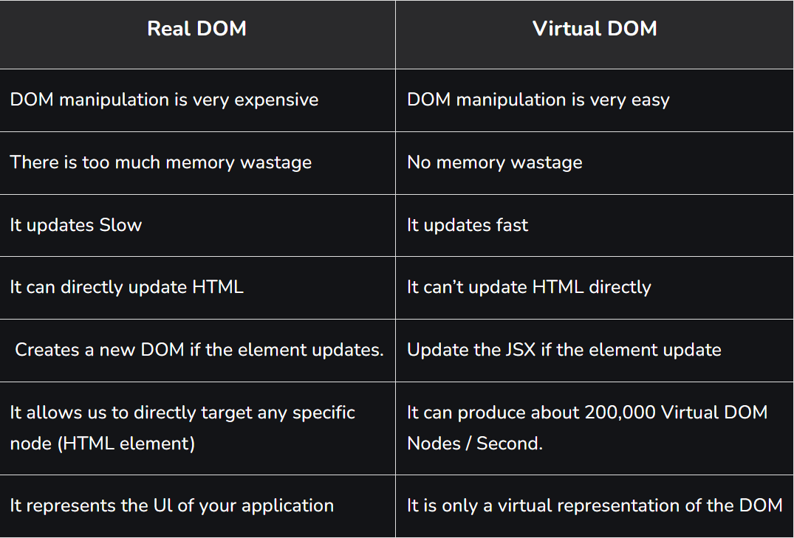

Slide 8
HTML.
<!DOCTYPE html>
<html lang="en">
<head>
<meta charset="UTF-8">
<meta name="viewport" content="width=device-width, initial-scale=1.0">
<title>Document</title>
</head>
<body>
<h1>dom and virtual dom</h1>
<div id="container1">
</div>
<div id="container2">
</div>
<script crossorigin src="https://unpkg.com/react@18/umd/react.development.js"></script>
<script crossorigin src="https://unpkg.com/react-dom@18/umd/react-dom.development.js"></script>
<script src="index.js"></script>
</body>
</html>

Slide 9
Raw react code.
function setTimer(){
let element1 =`<div><h1>rct</h1><input type ='text' />
<p>${new Date().toLocaleTimeString()}
</div>`
document.getElementById('container1').innerHTML = element1;
const element2 = React.createElement(
'div',
null,
React.createElement('h1', null, 'React'),
React.createElement('div', null,
React.createElement('input', {type:'text'})),
React.createElement('p', null, new Date().toLocaleTimeString())
)
ReactDOM.render(element2, document.getElementById('container2'))
}
setInterval(setTimer,1000)

