Slide 1
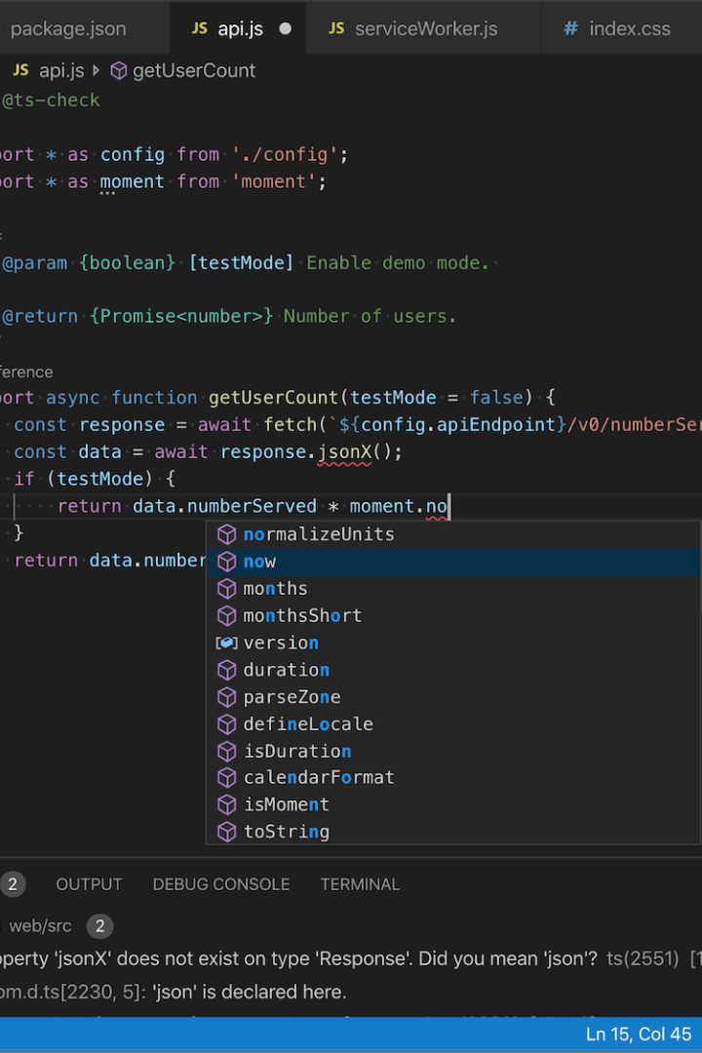


Promises and Asynchronous Programming in JavaScript
In this presentation, we will explore the fundamentals of synchronous and asynchronous programming in JavaScript and learn how to work with Promises and Async/Await. Let's dive in!
by shubham ss

Slide 2



The JavaScript Event Loop
What is it?
How does it work?
Why is it important?
The event loop is the core of JavaScript's concurrency model. It waits for events to enter its queue and processes them one by one.
When a synchronous function is called, the event loop is blocked until it finishes. Asynchronous functions, however, are added to a queue, and their callbacks are invoked once the call stack is empty.
The event loop enables JavaScript to effectively handle I/O and other non-blocking operations, making it a powerful and efficient language for web development.

Slide 3
Introduction to Promises
1
2
3
4
What are Promises?
Creating a Promise
Chaining Promises
Promise States
Promises are objects that represent a value that might not yet be available. They're used to handle asynchronous operations, making it easy to chain callbacks and handle errors.
A Promise constructor takes a callback function that receives `resolve` and `reject` functions as arguments. We use these to signal that the Promise has either fulfilled or failed.
Promise objects can be chained together using the `then` method, which receives a success callback and returns a new Promise object.
A Promise can be in one of three states: `pending`, `fulfilled`, or `rejected`. We can check the state of a Promise using the `Promise.prototype.state` method.

Slide 4
Promise Chaining and Error Handling
Chaining Promises
Error Handling
Promise.all()
We can chain multiple promises together using the `.then()` method, which will wait for each promise to resolve before moving on to the next.
We can add a `.catch()` method to handle errors that occur in the promise chain. This lets us gracefully handle errors without the app crashing.
We can use `Promise.all()` to execute an array of promises in parallel and wait for all of them to resolve before moving on to the next step.

Slide 5



Using Async/Await
What is Async/Await?
How does it work?
Benefits of async/await
Async/Await is a syntax for working with Promises that makes it easier to write asynchronous code in a synchronous style.
We mark a function as asynchronous using the `async` keyword, and use the `await` keyword to pause execution until a Promise resolves or rejects.
Async/Await code is cleaner and easier to read than Promises, and it doesn't require as much nesting or chaining. It also simplifies error handling.

Slide 6

Tips for Handling Errors in Promises
1
Use try/catch blocks
2
Be specific with error messages
3
Don't ignore errors
Try/catch blocks can be used to handle errors in a synchronous style, and can be used with Promises and Async/Await.
Error messages should be specific and provide enough information to help developers diagnose and fix problems.
Errors should always be acknowledged and handled in some way, even if it's just logging the error to the console.

Slide 7
Conclusion and Summary
Promises
Async/Await
Javascript Event Loop
Promises are a powerful way to handle asynchronous operations in JavaScript. They can be created and chained, and are an important part of modern web development.
Async/Await is a newer syntax for working with Promises that is simpler and easier to read. It is quickly becoming the preferred way to write asynchronous code in JavaScript.
The event loop is a core component of JavaScript's concurrency model. Understanding how it works is essential to writing efficient JavaScript code and building performant web applications.

