Slide 1




The Art of DOM Manipulation
Welcome to a guide on the powerful methods for DOM manipulation available to you as a web developer.
by shubham ss

Slide 2
Selecting Elements
getElementById()
getElementsByClassName()
Selects an element with the specified ID.
Selects elements with the specified class name.
getElementsByTagName()
querySelector()
Selects elements with the specified HTML tag name.
Selects the first matching element.

Slide 3


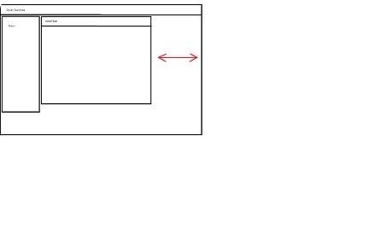
Working with Elements
Element.style()
JQuery
Tab Control
Modifies the CSS style of an element.
A concise library to manipulate elements easily.
Cycles through multiple elements, selecting one at a time.

Slide 4
Modifying Text and Attributes
textContent
removeAttribute()
Gets or sets the text content of an element.
Removes the specified attribute from an element.
1
2
3
4
innerHTML
setAttribute()
Gets or sets the HTML content.
Sets or changes the value of an attribute on the specified element.

Slide 5
Adding and Removing Elements
createElement()
appendChild()
removeChild()
Creates a new element with the specified tag name.
Adds a new child element to the specified element.
Removes a child element from the specified element.

Slide 6

DOM Traversal
1
parentNode
2
childNodes
Selects the parent element.
Selects all child elements.
3
nextSibling and previousSibling
Selects the next or previous sibling.

Slide 7
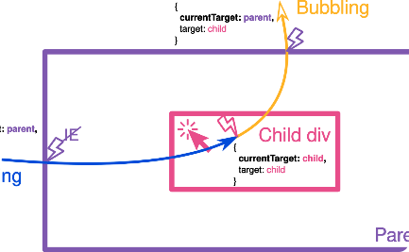
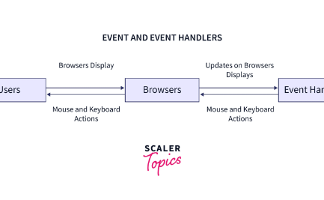
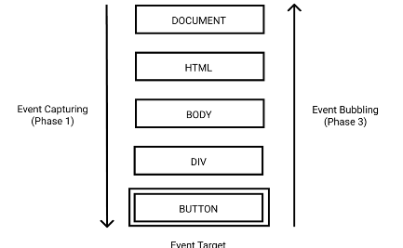
Event Listeners
event.target
addEventListener()
event.stopPropagation()
Returns the element on which the event was triggered.
Adds a listener to an element to respond to an event.
Prevents events from "bubbling" up the DOM tree.

Slide 8

The Power of DOM Manipulation
With a deep understanding of the DOM, the possibilities are endless. Take your skills to the next level and create stunning, interactive web pages.

