Slide 1
The DOM tree

Slide 2
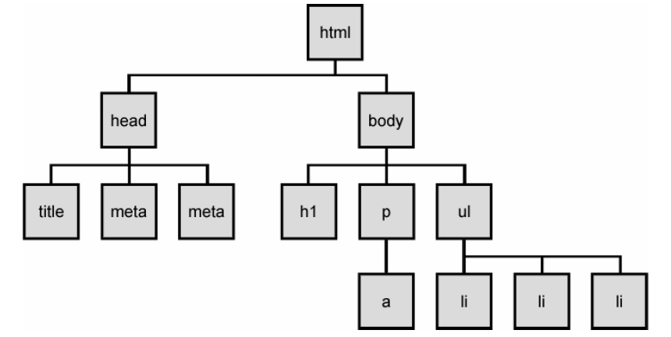
The DOM tree
Notes:
The elements of a page are nested into a tree-like structure of objects
the DOM has properties and methods for traversing this tree

Slide 3



Types of DOM nodes
<p>
This is a paragraph of text with a
<a href="/path/page.html">link in it</a>.
</p> HTML
element nodes (HTML tag)
can have children and/or attributes
text nodes (text in a block element)
attribute nodes (attribute/value pair)
text/attributes are children in an element node
cannot have children or attributes
not usually shown when drawing the DOM tree

Slide 4
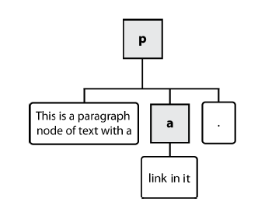
Types of DOM nodes
<p>
This is a paragraph of text with a
<a href="/path/page.html">link in it</a>.
</p> HTML

Slide 5
Traversing the DOM tree
name(s) | description
firstChild, lastChild | start/end of this node's list of children
childNodes | array of all this node's children
nextSibling, previousSibling | neighboring nodes with the same parent
parentNode | the element that contains this node
complete list of DOM node properties
browser incompatiblity information

Slide 6
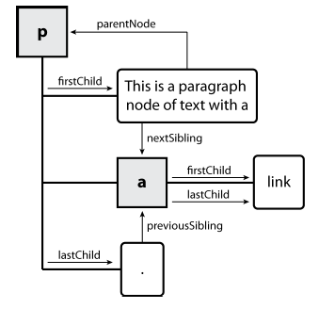
DOM tree traversal example
<p id="foo">This is a paragraph of text with a
<a href="/path/to/another/page.html">link</a>.</p> HTML

Slide 7
Elements vs text nodes
<div>
<p>
This is a paragraph of text with a
<a href="page.html">link</a>.
</p>
</div> HTML
Q: How many children does the div above have?
A: 3
an element node representing the <p>
two text nodes representing "\n\t" (before/after the paragraph)
Q: How many children does the paragraph have? The a tag?

Slide 8
Prototype's DOM element methods
absolutize | addClassName | classNames | cleanWhitespace | clonePosition
cumulativeOffset | cumulativeScrollOffset | empty | extend | firstDescendant
getDimensions | getHeight | getOffsetParent | getStyle | getWidth
hasClassName | hide | identify | insert | inspect
makeClipping | makePositioned | match | positionedOffset | readAttribute
recursivelyCollect | relativize | remove | removeClassName | replace
scrollTo | select | setOpacity | setStyle | show
toggle | toggleClassName | undoClipping | undoPositioned | update
viewportOffset | visible | wrap | writeAttribute
Notes:
categories: CSS classes, DOM tree traversal/manipulation, events, styles

Slide 9
Prototype's DOM tree traversal methods
method(s) | description
ancestors, up | elements above this one
childElements, descendants, down | elements below this one (not text nodes)
siblings, next, nextSiblings, previous, previousSiblings, adjacent | elements with same parent as this one (not text nodes)
Notes:
Prototype strips out the unwanted text nodes
notice that these are methods, so you need ()

Slide 10
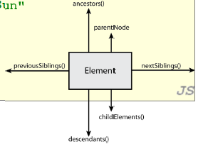
Prototype's DOM tree traversal methods
// alter siblings of "main" that do not contain "Sun"
var sibs = $("main").siblings();
for (var i = 0; i < sibs.length; i++) {
if (sibs[i].innerHTML.indexOf("Sun") < 0) {
sibs[i].innerHTML += " Sunshine";
}
} JS
Notes:
Prototype strips out the unwanted text nodes
notice that these are methods, so you need ()

Slide 11
Selecting groups of DOM objects
methods in document and other DOM objects for accessing descendants:
name | description
getElementsByTagName | returns array of descendents with the given tag, such as "div"
getElementsByName | returns array of descendants with the given name attribute (mostly useful for accessing form controls)

Slide 12
Getting all elements of a certain type
var allParas = document.getElementsByTagName("p");
for (var i = 0; i < allParas.length; i++) {
allParas[i].style.backgroundColor = "yellow";
} JS
<body>
<p>This is the first paragraph</p>
<p>This is the second paragraph</p>
<p>You get the idea...</p>
</body> HTML

Slide 13
Combining with getElementById
var addrParas = $("address").getElementsByTagName("p");
for (var i = 0; i < addrParas.length; i++) {
addrParas[i].style.backgroundColor = "yellow";
} JS
<p>This won't be returned!</p>
<div id="address">
<p>1234 Street</p>
<p>Atlanta, GA</p>
</div> HTML

Slide 14
Prototype's methods for selecting elements
var gameButtons = $("game").select("button.control");
for (var i = 0; i < gameButtons.length; i++) {
gameButtons[i].style.color = "yellow";
} JS
Prototype adds methods to the document object
(and all DOM element objects) for selecting groups of elements:
getElementsByClassName | array of elements that use given class attribute
select | array of descendants that match given CSS selector, such as "div#sidebar ul.news > li"

Slide 15
Prototype's methods for selecting elements
<ul id="fruits">
<li id="apples">apples
<ul>
<li id="golden-delicious">Golden Delicious</li>
<li id="mutsu" class="yummy">Mutsu</li>
<li id="mcintosh" class="yummy">McIntosh</li>
<li id="ida-red">Ida Red</li>
</ul>
</li>
<li id="exotic" class="yummy">exotic fruits
<ul>
<li id="kiwi">kiwi</li>
<li id="granadilla">granadilla</li>
</ul>
</li>
</ul>HTML
$('fruits').getElementsByClassName('yummy');
// -> [li#mutsu, …]
$('exotic').getElementsByClassName('yummy');
// -> JS

Slide 16
Prototype's methods for selecting elements
<ul id="fruits">
<li id="apples">
<h3 title="yummy!">Apples</h3>
<ul id="list-of-apples">
<li id="golden-delicious" title="yummy!" >Golden Delicious</li>
<li id="mutsu" title="yummy!">Mutsu</li>
<li id="mcintosh">McIntosh</li>
<li id="ida-red">Ida Red</li>
</ul>
<p id="saying">An apple a day keeps the doctor away.</p>
</li>
</ul>
$('apples').select('[title="yummy!"]');
// -> [h3, li#golden-delicious, li#mutsu]
$('apples').select( 'p#saying', 'li[title="yummy!"]');
//
$('apples').select('[title="disgusting!"]');
// JS
Notes:
-> [li#golden-delicious, li#mutsu, p#saying]

Slide 17
The $$ function
var arrayName = $$("CSS selector"); JS
// hide all "announcement" paragraphs in the "news" //section
var paragraphs = $$("div#news p.announcement");
for (var i = 0; i < paragraphs.length; i++) {
paragraphs[i].hide();
} JS
$$ returns an array of DOM elements that match the given CSS selector
like $ but returns an array instead of a single DOM object
a shorthand for document.select
useful for applying an operation each one of a set of elements

Slide 18
Common issues with $$
// get all buttons with a class of "control"
var gameButtons = $$("control");
var gameButtons = $$(".control"); JS
// set all buttons with a class of "control" to have red text
$$(".control").style.color = "red";
var gameButtons = $$(".control");
for (var I = 0; i < gameButtons.length; i++) {
gameButtons[i].style.color = "red";
} JS
Q: Can I still select a group of elements using $$ even if my CSS file doesn't have any style rule for that same group? (A: Yes!)

Slide 19
Creating new nodes
name | description
document.createElement("tag") | creates and returns a new empty DOM node representing an element of that type
document.createTextNode("text") | creates and returns a text node containing given text
// create a new <h2> node
var newHeading = document.createElement("h2");
newHeading.innerHTML = "This is a heading";
newHeading.style.color = "green"; JS
merely creating a node does not add it to the page
you must add the new node as a child of an existing element on the page...

Slide 20
Modifying the DOM tree
name | description
appendChild(node) | places given node at end of this node's child list
insertBefore(new, old) | places the given new node in this node's child list just before old child
removeChild(node) | removes given node from this node's child list
replaceChild(new, old) | replaces given child with new node
var p = document.createElement("p");
p.innerHTML = "A paragraph!";
$("main").appendChild(p); JS

Slide 21
Removing a node from the page
function slideClick() {
var bullets = document.getElementsByTagName("li");
for (var i = 0; i < bullets.length; i++) {
if (bullets[i].innerHTML.indexOf("children") >= 0) {
bullets[i].remove();
}
}
} JS
each DOM object has a removeChild method to remove its children from the page
Prototype adds a remove method for a node to remove itself

Slide 22
DOM versus innerHTML hacking
Why not just code the previous example this way?
function slideClick() {
$("thisslide").innerHTML += "<p>A paragraph!</p>";
} JS
Imagine that the new node is more complex:
ugly: bad style on many levels (e.g. JS code embedded within HTML)
error-prone: must carefully distinguish " and '
can only add at beginning or end, not in middle of child list
function slideClick() {
this.innerHTML += "<p style='color: red; " +
"margin-left: 50px;' " +
"onclick='myOnClick();'>" +
"A paragraph!</p>";
} JS

Slide 23
Problems with reading/changing styles
window.onload = function() {
$("clickme").onclick = biggerFont;
};
function biggerFont() {
var size = parseInt($("clickme").style.fontSize);
size += 4;
$("clickMe").style.fontSize = size + "pt";
} JS
style property lets you set any CSS style for an element
problem: you cannot (usually) read existing styles with it

Slide 24
Accessing styles in Prototype
function biggerFont() {
// turn text yellow and make it bigger
var size = parseInt($("clickme").getStyle("font-size"));
$("clickme").style.fontSize = (size + 4) + "pt";
} JS
getStyle function added to DOM object allows accessing existing styles
addClassName, removeClassName, hasClassName manipulate CSS classes

Slide 25
Common bug: incorrect usage of existing styles
this.style.top = this.getStyle("top") + 100 + "px";
// bad! JS
the above example computes e.g. "200px" + 100 + "px" , which would evaluate to "200px100px"
a corrected version:
this.style.top = parseInt(this.getStyle("top")) + 100 + "px"; // correct JS

Slide 26
Setting CSS classes in Prototype
function highlightField() {
// turn text yellow and make it bigger
if (!$("text").hasClassName("invalid")) {
$("text").addClassName("highlight");
}
} JS
addClassName, removeClassName, hasClassName manipulate CSS classes
similar to existing className DOM property, but don't have to manually split by spaces

Slide 27
Example: createElements
<html>
<head>
<script src=" https://ajax.googleapis.com/ajax/libs/prototype/1.7.0.0/prototype.js " type="text/javascript"></script>
<script src="paragraph.js " type="text/javascript"></script>
</head>
<body>
<div id="paragrapharea">
<button id="add">Add a paragraph</button>
</div>
</body>
</html>

Slide 28
Example: createElements
window.onload = function(){
var button = $("add");
button.onclick = addParagraphClick;
}
function addParagraphClick(){
var paragraph = document.createElement("p");
paragraph.innerHTML = "All work and no play makes Jack a dull boy";
var area = $("paragrapharea");
area.appendChild(paragraph);
}
function addListClick(){
} JS

Slide 29
Javascript Exercises
Create a webpage with an of Homer Simpson image at the center of the page. Develop a script that prints an alert: “Duh, you are hovering!!” every time the mouse crosses over the image.
Add 5 buttons to your webpage: red, yellow, green, black, and silver. Every time you click on one of these buttons the background should take the corresponding color.

Slide 30
Javascript Exercises
Add a link with the text: “CLICK ME!”. Develop a function that randomly chooses between the following websites to link your text:
http://slashdot.org/
http://www.thinkgeek.com/
http://despair.com/
http://www.redbubble.com/
http://googleresearch.blogspot.com/

