Slide 1
Document Object Model (DOM)
INFO/CSE 100, Spring 2006
Fluency in Information Technology
http://www.cs.washington.edu/100

Slide 2




References
References
  JavaScript, The Definitive Guide
    by David Flanagan. Publisher O'Reilly
  W3C Document Object Model
    http://www.w3.org/DOM/
    http://www.w3.org/2003/02/06-dom-support.html
  Document Object Model in Mozilla
    http://www.mozilla.org/docs/dom/

Slide 3
What the heck is the DOM?
Document Object Model
  Your web browser builds a model of the web page (the document) that includes all the objects in the page (tags, text, etc)
  All of the properties, methods, and events available to the web developer for manipulating and creating web pages are organized into objects
  Those objects are accessible via scripting languages in modern web browsers
Notes:
Mental model of a car. When you rent a car that you have never driven before, do you freak out about it? No! You have a model of how to drive it in your mind. This is called a mental model. Your web browser builds an actual model of a web page...

Slide 4
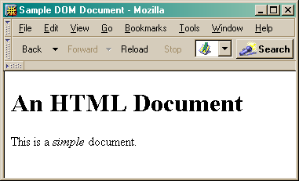
This is what the browser reads (sampleDOM.html).
<html>
<head>
<title>Sample DOM Document</title>
</head>
<body>
<h1>An HTML Document</h1>
<p>This is a <i>simple</i> document.
</body>
</html>
This is what the browser displays on screen.

Slide 5
Document
This is a drawing of the model that the browser is working with for the page.
<html>
<head>
<body>
<title>
"Sample DOM Document"
<h1>
<p>
"An HTML Document"
"This is a"
<i>
"document"
"simple"
Figure 17-1. The tree representation of an HTML document
Copied from JavaScript by Flanagan.

Slide 6
Why is this useful?
Because we can access the model too!
  the model is made available to scripts running in the browser, not just the browser itself
    A script can find things out about the state of the page
    A script can change things in response to events, including user requests
  We have already used this capability in the GUI programming that we've done

Slide 7
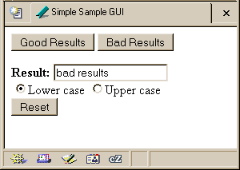
Recall our simple GUI example
This GUI has several simple controls.
Two buttons to control the results
One text field to display the results
One pair of radio buttons to control the display
One button to reinitialize
http://www.cs.washington.edu/education/courses/100/04au/slides/16-dom/gui.html

Slide 8
setResults(resultString)
<script type="text/javascript">
function setResults(resultString) {
var tempString = resultString;
if (document.getElementById("radioLC").checked) {
tempString = tempString.toLowerCase();
} else if (document.getElementById("radioUC").checked) {
tempString = tempString.toUpperCase();
}
document.getElementById("resultField").value = tempString;
}
</script>
the highlighted script above makes reference to several objects in the document object model

Slide 9
document.getElementById("radioLC").checked
Reference to several nodes in the model of the page that the browser constructed
document
  The root of the tree is an object of type HTMLDocument
  Using the global variable document, we can access all the nodes in the tree, as well as useful functions and other global information
    title, referrer, domain, URL, body, images, links, forms, ...
    open, write, close, getElementById, ...

Slide 10
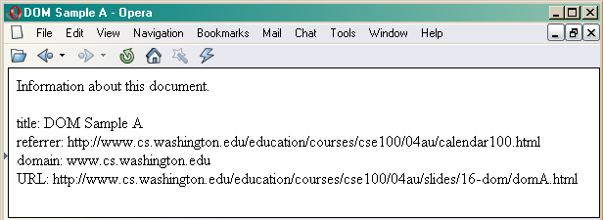
Some information from a document
<html>
<head>
<title>DOM Sample A</title>
</head>
<body>
Information about this document.<br>
<script type="text/javascript">
document.write("<br>Title: ",document.title);
document.write("<br>Referrer: ",document.referrer);
document.write("<br>Domain: ",document.domain);
document.write("<br>URL: ",document.URL);
</script>
</body>
</html>
Notes:
Show demo DOM-SampleA.html

Slide 11
document.getElementById("radioLC").checked
getElementById("radioLC")
  This is a predefined function that makes use of the id that can be defined for any element in the page
  An id must be unique in the page, so only one element is ever returned by this function
  The argument to getElementById specifies which element is being requested

Slide 12
Some information about elements
<html>
<head>
<title>DOM Sample B</title>
<script type="text/javascript">
function showInfo() {
var element = document.getElementById("opener");
var buffer = element.id + " tag is " + element.tagName;
alert(buffer);
element = document.getElementById("actionItem");
buffer = element.id + " tag is " + element.tagName;
buffer += ", type is "+element.type;
alert(buffer);
}
</script>
</head>
<body>
<p id="opener">The id attribute is very helpful.</p>
<p id="closer">This is the closing paragraph.</p>
<form>
<button id="actionItem" type="button" onclick="showInfo()">Show Info</button>
</form>
</body>
</html>
Notes:
Note Element doesn't refer to the value! Just the element. We have to explicitly ask for the value or the attribute values (see above).

Slide 13
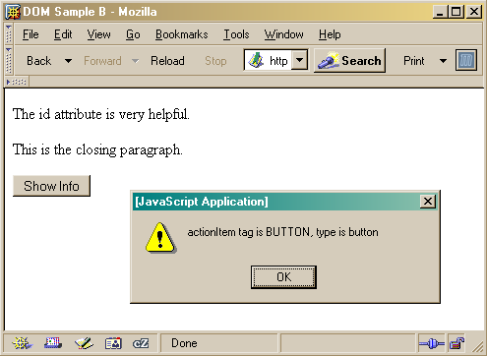
Notes:
Show demo DOM-SampleB.html

Slide 14
document.getElementById("radioLC").checked
checked
  This is a particular property of the node we are looking at, in this case, a radio button
  Each type of node has its own set of properties
    for radio button: checked, name, ...
    refer to the HTML DOM for specifics for each element type
  Some properties can be both read and set

Slide 15
Some specific properties
<head>
<title>Simple Sample GUI</title>
<script type="text/javascript">
function setResults(resultString) {
var tempString = resultString;
if (document.getElementById("radioLC").checked) {
tempString = tempString.toLowerCase();
} else if (document.getElementById("radioUC").checked) {
tempString = tempString.toUpperCase();
}
document.getElementById("resultField").value = tempString;
}
</script>
</head>

Slide 16
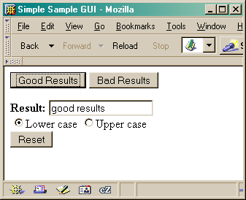

Slide 17
Just the tip of the DOM
The HTML Document Object Model is a standard for structuring data on a web page
  The field is advancing rapidly as people recognize the benefits of standardized structure and access
  The DOM is steadily improving to cover general purpose data structuring requirements
XML (Extendible Markup Language) also uses the Core DOM to specify its structured data
  similar to HTML but more carefully defined

Slide 18
Getting vs. Setting
var oldvalue = document.getElementById("resultField").value;
document.getElementById("resultField").value = "new value";

Slide 19
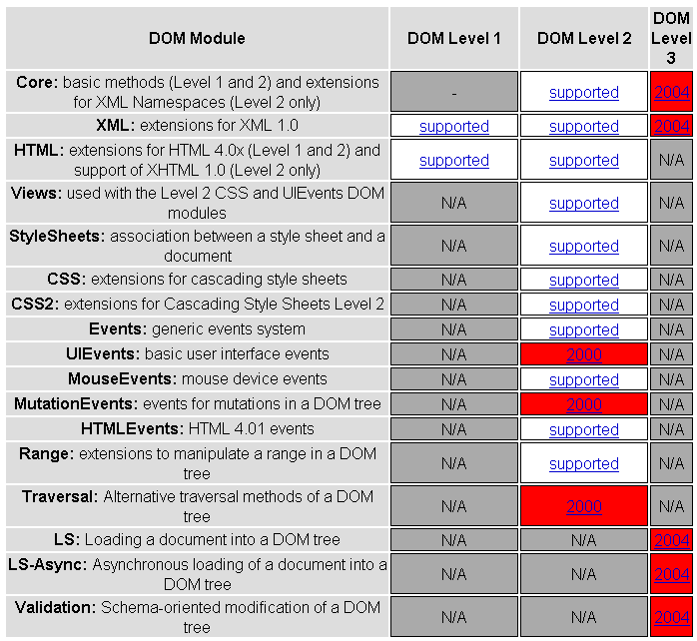

Slide 20
This is what the browser reads (domC.html).
<html>
<head>
<title>DOM Sample C</title>
<script type="text/javascript">
var switchCount = 0;
var adjectives = ["simple","complex","fascinating","unique"];
function switcher() {
switchCount = (switchCount + 1) % adjectives.length;
var italicNode = document.getElementById("adjPhrase");
italicNode.firstChild.nodeValue = adjectives[switchCount];
}
</script>
</head>
<body>
<h1>An HTML Document</h1>
<p>This is a <i id="adjPhrase">simple</i> document.
<form>
<button type="button" onclick="switcher()">switch</button>
</form>
</body>
</html>

Slide 21
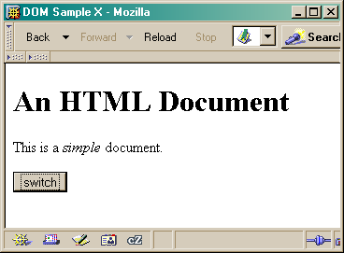
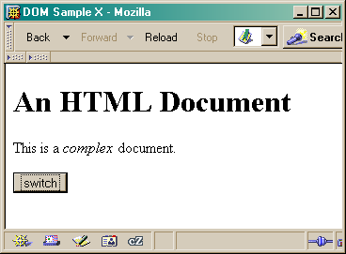

This is what the browser displays on screen.
Notes:
Show demo DOM-SampleC.html

