Slide 1
Function
A group of statements that is put together (or defined) once and then can be used (by reference) repeatedly on a Web page
Also known as subprogram, procedure, subroutine

Slide 2
Advantages of Functions
Number of lines of code is reduced
Code becomes easier to read & understand
Code becomes easier to maintain as changes need to be made only at a single location instead multiple locations

Slide 3
Keyword
Pair of parenthesis
Function definition enclosed in a pair of curly braces
Function
identifier
Function ‘arguments’ separated by commas
function writeList( heading, words ) {
document.write( heading + "<BR>" ) ;
for ( k = 0 ; k < words.length ; k = k + 1 ) {
document.write( words[ k ] + "<BR>" ) ;
}
}

Slide 4
Arguments of a Function
A comma-separated list of data
Arguments define the interface between the function and the rest of the Web page
Arguments values are passed to the function by value (some popular languages pass arguments ‘by reference’ as well)

Slide 5
To ensure that a function is defined before it is called up, define all functions in the HEAD portion of Web pages

Slide 6
Two Ways of Calling Functions
function popUp( message ) {
window.alert( message ) ;
}
popUp( “Warning!” ) ;
A function call appearing as a complete statement
A function call appearing as part of a statement. Definitions of such functions include a ‘return’ statement
function add( a, b ) {
c = a + b ;
return c ;
}
sum = add( 2, 4 ) ;
document.write( sum ) ;

Slide 7
What Would this Statement Do?
factorial( factorial ( 3 ) ) ;
This is termed as the
recursive
use of a function

Slide 8
Methods
Methods are functions
They are unusual in the sense that they are stored as properties of objects

Slide 9
Object: A named collection of properties
A collection of properties
All objects have the “name” property: it holds the name of the object (collection)
name
prop 8
prop 1
prop 3
prop 5
prop 2
prop 7
prop 6
prop 4

Slide 10
Predefined, Top-Level or Built-In Functions
Event handlers are not the only functions that come predefined with JavaScript. There are many others.
Practically, there is no difference between predefined functions and those that are defined by the programmer (termed as user-defined or custom functions)
There are many of them, but here we discuss only two: parseInt( ), parseFloat( )

Slide 11
Local Variables
Declaring variables (using the var keyword) within a function, makes them local
They are available only within the function and hold no meaning outside of it

Slide 12
Local –vs- Global
Global variables can make the logic of a Web page difficult to understand
Global variables also make the reuse and maintenance of your code much more difficult
HEURISTIC:
If it’s possible to define a variable as local, do it!

Slide 13
Event Handlers
Special-purpose functions that come predefined with JavaScript
They are unusual in the sense that they are mostly called from the HTML part of a Web page and not the <SCRIPT> … </SCRIPT> part

Slide 14
Today’s Goal: Event Handlers
To become able to appreciate the concept of event handlers:
What are they?
What do they do?
How do we benefit from them?
To learn to write simple programs that use event handlers

Slide 15
What is Event Handling?
Capturing events and responding to them
The system sends events to the program and the program responds to them as they arrive
Events can include things a user does - like clicking the mouse - or things that the system itself does - like updating the clock. Today we will exclusively focus on user-events

Slide 16
Event Driven Programs
Programs that can capture and respond to events are called ‘event-driven programs’
JavaScript was specifically designed for writing such programs
Almost all programs written in JavaScript are event-driven

Slide 17
JavaScript Handling of Events
Events handlers are placed in the BODY part of a Web page as attributes in HTML tags
Events can be captured and responded to directly with JavaScript one-liners embedded in HTML tags in the BODY portion
Alternatively, events can be captured in the HTML code, and then directed to a JavaScript function for an appropriate response

Slide 18
Let’s now revisit lecture 15 where we introduced event handlers for the first time

Slide 19
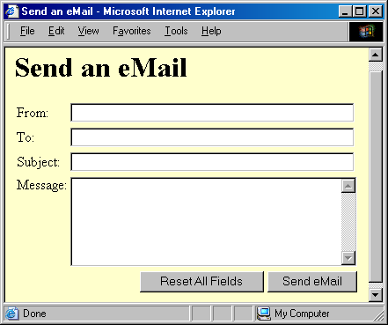
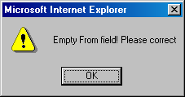

Slide 20
<INPUT type=“submit” name=“sendEmail” value=“Send eMail” onMouseOver= “if (document.sendEmail.sender.value.length < 1) window.alert(‘Empty From field! Please correct’)” >
Additional JavaScript code for the smart ‘Send eMail’ button that does not allow itself to be clicked if the “From” text field is left blank

Slide 21
That was event handling through what we may call ‘in-line JavaScript’ That is, the event was captured and handled with a JavaScript one-liner that was embedded in the HTML tag

Slide 22
In-Line JavaScript Event Handling (1)
Event handlers are placed in the BODY portion of a Web page as attributes of HTML tags
The event handler attribute consists of 3 parts:
The identifier of the event handler
The equal sign
A string consisting of JavaScript statements enclosed in double or single quotes

Slide 23
In-Line JavaScript Event Handling (2)
Multiple JavaScript statements (separated by semicolons) can be placed in that string, but all have to fit in a single line; no newline characters are allowed in that string
Due to this limitation, sophisticated event handling is not possible with in-line event handling

Slide 24
Another - more sophisticated - way of accomplishing the same task

Slide 25
JavaScript that goes between the <SCRIPT>, </SCRIPT> tags:
function checkForm() {
if ( document.sendEmail.sender.value.length < 1) {
window.alert( “Empty From field! Please correct” );
}
}
JavaScript included as an attribute of the “Send eMail” button:
onMouseOver=“checkForm( )”

Slide 26
Usage Guideline
For very short scripts, “all code in the tag” works well
The “code in the HEAD portion” is the right choice for developing larger JavaScript scripts
It makes the code easier to read
It allows the reuse of a function for multiple event handlers

Slide 27
Another event-handling example; this time from lecture 18

Slide 28
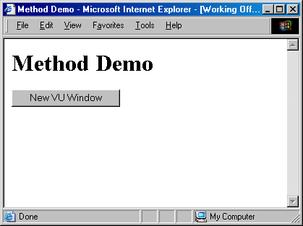
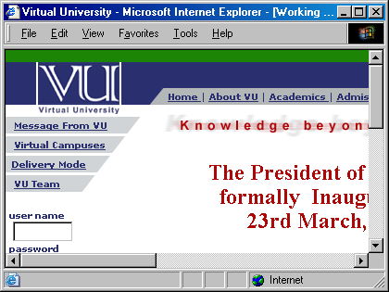

Slide 29
JavaScript that goes between the <SCRIPT>, </SCRIPT> tags:
function vuWindow() { window.open(“http://www.vu.edu.pk/”) ; }
JavaScript included as an attribute of the “New Window” button:
onClick=“vuWindow()”

Slide 30
A Few of My Favorite Event Handlers
onClick
onDblClick
onMouseOver
onMouseDown
onFocus
onBlur
onReset
onSubmit
onLoad
onUnload

Slide 31
There are many more: there is an expanded, but still incomplete list in your book Now let’s look at some of these error handlers in a bit more detail

Slide 32
onFocus & onBlur
onFocus executes the specified JavaScript code when a window receives focus or when a form element receives input focus
onBlur executes the specified JavaScript code when a window loses focus or a form element loses focus

Slide 33
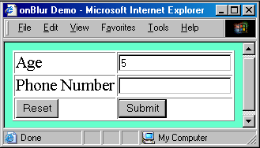
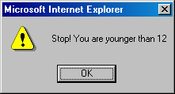

Slide 34
JavaScript that goes between the <SCRIPT>, </SCRIPT> tags:
function checkAge( ) {
if( parseInt( document.form1.age.value ) < 12 ) {
window.alert( "Stop! You are younger than 12" ) ;
}
}
JavaScript included as an attribute of the INPUT tag:
<INPUT type="text" name="age"
onBlur="checkAge( ) "
>

Slide 35
<HTML><HEAD> <TITLE>onBlur( ) Demo</TITLE> <SCRIPT> function checkAge() { if( parseInt(document.form1.age.value) < 12) { window.alert("Stop! You are younger than 12" ) ; } } </SCRIPT></HEAD> <BODY bgcolor="#66FFCC"> <FORM name="form1" method="post" action=""> <TABLE border="1"> <TR> <TD>Age</TD> <TD><INPUT type="text" name="age" onBlur="checkAge()"> </TD></TR><TR> <TD>Phone Number</TD> <TD><INPUT type="text" name="phNo"></TD> </TR><TR> <TD><INPUT type="reset" value="Reset"></TD> <TD><INPUT type="submit" value="Submit"></TD></TR> </TABLE></FORM></BODY></HTML>

Slide 36
onLoad & onUnload
onLoad executes the specified JavaScript code when a new document is loaded into a window
onUnload executes the specified JavaScript code when a user exits a document
What is the key difference between these 2 and the 4 event handlers (onMouseOver, onClick, onFocus, onBlur) that we have used so far?

Slide 37
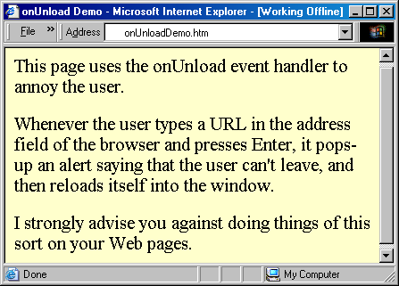
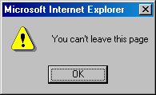
onUnloadDemo.htm
onUnloadDemo.htm
http://www.vu.edu.pk/
onUnloadDemo.htm

Slide 38
<HTML> <HEAD> <TITLE>onUnload Demo</TITLE> <SCRIPT> function annoyUser( ) { currentUrl = window.location ; window.alert( "You can't leave this page" ) ; window.location = currentUrl ; } </SCRIPT></HEAD> <BODY onUnload="annoyUser( )"> This page uses the onUnload event handler … </BODY></HTML>

Slide 39
<HTML> <HEAD> <TITLE>onUnload Demo</TITLE> <SCRIPT> function annoyUser( ) { currentUrl = window.location ; window.alert( "You can't leave this page" ) ; window.location = currentUrl ; } </SCRIPT></HEAD> <BODY onUnload="annoyUser( )"> This page uses the onUnload event handler … </BODY></HTML>

Slide 40
More Uses for onLoad/onUnload?
onLoad can be used to open multiple Windows when a particular document is opened
onUnload can be used to say “Thank you for the visit” when a user is leaving a Web page
At times, a user opens multiple inter-dependent windows of a Web site (e.g. VULMS). onUnload can be used to warn that all child Windows will become inoperable if the user closes the parent Window

Slide 41
A Note on Syntax (1)
Mixed-case capitalization of event handlers (e.g. onClick) is a convention (but not a requirement) for JavaScript event handlers defined in HTML code. Using ‘ONCLICK’ or ‘onclick’ as part of a an HTML tag is perfectly legal as well

Slide 42
A Note on Syntax (2)
At times, you may wish to use event handlers in JavaScript code enclosed in <SCRIPT>, </SCRIPT> tags
In those cases you have to strictly follow the JavaScript rule for all event handler identifiers: they must all be typed in small case, e.g. ‘onclick’ or ‘onmouseover’

