Slide 1
Bayesian and decision network
Swapnil Sagar

Slide 2
THE DOMAIN
Sports Team Management
Team Management related to injuries and taking decision to manage the team for best results.
Prepare for an upcoming tournament.
Big problem in school or club level sports management.

Slide 3
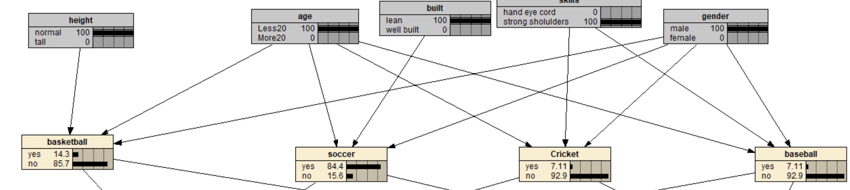
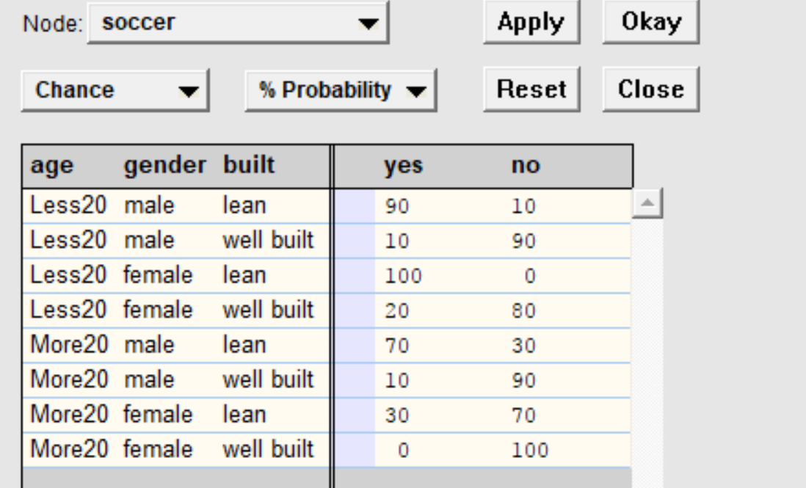
THE IDEA- BAYSIAN NETWORK
First layer – Which sports to go for – depends on Physical attributes and skills

Slide 4
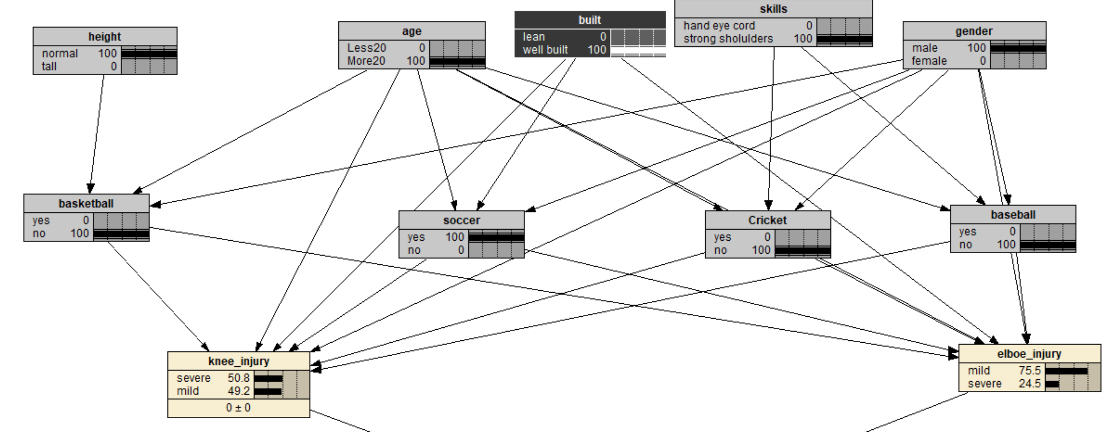
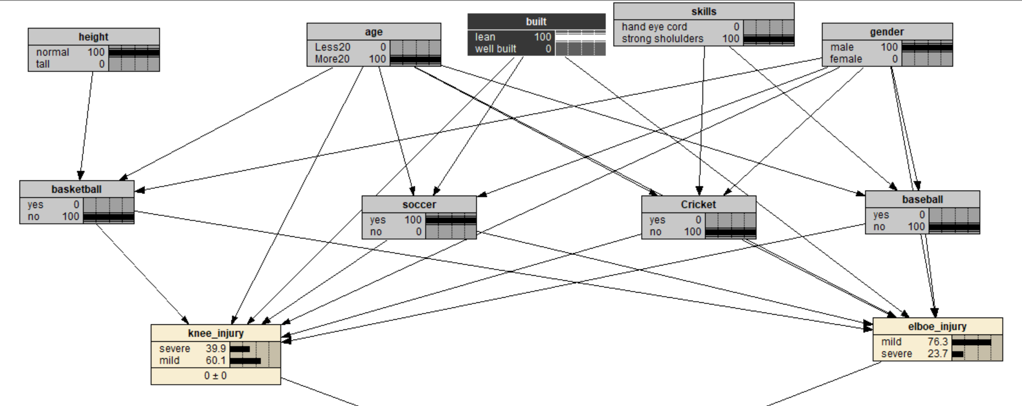
Second Layer – Type of injury and severity of the injury

Slide 5
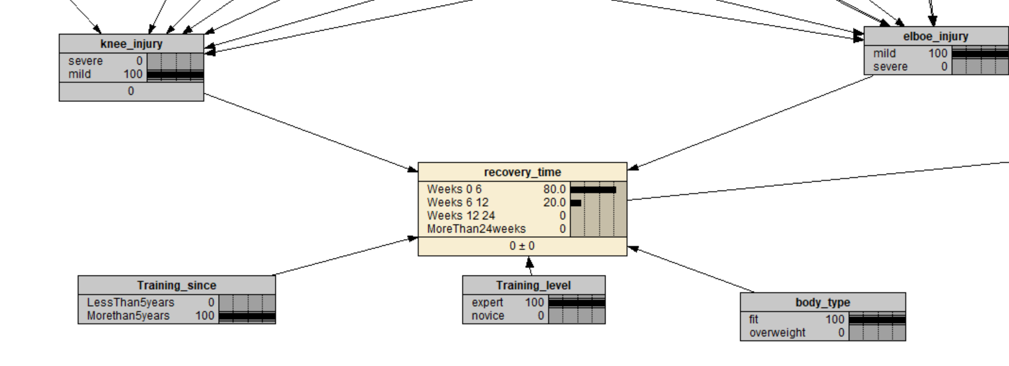
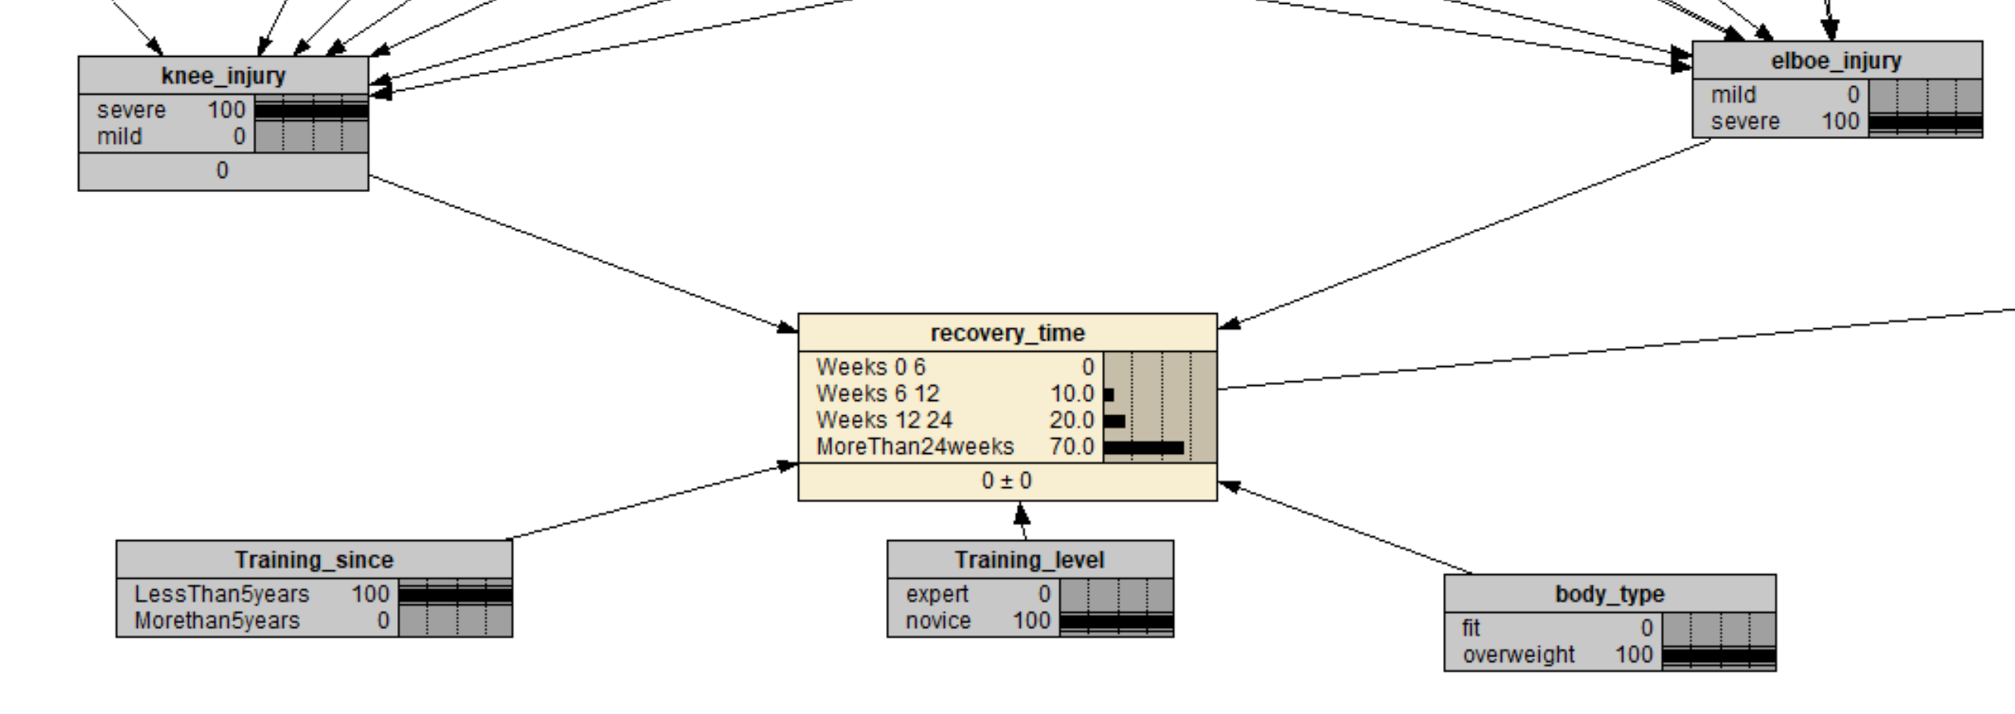
Final layer – Recovery time probabilities

Slide 6
THE IDEA – DECISION NETWORK
>In case of a player being injured, decision to be maid – Get replacement or Not.
>Usually deciding the squad and getting best out of possible squad is of utmost importance going into any tournament.
>The Utility value of in all practical sense is the value of loosing or winning as is in any aspect of life.

Slide 7
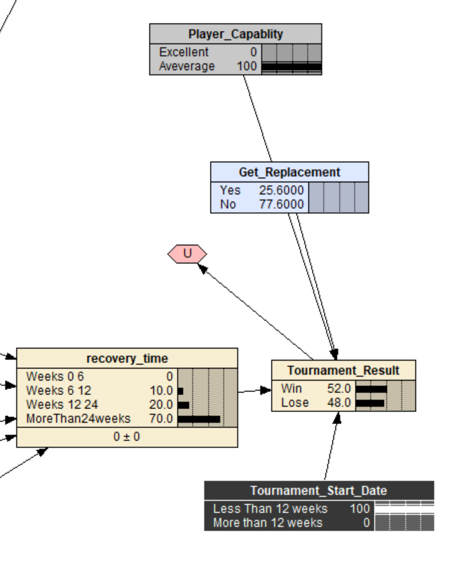
Expected Utility of every action – “yes” or “no” is calculated by the summation of
P(Resulting state – “Win” / “Lose” | action
(Get_Replacement), evidence (Player_Capability, recovery_time, Tournament_Start_Date)

Slide 8
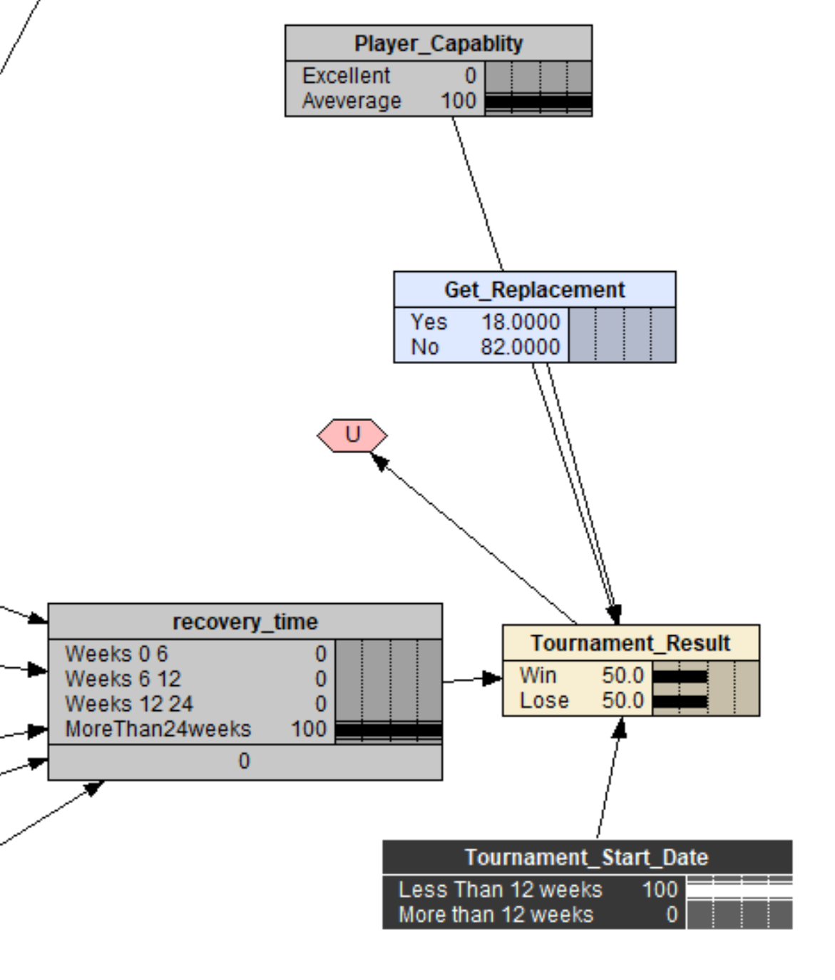
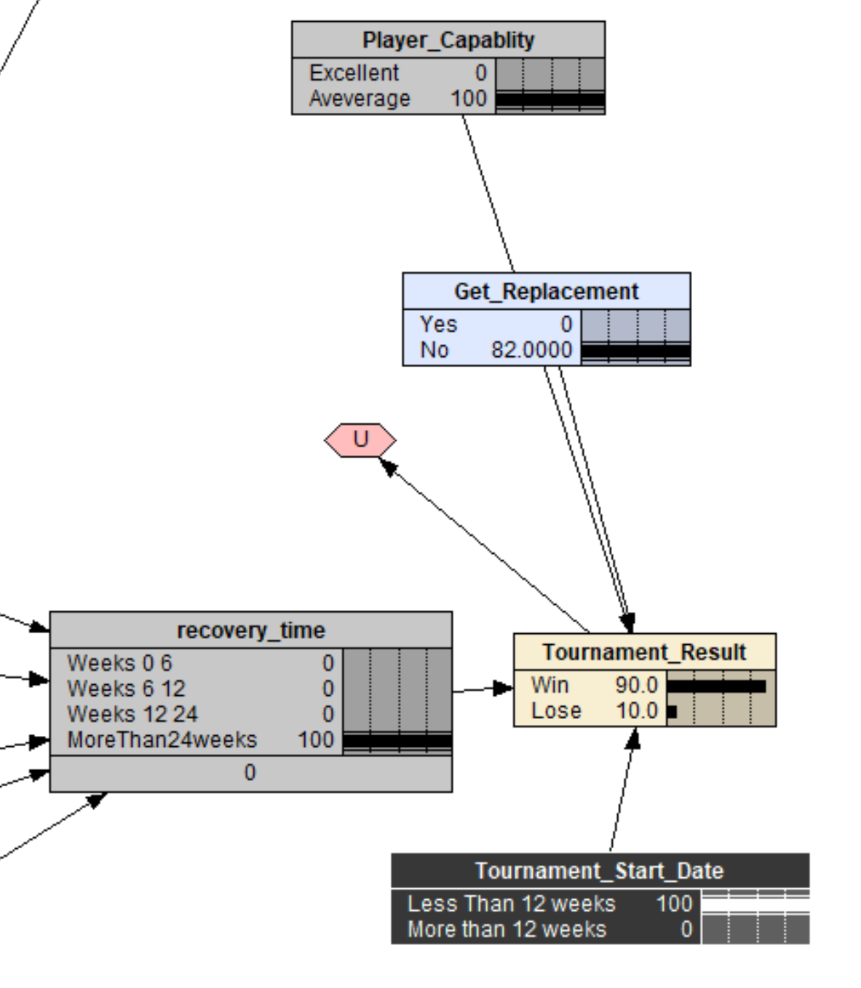

Slide 9
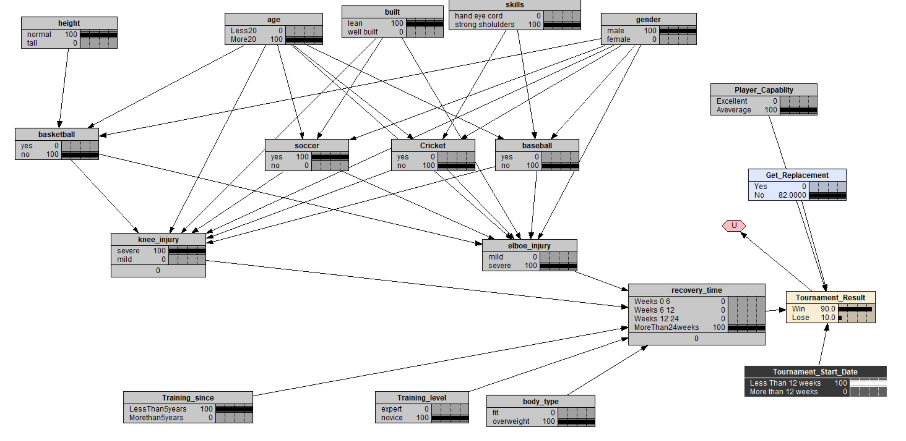

Slide 10
The Issue
>Sort of a new domain, so no statistic for utility of system
>CPT values needs to be learned.
>Change nodes to be experimented with.
>Lot of study is needed to make complete coherent sense of the system.

Slide 11
FUTURE SCOPE
>Each layer can be turned into an Independent and similar sort of domains
>Integration between layers can be way more sophisticated.
>Use learning to get CPT values, especially for recovery_time node.
>More chance node depending on Decision Node
>Full Markov Decision Process implementation.
>Utility values from experience and human values

Slide 12
QUESTIONS ?
THANK YOU

