Slide 1



Cloud Native Workshop
Spring Boot and Actuator
Pivotal Cloud Foundry
Notes:
I want to talk to you about cloud native applications, and bringing microservice architectures into production in the enterprise.

Slide 2
Agenda
Challenges building non-Boot applications
What is Spring Boot?
Capabilities

Slide 3
Agenda
Challenges building non-Boot applications
What’s new in Spring Boot 2.0?
Capabilities

Slide 4
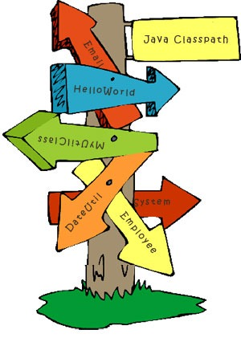
Classpath Hell
A Jar is missing
There is one Jar too many
A class is not visible where it should be

Slide 5
Resolving Classpath Hell
start
Unresolved symbol?
Yes
No
build
Yes
NoClassDefFound?
Read docs/blogs/copy previous project structure
run
Write Code
No
Download jars
Add jars to classpath
end

Slide 6
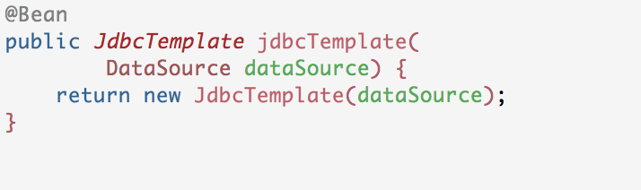
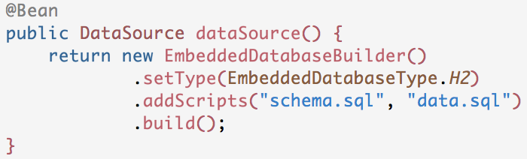
Boilerplate code
Every application that accesses a relational database with JDBC needs to configure a JdbcTemplate and a DataSource

Slide 7
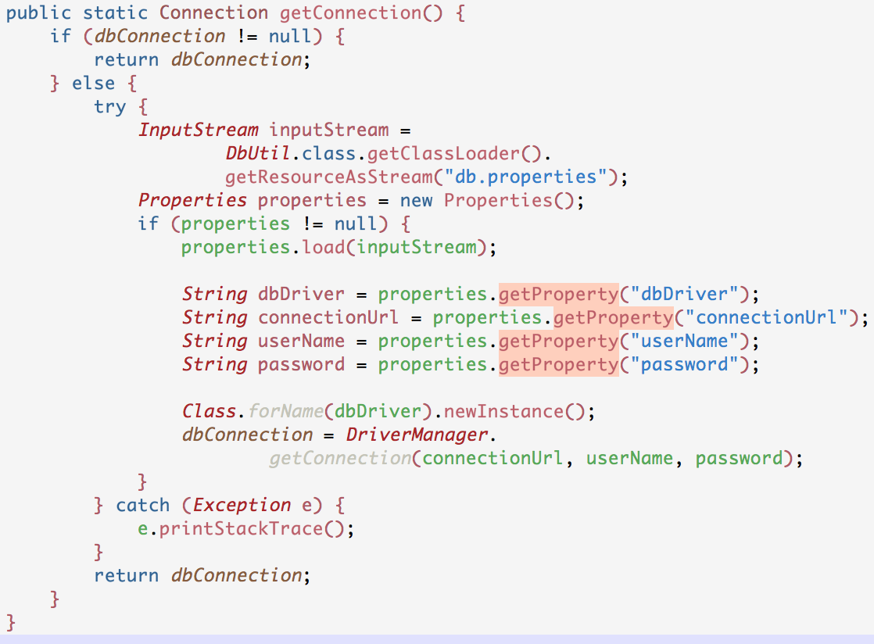
Boilerplate code
To get a db connection
Set Driver
Set Connection URL
Set Username
Set Password
Catch Exceptions

Slide 8
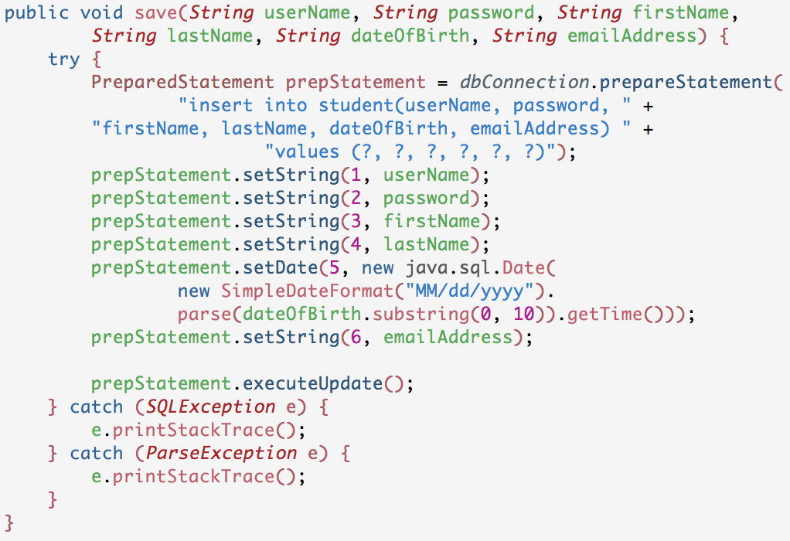
Boilerplate code
For CRUD Operations
Prepare Statement
Set Parameters
Execute Statement
Catch Exceptions

Slide 9
Agenda
Challenges building non-Boot applications
What is new in Spring Boot 2.0?
Capabilities

Slide 10
Spring Boot
Spring Boot is an opinionated framework to simplify bootstrapping and development of new Spring Applications
Notes:
Spring Boot is designed to help us build good apps rapidly. A key piece of making this happen is how Boot plugs in its opinions. Boot is not an exclusive concept. There are other opinionated frameworks out there like Play and Dropwizard. Some of these may even leverage Boot under the hood and use features of Boot that are very useful. However, Spring Boot, to it’s credit, makes things trivial for the Developer to say, “No. I don’t agree with you Boot. I know what I’m doing and I’d like to do it my way because I understand my business use case better than you do.” Boot tries to be non-intrusive. i.e. Boot says “Mr Developer, I will only start doing things if you choose not to.” And if the Developer chooses to build his application the way he likes, Boot will happily step aside.
Boot believes the correct way is the easiest way.
While, the Spring Framework makes things simple. Spring Boot takes Spring a step further by making the simplest thing the easiest.

Slide 11
Spring Boot 2.0 – Whats new
A Java 8 baseline, and Java 9 support.
Reactive web programming support with Spring WebFlux/WebFlux.fn.
Auto-configuration and starter POMs for reactive Spring Data Cassandra, MongoDB, Couchbase and Redis.
Support for embedded Netty.
HTTP/2 for Tomcat, Undertow and Jetty.
Kotlin support.
A brand new actuator architecture, with support for Spring MVC, WebFlux and Jersey.
Micrometer based metrics with exporters for Atlas, Datadog, Ganglia, Graphite, Influx, JMX, New Relic, Prometheus, SignalFx, StatsD and Wavefront.
Quartz scheduler support.
Greatly simplified security auto-configuration.
Notes:
Spring Boot is designed to help us build good apps rapidly. A key piece of making this happen is how Boot plugs in its opinions. Boot is not an exclusive concept. There are other opinionated frameworks out there like Play and Dropwizard. Some of these may even leverage Boot under the hood and use features of Boot that are very useful. However, Spring Boot, to it’s credit, makes things trivial for the Developer to say, “No. I don’t agree with you Boot. I know what I’m doing and I’d like to do it my way because I understand my business use case better than you do.” Boot tries to be non-intrusive. i.e. Boot says “Mr Developer, I will only start doing things if you choose not to.” And if the Developer chooses to build his application the way he likes, Boot will happily step aside.
Boot believes the correct way is the easiest way.
While, the Spring Framework makes things simple. Spring Boot takes Spring a step further by making the simplest thing the easiest.

Slide 12
Spring Boot 2.0 Resources
https://spring.io/blog/2018/03/01/spring-boot-2-0-goes-ga
Notes:
Spring Boot is designed to help us build good apps rapidly. A key piece of making this happen is how Boot plugs in its opinions. Boot is not an exclusive concept. There are other opinionated frameworks out there like Play and Dropwizard. Some of these may even leverage Boot under the hood and use features of Boot that are very useful. However, Spring Boot, to it’s credit, makes things trivial for the Developer to say, “No. I don’t agree with you Boot. I know what I’m doing and I’d like to do it my way because I understand my business use case better than you do.” Boot tries to be non-intrusive. i.e. Boot says “Mr Developer, I will only start doing things if you choose not to.” And if the Developer chooses to build his application the way he likes, Boot will happily step aside.
Boot believes the correct way is the easiest way.
While, the Spring Framework makes things simple. Spring Boot takes Spring a step further by making the simplest thing the easiest.

Slide 13
Spring Boot Adoption
Monthly Maven downloads
4.2M
Source: oss.sonatype.org

Slide 14
Agenda
Challenges building non-Boot applications
What is Spring Boot?
Capabilities

Slide 15
Capabilities
Quick start project generation
Automatic project dependency management
Configuration drift prevention
Conditional configuration

Slide 16
Capabilities
Developer Productivity Tooling
Auto-configuration
Monitoring and management endpoints
Microservices-friendliness

Slide 17
Spring Initializr
(Quick start project generation)

Slide 18
Spring Initializer
Spring Initializr is a configurable service to consistently and easily generate a quick start project

Slide 19
Spring Initializer
Generates a Spring Boot project structure
Provides a Maven/Gradle build specification
Doesn’t generate application code
You can customize the Spring Initialzr
https://github.com/spring-io/initializr/

Slide 20
Spring Boot starters
(Automatic project dependency management)

Slide 21
Spring Boot starters
Are virtual packages deployed to Maven central
They pull in other dependencies while containing no code of their own
spring-boot-starter-web
spring-web
spring-boot-starter-tomcat
spring-boot-starter-validation
spring-webmvc
jackson-databind

Slide 22
Profiles
(Conditional configuration)

Slide 23
Profiles
Segregate parts of the application configuration and make it available in certain environments via
Annotations
Properties file

Slide 24
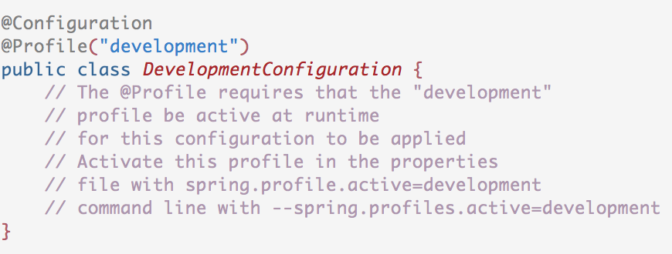
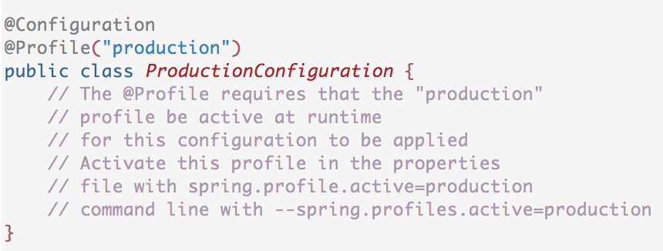
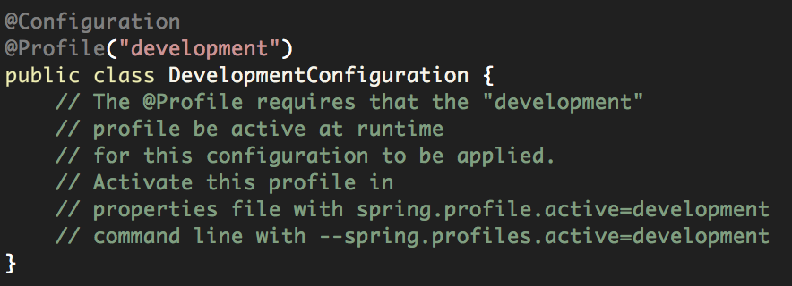
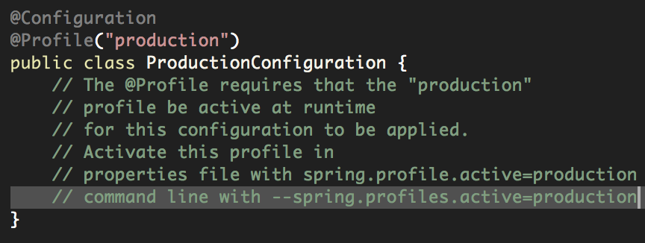
Profiles
Mark @Component or @Configuration with @Profile to limit when it is loaded.

Slide 25
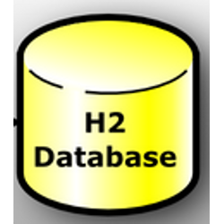
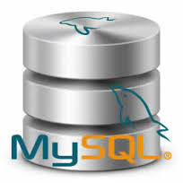
Profiles
Checkout code from source control
Active config
Build an executable jar
Dev. Configuration
Dev. Configuration
Active config
Configuration activated based on active profile
Check out code from a Version Control System
Prod. Configuration
Prod. Configuration
Prod. Configuration
Deploy anywhere
Boot Application
It Just Works!
Boot Application
No Code Changes
No Configuration Changes
Dev. Environment
Prod. Environment

Slide 26
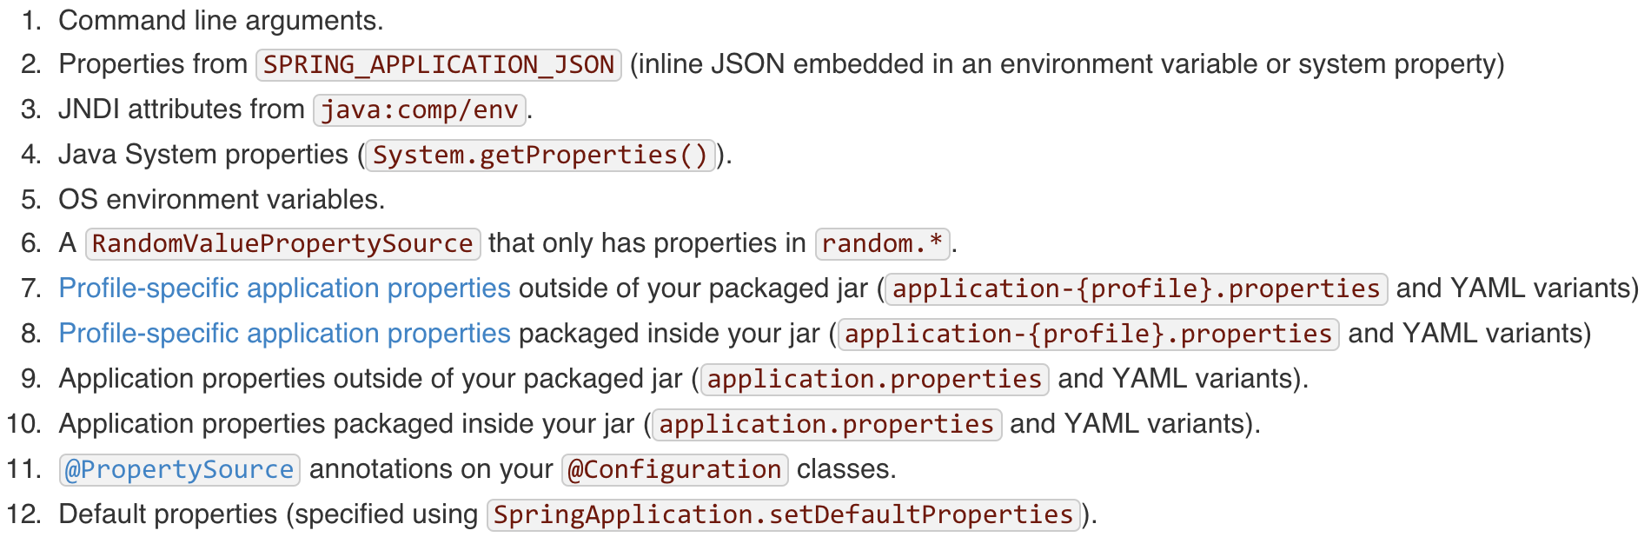
Precedence of externalized configuration

Slide 27
Actuator
(Monitoring & Management Endpoints)

Slide 28
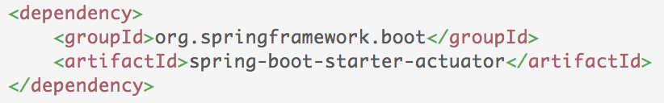
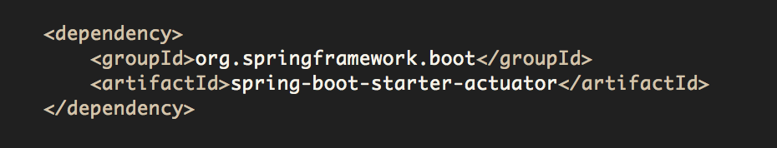
Actuator
Offers production-ready features such as monitoring and metrics to improve operator efficiency

Slide 29
Actuator
Actuator Services are exposed through
HTTP endpoints
shell interface
JMX Beans
REST endpoint (Spring MVC App)
shell interface
JMX
beans
Spring Boot Application
Actuator

Slide 30
Types of Actuator Endpoints
Configuration
/beans
/autoconfig
/env
/configprops
/controller
Metrics
/metrics
/trace
/dump
Miscellaneous
/shutdown
/info

Slide 31
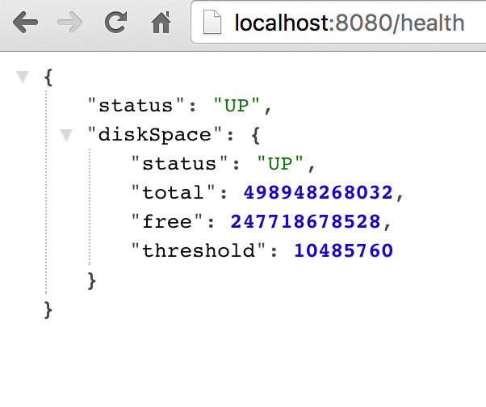
/health
Reports health metrics for the application
Each check returns a Health object
status
UP
DOWN
UNKONWN
OUT_OF_SERVICE
Plugin your own health definitions

Slide 32
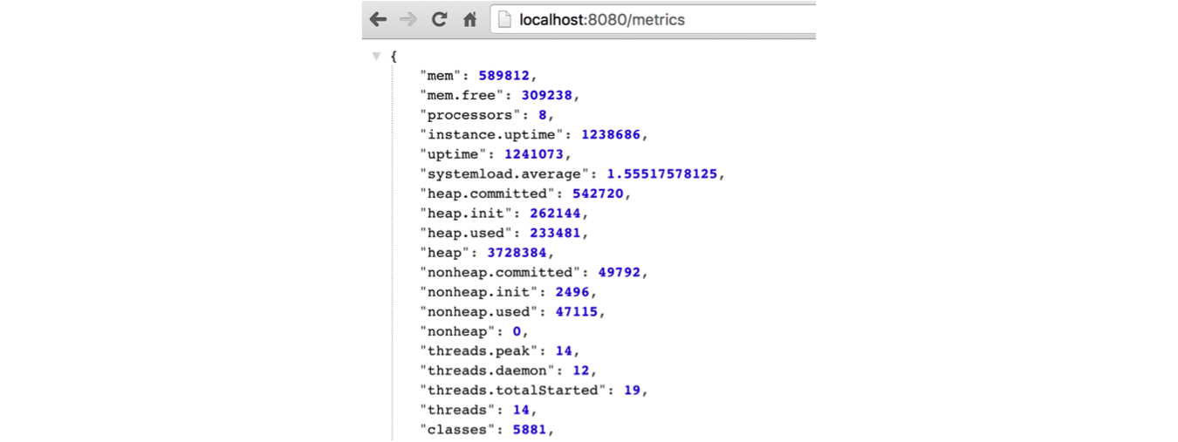
/metrics
Reports application metrics such as
Memory usage and
HTTP request counters

Slide 33
Microservices
(Microservices-friendliness)

Slide 34
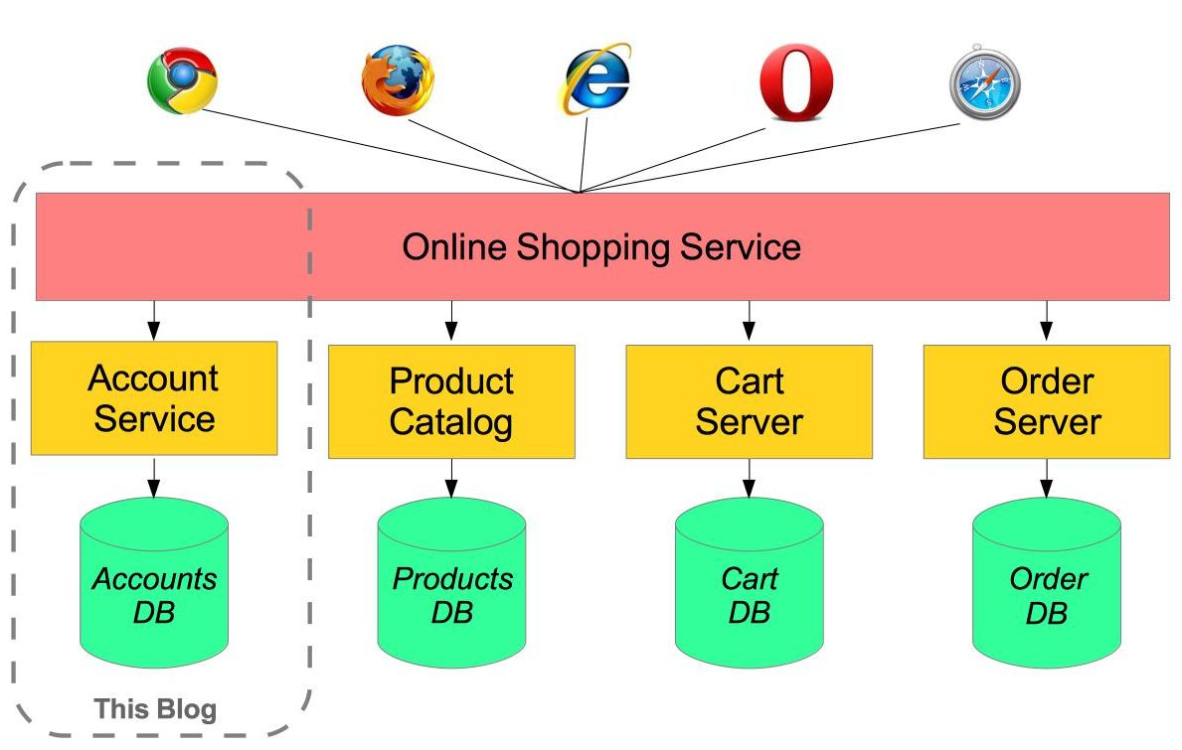
Microservices
Each microservice is a Spring Boot fat jar
Microservice

Slide 35


Thank You

