Slide 1

Sentinel-AI
Swayam Sahoo
Where artificial intelligence meets market inefficiency

Slide 2
The Problem
Prediction markets should reflect collective knowledge, but in practice they lag reality
This creates inefficiencies in the markets
News move faster than market pricing
Bias leads to inefficient pricing
Traders lack structured reasoning behind movements
Opportunities are difficult to detect real time
Result: Profit left on the table

Slide 3
The solution
Sentinel-AI:
Domain-agnostic, News-driven, opportunity analysis
Ingests real-time news & social signals
Clusters articles into event narratives
Extracts implied probability movement
Scores confidence using bias-calibrated sentiment models
Outputs market-ready recommendations

Slide 4
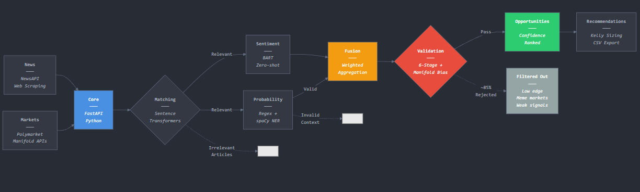
How it works
Collect live prediction market data from Manifold, Polymarkte etc
Collect news articles from a varied topic range
Feed into FastAPI pipeline
Use sentence transformers to match articles to markets based on meaning
a) Extract explicit signals from text (ie polls and percents) and confirm context with spacy
b) Zero-shot transformer to determine negative or positive trend
Combine probability + sentiment using weighted scoring (confidence, credibility, relevance, recency)
Six-stage filtering process and Manifold bias correction
Rank markets by expected edge, urgency and confidence
Recommend trades and apply Kelly sizing

Slide 6
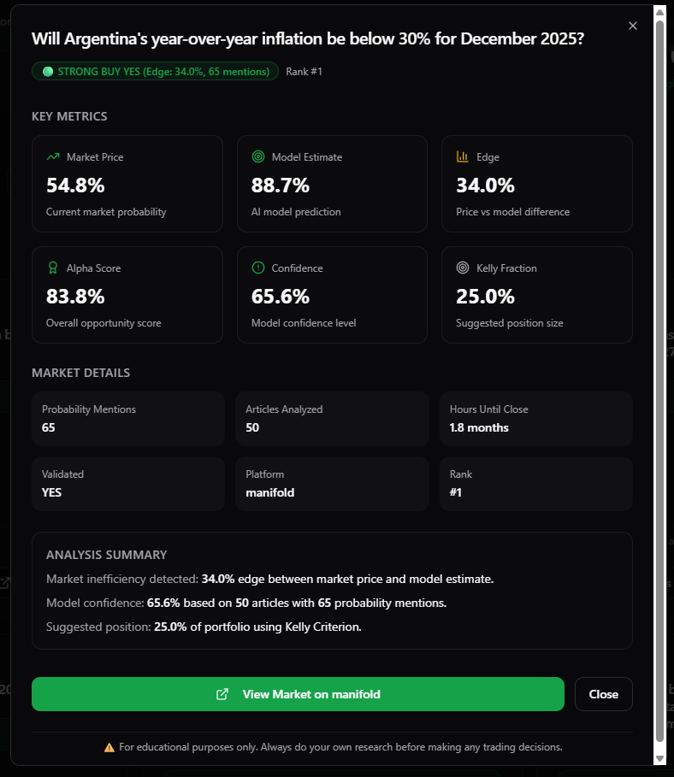
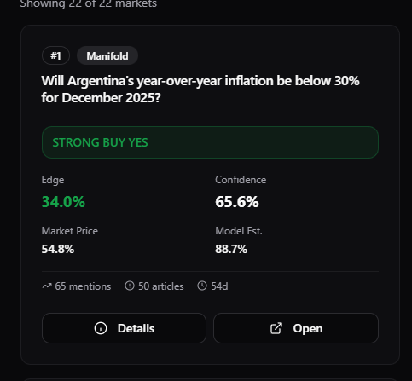
Example

Slide 7
Ethical Considerations
No signal fabrication
No misinformation amplification
Transparent source traces & confidence scores
Designed for analysis and not manipulation

Slide 8
Next steps
Market expansion
Source expansion
Live Trading and alerts
API Release
Backtesting Engine
Add more sites (Kalshi, Polymarket etc)
Expand to social signals (X, Discord, TikTok topic clusters)
Deploy live alert & auto-trade execution module
Release API for third party forecasters
Backtest with historical markets to fine tune and verify our model

Slide 9
Thank you
Any Questions?

