Slide 1
Project
Name : V. Sharavana Devankanda Sai
Reg No:24AFCSE329
College Name : Annamacharya University
Department : Computer Science and Engineering
Email:ssai7955433@gmail.com
Mobile Number:8247696886
Project Name : AI Resume Analyzer

Slide 2
Problem Statement
• Manual resume screening is slow
• AI automates analysis
• Improves efficiency

Slide 3
Objectives
• Upload Resume PDF
• Extract Text
• Analyze Resume
• Estimate ATS Score

Slide 4
Technologies
• Python
• Streamlit
• Groq API
• PyPDF2
• dotenv

Slide 5
Architecture
• Upload Resume
• Extract Text
• AI Analysis
• Display Results

Slide 6
Features
• Strength Analysis
• Weakness Analysis
• Suggestions
• ATS Score
• Missing Skills

Slide 7
Code Explanation
• app.py for UI

Slide 8
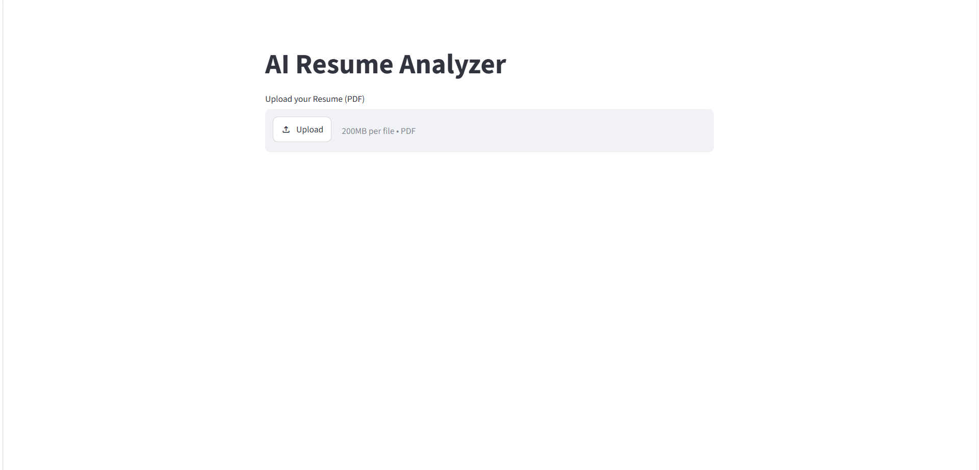
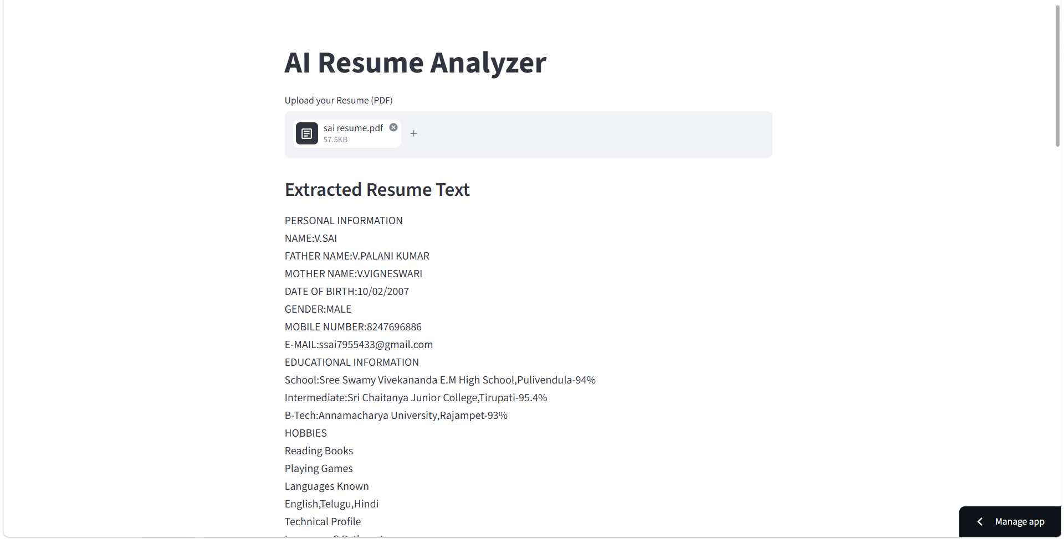
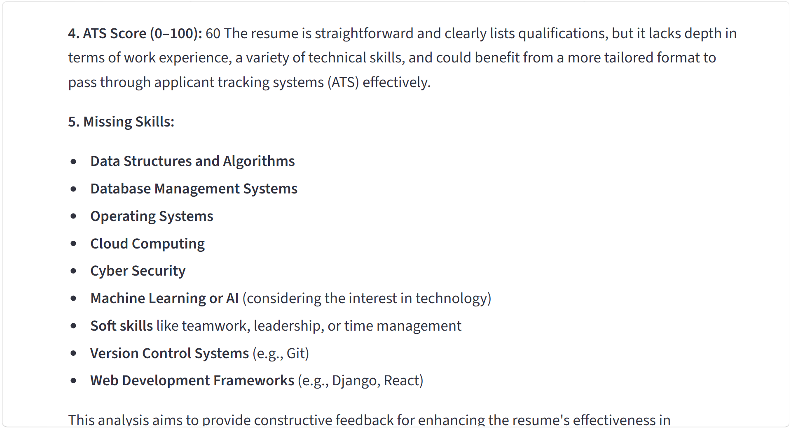
Screenshots
• Resume Upload
• Home Page
• Resume Upload
• Analysis Output
• ATS Score
• ATS Score

Slide 9
Challenges
• PDF extraction issues
• Different formats
• ATS estimation

Slide 10
Conclusion
• Saves time
• Improves resumes
• Helps job seekers

