Slide 1
Semantic Segmentation
Samsung AI Expert Course

Slide 2
Table of contents
Project Summary
Purpose
FCN8s
Introducing baseline Model : Tool, Architecture, Dataset, Loss
Measuring performance : mean IOU, per class IOU
Project Detail
Deeplab V1
Deeplab V2
Individual tune-up result
Conclusion

Slide 3
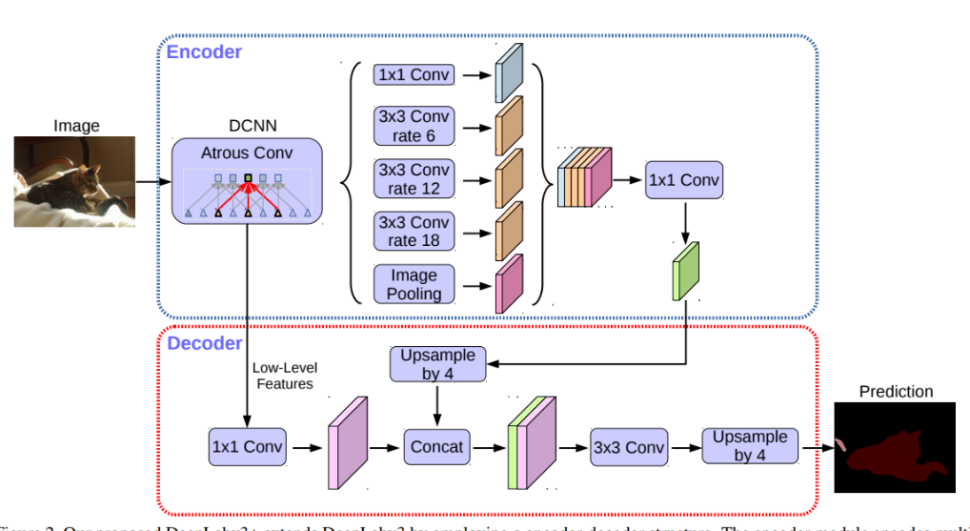
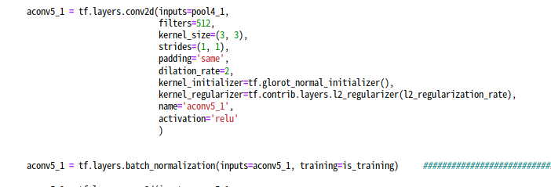
Individual tune-up
Model’s Feature specialized
Initializer
Normalization
Layer

Slide 4
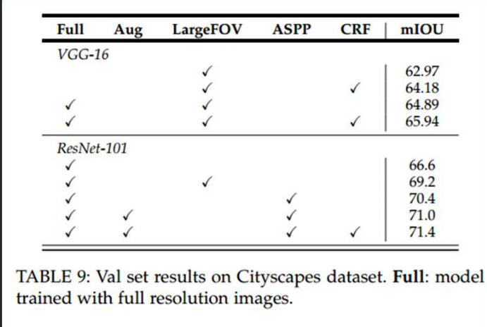
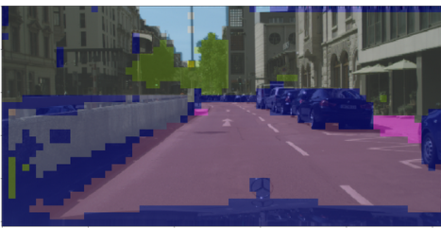
Individual tune-up
Performance measured
Mean IOU
Per class IOU
Training & validation loss
Result as visualized prediction

