Slide 1


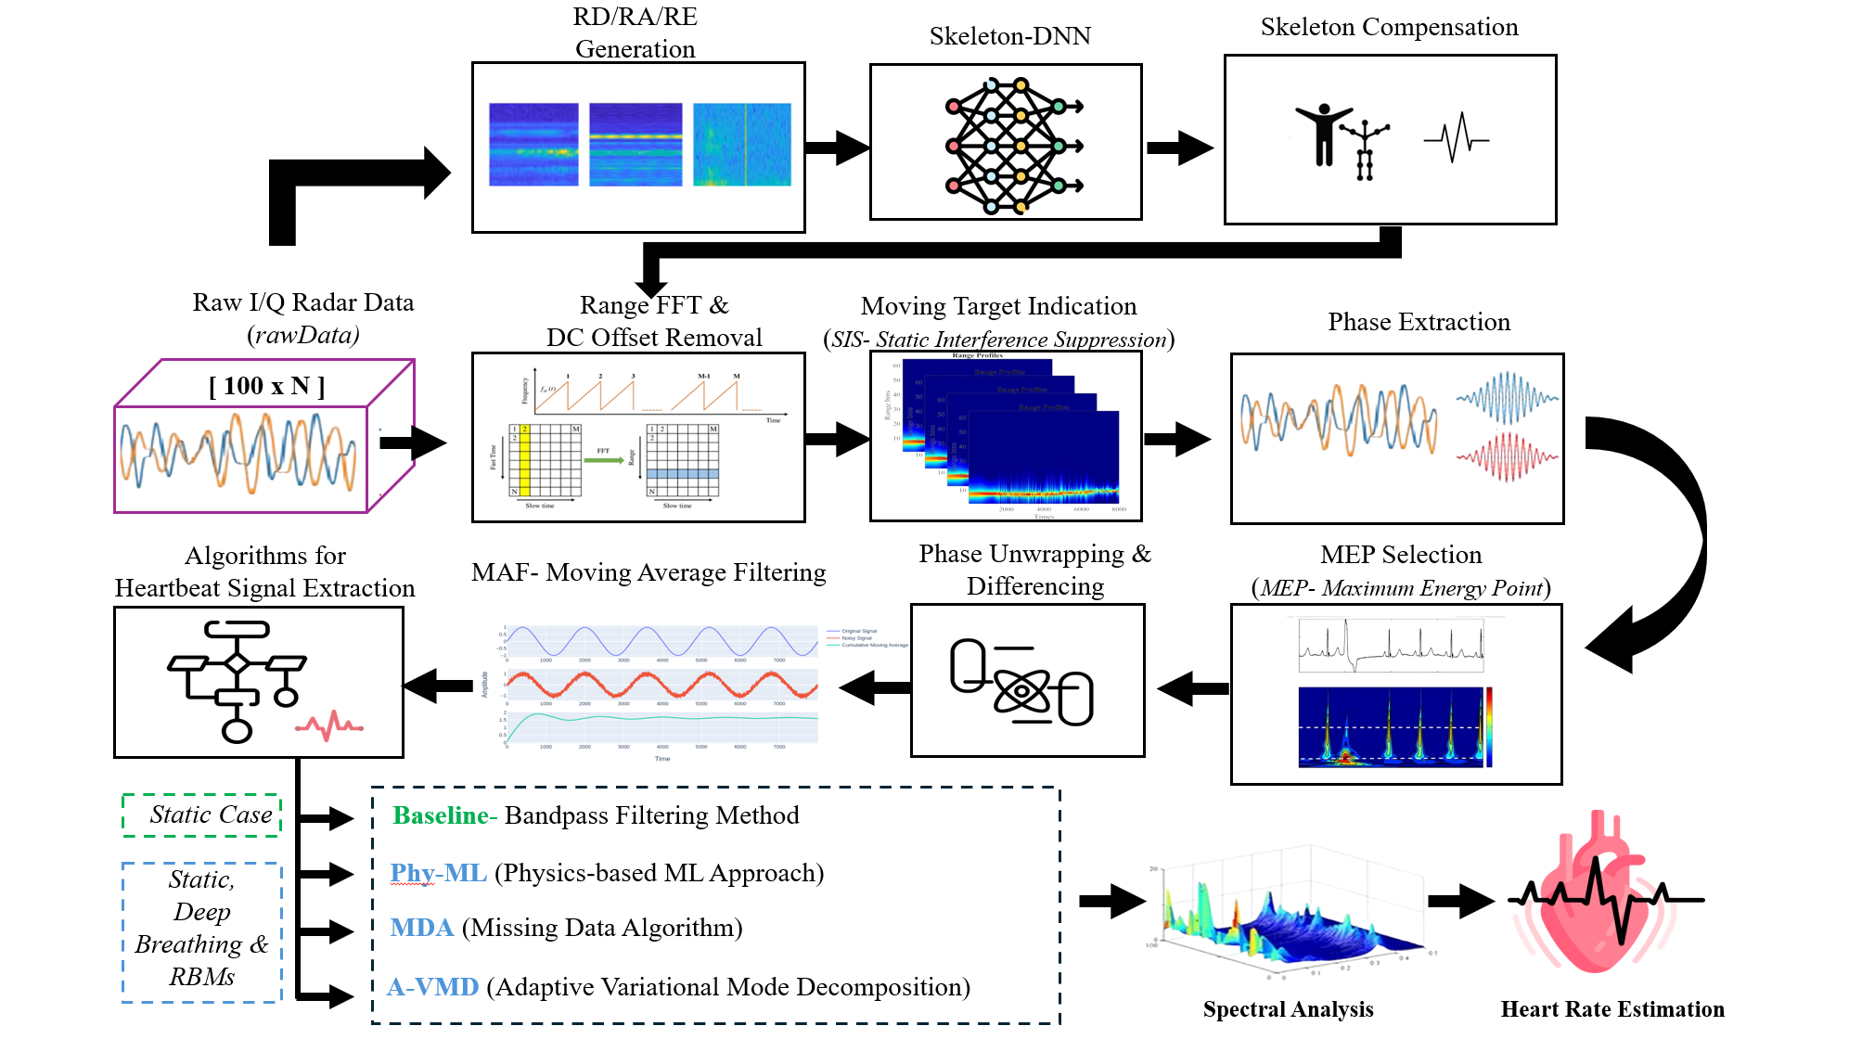
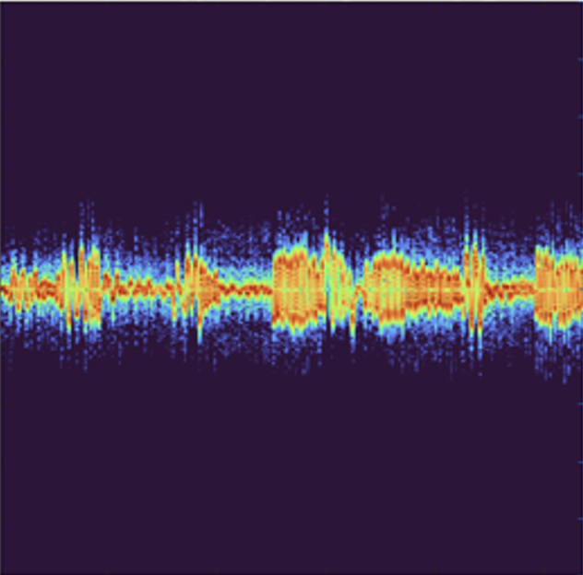

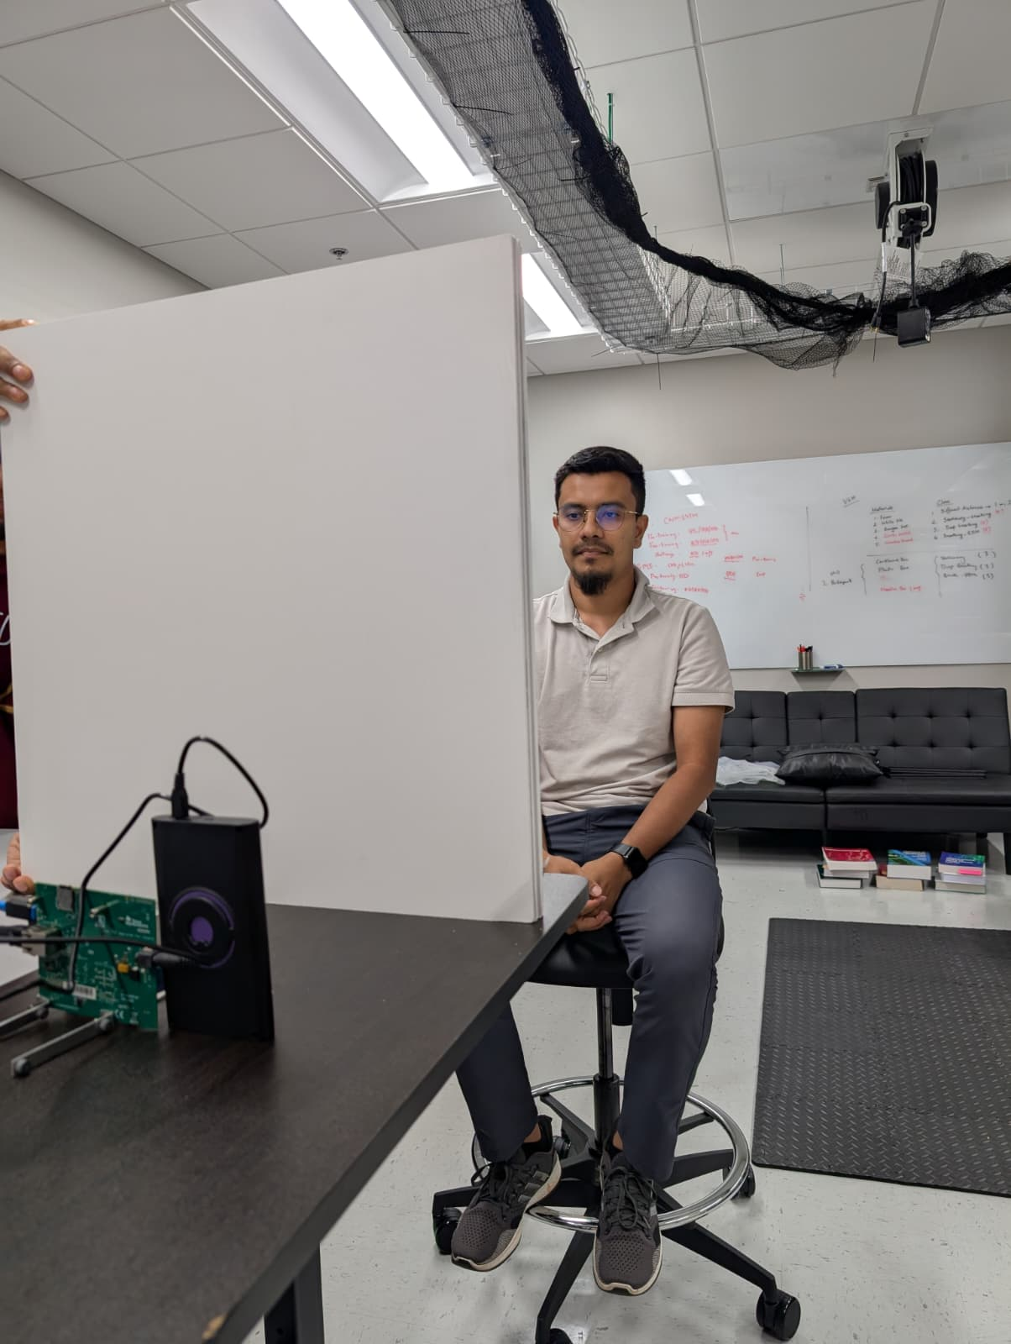
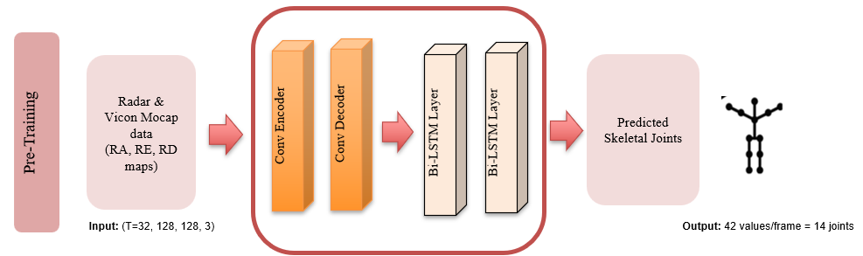
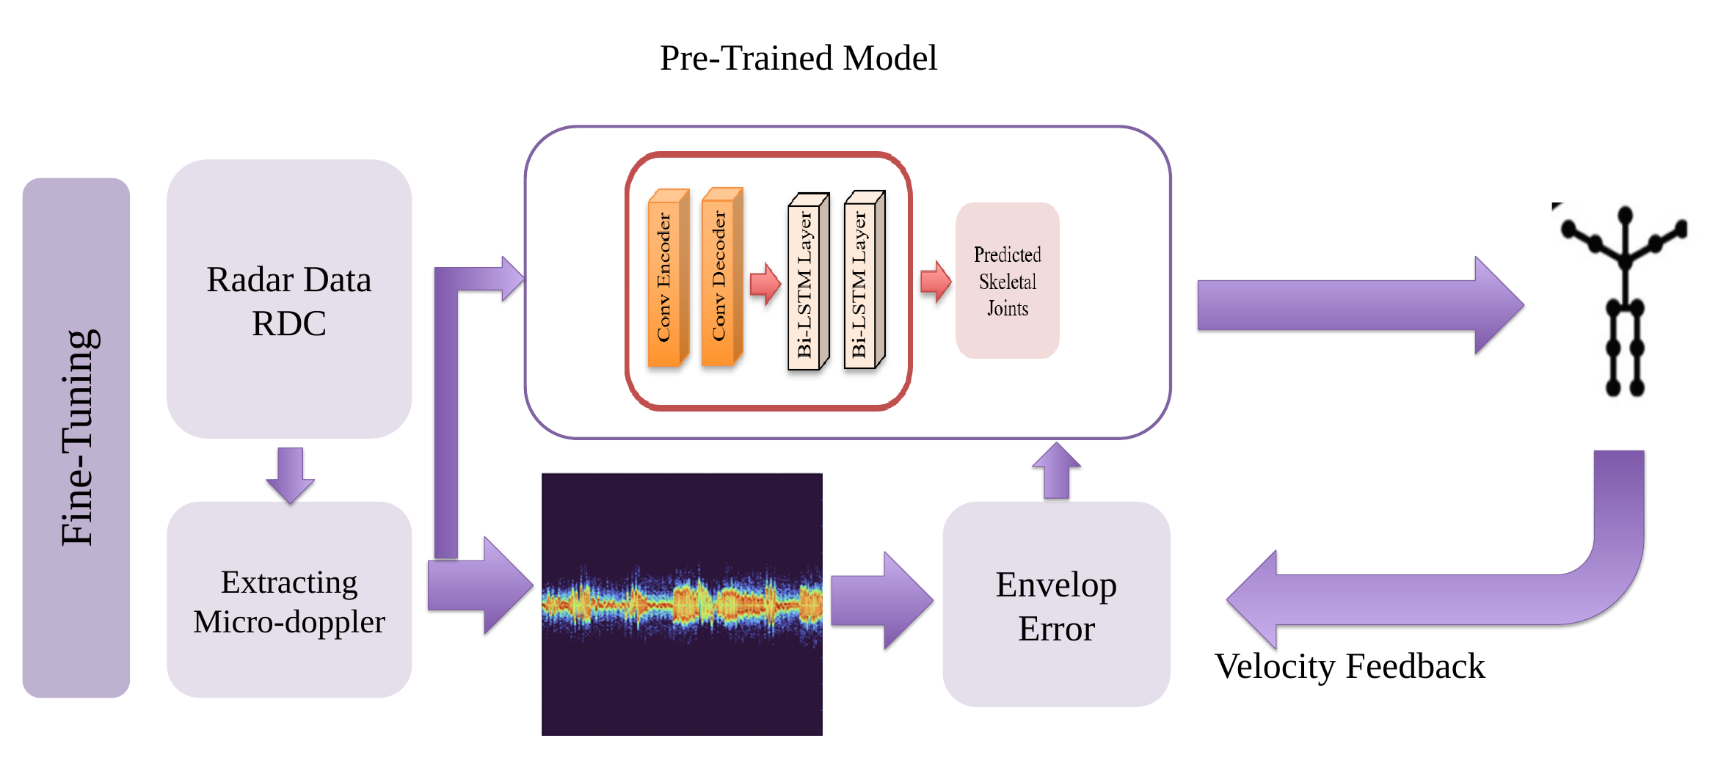

Radar-based Heart-Rate Sensing
in Emergency Response Scenarios
POSTER 2.1
THEME 2
Muhammad Moiz, Sultanus Salehin
PI: Dr. Sevgi Z. Gurbuz
Department of Electrical & Computer Engineering, North Carolina State University
Graphical Abstract
Introduction
Physics-Guided Skeleton Estimation for Motion Compensation
1 · The heartbeat is buried
Once a survivor has been located inside a collapsed building, the next question is whether they are still alive. Radar can answer it without entering, without light, and without putting a sensor on the body.
Breathing and heartbeat move the chest wall by millimeters, and that displacement modulates the phase of the radar return. Reading it is straightforward while the subject holds still.
A trapped survivor does not hold still. Random body movements, posture shifts, limb motion, are orders of magnitude stronger than cardiac micro-motion, non-stationary, and broad enough to overlap the cardiac band.
An RF skeleton estimator (CAE+Bi-LSTM) tracks 14 body keypoints from range–azimuth, range–elevation and range–Doppler maps.
Kinematic cycle-consistency keeps the estimate biomechanically plausible, supervised by the radar’s own micro-Doppler envelopes rather than optical ground truth.
Subtracting the estimated skeleton motion phase leaves only respiration and heartbeat.
Benchmarked baselines and proposed algorithm on Intel Core Ultra 7 laptop silicon.
Body motion is orders of magnitude stronger than chest motion, and it spreads across the cardiac band. Filtering alone cannot separate them.
Sensing through
the wall
Trapped survivor
No line of sight, no
contact sensor on the body
never stays still
2 · The RF skeleton measures it
A CAE + Bi-LSTM predicts 14 joints per frame from RA, RE, and RD maps.
Kinematic cycle consistency ties the predicted joint velocities to the measured micro-Doppler envelopes
3 · Remove it, read the heartbeat
Radar rover
Collapsed structure
cardiac band 0.8–2.5 Hz
Skeleton compensation removes the gross motion, and the residual phase carries the beat.
0.88 s
35.69 J
Processing latency per inference
CPU energy per inference
Dataset & Results
Range FFT and static-interference suppression, phase extraction at the maximum-energy point, skeleton-guided compensation, then spectral analysis in the cardiac band.
Figures of merit and overall score
Human Subject
Scenario | Metric | Bandpass | Sk-RBM (ours) | MDM | A-VMD
Stationary | FoM AHR | 0.003 | 0.007 | 0.002 | 0.009
 | FoM HRV | 0.255 | 1.307 | 0.071 | 0.407
 | Score | 3.267 | 9.230 | 2.131 | 12.862
Deep breathing | FoM AHR | 0.003 | 0.007 | 0.007 | 0.011
 | FoM HRV | 0.182 | 1.083 | 0.086 | 0.385
 | Score | 2.983 | 9.407 | 7.649 | 10.484
Random body motion | FoM AHR | 0.004 | 0.008 | 0.010 | 0.006
 | FoM HRV | 0.188 | 0.333 | 0.081 | 0.035
 | Score | 3.931 | 8.877 | 10.218 | 6.375
Total Score | __ | 3.394 | 9.171 | 6.667 | 9.907
Wall Barrier
Pre-training on Simulated radar data
77GHz AWR2243 mmwave Radar
10GHz Vayyar Walabot UWB Radar
FOM AHR: Figure-of-merit Average Heart Rate, FOM HRV: Figure-of-merit Heart Rate Variability; Higher score means better performance
Fine-tuning - no positional ground truth
Efficiency Analysis
Conclusion
Methods | Latency (s) | Energy (J) | CPU Util (%) | Power (W)
Bandpass | 0.20 | 8.09 | 90.9 | 40.9
Sk-RBM | 0.88 | 35.69 | 89.7 | 40.4
MDM | 4.26 | 159.58 | 83.1 | 37.4
A-VMD | 17.07 | 711.76 | 92.1 | 41.4
Skeleton-guided RBM compensation effectively separates gross body motion from cardiac micro-motion
Low latency (0.88s), and reduced energy consumption (35.69J)
Lowest peak memory usage (175MB) among all evaluated methods
Explore multi-person and through-wall scenarios using UWB radars
Integrating this approach with a mobile robot
Intel Core Ultra 7 268V. Sk-RBM is the only motion-aware method that also cuts peak memory, and runs about 20× cheaper than A-VMD.

