Slide 1


6th International Conference “2025 Devices for Integrated Circuit (DevIC)”)”
Date: 5-6 April, 2025, 2025
Covariance Matrix-Based DOA Estimation Using CNN: Performance Across Narrow and Wide Grids
Paper ID - 414
Notes:
Good [morning/afternoon/evening] everyone! Today, I am presenting our work titled ‘Covariance Matrix-Based DOA Estimation Using CNN: Performance Across Narrow and Wide Grids.’ This work is authored by ( all the names) and presented by myself, Tanvir Ahmed. This presentation will cover our approach to improving DOA estimation using deep learning, its motivation, methodology, results, and future directions.

Slide 2
Outline
Introduction
Motivation
Related Works
Project Objective
Dataset Preparation
Model Architecture & Parameters
Results
Ablation Study
Computational Complexity Analysis
Conclusion & Future Work
Notes:
To give you an overview of this presentation, I will begin with an introduction to DOA estimation, followed by the motivation behind using deep learning. I will then discuss some related works before moving into our project objectives. Next, I will go over the dataset preparation, model architecture, and parameters used in our approach. After that, I will present our results, including an ablation study and computational complexity analysis. Finally, I will conclude with key findings and discuss future directions.

Slide 3

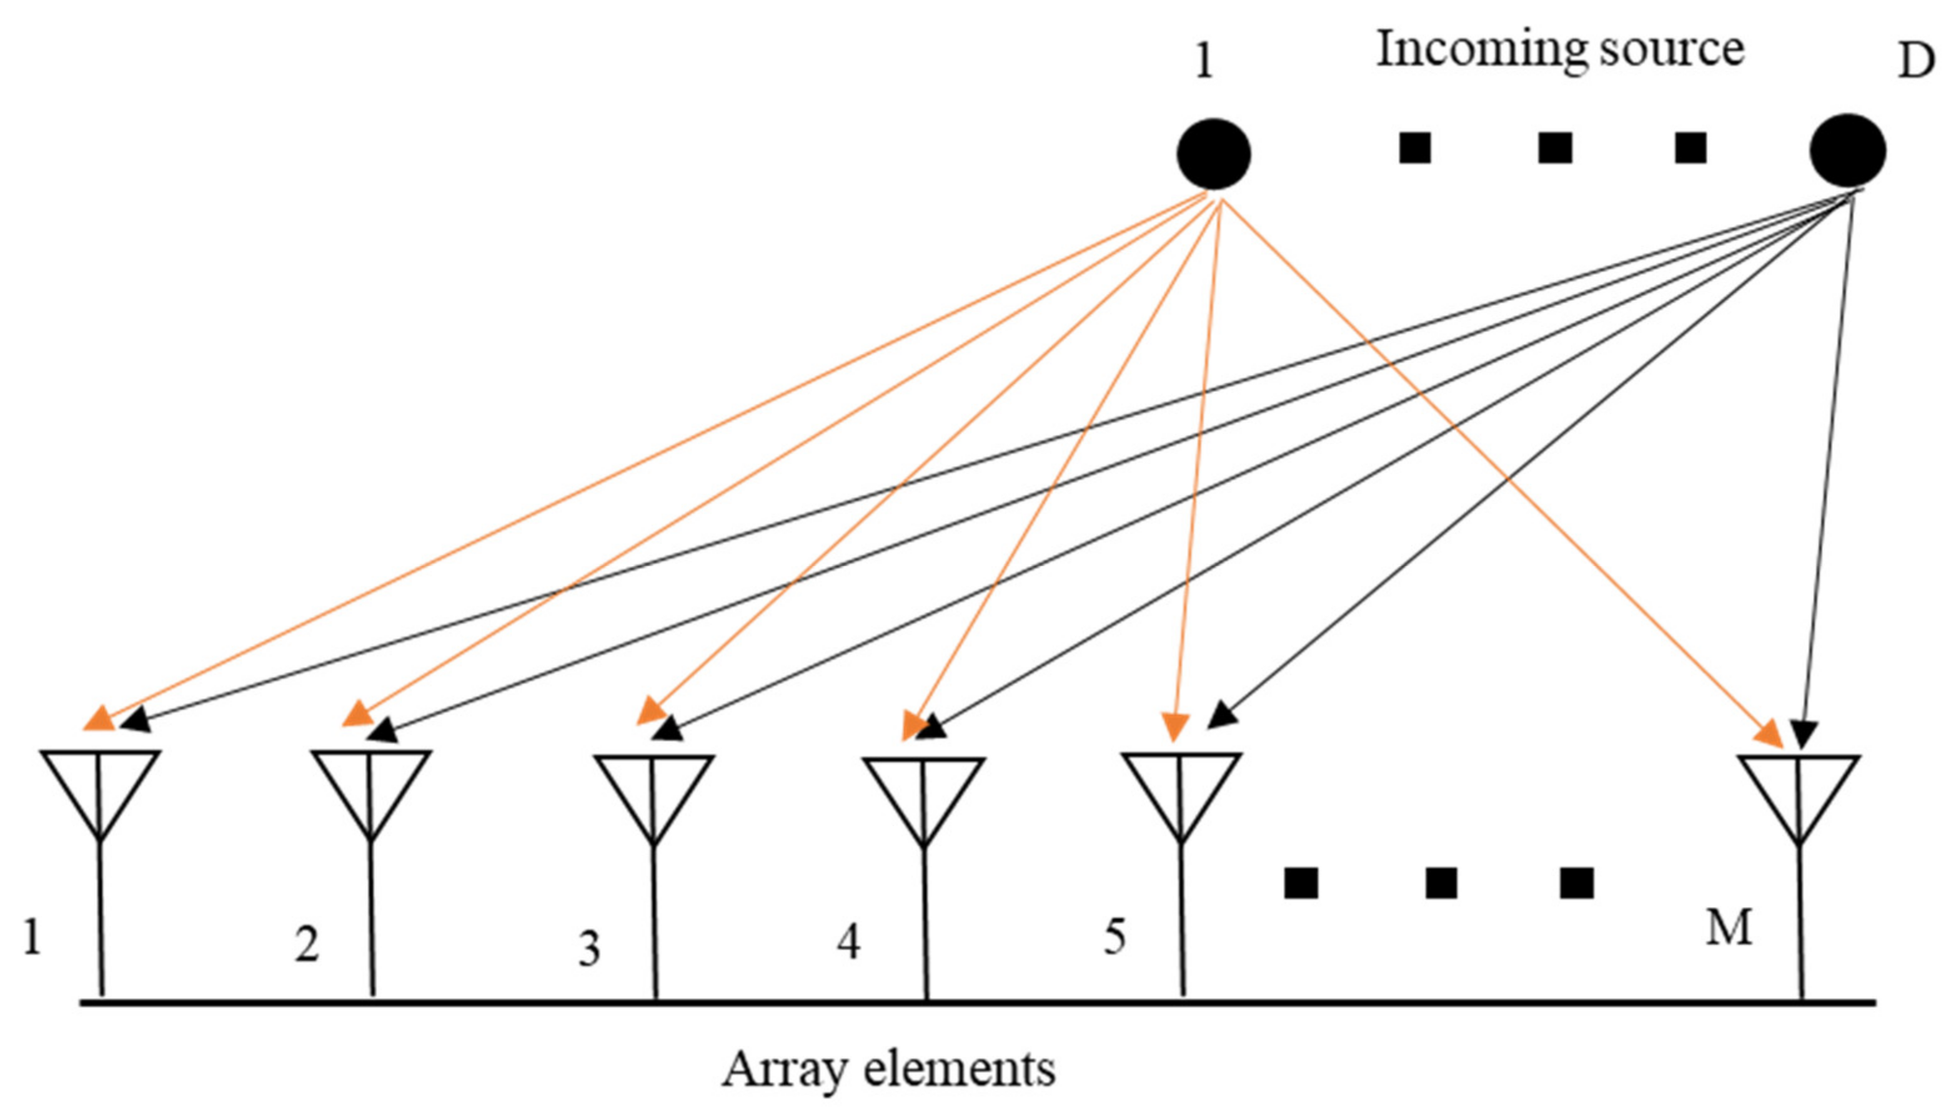
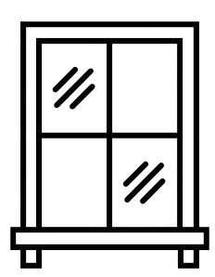



Introduction
What is DOA Estimation?
DOA estimation is the process of determining the angle at which signals arrive at an array of sensors or antennas.
Key Applications of DOA Estimation:
Radar Systems, Sonar Systems: Vital in underwater object detection, navigation, and exploration, Wireless Communications, Autonomous Vehicles:
Challenges in DOA Estimation:
Processing signals from large arrays demands significant computational power.
Noise and Interference, Model Mismatch.
Notes:
Direction-of-Arrival, or DOA, estimation is a fundamental task in signal processing where we determine the angles at which signals arrive at an array of sensors or antennas. This technique is critical in applications such as radar, sonar, wireless communications, and autonomous navigation. However, traditional DOA estimation techniques face challenges such as high computational complexity, sensitivity to noise, and performance degradation due to model mismatches. Our study explores deep learning as an alternative solution to improve DOA estimation accuracy and efficiency.
DOA estimation plays a crucial role in multiple domains. Radar systems use it for tracking and identifying objects. Sonar systems depend on it for underwater navigation and object detection. In wireless communications, it is vital for improving signal quality through beamforming. Additionally, it supports autonomous vehicles in obstacle detection and navigation. Despite its importance, DOA estimation is computationally expensive and struggles with noise and real-world variations. Traditional methods are highly sensitive to low SNR conditions, making robust estimation challenging.

Slide 4
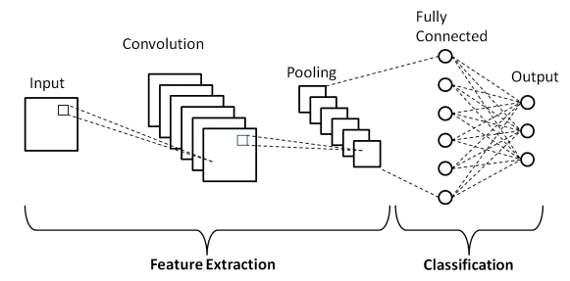
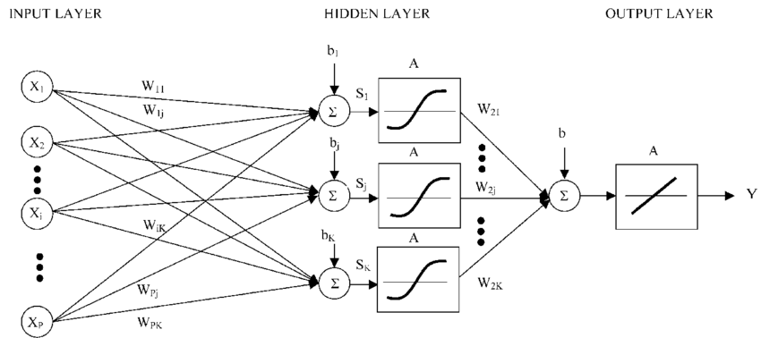
Motivation
Limitations of Traditional Methods:
MUSIC & ESPRIT Algorithms: Require prior knowledge of the number of signal sources, Performance degrades with coherent signals or under low SNR conditions, Sensitivity to Model Mismatch: Hardware imperfections and environmental variations impact accuracy.
Advantages of Deep Learning:
Automatic Feature Extraction: Learns complex patterns from data without manual intervention.
Robustness: Handles noise and imperfections better than classical methods.
Efficiency & Adaptability.
Notes:
Traditional methods like MUSIC and ESPRIT are widely used but have limitations: they require prior knowledge of signal sources and struggle with coherent signals and low SNR conditions. These methods are also sensitive to model mismatches, meaning real-world factors like hardware imperfections significantly degrade accuracy. Deep learning, on the other hand, offers key advantages: it can automatically extract features from data, is more robust to noise, and is efficient in handling nonlinear relationships. These benefits make deep learning a promising approach for DOA estimation

Slide 5
Related Works
Authors | Key Takeaways | Limitations
Huang et al. (2018) | - Used DNNs for offline and online learning. - Achieved superior DOA estimation compared to traditional methods. | - Model performance dependent on massive MIMO setups. - Requires extensive computational resources for training.
Zheng et al. (2024) | - Utilized raw signal components for DOA estimation. - Showed improvements in multi-source and low-SNR environments. | - Struggles with real-world implementation due to dependence on raw signal variations.
Chung et al. (2022) | - Validated deep learning-based DOA estimation using real-world datasets collected via USRP. | - Performance degrades under severe noise conditions.
Chen et al. (2024) | - Introduced SDOA-Net using convolutional layers to address antenna imperfections. | - Requires further validation on diverse datasets.
Notes:
Various studies have explored deep learning for DOA estimation. Researchers have investigated deep neural networks (DNNs), convolutional neural networks (CNNs), and hybrid approaches to improve estimation accuracy. CNNs, in particular, have shown promising results in extracting spatial features from covariance matrices. However, challenges remain in optimizing model architectures, reducing computational complexity, and ensuring robustness under extreme noise conditions. Our approach builds upon these works by proposing a CNN-based model that processes covariance matrices for improved DOA estimation.

Slide 6
Project Objective
Primary Goal:
- Designing and implementing a robust deep convolutional neural network (CNN) model for Direction-of-Arrival (DOA) estimation.
Specific Objectives:
- Utilizing Covariance Matrices: Leveraging the data from offline settings where covariance matrices of signals received by a sensor or antenna array as input features for the CNN. (Dataset)
- Achieving High Accuracy: Ensuring accurate DOA estimation, even in challenging scenarios with low signal-to-noise ratios (SNR).
- Simplifying Parameter Tuning: Developing a system that minimizes the need for extensive manual parameter tuning, unlike traditional algorithms.
Expected Outcomes:
- Noise Robustness - Efficiency
Notes:
Our primary goal is to design and implement a robust deep learning-based DOA estimation model. Specifically, we aim to:
Leverage covariance matrices as input features for the CNN.
Achieve high accuracy even under low SNR conditions.
Minimize parameter tuning to enhance usability.
Our expected outcomes include improved noise robustness and computational efficiency, making this solution suitable for real-time applications.

Slide 7


Dataset Preparation
Design Considerations
Dataset Characteristics
SNR Levels
- 5 different SNR levels
- {-20, -15, -10, -5, 0} DB
Grid Resolution for angle prediction
Grid
- Resolution 1$°$
- Narrow grid ranging from -60$°$ to 60$°$, 121 grid points
- Wide grid ranging from -90$°$ to 90$°$, 181 grid points
Multiple SNR levels for robustness
Handling targets with varying separations
Targets
- 2 targets
- All combination for narrow grid => $\left(\begin{matrix}161 \\ 2\end{matrix}\right)$ i.e. 7260
- All combination for narrow grid => $\left(\begin{matrix}181 \\ 2\end{matrix}\right)$ i.e. 16290
Antennas
- Array of 16 antennas
Notes:
The success of any deep learning model largely depends on the quality and diversity of its dataset. For DOA estimation, we needed a dataset that captured a wide range of realistic conditions, including different signal-to-noise ratios and varying angular resolutions.
Dataset Characteristics:
We designed a synthetic dataset specifically to train and evaluate our CNN-based DOA estimation model.
The dataset was structured into two configurations:
Narrow Grid: Covers angles from -60° to 60°, totaling 121 grid points.
Wide Grid: Extends from -90° to 90°, resulting in 181 grid points.
Each configuration consists of multiple signal scenarios to train the model across a diverse range of input conditions.
Design Considerations:
Signal-to-Noise Ratio (SNR) Levels: We introduced five different SNR conditions ranging from -20 dB to 0 dB to simulate real-world challenges, ensuring the model is robust under noise.
Antenna Configuration: We used a 16-element uniform linear array (ULA), which is commonly employed in DOA estimation.
Covariance Matrix Representation: Instead of raw signals, we computed 16 × 16 covariance matrices to capture the spatial and statistical properties of the received signals.
Final Dataset Size:
Narrow Grid: 36,300 samples
Wide Grid: 81,450 samples
With this dataset, our model can effectively learn to estimate DOAs with high precision, even in challenging noise conditions."

Slide 8
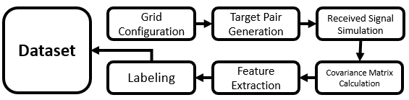
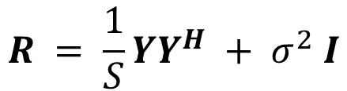
Dataset Preparation
Covariance Matrix Generation
- Antenna array response for angle combinations
- Signal generation (200 snapshots)
- Addition of noise based on SNR
- Matrix shape 16 x 16
$$R = \frac{1}{S}YY^{H} + σ^{2} I$$
Feature Extraction
-Extraction of the Real, Imaginary and Phase components of the matrix
- A matrix of shape 16 x 16 x 3 for each sample
Overall Dataset Composition
- Narrow Grid
  Total samples: 7260 X 5 = 36,300
  Feature shape: 36,300 x 16 x 16 x 3
  Label shape : 36,300 x 121
Label
- Target angles as a sparse vector
- 1 ➔ Target presence, 0 ➔ Target absence
- Wide Grid
  Total samples: 16290 X 5 = 81,450
  Feature shape: 81,450 x 16 x 16 x 3
  Label shape : 81,450 x 181
Notes:
In this slide, I will explain the dataset preparation process, which is crucial for training our deep learning-based DOA estimation model."
Covariance Matrix Generation
"We begin by generating covariance matrices, which serve as the primary input to our model. The covariance matrix captures the spatial correlation of the received signals, making it a powerful representation for DOA estimation."
To achieve this, we simulate the antenna array response for different angle combinations.
Each signal is generated using 200 snapshots, ensuring a sufficient amount of data for robust training.
We introduce noise based on different SNR levels (-20 dB to 0 dB) to make the dataset more realistic and improve generalization.
The resulting covariance matrix has a shape of 16 × 16, which aligns with our 16-element uniform linear array.
"The mathematical representation of the covariance matrix is shown here, where Y represents the received signal matrix, and the term σ² I accounts for noise."
Feature Extraction
"Next, we extract key features from the covariance matrix to enhance model performance."
Instead of using raw signals, we decompose the covariance matrix into three key components: Real, Imaginary, and Phase.
Each sample is represented as a 16 × 16 × 3 tensor, where the three channels correspond to these components.
This structured representation allows the CNN to extract meaningful spatial features from the covariance matrix.
Labeling
"For supervised learning, we need labeled data."
We represent target angles as a sparse vector to indicate the presence or absence of signals at specific angles.
A value of 1 signifies target presence, while a value of 0 indicates target absence at a given angle.
This labeling approach allows the model to learn the exact positions of signal sources within the angular grid.
Overall Dataset Composition
"Now, let’s look at how the dataset is structured for different angular resolutions."
Narrow Grid
The narrow grid spans from -60° to 60°, with 121 possible target angles.
We generate 7,260 unique signal configurations, and with five different SNR levels, this results in a total of 36,300 samples.
Each sample has a feature shape of 16 × 16 × 3, while the label matrix is 36,300 × 121, corresponding to the 121 possible angles.
Wide Grid
The wide grid spans from -90° to 90°, covering 181 angles.
Here, we generate 16,290 signal configurations, and with five SNR levels, the dataset expands to 81,450 samples.
Each sample retains the same 16 × 16 × 3 feature shape, but the label matrix expands to 81,450 × 181.

Slide 9
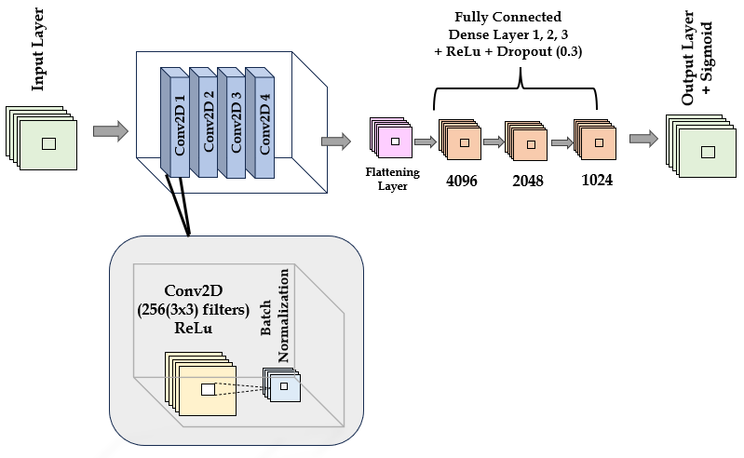
Model Architecture
Model structure:
Input layer to load the dataset
4 Convolutional layers with Normalization and ReLU Activation Function, 256 filters with the size of 3×3
Flatten Layer to flatten the output of the convolutional model to feed it to a Fully Connected (Dense) layer
3 Fully Connected layers with Dropout and ReLU Activation Functions, with 4098, 2048, and 1024, respectively
Fully Connected layer with Sigmoid Activation Function as the output
Notes:
Now that we have our dataset, let’s look at the architecture of our deep learning model.
We designed a Convolutional Neural Network (CNN) to process covariance matrices and extract spatial features relevant for DOA estimation. The CNN architecture includes multiple layers that successively refine and learn features from the input data.
Structure of Our CNN Model:
Input Layer:
The model takes 16 × 16 × 3 covariance matrices as input, where the three channels represent the real, imaginary, and phase components of the covariance matrix.
Four Convolutional Layers:
Each layer has 256 filters of size 3 × 3.
ReLU activation is used to introduce non-linearity, allowing the model to capture complex spatial patterns.
Batch normalization is applied after each layer to stabilize the training process and improve convergence.
Flattening Layer:
This layer converts the 2D feature maps from the convolutional layers into a 1D vector, making it suitable for fully connected layers.
Three Fully Connected (Dense) Layers:
These layers progressively refine the extracted features.
The neuron sizes are 4,096 → 2,048 → 1,024, allowing the network to learn hierarchical representations of the data.
Dropout (0.3) is used to reduce overfitting.
Output Layer:
The final layer applies a sigmoid activation function to perform binary classification for each angular grid point, determining the presence or absence of a DOA.
With this structure, the model balances complexity and computational efficiency, ensuring accurate DOA estimation with minimal computational overhead

Slide 10
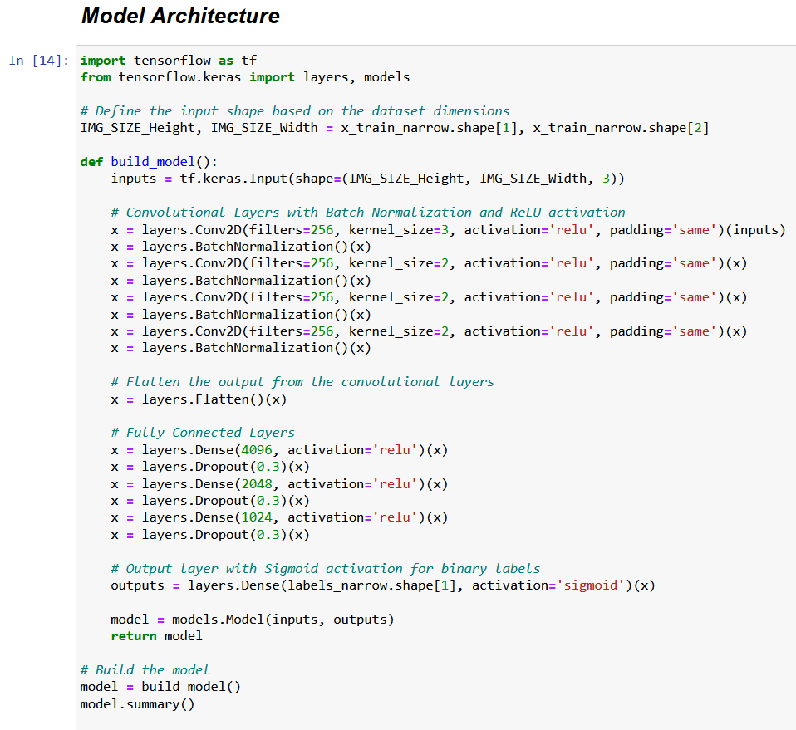
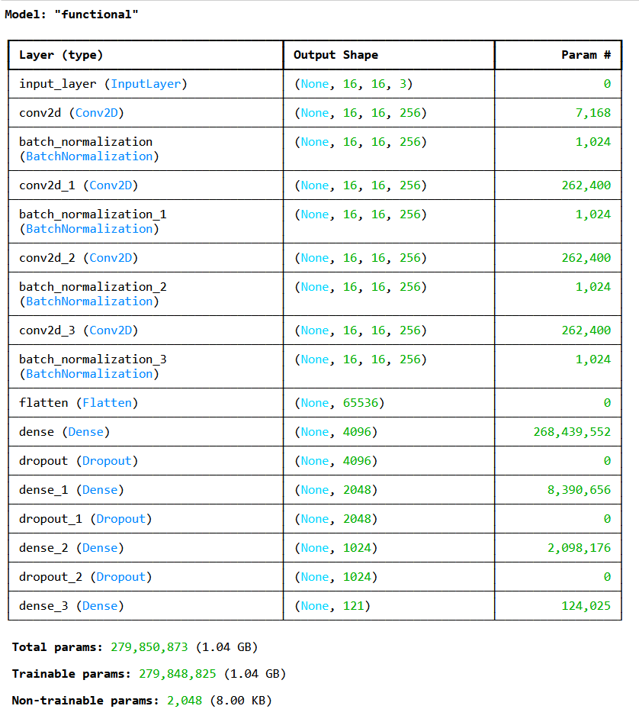
Model Parameters
Model training:
Implemented in tensorflow
Dropout (0.3) for regularization
Train for 200 epochs, Adam Optimizer.
Loss: BCE (Binary Cross Entropy)
Model parameters:
Conv layers capture local features
Dense layers capture global features
Total Number of Trainable Parameters: Almost 280M
Notes:
With the model architecture defined, let’s now discuss how the model was trained and optimized.
Training Configuration:
We implemented our model in TensorFlow and trained it for 200 epochs.
The Adam optimizer was used due to its adaptive learning rate, which helps achieve faster convergence.
We used Binary Cross-Entropy (BCE) loss, which is suitable for our binary classification task.
Regularization Techniques:
To prevent overfitting, we applied Dropout (0.3) in the dense layers.
Batch normalization was used in convolutional layers to improve stability.
Trainable Parameters:
The convolutional layers have relatively low trainable parameters, as they mainly focus on local feature extraction.
The fully connected layers, on the other hand, have a large number of trainable parameters, responsible for learning global patterns.
The total number of trainable parameters exceeds 280 million, making this a highly expressive model capable of capturing intricate DOA patterns.
By optimizing these parameters, we ensured that our model generalizes well across different noise levels and signal conditions.

Slide 11
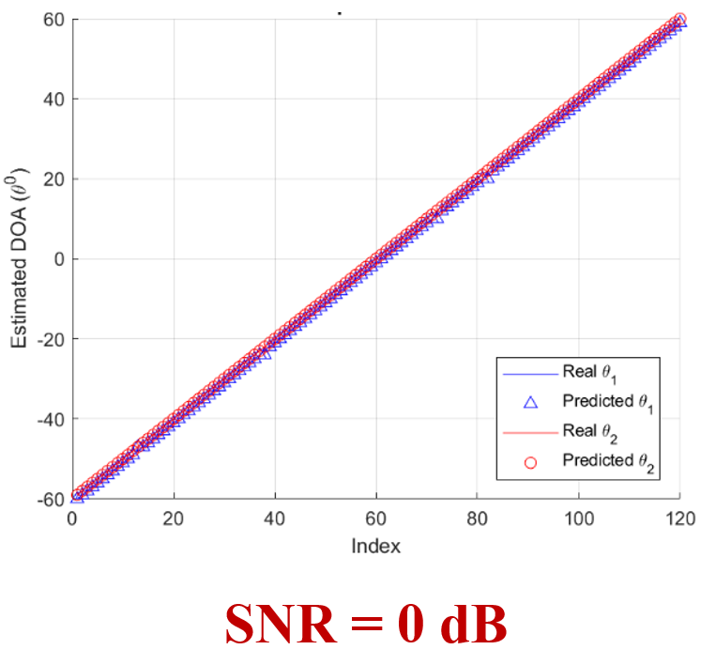
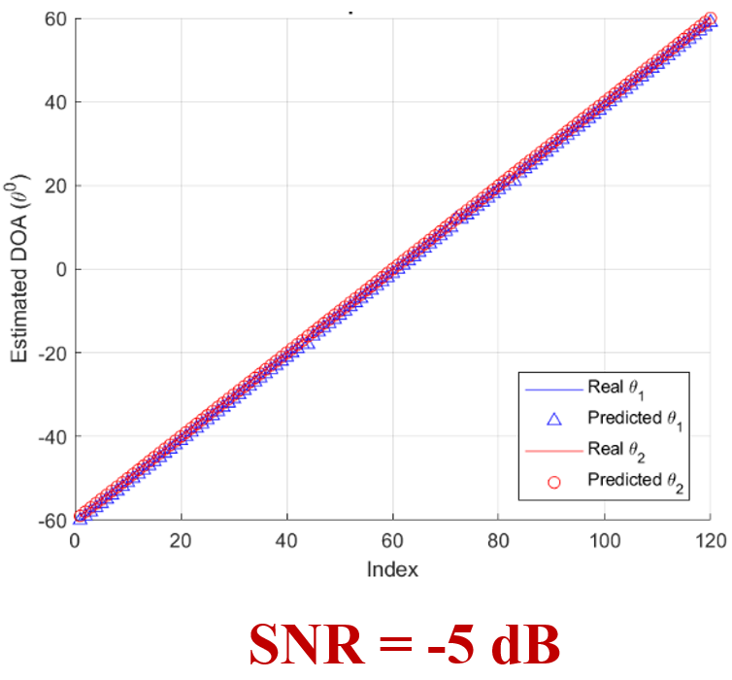
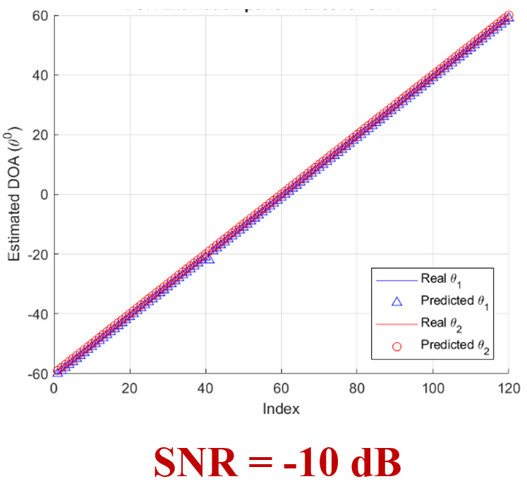
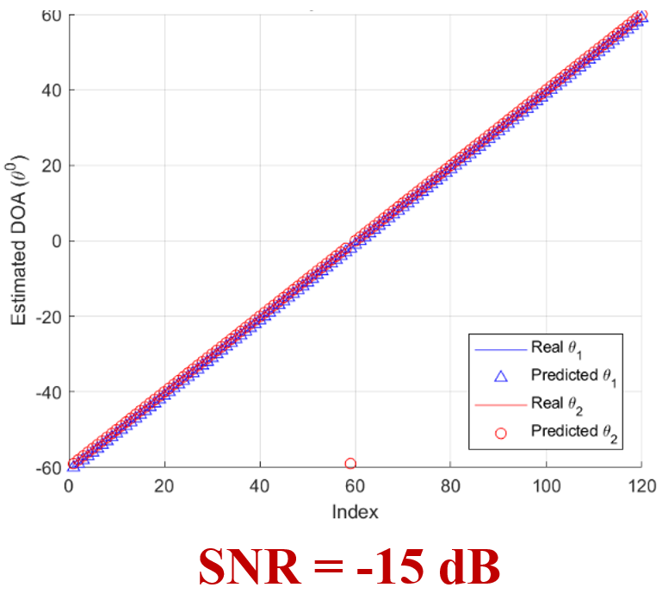
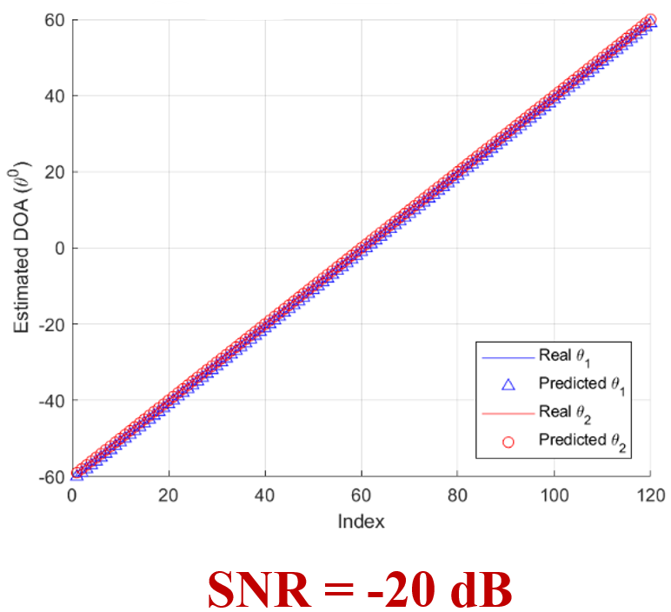
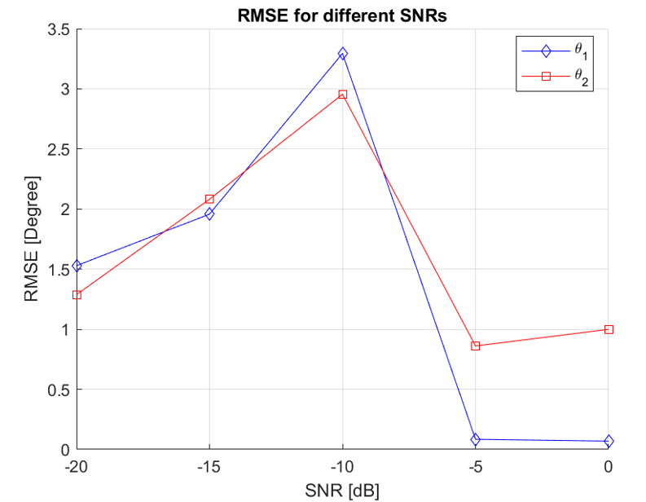
Results
Narrow Band Grid
RMSE
Notes:
Now, let’s move on to the results of our model's performance on the Narrow Band Grid. Our primary metric for evaluation is the Root Mean Square Error (RMSE), which measures the deviation of the estimated DOA angles from the actual target angles. Lower RMSE values indicate better accuracy."
Model Performance on Narrow Grid
"The Narrow Band Grid consists of angles ranging from -60° to 60°, with a total of 121 angular points. This grid has a relatively higher resolution compared to the wide grid, meaning the angular separation between points is smaller. The model's performance on this dataset is particularly strong due to its ability to learn fine-grained features."
RMSE Trend Across SNR Levels:
At 0 dB SNR, our model achieves near-perfect estimation, with minimal deviation between predicted and actual DOAs.
As noise increases, particularly at -5 dB and -10 dB, we observe a slight increase in RMSE, but the model still maintains high accuracy.
Even under severe noise conditions at -15 dB and -20 dB, the RMSE remains below 3.5 degrees, which is a remarkable achievement compared to traditional DOA estimation methods.
Reasons for High Accuracy in Narrow Grid:
The higher density of angles in the narrow grid provides the model with more training samples for closely spaced angles, improving its ability to distinguish between them.
The covariance matrix captures subtle spatial features more effectively in a narrow grid scenario, allowing the CNN to generalize well.
Even under low SNR conditions, the network successfully extracts features that are robust to noise, thanks to the deep convolutional layers and their ability to filter out irrelevant variations.
Comparison with Traditional Methods:
Traditional approaches like MUSIC and ESPRIT struggle significantly at low SNR levels, as their performance degrades in the presence of noise and correlated signals.
In contrast, our deep learning model retains its high accuracy, proving the effectiveness of a CNN-based covariance matrix processing method in DOA estimation.
Key Takeaway
"The results for the narrow grid confirm that our CNN-based approach is highly reliable for high-resolution DOA estimation. Even in challenging noise conditions, our model maintains an RMSE of less than 3.5 degrees, outperforming traditional techniques. This level of accuracy makes our method highly suitable for applications requiring precise angle detection, such as radar tracking and beamforming in wireless communications."
"Next, let’s analyze the results for the Wide Band Grid, which presents additional challenges due to the broader angular range."

Slide 12
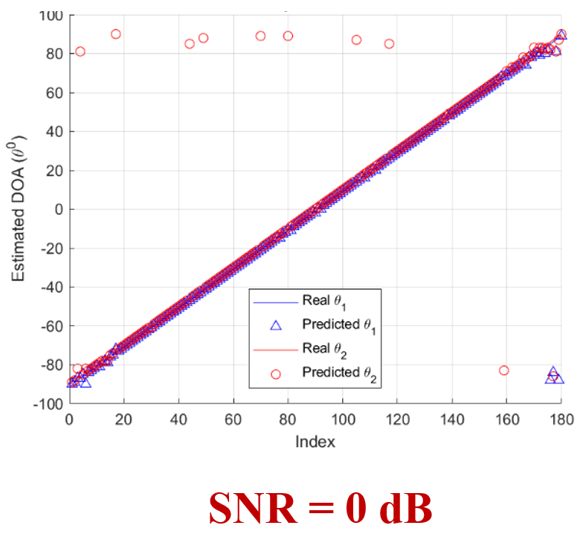
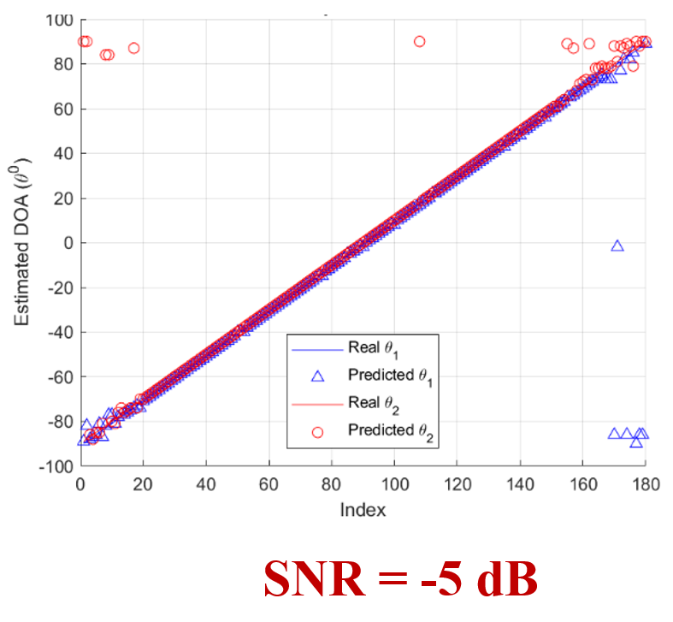
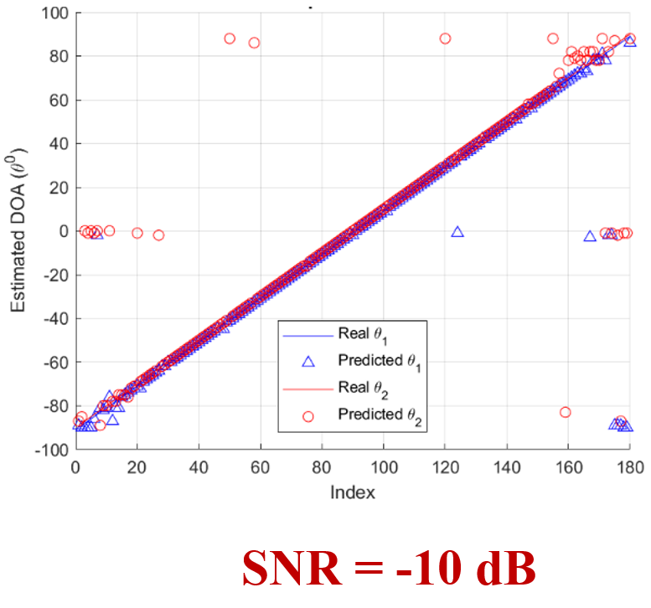
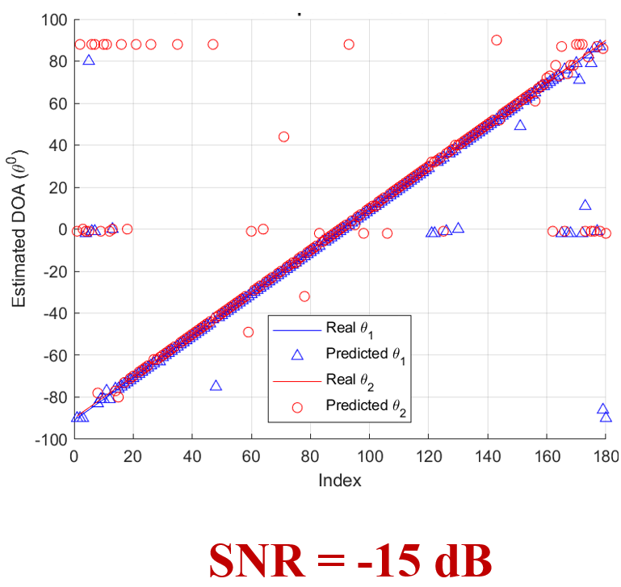
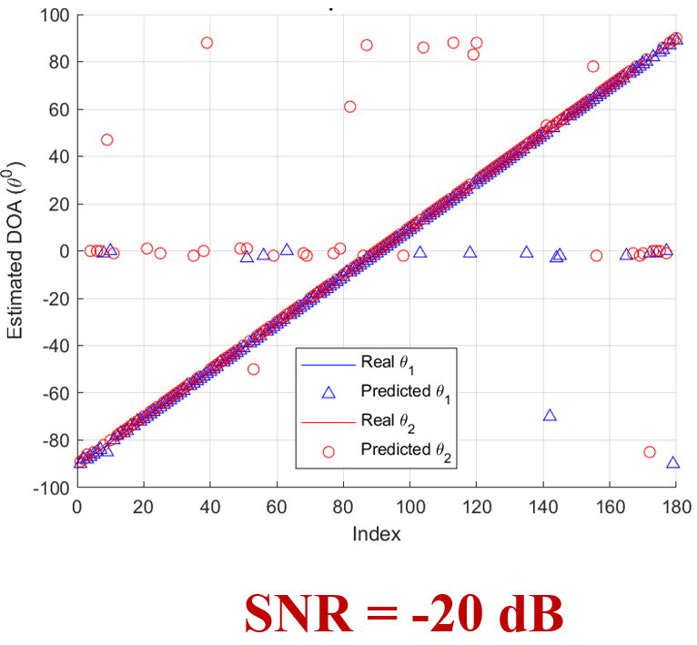
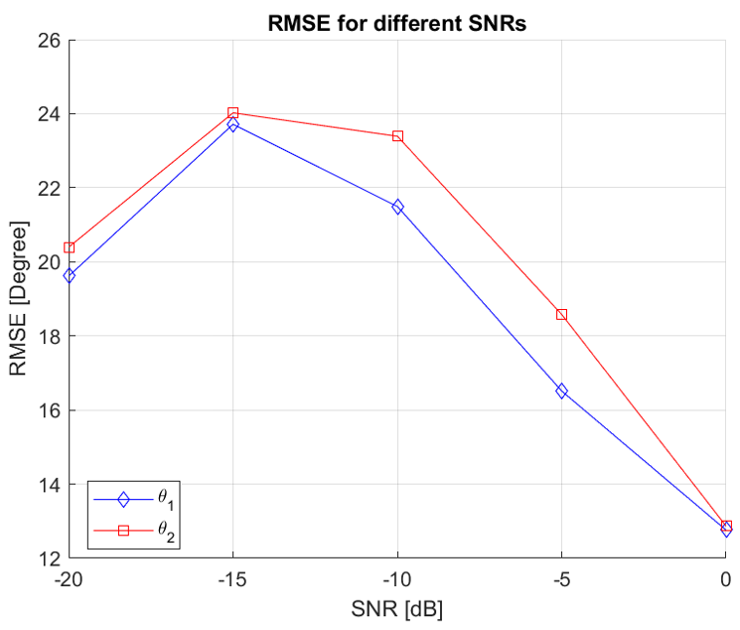
Results
Wide Band Grid
RMSE
Notes:
Now, let’s look at the results for the Wide Band Grid. Unlike the narrow grid, the wide grid spans a broader range, from -90° to 90°, with a total of 181 angular points. Because the angular resolution is lower and the dataset has more widely spaced target angles, DOA estimation becomes more challenging."
Model Performance on Wide Grid
RMSE Trend Across SNR Levels:
At 0 dB SNR, the model achieves good accuracy, with an RMSE that remains relatively low, similar to the narrow grid scenario.
However, as the noise level increases to -5 dB and -10 dB, the RMSE starts increasing more noticeably compared to the narrow grid. This is due to the wider angular separation between grid points, making precise estimation more difficult.
At -15 dB and -20 dB, the RMSE increases further, reaching a maximum of approximately 24 degrees. This is expected, as the model struggles to distinguish target angles that are widely spaced apart in the presence of high noise.
Challenges in Wide Grid DOA Estimation:
Since the angular resolution is lower, there are fewer training samples for closely spaced angles, which affects the model’s ability to generalize as well as it does in the narrow grid.
The covariance matrix representation, while effective, becomes less informative in scenarios where angular separations are too large, making the problem inherently more difficult.
The model still manages to generalize well, but extreme noise and broad angular ranges lead to some prediction errors and increased RMSE values.
Comparison with Traditional Methods:
While our CNN-based approach sees a drop in performance compared to the narrow grid, it still outperforms traditional methods like MUSIC and ESPRIT, which suffer even more at low SNR levels.
Traditional methods exhibit significantly higher RMSE values for wide grids due to their dependency on strong signal conditions and their sensitivity to model mismatches.
Our deep learning-based method, despite the increased difficulty, retains a reasonable RMSE even in low SNR conditions, proving its robustness compared to classical techniques.
Key Takeaway
"The results for the wide grid demonstrate that while our model maintains strong performance, the estimation becomes more challenging as the angular range increases. The RMSE values increase to around 24 degrees at the lowest SNR levels, but our model still performs significantly better than traditional DOA estimation methods. These findings highlight the need for further optimizations, such as hybrid models that combine deep learning with classical approaches or architectures specifically designed for broader angular estimation tasks."
"In the next section, we will discuss an Ablation Study, where we analyze different design choices and their impact on model performance.

Slide 13
Ablation Study
Comparison of different input representations:
Full covariance matrix vs. reduced representations
Excluding phase information increased RMSE
Testing different network depths:
CNN-Small: 47% faster inference but slight accuracy drop
Res-CNN: Higher accuracy but computationally expensive
Angular resolution impact:
1° resolution: More accurate
2° resolution: Faster but less precise
Notes:
To better understand our model’s behavior, we conducted an ablation study, evaluating the effects of different design choices.
1. Input Representation:
Full covariance matrix (real, imaginary, and phase) provides the best accuracy.
Removing the phase component significantly increases RMSE, proving its importance in DOA estimation.
2. Network Depth:
CNN-Small:
Reducing the number of convolutional layers improves inference speed by 47%, but causes a slight accuracy drop.
Res-CNN:
A deeper network slightly improves accuracy, but increases computational cost.
3. Angular Resolution:
1° Resolution: More accurate but computationally expensive.
2° Resolution: Faster but less precise, leading to small accuracy degradation.
These insights help us refine our model for better performance in real-time applications.

Slide 14



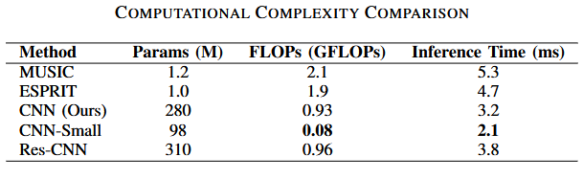
Computational Complexity Analysis
Notes:
Finally, we assessed the computational complexity of our CNN model.
Key Findings:
Our model requires 0.93 GFLOPs for inference, making it computationally efficient.
Inference time:
CNN (ours): 3.2 ms
CNN-Small: 2.1 ms (optimized for speed)
Res-CNN: 3.8 ms (optimized for accuracy)
Comparison with Traditional Methods:
MUSIC: 5.3 ms
ESPRIT: 4.7 ms
Our CNN achieves higher accuracy with lower inference time, making it suitable for real-time applications.
This analysis highlights the trade-off between model depth, accuracy, and computational efficiency, providing insights into optimizing deep learning models for DOA estimation.

Slide 15
Conclusion & Future Direction
Deep Learning Models can overcome the limitations of the analytical methods, like low performance under low SNR, targets that are close to each other, imperfections
Using the Real, Imaginary, and Phase of the Covariance Matrix as Input
Creating a dataset for all the different combinations for two targets, for Narrow Band Grid and Wide Band Grid
The trained model for the Narrow Band can effectively estimate the DOAs
The trained model for the Wide Band has errors and misclassification for some DOAs.
Future Directions-
- Hybrid deep learning models, Real-world dataset expansion
- Lightweight architectures for real-time applications, Incorporating temporal dynamics (RNNs, attention mechanisms)
Notes:
"In conclusion, our deep learning-based DOA estimation model overcomes limitations of traditional analytical methods. By utilizing real, imaginary, and phase components of covariance matrices, we achieved high accuracy in both narrow and wide grid configurations. However, challenges remain in improving accuracy for wider grids.
Future directions include:
Hybrid deep learning models combining MUSIC or ESPRIT with CNNs.
Expanding real-world datasets for better generalization.
Lightweight architectures for real-time applications.
Integrating RNNs or attention mechanisms for enhanced performance

Slide 16
Key References
F. Wen, J. Shi, J. He, and T.-K. Truong, “2D-DOD and 2D-DOA estimation using sparse L-shaped EMVS-MIMO radar,” IEEE Transactions on Aerospace and Electronic Systems, vol. 59, no. 2, pp. 2077–2084, 2023.
H. Lee, J. Ahn, Y. Kim, and J. Chung, “Direction-of-arrival estimation of far-field sources under near-field interferences in passive sonar array,” IEEE Access, vol. 9, pp. 28,413–28,420, 2021.
C. Yu, Y. Li, L. Li, Z. Huang, Q. Wu, and R. C. de, “Dual Lawson norm-based robust DOA estimation for RIS-aided wireless communication systems,” IEEE Transactions on Aerospace and Electronic Systems, pp. 1–11, 2024.
P. Chen, Z. Chen, L. Liu, Y. Chen, and X. Wang, “SDOA-Net: An efficient deep learning-based DOA estimation network for imperfect array,” IEEE Transactions on Instrumentation and Measurement, 2024.
Notes:
These are the key references.

Slide 17
Thank you!

