Slide 1
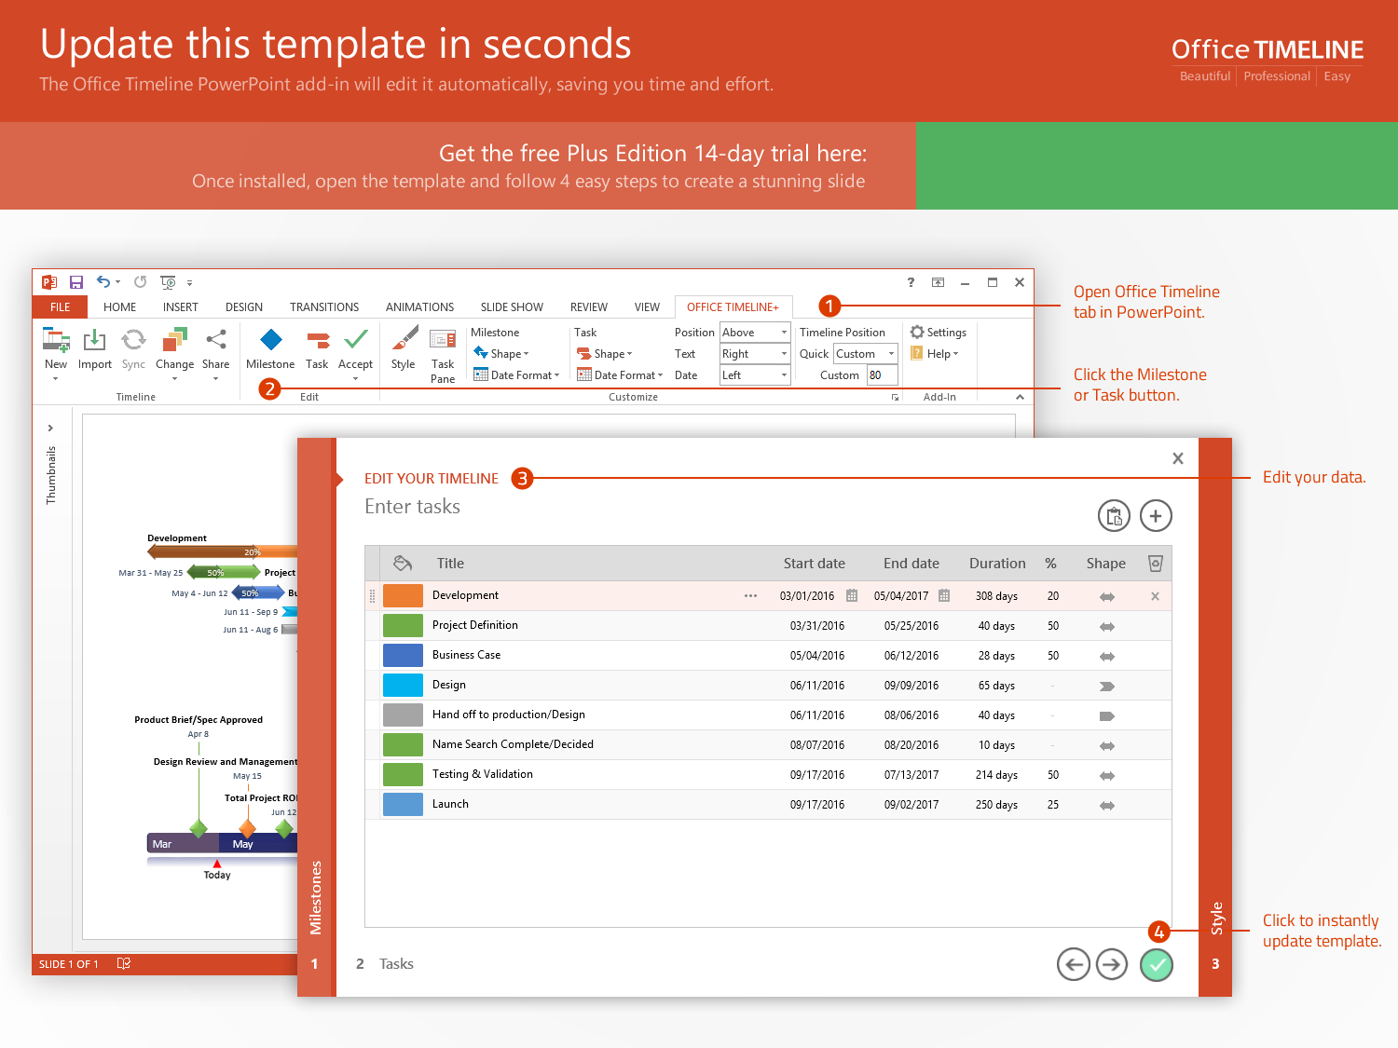
https://www.officetimeline.com/14-days-trial

Slide 2
11 days
Analysis and design
May 19 – Oct 20
100%
3 days
analysis
5/19 - 5/23
1 day
design
5/26 - 5/28
5 days
Sub-task 3
5/29 - 6/2
10 days
Development
Oct 20 - Dec 20
65%
0 days
Sub-task 1
6/3 - 6/4
5 days
Sub-task 2
6/5 - 6/9
5 days
Sub-task 3
6/10 - 6/16
0 days
Sub-task 4 - zero duration
6/17
11 days
Evaluation
Dec 20 – Feb 20
15%
5 days
Sub-task 1
6/18 - 6/23
1 day
Sub-task 2
6/24 - 6/26
5 days
Sub-sections 1
6/27 - 7/3
4 days
Sub-sub-task 1
6/27 - 7/2
1 day
Sub-sub-task 2
7/3
2017
2017
Week 1
2
3
4
5
6
7
8
2017
Today
Tue May 23
Sun Jun 18
Milestone 2
Sat Jun 3
Milestone 4
Mon Jul 3
Fri May 19
Milestone 3
Milestone 5
Milestone 1

