Slide 1


Predicting Car Crashes in Montgomery County:
Can Machine Learning Help Us Understand What Factors Lead to Car Crashes?
Project Presentation
Student: Salifou SYLLA
DATA SCIENCE CERTIFICATE
DATA 205 - Capstone Experience in Data Science
Prof. Michael Iapalucci
Mathematics, Statistics, and Data Science Department
Montgomery College
Fall 2020

Slide 2
Contents
Project Plan Overview
Data Cleaning
Descriptive Statistics
Data Product Description
DataMontgomery Experience

Slide 3
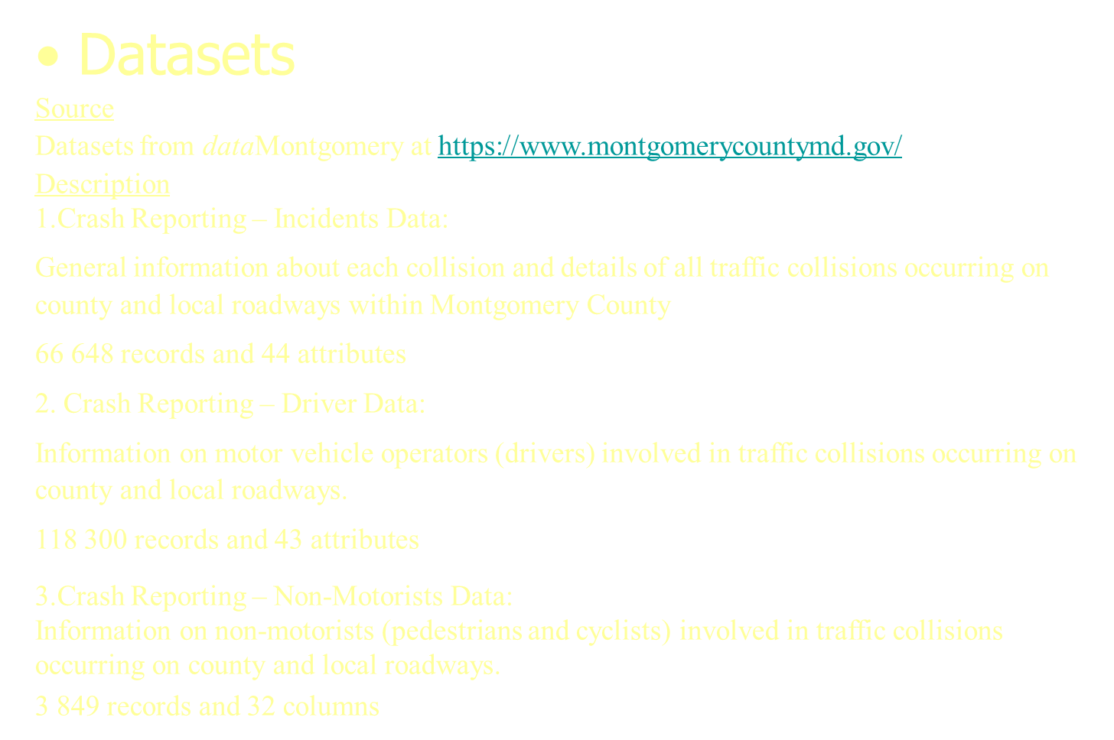
Project Plan Overview

Slide 4
Goals
Dataset contains different information about traffic collisions occurred in the Montgomery County from 2015 to 2020. The main goal is to extract some insights that can be useful to reduce the number of accidents in the County. The datasets analysis is to find out:
When are the most dangerous times to be driving?
Which parts of county has the most traffic fatalities and/or crashes?
Condition of roadway surface on collisions
Non-Motorists involvements in car crashes
Crashes by type of vehicles
Predicting factors that contribute to crashes
Approach
Visualizations
Anaconda: Open-source of python for scientific computing (Machine learn. Applications)
Jupyter Notebook: Web application to create and share documents that contain live code (e.g. Python code) visualizations. explanatory text (written in markdown syntax)
Matplotlib: python package for visualization
Seaborn: library for making statistical graphics in Python
Machine Learning Algorithms
Multi Class Classification using Decision Tree, Random Forest, and Naïve Bayes

Slide 5
Data Cleaning
Import python necessary classes, modules and libraries
NumPy : Python library used for working with arrays
Pandas: module mainly works with the tabular data (DataFrame)
Reading data from the dataMontgomery URL each time in the code.
incidentsData = pd.read_csv(url)
1. Crash Reporting - Incidents Data (66,648 records, 44 attributes, weekly update) at
https://data.montgomerycountymd.gov/Public-Safety/Crash-Reporting-Incidents-Data/bhju-22kf
2. Crash Reporting - Drivers Data (118,300 records, 43 attributes, weekly update) at
https://data.montgomerycountymd.gov/Public-Safety/Crash-Reporting-Drivers-Data/mmzv-x632
3. Crash Reporting - Non-Motorists Data (3,849 records, 32 attributes, weekly update) at
https://data.montgomerycountymd.gov/Public-Safety/Crash-Reporting-Non-Motorists-Data/n7fkdce5
Combining DataFrames with Pandas
pandas.concat() function concatenates the three DataFrames and returns a new dataframe with the new columns as well. The dataframe row that has no value for the column will be filled with NaN.

Slide 6
Data Cleaning (Cont.)
Merging the three datasets will cause the merged dataframe to have many missing value filled with NaN. We will clean each dataset sparely.
1. Incidents Dataset
Dropping unnecessary columns
Column with high percentage of missing value are dropped
# Drop unnecessary columns.
incidentsData.drop(['local_case_number’, …, ], axis=1 ,inplace=True)
# Rows with missing value are dropped
incidentsData.dropna(inplace=True)
(66 648, 44) - > (21 569, 25)
2. Drivers Dataset
(118 300, 43) - > (69 045, 24)
3. Non-Motorists Dataset
(3 849, 32) - > (1 001, 22)

Slide 7
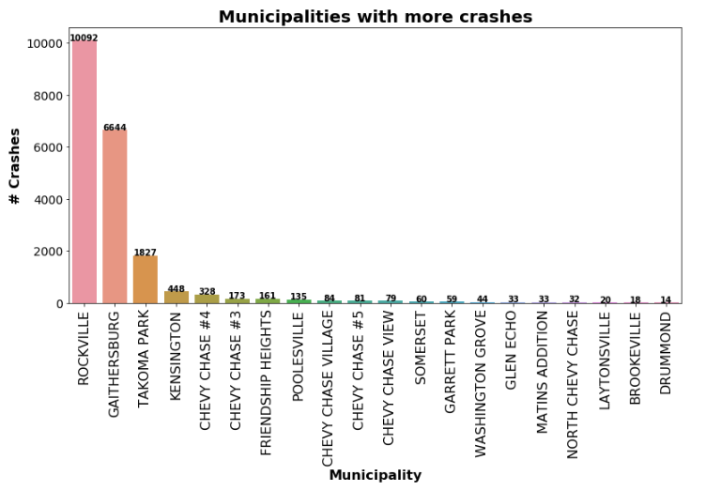
Descriptive Statistics

Slide 8
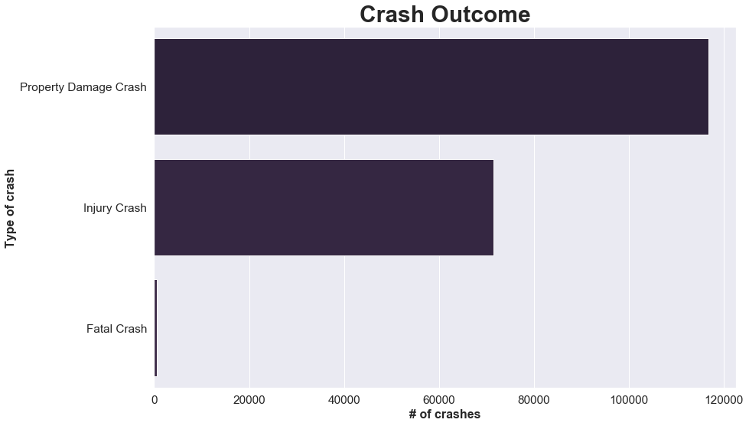
The total death in car crash crashes since the year 2015, up to 2020 is 531.
While the total number of injuries and properties damage in car accidents reach 71506, 116760 respectively

Slide 9
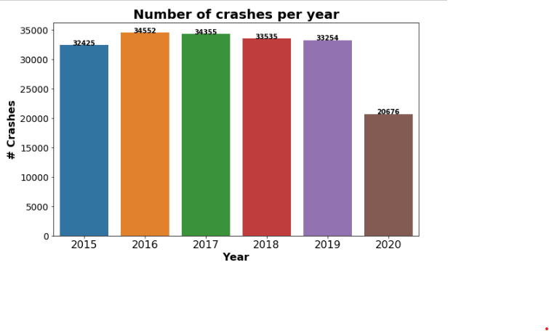

Slide 10
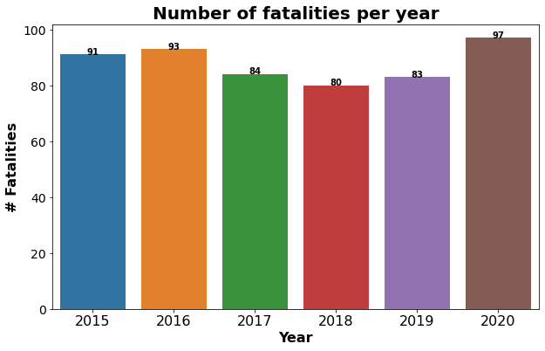

Slide 11
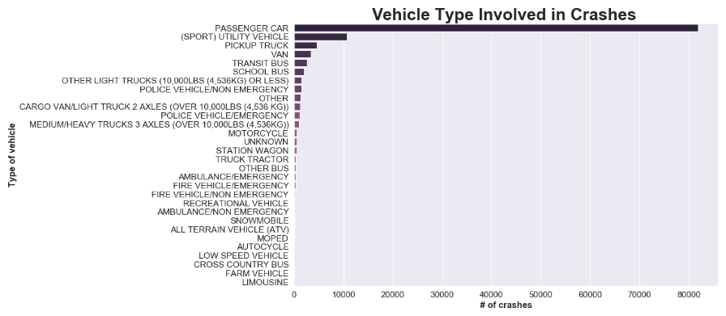

Slide 12
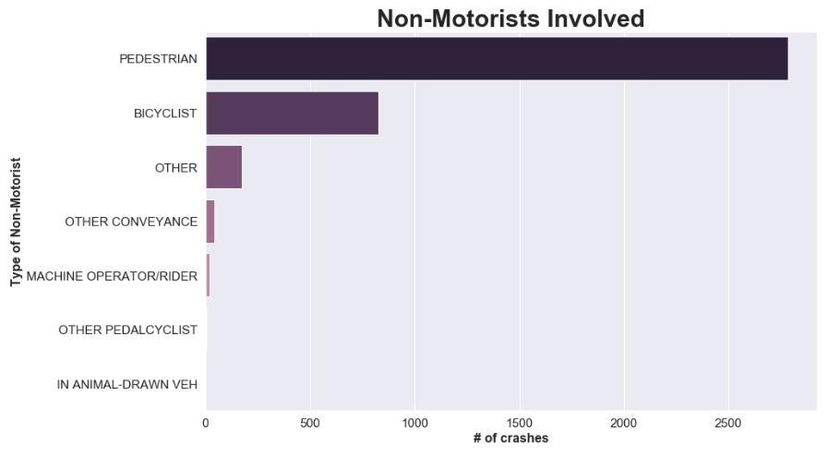

Slide 13
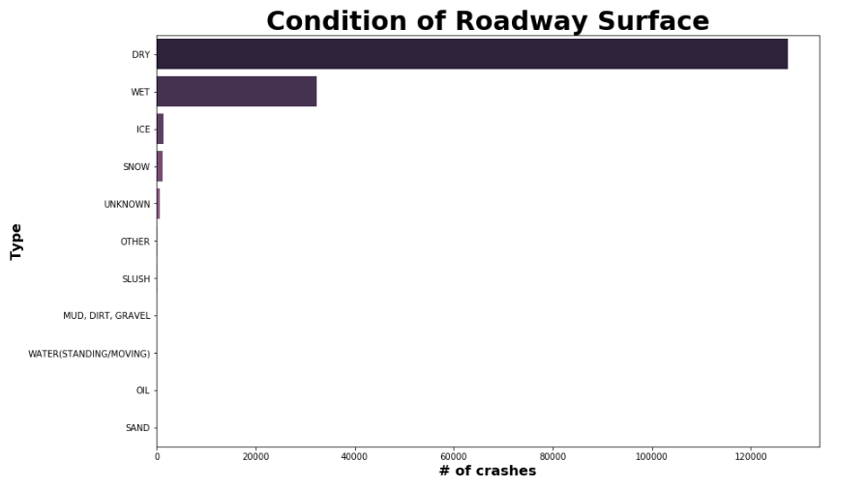

Slide 14
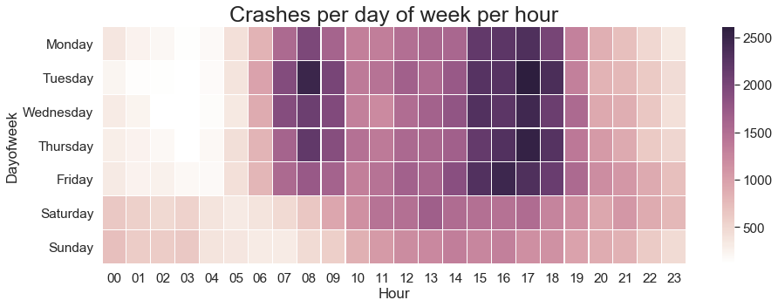
Most of crashes occur during the workweek between 3:00 and 6:00 PM.

Slide 15
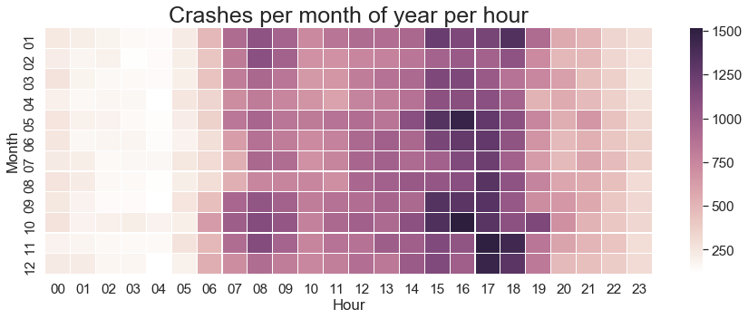

Slide 16
Data Product Description
Approach
Use of Machine Learning to solve our problem
Multi-Class Classification problem and predict the outcome of a crash as Fatal, Injury or Property Damage.
Incidents Dataset → Multi Class Classification using Decision Tree
1. Categorical Encoding
1.1 Label Encoding
Label encoding is simply converting each value in a column to a number. Each label is assigned a unique integer based on alphabetical ordering.
1.2 One-Hot Encoding
Creates additional features based on the number of unique values in the categorical feature.
2. Feature selection using Mutual Information
MI measures how much information the presence/absence of a term contributes to making the correct classification decision on. It is calculated between two variables and measures the reduction in uncertainty for one variable given a known value of the other variable. KL (Kullback-Leibler)divergence between the joint probability distribution and the product of the marginal probabilities for each variable.

Slide 17
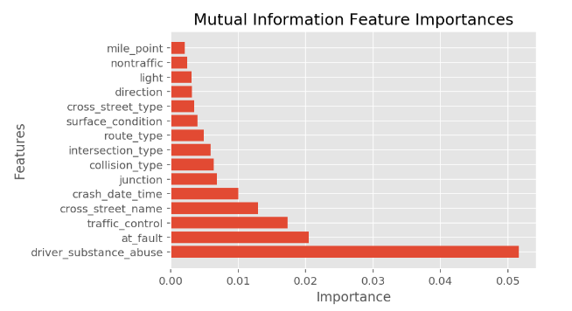

Slide 18
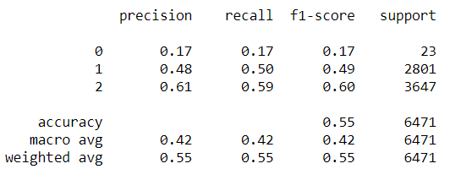

2. Decision Tree
A decision tree is a flowchart-like tree structure where an internal node represents feature(or attribute), the branch represents a decision rule, and each leaf node represents the outcome. The topmost node in a decision tree is known as the root node.
3. Classification Report
The classification report displays the Precision, Recall , F1 and Support scores for the model.
Precision score means the level up-to which the prediction made by the model is precise. The precision for Fatal Crash is 0.17, Injury 0.48, and for Property Damage is 0.61. Recall is the amount up-to which the model can predict the outcome. F1 and Support scores are the amount of data tested for the predictions. In the incidents dataset the data tested Fatal Crash is 23, for Injury Crash 2801, and for the Property Damage is 3647.
4. Confusion Matrix
Confusion matrix is a table which describes the performance of a prediction model. A confusion matrix contains the actual values and predicted values.
4. Accuracy Score
Accuracy score is the percentage of accuracy of the predictions made by the model. The accuracy score is 0.55

Slide 19
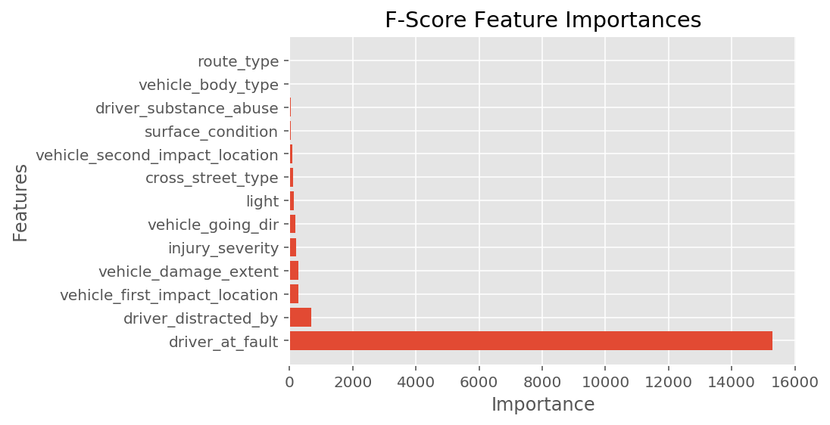
Drivers Dataset → Multi Class Classification by Random Forest
Feature selection
Random Forest Algorithm
It builds multiple decision trees and merges them together to get a more accurate and stable prediction.

Slide 20
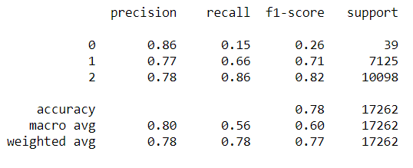

Classification Report
Confusion Matrix
Accuracy Score
0.78

Slide 21

Non-Motorist Dataset → Multi Class Classification using Naïve Bayes
Feature selection
Naive Bayes Algorithm
It is a classification technique based on Bayes’ Theorem with an assumption of independence among predictors. In simple terms, a Naive Bayes classifier assumes that the presence of a particular feature in a class is unrelated to the presence of any other feature.

Slide 22
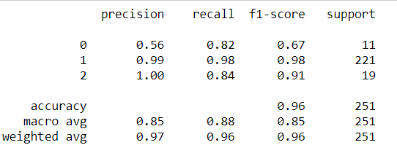

Classification Report
Confusion Matrix
Accuracy Score
0.96

Slide 23
DataMontgomery Experience
Datasets
Quality / Issues
The data is good if it accomplishes its intended task.
Consistent Data
The data within these datasets are structured.
Data Security:
The data is handled in a professional and secure manner.
Well defined data
Reliability refers to the degree to which you can trust your data.
This data can be trusted because it is owned by the county.
The datasets are lack of information about the driver such as age, sex. I intended to provide some charts about the rate ( percentage ) of fatal accident by group age (16-19y; 20-24y; ….; 65-74; 75+). There is not specific about fatalities, the number of fatality in each crash.

Slide 24
Thanks !

