Slide 1
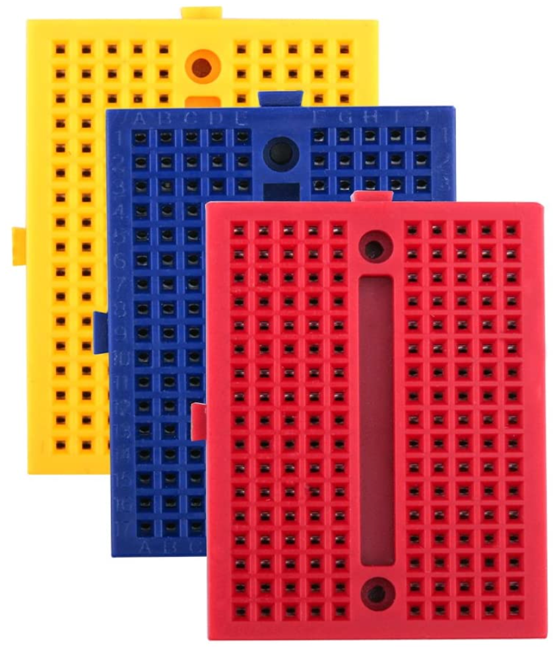
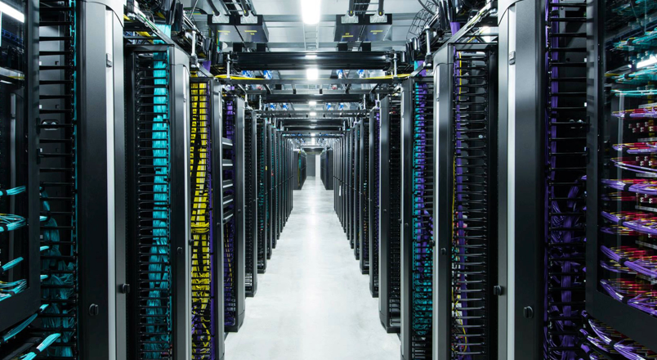
Monitoring Data Center Temperature & Humidity Level
IoT with ESP32 Training
MODULE 2c
Humidity
Temperature
safyzan salim
019 622 0575
IoT with ESP32 Training|Rev01-JAN2021|Loc/Date

Slide 2
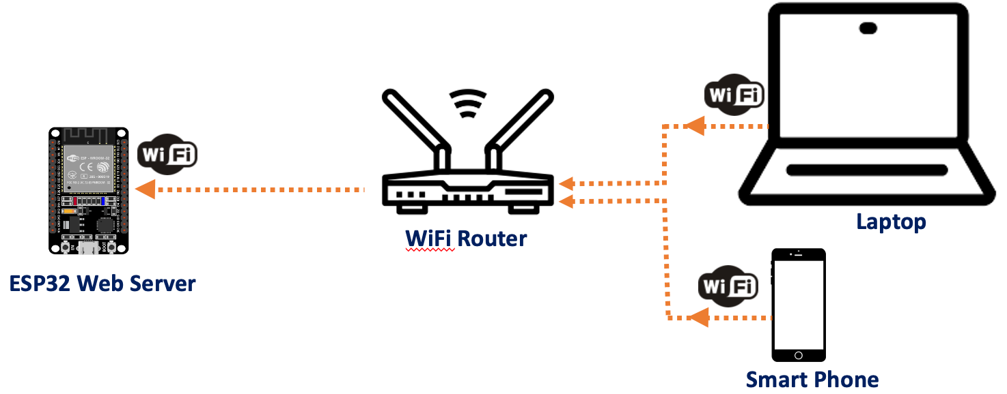
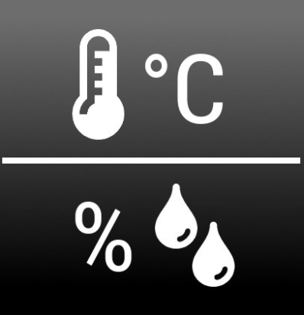
2c. Monitoring Data Center Temperature & Humidity Level
Project Overview
This tutorial will teach you how to build a mobile monitoring system for data center that captures its temperature & humidity level by using DHT11 & ESP32. It is a combination of previous 2 exercises that we have went through; i.e., ii-esp32+dht.pptx & iii-esp32+sta.pptx.
Rev01 JAN2021

Slide 3
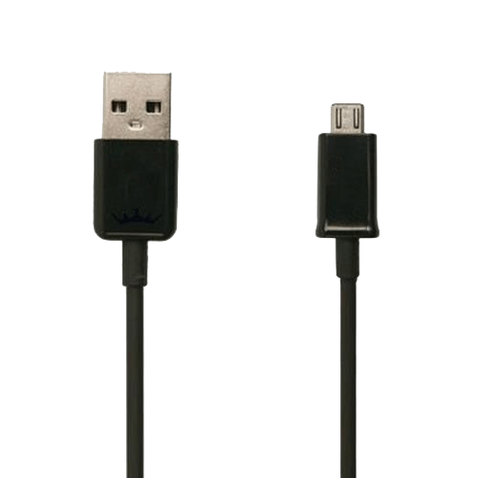
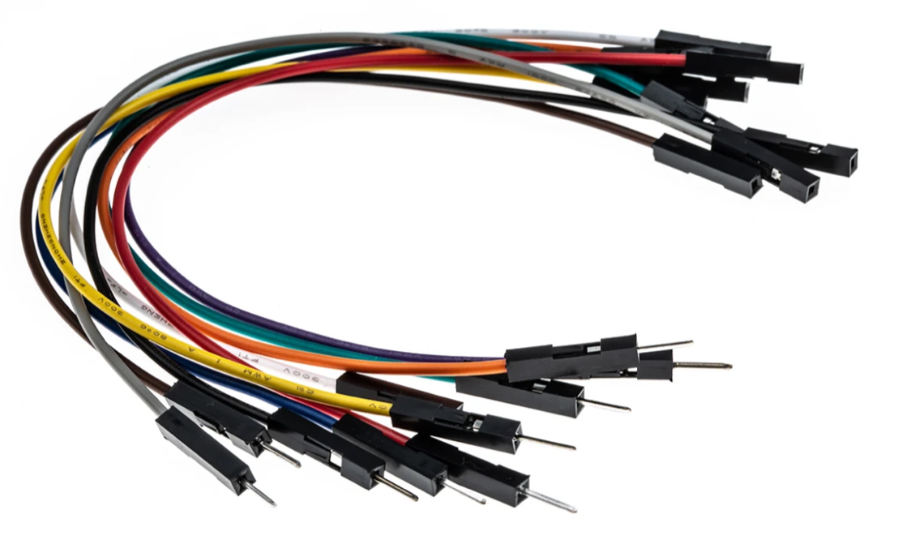
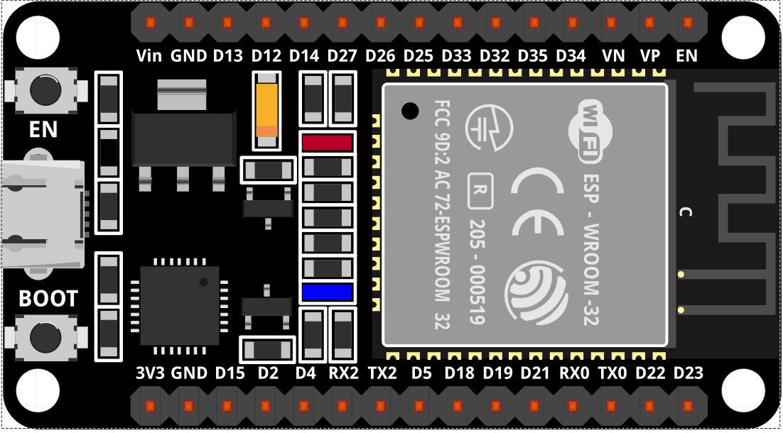
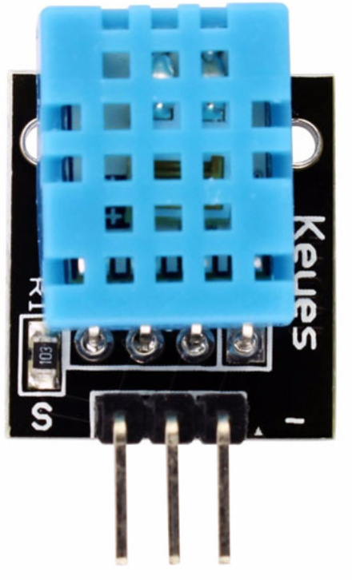
2c. Monitoring Data Center Temperature & Humidity Level
Components
→ 1 x ESP-32 Wifi+Bluetooth 2-In-1 Development Board for Arduino (30 pin) + Cable.
→ 1 x Temperature & Humidity Sensor, DHT11.
→ Jumpers (male to female).
→ 2 x Mini Breadboard.
Rev01 JAN2021

Slide 4
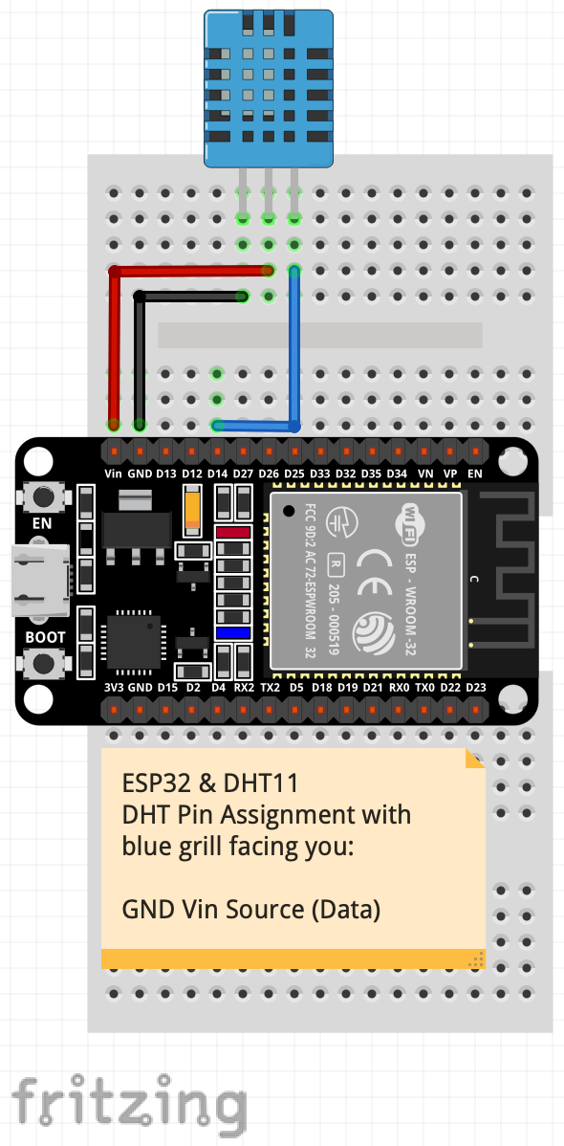
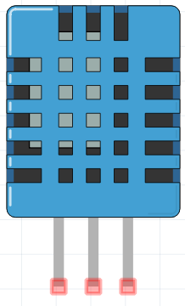
2c. Monitoring Data Center Temperature & Humidity Level
Schematic Diagram
→ Check a few times the connections that have been made before plugging ESP32 to USB port. This might prevent short circuit to DHT11. Watch out on sensors’ pin. Same type, doesn’t mean same pin configurations.
GND
Vin
Signal
Rev01 JAN2021

Slide 5

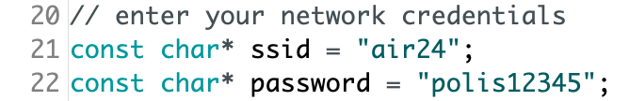
2c. Monitoring Data Center Temperature & Humidity Level
Working File
→ Download the file working file from http://bit.ly/3aB3WBL by click at ..
→ Unzip and find sketch-iv_esp32-dht11-sta.ino. Double click to open the file with Arduino IDE.
→ Click OK when Arduino pop-up window appears. This action will create a folder that carry same name with sketch (sketch-iv_esp32-dht11-sta.ino) and move the sketch into it. Click Cancel will not open the sketch at all.
→ Before upload the sketch to the board, modify the following two variables and suit with your network credentials. This will allow ESP32 establish connection with your network.
→ Upload the sketch to your ESP32 board. Ensure that you have selected the right board
and set the current port. Don’t forget to press BOOT button. Refer to Troubleshoot section if you have problem.
Rev01 JAN2021

Slide 6
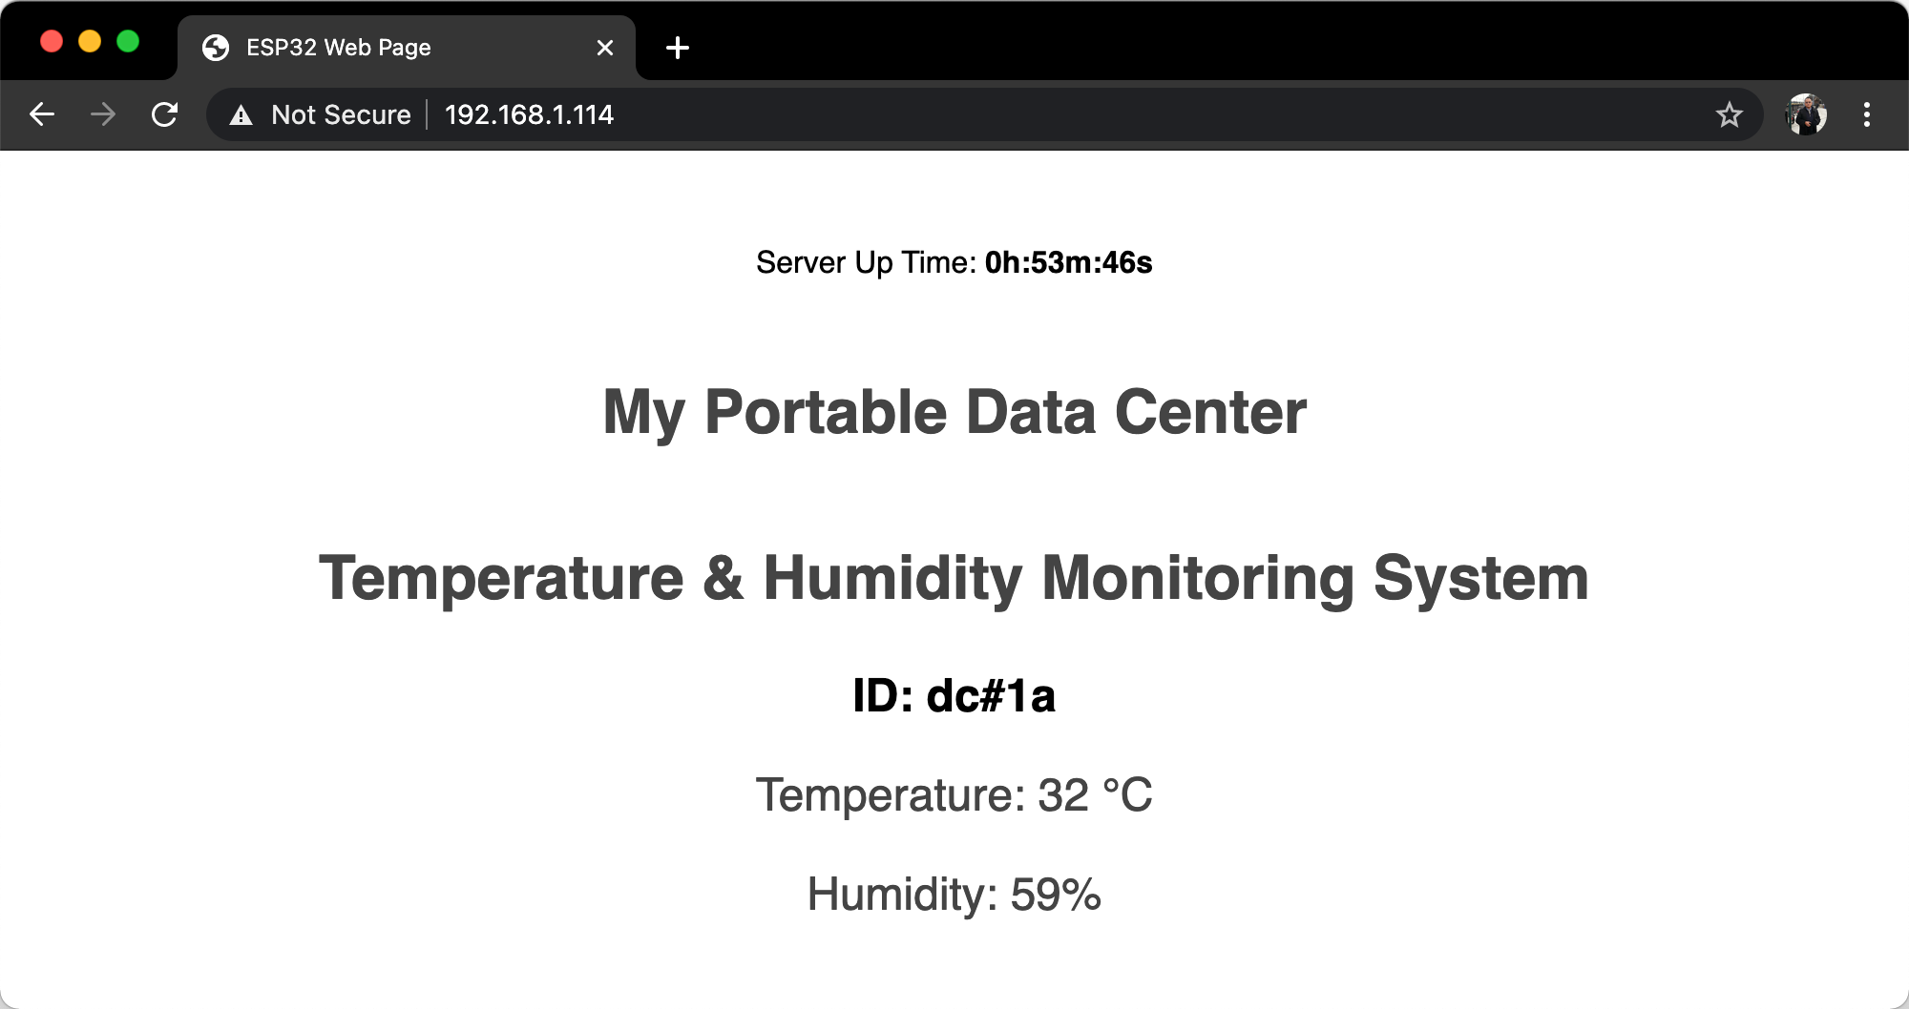
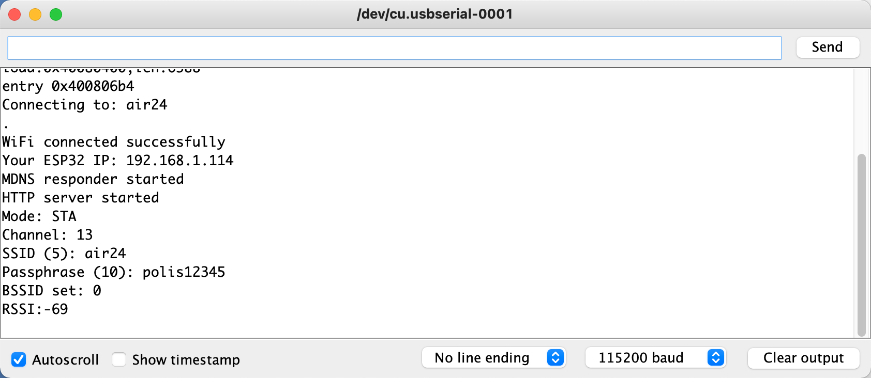
2c. Monitoring Data Center Temperature & Humidity Level
The Output
→ Open a browser and type the ESP32 IP address, 192.168.1.114
IP address released by air24
Rev01 JAN2021

Slide 7
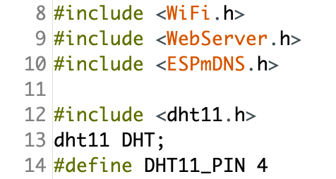
iii. Create a Web Server with ESP32 and Arduino IDE
Code Explanation
→ Filename: sketch-iv_esp32-dht11-sta.ino
→ Additional library needed was dht11.h.
→ sketch-iv_esp32-dht11-sta.ino is a combination of previous 2 exercises; sketch-ii & sketch-iii.
→ First, add dht11 initialization, connect SIGNAL pin of the sensor to D4 at ESP32.
dht11 initialization
Rev01 JAN2021

Slide 8
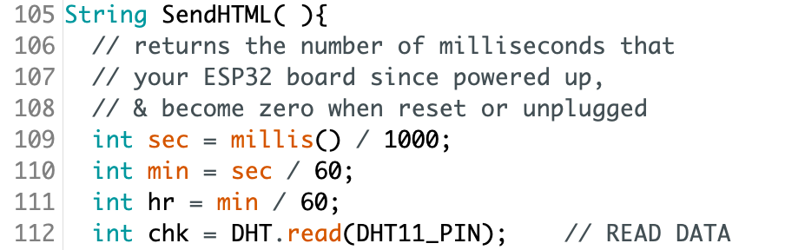
iii. Create a Web Server with ESP32 and Arduino IDE
Code Explanation
→ Write Arduino syntax such as, read sensor value, turn on LED, control servo motor etc. within SendHTML( ) function. This function is invoke by loop ( ) function. It’s a non-stop process. Thus the reading will keep updated depends on time interval set.
→ The DHT.read(4) tasks is to gather the DHTLIB health status, the current temperature & also the humidity. You may open dht11.cpp for better understanding.
Call dht11.cpp function
Rev01 JAN2021

Slide 9
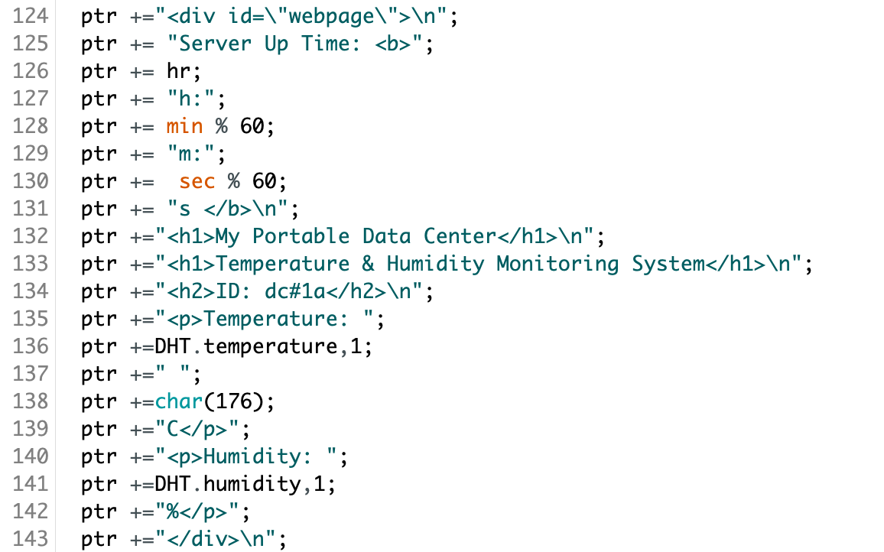
iii. Create a Web Server with ESP32 and Arduino IDE
Code Explanation
→ Remember, writing a program a top down-process. You have to declare the variables first before using it, get the data, than write the formula for process, finally, display the results. It is similar as cooking. You cannot skip the order.
Sensor ID
Display temperature in decimal at web page
Degree symbol
Display humidity in decimal at web page
Rev01 JAN2021

Slide 10
2c. Monitoring Data Center Temperature & Humidity Level
QUESTIONS?
Questions?
Rev01 JAN2021

Slide 11
2c. Monitoring Data Center Temperature & Humidity Level
EXERCISE
Add a RED led and GREEN led. When the temperature less than 27°C, only GREEN led goes off. When the temperature greater than 27°C, only RED led goes off.
Hint: -use conditional statement:
-digital write
[30 minutes activity]
Rev01 JAN2021

Slide 12
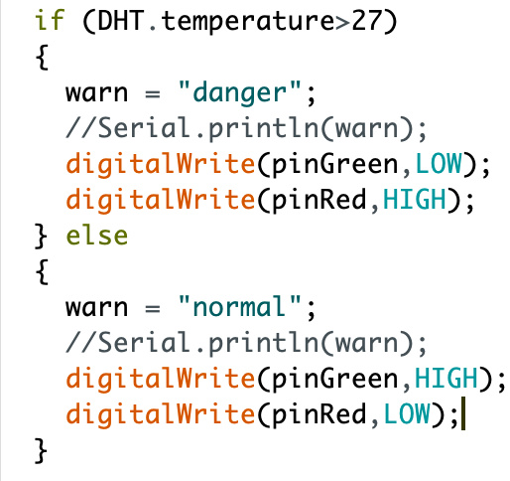
2c. Monitoring Data Center Temperature & Humidity Level
ANSWER
Don’t forget to initialize pinMode( );
Rev01 JAN2021

Slide 13
2c. Monitoring Data Center Temperature & Humidity Level
TROUBLESHOOT GUIDE
Failed to upload the sketch to ESP32? Follow these steps:
→ Press REBOOT button until the IDE approaches Connecting… segment;
→ OR, check whether you have chosen the correct Board and set the correct PORT;
* Choose the right board by going to Tools > Boards > ESP32 Dev Module
* Select the correct port at Tools > Port > choose the appropriate serial port
→ OR, unplugging the board from USB and plugging back;
→ OR, Verify to confirm that your sketch is error free;
→ OR, Swap to other PC / Laptops;
→ OR, Use different board;
→ You are using micro-USB power cable instead of power & data cable.
Rev01 JAN2021

