Slide 1
CBIO313
Diabetes Prediction from
Clinical Measurements
Comparing five machine learning algorithms on the Pima Indians dataset
Shahd Sameh Safwat
231002256
Data Mining & Machine Learning · Instructor: Dr. Muhammad Elsayeh
Notes:
Title slide. Course project comparing five ML algorithms for diabetes screening on the Pima Indians dataset.

Slide 2
The problem
Why this matters
1
Silent onset
Type 2 diabetes develops silently. By the time symptoms appear, damage to the kidneys, retina and nerves is often already underway.
The two errors are not equally costly
False positive
2
A healthy patient goes for one extra blood test. Inconvenient.
Screening is expensive
Screening programmes exist for this reason — but a full diagnostic workup is expensive and cannot be given to everyone.
False negative
3
The goal
An undiagnosed diabetic is sent home reassured. Serious.
A cheap triage step that flags who most needs that workup, using measurements already taken at a routine visit.
CBIO313 · Diabetes Prediction
1
Notes:
The asymmetry of the two errors is the premise for everything later — it is why accuracy is the wrong target and why the threshold gets moved.

Slide 3
Objectives
What the project set out to do
Clean a dataset where missing values were silently recorded as zeros
Explore how each measurement relates to diabetes status
1
2
Train and compare five algorithms from the course
Evaluate with metrics suited to imbalanced medical screening — not accuracy alone
3
4
Tune the best model and choose a threshold appropriate for screening
Explain why the model predicts what it predicts
5
6
CBIO313 · Diabetes Prediction
2
Notes:
Six objectives, in the order the report follows them.

Slide 4
The dataset
Pima Indians Diabetes Database — UCI / NIDDK
768
8
35%
21+
patients
features
have diabetes
women, Pima heritage
Eight measurements: pregnancies, plasma glucose, blood pressure, skin-fold thickness, serum insulin, BMI, family-history score, age.
Target: Outcome — 1 = diabetes, 0 = no diabetes. 500 negative / 268 positive.
All patients are women of Pima heritage aged 21+ near Phoenix, Arizona — a narrow population, revisited in the limitations.
CBIO313 · Diabetes Prediction
3
Notes:
768 patients, 8 features, 35% positive. The narrow population is the single biggest limitation and comes back at the end.

Slide 5
Finding 1: the zeros are not zeros
The most important preprocessing step
Five columns report a minimum of 0 — glucose, blood pressure, skin thickness, insulin, BMI. None is biologically possible in a living patient.
Column | Zeros | % of rows
Insulin | 374 | 48.7%
SkinThickness | 227 | 29.6%
BloodPressure | 35 | 4.6%
BMI | 11 | 1.4%
Glucose | 5 | 0.7%
These are missing measurements that were never marked as missing. Left alone, a model reads insulin = 0 as a real, extremely low reading — the opposite of the truth.
Dropping incomplete rows would throw away nearly half the dataset.
Instead: mark as NaN, then impute the median inside the model pipeline.
CBIO313 · Diabetes Prediction
4
Notes:
Nearly half of the insulin column and 30% of skin-fold thickness are missing values disguised as zeros. This single fix matters more than the choice of algorithm.

Slide 6
Preprocessing
And how we avoided cheating
Impute (median)
→
Scale (StandardScaler)
→
Classify
One estimator, identical for all five algorithms.
Three places this project could have quietly cheated
✓
✓
✓
Imputation inside the pipeline
Winner chosen on CV score
Threshold from out-of-fold predictions
Taking the median over all 768 rows and then splitting would leak test data into training and inflate every score.
The winner was chosen on cross-validated training score, never on test performance. Picking by test score is model selection on the test set.
The threshold was chosen from out-of-fold training predictions. The test set was used exactly once, at the very end.
CBIO313 · Diabetes Prediction
5
Notes:
Imputation lives inside the pipeline so the median is recomputed within every CV fold. The test set is touched exactly once.

Slide 7
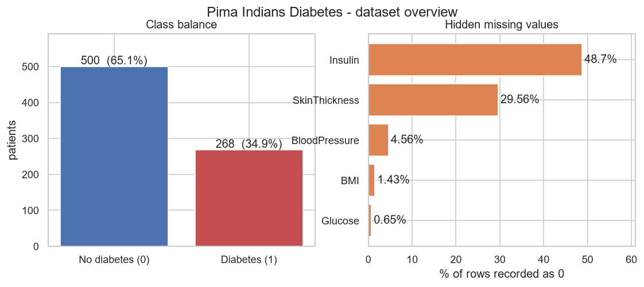
Exploratory data analysis
Class balance and missing data
A model that always says "no diabetes" scores 65% accuracy and catches zero diabetics. That is the benchmark every accuracy figure must be read against.
CBIO313 · Diabetes Prediction
6
Notes:
The majority-class baseline is 65% accuracy. Every accuracy number later has to beat that to mean anything.

Slide 8
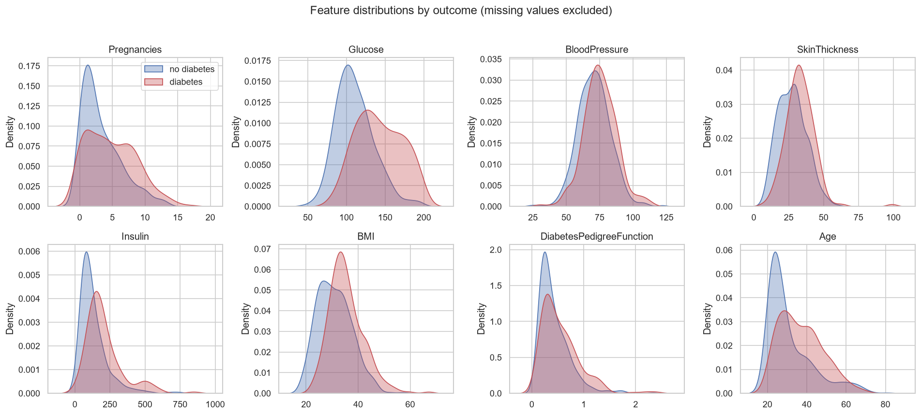
Which measurements separate the groups?
Glucose separates the two groups most clearly. BMI and Age shift moderately.
BloodPressure and SkinThickness overlap almost entirely — they will contribute little.
CBIO313 · Diabetes Prediction
7
Notes:
Kernel density estimates per feature, split by outcome, with missing values excluded. Glucose is the standout separator.

Slide 9
Five algorithms
Each in the identical impute → scale → classify pipeline
Logistic Regression
Linear baseline, interpretable coefficients
SVM (RBF)
Maximum margin with a non-linear kernel
K-Nearest Neighbours
Non-parametric, purely local decision rule
Random Forest
Bagged ensemble of 300 trees
Decision Tree
Interpretable rules, reference for the ensemble
Stratified 5-fold cross-validation on the training set only — the test set stays sealed.
CBIO313 · Diabetes Prediction
8
Notes:
All five share the same pipeline, so differences are attributable to the algorithm. The single decision tree is the clear outlier.

Slide 10
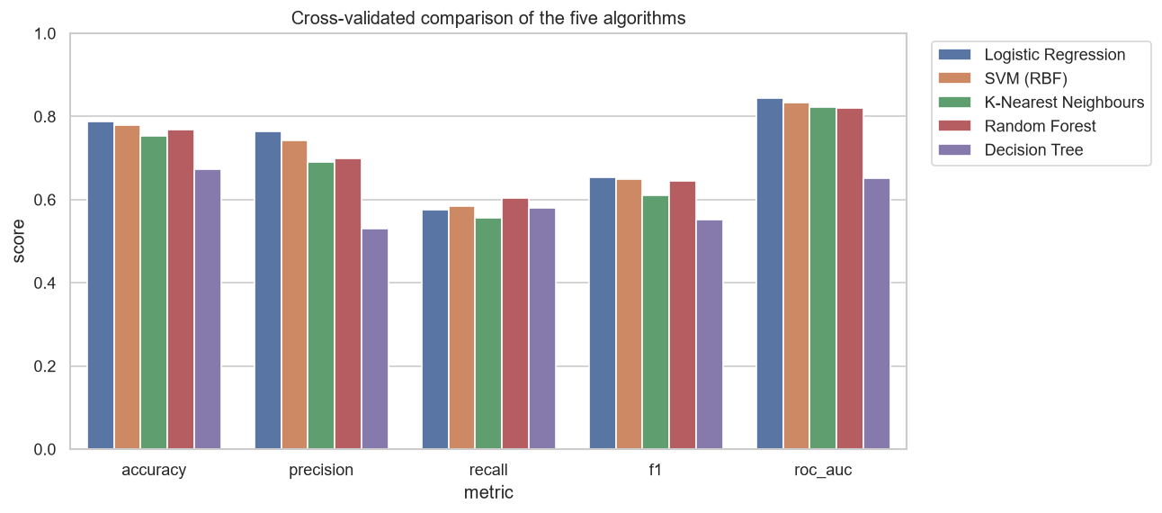
Model comparison
Cross-validated on the training set
Notice: recall is far below accuracy for every single model.
At the default cut-off these classifiers catch only about 55–60% of diabetics.
CBIO313 · Diabetes Prediction
9
Notes:
Five metrics side by side. The recall gap is the thing to point at — it sets up the threshold discussion.

Slide 11
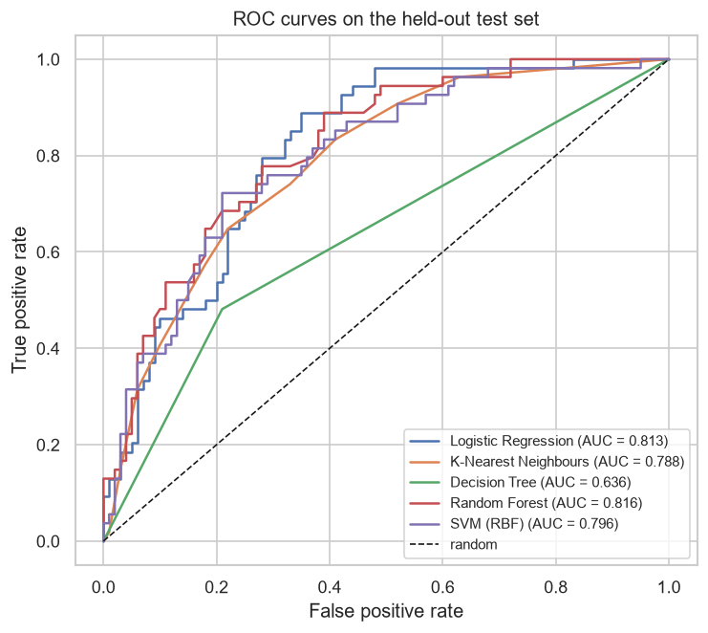
Held-out test set
ROC curves — the test set's one and only use
Model | Acc. | Recall | ROC-AUC
Random Forest | 0.740 | 0.537 | 0.816
Logistic Regression | 0.708 | 0.500 | 0.813
SVM (RBF) | 0.740 | 0.556 | 0.796
K-Nearest Neighbours | 0.734 | 0.574 | 0.788
Decision Tree | 0.682 | 0.481 | 0.636
Four of the five curves sit close together. Recall at the default cut-off never reaches 0.58 — no model is screening-ready out of the box.
CBIO313 · Diabetes Prediction
10
Notes:
This is the only time the test set is used. Ranking is broadly consistent with cross-validation, which is reassuring.

Slide 12
Hyperparameter tuning
GridSearchCV, scored on ROC-AUC
Grids are scored on ROC-AUC, not recall. Optimising directly on recall rewards models that just predict "diabetic" more often — in the limit, flagging everyone scores perfect recall. ROC-AUC ranks models independently of the threshold.
Logistic Regression
CV ROC-AUC
Test ROC-AUC
C=0.1, class_weight=balanced
0.8450
0.8104
Random Forest
CV ROC-AUC
Test ROC-AUC
class_weight=None, max_depth=5, min_samples_leaf=3, n_estimators=400
0.8388
0.8119
SVM (RBF)
CV ROC-AUC
Test ROC-AUC
C=1, class_weight=balanced, gamma=0.01
0.8493
0.8096
Selected: SVM (RBF) — CV ROC-AUC 0.849, test ROC-AUC 0.810
CBIO313 · Diabetes Prediction
11
Notes:
Three models were tuned. SVM wins on cross-validated ROC-AUC; the three test scores are within 0.003 of each other.

Slide 13
Finding 2: the threshold is the real result
Where the marks are
predict() flags a patient at probability 0.50. That cut-off maximises accuracy — the wrong target for screening. We chose the threshold from out-of-fold training predictions to reach 80% recall.
Operating point | Accuracy | Precision | Recall | Missed diabetics
Default 0.50 | 0.708 | 0.600 | 0.500 | 27 of 54
Chosen 0.285 | 0.721 | 0.571 | 0.815 | 10 of 54
+1.3
+31
27 → 10
points of accuracy
points of recall
missed diabetics
Accuracy was simply not measuring the thing we care about — the whole gain cost 2.9 points of precision.
CBIO313 · Diabetes Prediction
12
Notes:
Same model, same probabilities — only the cut-off moved. Accuracy barely notices; recall moves 31 points.

Slide 14
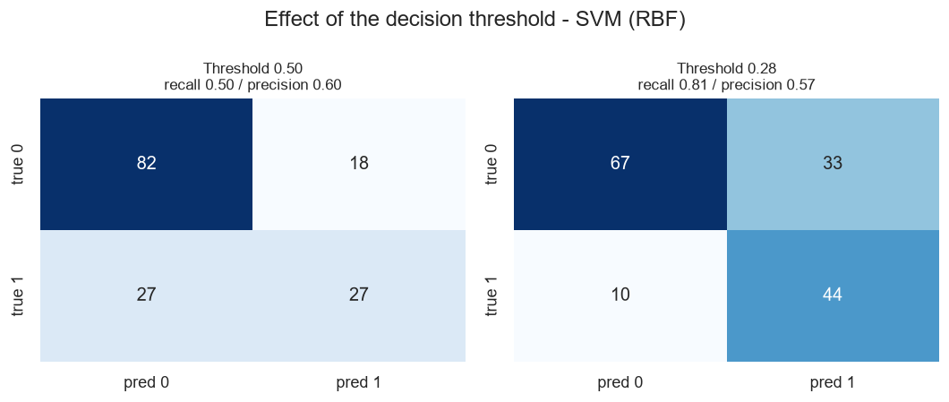
The same model, two operating points
Bottom-left cell = diabetics the model sent home. That is the number to watch.
CBIO313 · Diabetes Prediction
13
Notes:
Confusion matrices at 0.50 and at 0.285. False negatives drop from 27 to 10; false positives rise from 18 to 33.

Slide 15
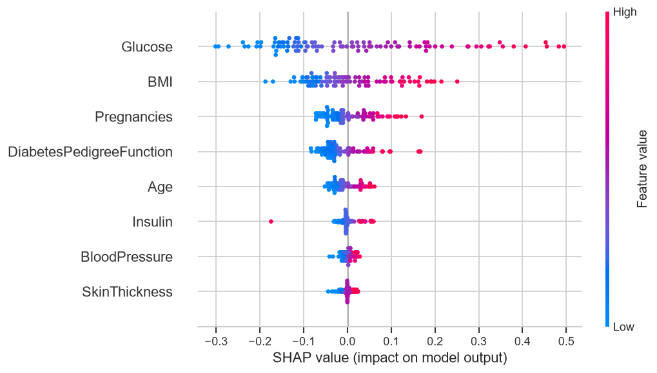
Explainability
Permutation importance and SHAP agree
Each dot is one patient
Right = pushed towards diabetes
Red = high value, blue = low
Glucose, then BMI
High glucose pushes towards diabetes; low glucose pulls back. The direction is clinically correct — a model with the right accuracy but an inverted relationship would be dangerous, and this plot would expose it.
CBIO313 · Diabetes Prediction
14
Notes:
SHAP beeswarm on the tuned SVM. Ranking matches permutation importance, and the direction of effect is clinically sensible.

Slide 16
Live demonstration
Bonus: Streamlit prediction app
Enter eight measurements on the sidebar
$ streamlit run src/app.py
1
Get a predicted probability and a screening decision at the tuned threshold
2
Default patient
23.5%
See how the patient compares to the population
not flagged
3
See a per-patient SHAP explanation of that specific prediction
4
Raise glucose to 190
78.6%
flagged for confirmatory testing
CBIO313 · Diabetes Prediction
15
Notes:
Live demo of the Streamlit app. Show the default patient, then raise glucose to 190 to cross the threshold.

Slide 17
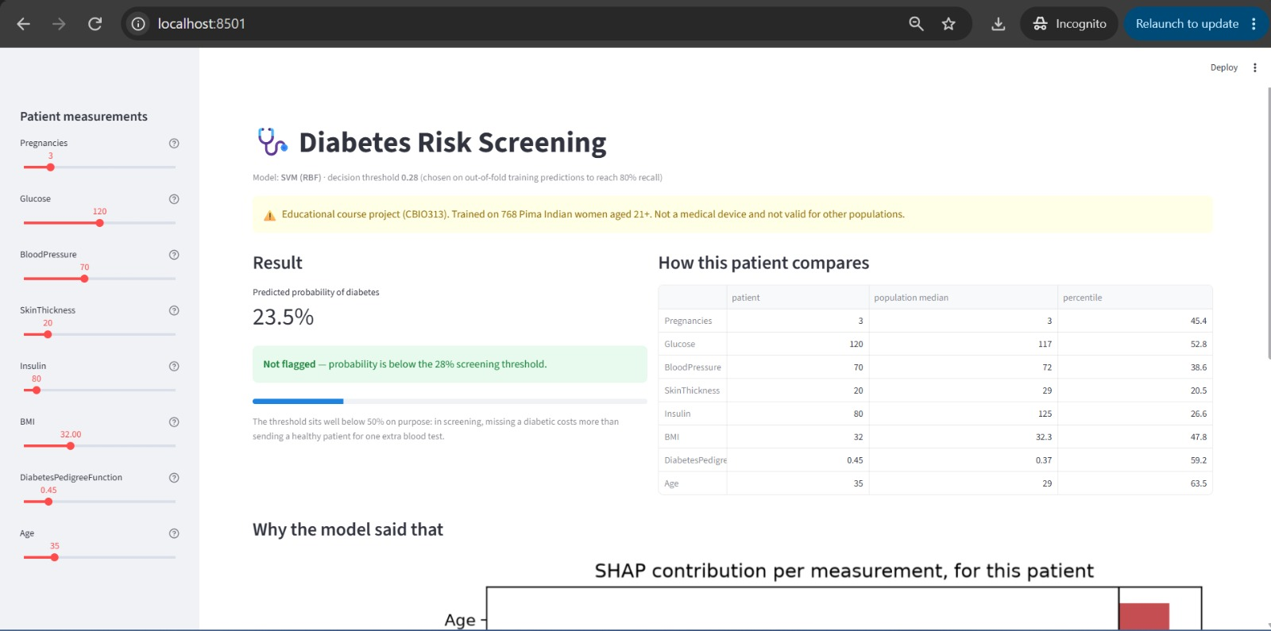

Slide 18
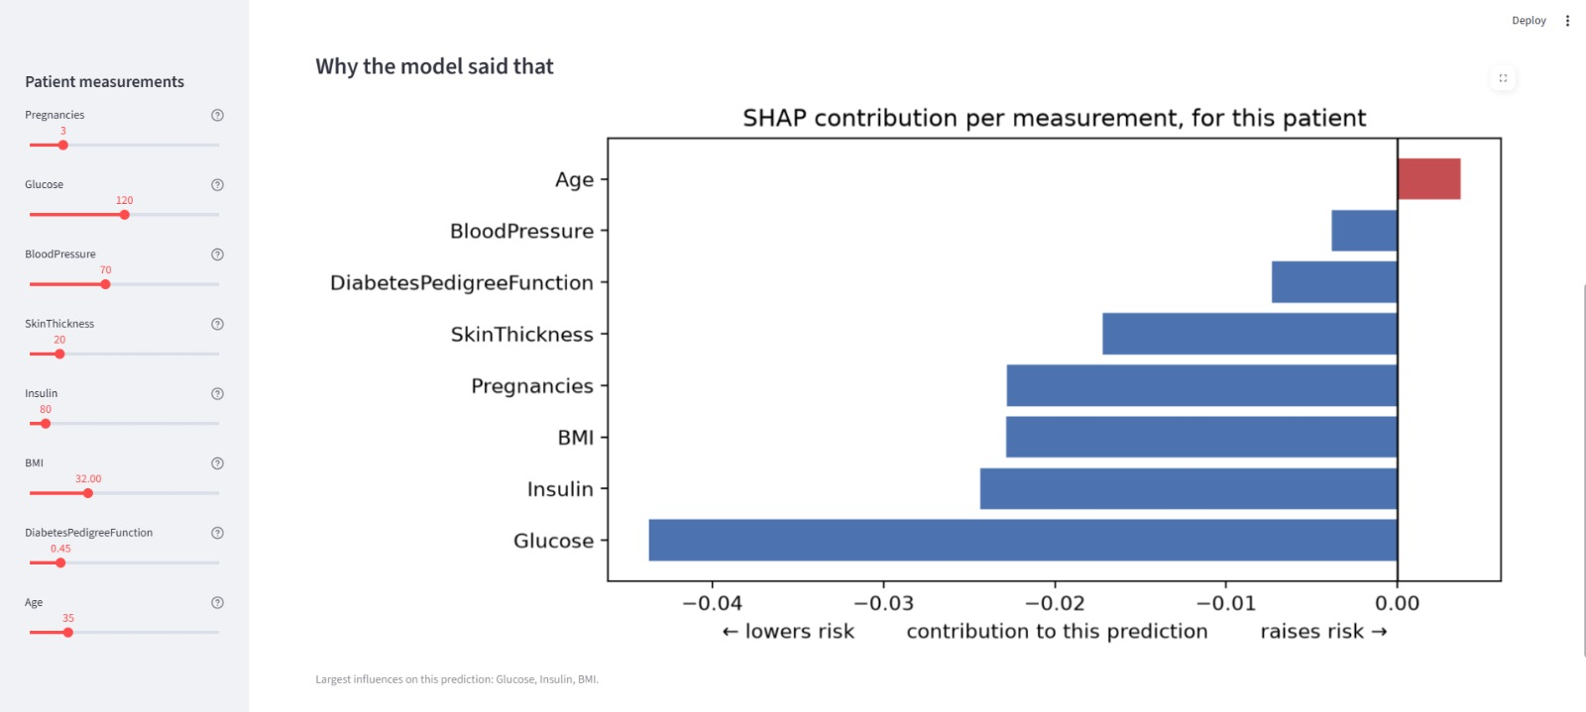

Slide 19
Limitations
What this model cannot do
Narrow population
768 patients, all women of Pima heritage aged 21+. Nothing transfers to men, other ethnicities, or younger patients.
1
Heavy imputation
49% of insulin and 30% of skin-fold values were filled in — and both rank near the bottom of the importance plots.
2
Missingness is probably not random
Median imputation assumes it is.
3
No external validation
One 154-patient test split, so the interval around a recall of 0.81 is wide.
4
Information ceiling
Eight coarse measurements carry limited signal. Better results need better features (HbA1c, fasting glucose), not fancier models.
5
This is a course project, not a medical device.
CBIO313 · Diabetes Prediction
16
Notes:
Be direct about scope. The narrow population and the absence of external validation are the two that matter most.

Slide 20
Conclusion
0.810
81%
10 of 54
5
test ROC-AUC
of diabetics caught
missed, down from 27
algorithms compared
The gains came from preprocessing and from matching the operating point to the clinical cost of each error — not from the choice of algorithm.
Four of the five models landed within a few points of each other. A well-regularised linear model was competitive with everything more elaborate.
As a triage aid flagging ~80% of diabetics for confirmatory testing, the model is plausible and its behaviour is explainable.
17
Notes:
Close on the framing: the win came from preprocessing and threshold choice, not from a fancier algorithm.

Slide 21
Thank you
Questions?
github.com/ssameh12/diabetes-prediction-cbio313
Shahd Sameh Safwat · 231002256
Notes:
Thank you slide with the repository link.

