Slide 1
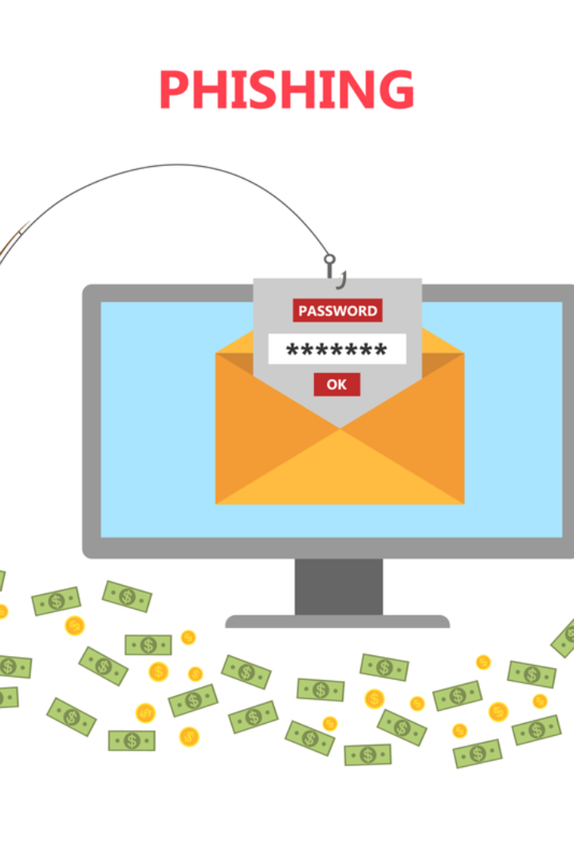

Mastering the Art of Phishing Defense
Welcome to the presentation on phishing attacks. Learn how to identify and sidestep email scams, malicious websites, and social engineering tactics.

Slide 2

What are Phishing Attacks?
Get ready to dive into the world of phishing. Discover the elaborate schemes that cybercriminals use to manipulate unsuspecting victims.

Slide 3

The Three Faces of Phishing
Email Attacks
Web-Based Traps
Unravel the deceptive techniques employed by phishing emails and learn how to spot those sneaky maneuvers.
Beware of malicious websites masquerading as legitimate sources. Uncover tips to unveil their true nature.
Social Engineering Tactics
Arm yourself with the knowledge needed to shield against manipulative strategies utilized by cunning attackers.

Slide 4

Unmasking Phishing Emails
1
Red Flags
2
Social Engineering Tricks
Learn to identify suspicious elements like misspellings, generic greetings, and urgent requests that expose a phishing email.
Discover how attackers exploit emotions and create a false sense of urgency to trick victims into taking the bait.
3
Check Before You Click
Glean proactive steps to verify emails' authenticity and avoid falling victim to phishing attempts.

Slide 5


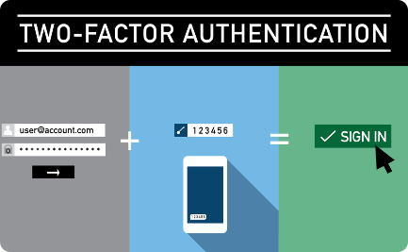
Avoiding the Web Webs
Scrutinize URLs
Protect Personal Data
Strengthen Authentication
Unveil ingenious ways to verify website legitimacy, ensuring safe internet browsing for you and your organization.
Arm yourself with powerful strategies to safeguard sensitive information from falling into the hands of cybercriminals.
Go beyond passwords and implement stronger security measures to fortify your online presence.

Slide 6

Defending Against Social Engineering
1
Anatomy of a Social Engineering Attack
Explore the psychological tactics used by cyber attackers to manipulate individuals and gain unauthorized access.
2
Building Awareness
Educate yourself and your colleagues about social engineering techniques to create a culture of vigilance.
3
Exercising Caution
Master the art of skepticism and develop a critical mindset to prevent being deceived by social engineering tactics.

Slide 7

Reporting and Responding to Phishing Attacks
1
Stay Calm, Act Swiftly
2
Report to Authorities
Discover the crucial steps to take if you suspect you've become a victim of a phishing attack.
Learn how to report phishing incidents, contributing to the fight against cybercrime and protecting others.
3
Continuous Vigilance
Stay proactive and updated on emerging phishing trends to remain one step ahead of evolving threats.

Slide 8
Educating Others: Empowerment through Awareness
Understand the importance of spreading the knowledge gained to defend against phishing and make the internet a safer place for everyone.

