Slide 1
Pizza Temptations
Auth0 Authentication & Authorization

Slide 2
Agenda
Tenant Creation
Application Creation
Login through Auth0
Auth0 Authorization & Verification
Auth0 User Data
Auth0 Logout

Slide 3
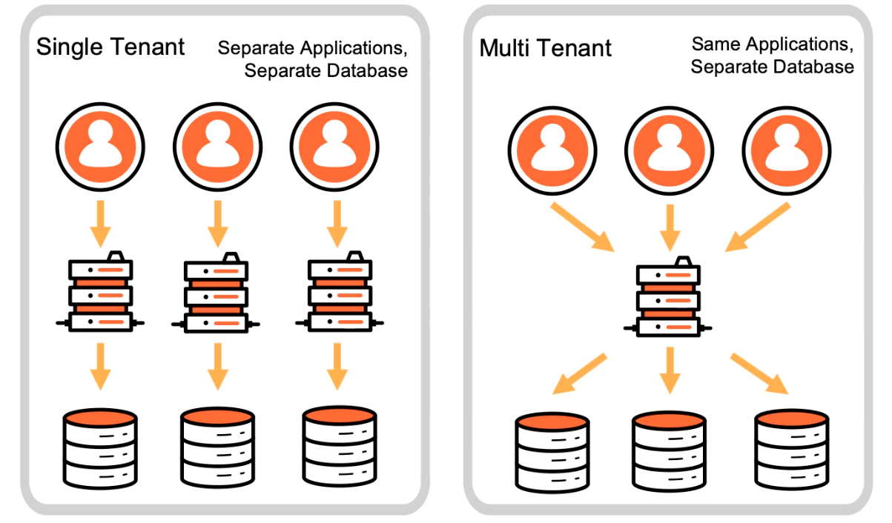
Tenant - dev-lyqevnst.us.auth0.com
Notes:
This is a logical isolation unit. The term tenant is borrowed from the phrase "software multi-tenancy" and refers to an architecture where a single instance of the software serves multiple tenants.
One tenant – one application
One tenant – can hold multiple applications for enterprise SSO

Slide 4
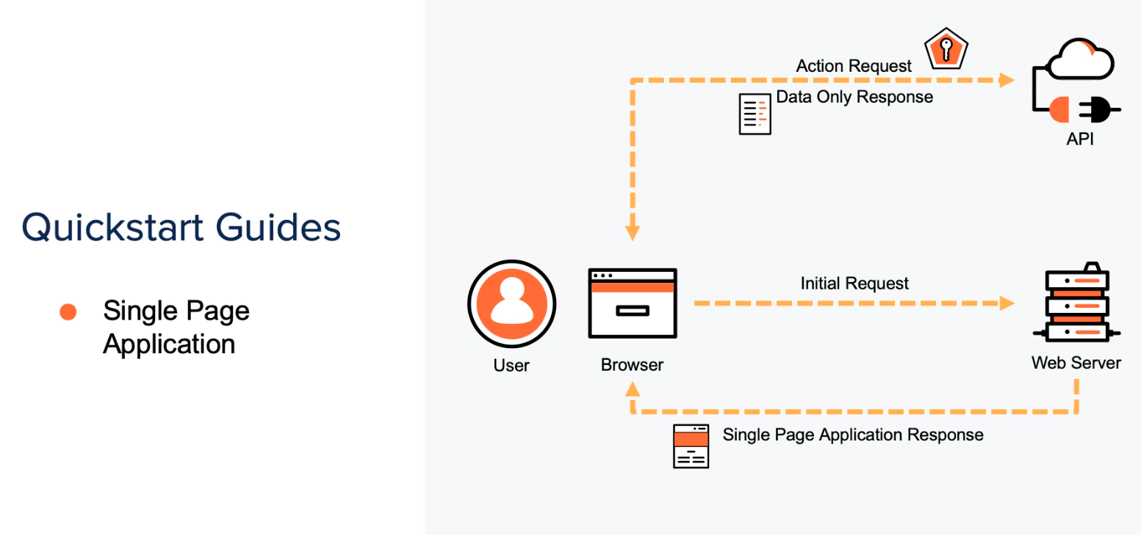
Application Stack
Notes:
A single page application is an application that renders once on the server and then the rest of the execution happens on the users’ browser. Application API is present, where we can do actions: createOrder, OrderHistory

Slide 5
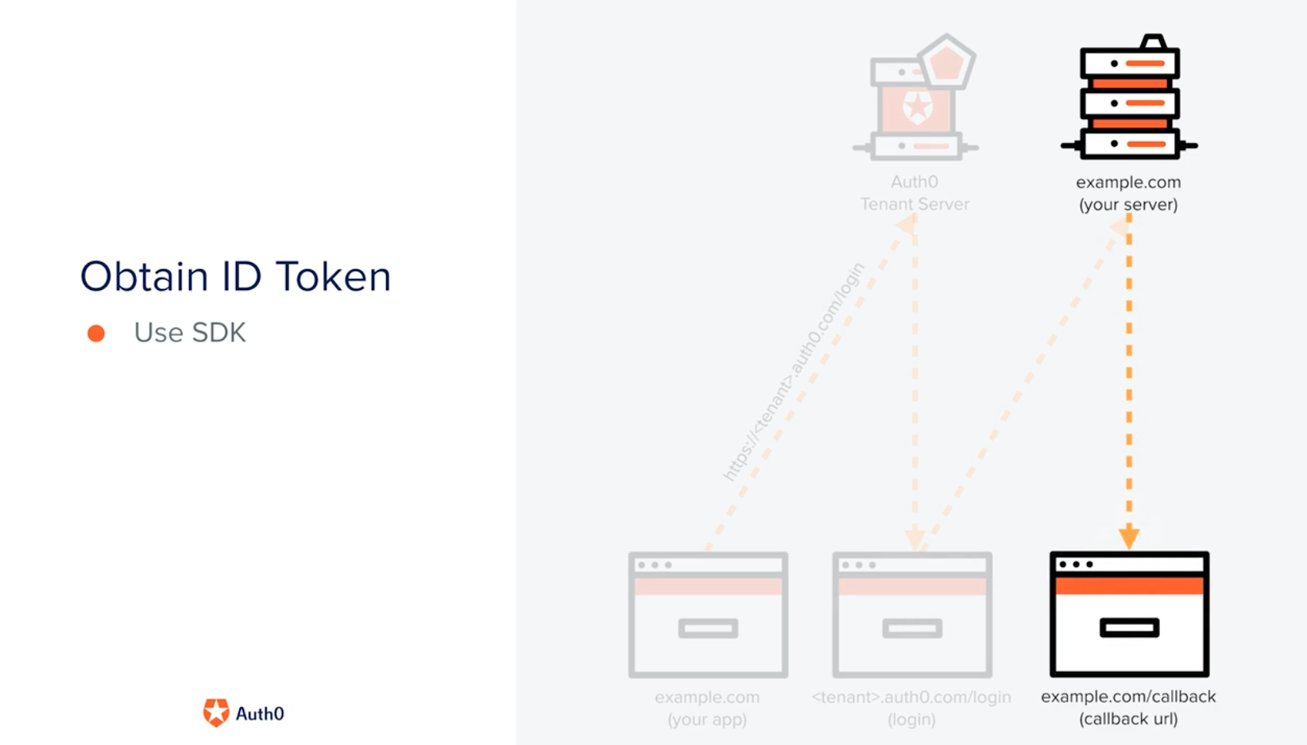
Login with Auth0
Notes:
Login with Auth0 SDK which presents a universal login
using native username&password/also the social login provider/ADFS
From customers perspective, they might be having their local databases - we can import users with their hashed password - so migration from application to Auth0 authentication is easy
We can also set up MFA to get into enterprise applications
Auth0 returns back the application to callback URL that is mentioned here and an ID Token
Profile Information:
User is created in Auth0
How is the profile retrieved: if user is authenticated then it does - I'm guessing it uses the browser session info /localstorage to send the user information for authentication
auth0.getUser()
auth0.getTokenSilently()
Client is authenticated with a user

Slide 6
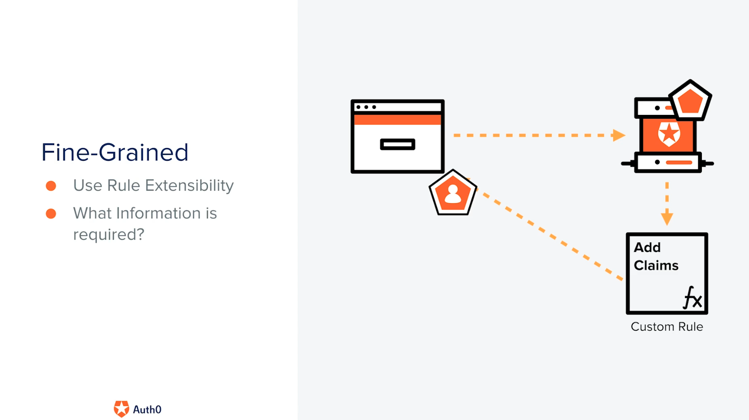
Auth0 Authorization
Notes:
Auth0 can adds a custom claim i.e. view:orders and then sends back the token to the application
Explain the permissions, and the roles that are created
Explain JWT debugging shows the scope
Explain how API is using it

Slide 7
Logout
Logout URL
Sessions Time out
Application Session
Auth0 Session
IDP Session

