Slide 1
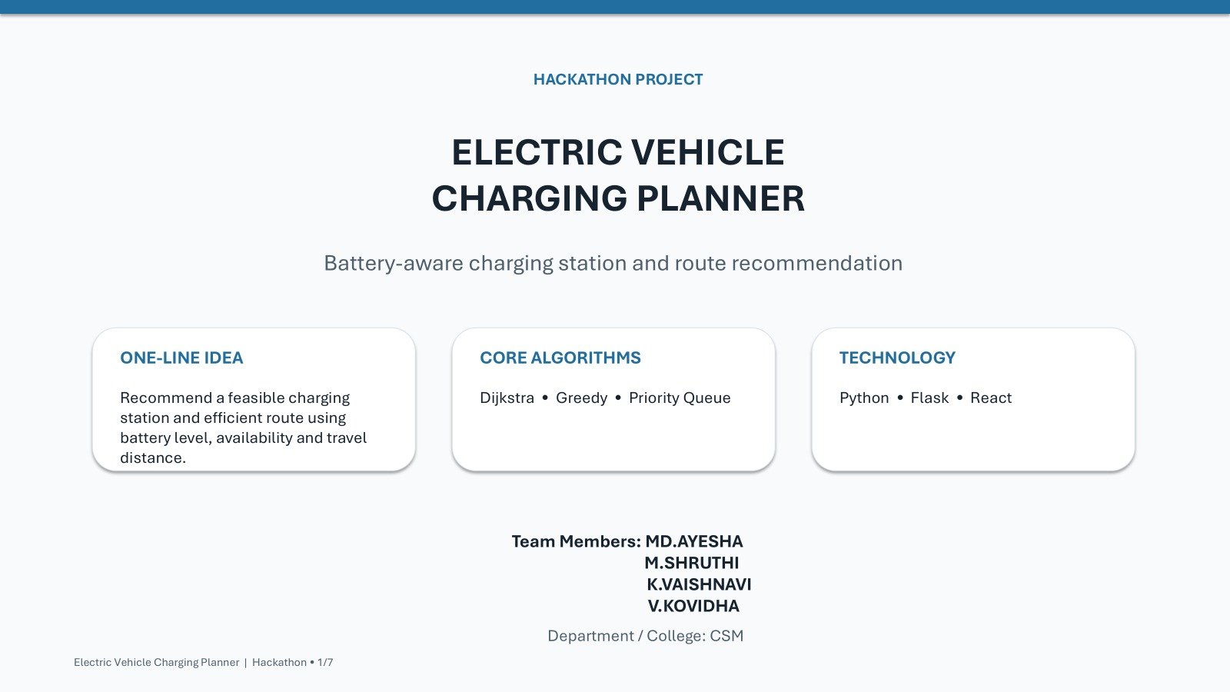

Slide 2
SMART MOBILITY / DESIGN & ANALYSIS OF ALGORITHMS
Electric Vehicle
Charging Planner
Intelligent station recommendations and energy-aware route planning
Core algorithms: Dijkstra • Greedy • Priority Queue
PROJECT PRESENTATION
01 / 08

Slide 3
01 • PROBLEM OVERVIEW
The challenge: reach a charger before energy runs low
An EV driver needs a route that is practical—not just the shortest distance.
What the planner must consider
From request to recommendation
• Current battery level and estimated energy needed
• Road connections and travel distance between locations
• Charging-station availability and charging status
• A route with feasible stops and clear reasoning
EV
EV
EV
Start
battery
Route
search
Charge
stop
Feasible path + station choice
EV CHARGING PLANNER • DAA PROJECT
02 / 08

Slide 4
02 • SYSTEM MODEL
Represent the journey as a weighted graph
Locations become nodes; roads become edges with non-negative travel costs.
Planner inputs
4
B
3
A
C
• Start and destination
• Battery capacity and current charge
• Energy use per kilometre
• Station location, availability and status
• Road distance / travel cost
1
2
3
2
2
F
2
D
4
E
Example network • edge labels represent distance/cost units
Output: route, stops, cost & explanation
EV CHARGING PLANNER • DAA PROJECT
03 / 08

Slide 5
03 • CORE ALGORITHMS
Three algorithms, three complementary roles
Each method contributes a visible decision to the final recommendation.
PATH
ORDER
STOP
DIJKSTRA
PRIORITY QUEUE
GREEDY
Least-cost path
Next node to explore
Feasible charging stop
Finds the lowest total route cost across connected locations.
Selects the unexplored location with the smallest tentative cost.
Chooses a nearby reachable station using a defined local rule.
Priority rule: smallest tentative route cost first | Greedy rule: feasible station with the best local distance/availability trade-off
EV CHARGING PLANNER • DAA PROJECT
04 / 08

Slide 6
04 • ALGORITHM WORKFLOW
How a recommendation is produced
The planner filters infeasible options, searches the network and explains the selected path.
1
2
3
4
5
6
Read request
Build graph
Check feasibility
Run Dijkstra
Choose stop
Explain result
Battery, origin, destination
Nodes, road costs, stations
Estimate reachable distance
Priority queue explores lowest cost
Greedy rule among feasible stations
Route, charge stop, cost, reason
Decision trace: record explored nodes, tentative costs, skipped stations and the reason for each selected stop.
EV CHARGING PLANNER • DAA PROJECT
05 / 08

Slide 7
05 • ILLUSTRATIVE EXAMPLE
A route should be both short and energy-feasible
Sample values demonstrate the decision logic; they are not live station data.
Example trip
Decision trace
• Estimate energy required for each road segment.
• Remove routes or stations that exceed available energy.
• Use Dijkstra to compare total path costs.
• Use station availability and a greedy feasibility rule to select a stop.
• Present the chosen route with distance and remaining-charge estimate.
Current battery: 60% of capacity
Start → reachable station → destination
Key idea: shortest path ≠ always feasible path
EV CHARGING PLANNER • DAA PROJECT
06 / 08

Slide 8
06 • PROTOTYPE DESIGN
A simple interface makes the algorithm understandable
The app can show both the recommendation and the reasoning behind it.
EV CHARGING PLANNER / ROUTE RESULTS
Suggested stack
Recommended route
1
React
S
D
Map, inputs and result cards
A
2
Flask
B
API and algorithm execution
3
Python
Origin Available charger Road node Destination
Graph, Dijkstra, Greedy, queue
4
Station data
Route cost: 12 units • Selected stop: Station S • Status: feasible
Availability and road network
EV CHARGING PLANNER • DAA PROJECT
07 / 08

Slide 9
07 • SOLUTION & CONCLUSION
From route calculation to informed travel
Proposed solution
Conclusion
• Model roads as a weighted graph.
• Use a priority queue with Dijkstra for least-cost routing.
• Apply a greedy rule to select a reachable, available charging stop.
• Show the path, costs and decision trace in the UI.
The prototype combines route optimization with battery and station constraints. By exposing the choices and estimated costs, it helps users understand why a route and charging stop were recommended.
Next steps: connect live station feeds, add traffic-aware costs, and validate energy estimates with real trip data.
08 / 08

