Slide 1
FULL-STACK PROJECT · EMERGENCY RESPONSE
EMERGENCY
RESOURCE
SHARING SYSTEM
A MERN-based platform for finding, managing, and sharing critical resources.

Slide 2
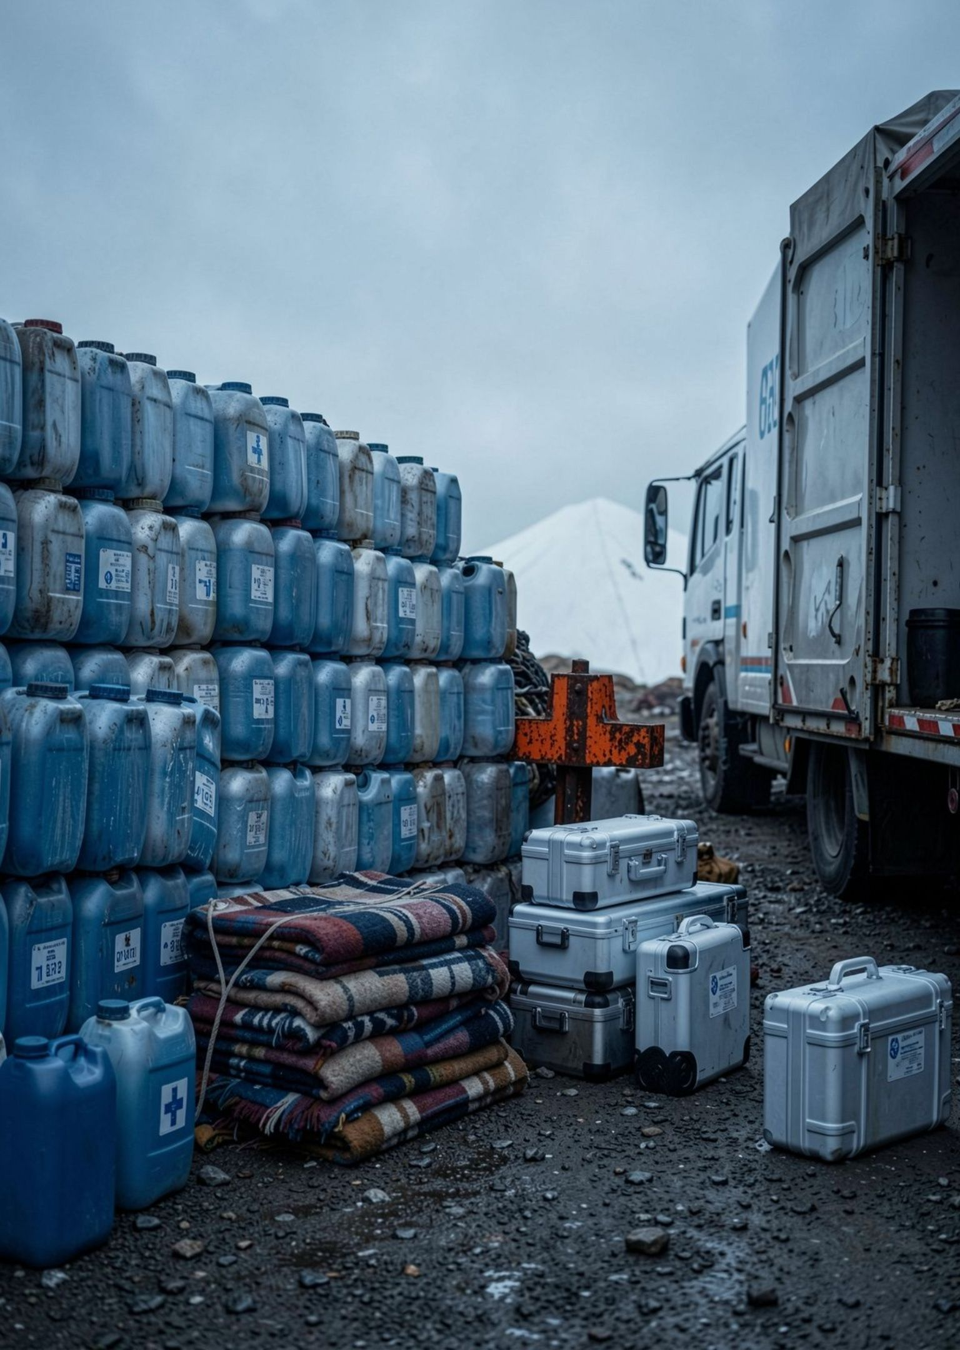



THE PROBLEM
Emergencies create a coordination gap
Urgent needs move faster than disconnected information.
Immediate needs
Scattered supply
Shared visibility
A digital system can connect need, supply, and ownership.
People need supplies, shelter, transport, and medical support quickly.
Available resources are often spread across people, groups, and locations.

Slide 3




PROJECT SCOPE
Project objectives
Build a practical system that demonstrates both product thinking and full-stack delivery.
Demonstrate MERN development
Manage resource records
Connect a responsive interface, REST APIs, business logic, and persistent storage.
Track quantities, locations, owners, and availability in one model.
Deliver clear CRUD workflows
Support controlled access
Use REST APIs to create, read, update, and delete information.
Use authentication and role-based access where required.

Slide 4
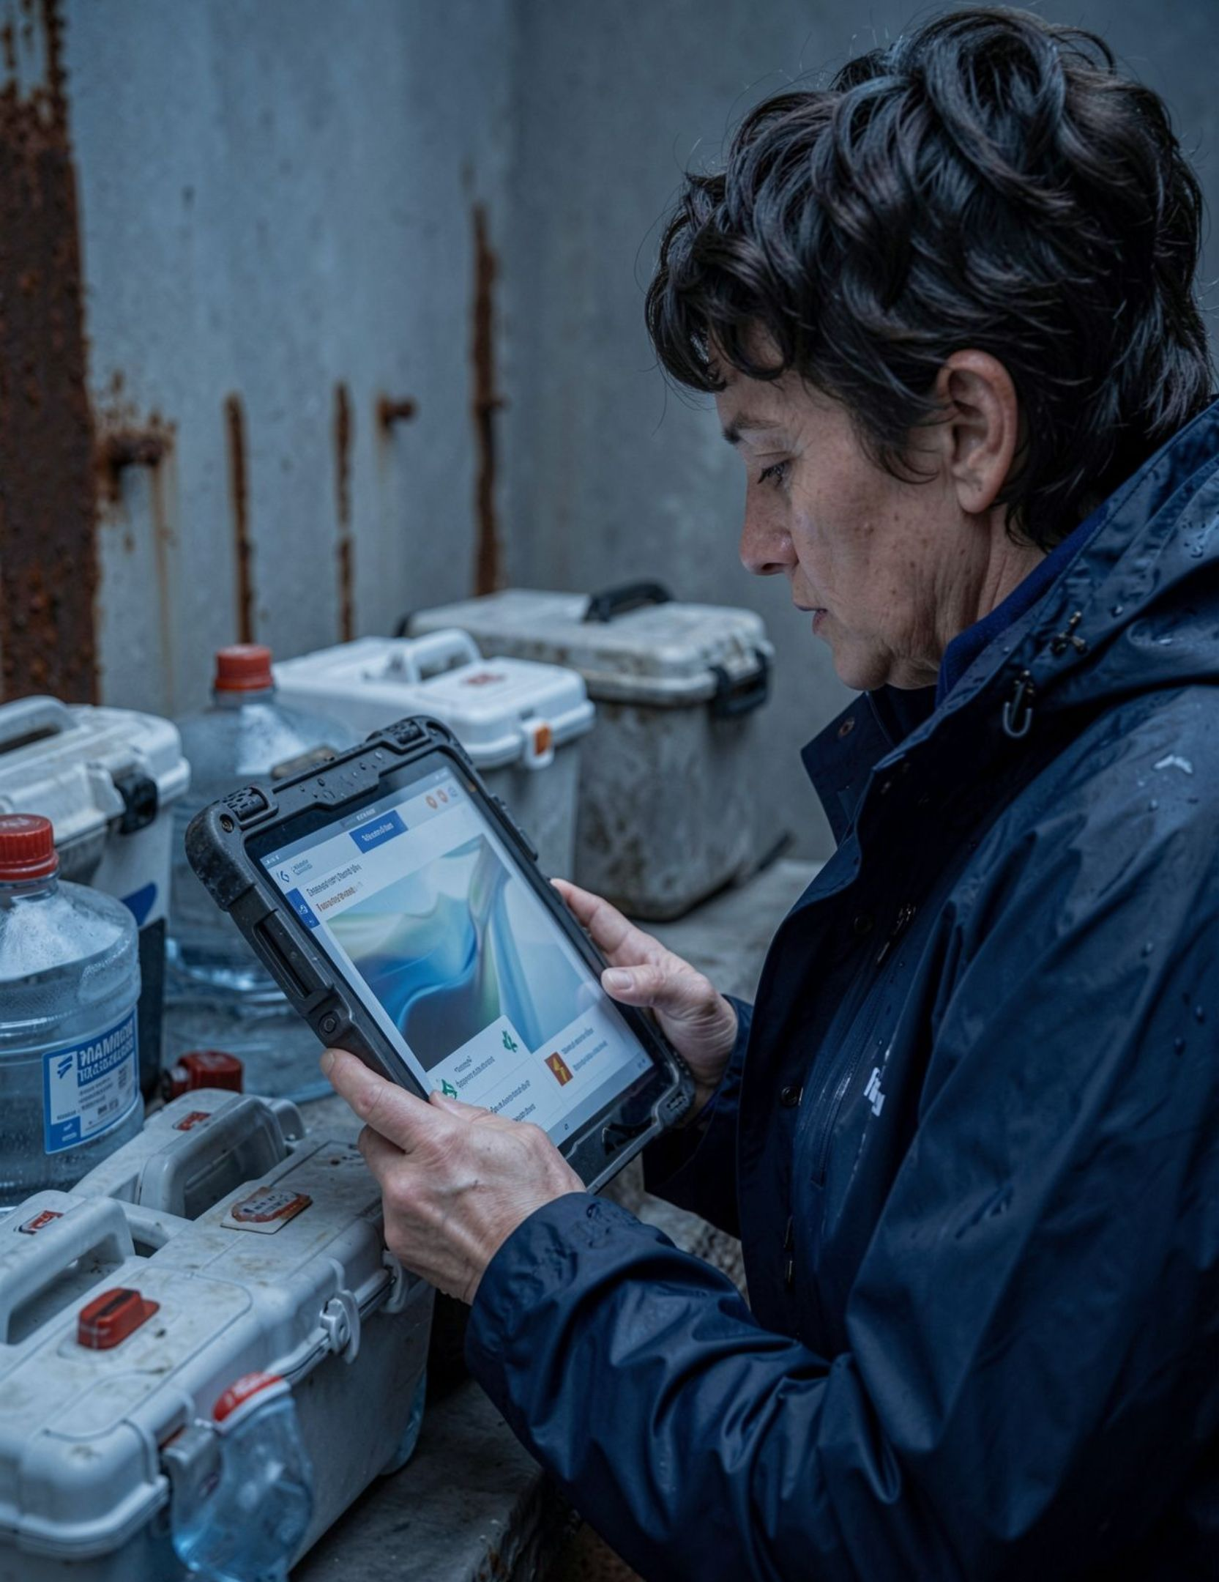
THE SOLUTION
The solution: one shared resource view
Users can add, discover, update, and manage emergency resources from a single responsive interface.
Search with context: Filter by resource type, location, and availability.
See ownership clearly: Know who owns a resource and how much is available.

Slide 5




DATA MODEL
Resource records capture what matters
Each record answers the questions a responder needs before acting.
Resource
Quantity
Location
Food, water, medicine, shelter, vehicles, or equipment.
Current amount or capacity.
Where the resource can be accessed.
Owner
Availability
Person, organization, or response team.
Available, reserved, or unavailable.

Slide 6



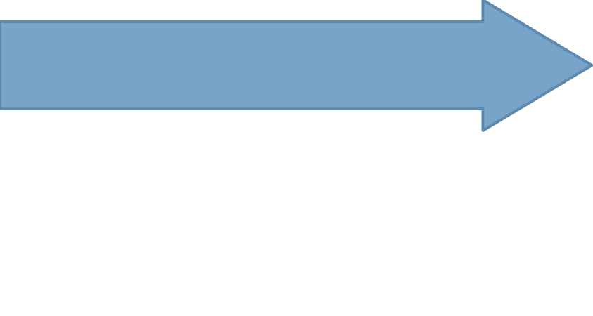
INFORMATION LIFECYCLE
CRUD operations keep information current
The system follows a simple loop from first entry to completed response.
Delete
Update
Remove outdated or completed records.
Read
Change quantity, location, or status.
Create
Find and filter available resources.
Add a new resource record.
Why it matters · Current records help responders act on what is available now, not what was true earlier.

Slide 7

SYSTEM DESIGN
MERN architecture connects the experience
React UI
Node & Express
MongoDB Storage
JSON Response
React
Node.js + Express
MongoDB
Responsive user interface and resource dashboards
REST API routes and business logic
Flexible storage for resource records and users
API flow: UI request → Express route → MongoDB → JSON response

Slide 8

ACCESS CONTROL
Authentication protects access
The system keeps discovery fast while making resource management accountable.
01
Sign in first
Users authenticate before managing emergency resources.
02
Separate roles
Common users, resource owners, and administrators receive different access.
03
Protect the record
Permissions safeguard data without slowing resource discovery.

Slide 9
OPERATING SCENARIO
Typical emergency sharing workflow
Ownership, search, status, and oversight form one continuous response loop.
Monitor
Update
Administrators review records and remove stale entries.
Search
The owner marks a resource reserved or used.
Register
Responders filter by type, quantity, and location.
A resource owner records available supplies.
Result · Everyone sees the same resource status as the response evolves.

Slide 10
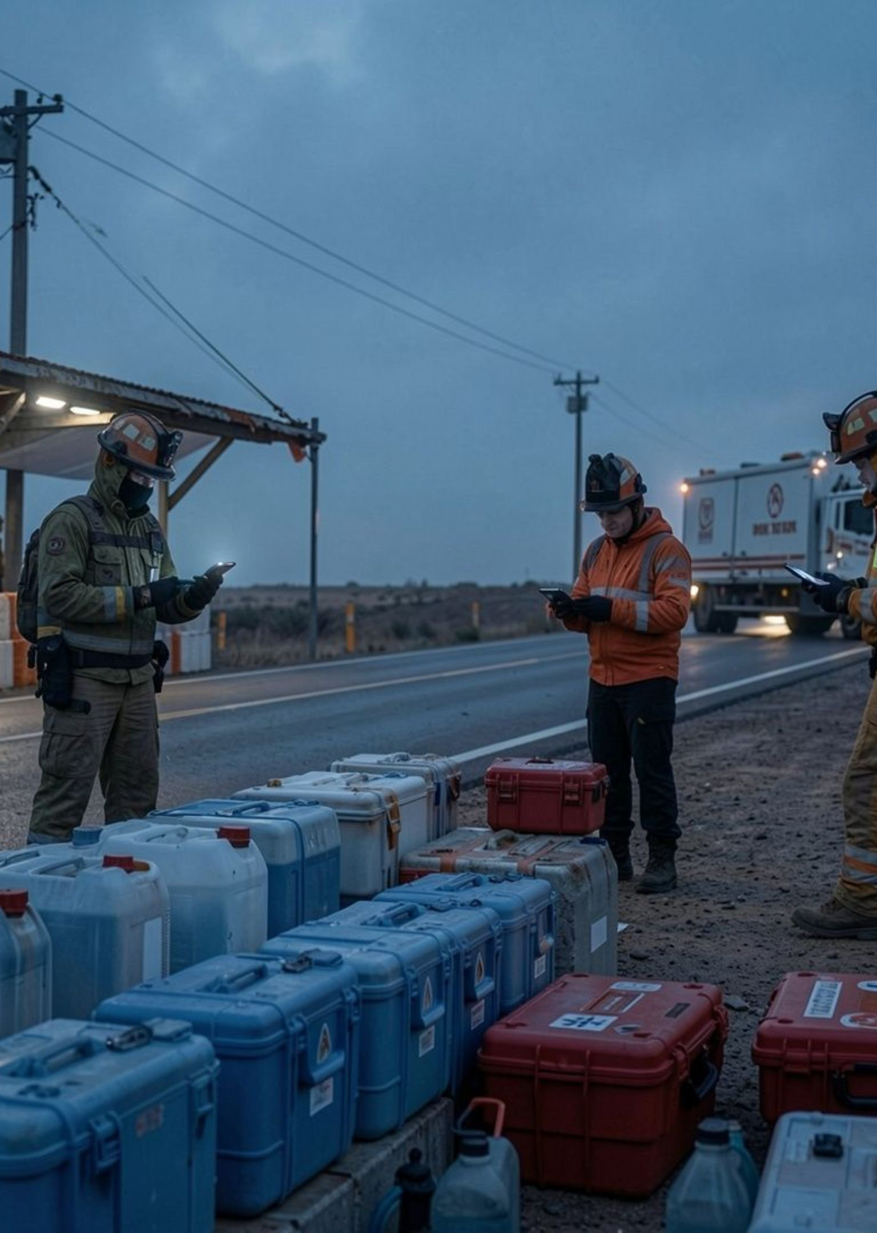
EXPECTED RESULTS
Expected results and future scope
Faster discovery of available emergency resources
Clear ownership and availability tracking
Practical demonstration of MERN CRUD and REST API skills
Future scope
Maps, notifications, live updates, analytics, and mobile support

