Slide 1

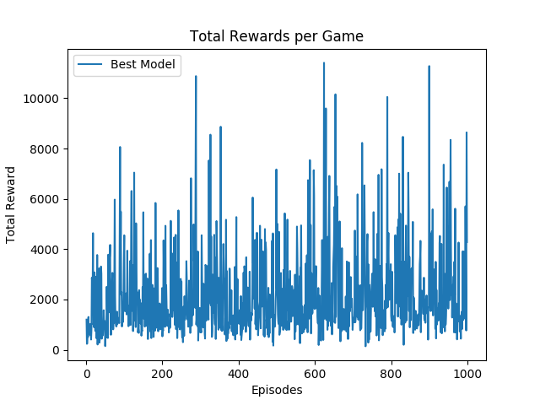
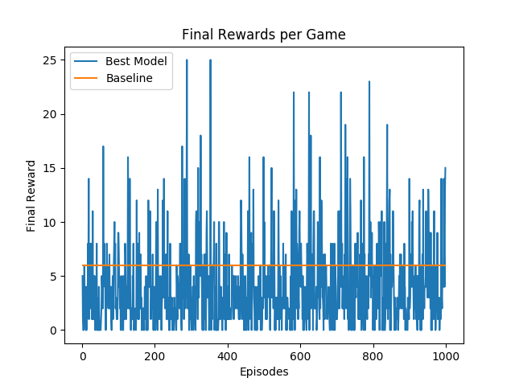


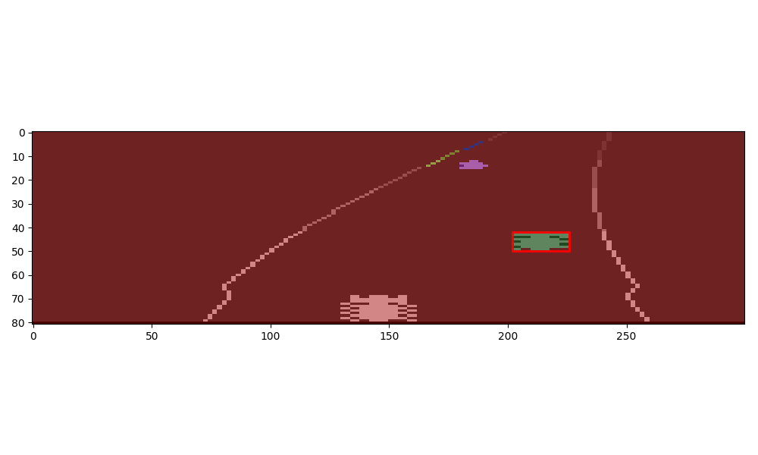
Reinforcement Learning: Autonomous Race Car
Olivier Pham(mdopham@stanford.edu), Stephanie Sanchez(ssanche2@stanford.edu), Vishal Subbiah (svishal@stanford.edu)
Background and Motivation
The Model
Results and Discussion
Autonomous vehicles for the real world environment have been a long term ambition and in recent years endeavors towards this objective have shown very promising results. But what about autonomous driving for video games? If we can simulate autonomous driving in a game, it may give further insight to applying it in the real world.
Player Class: The constructor for the Player class takes the Atari environment as input and utilizes MDP class. The environment is used to trigger the start state. The actions are as described Inputs and Outputs. We have defined a success and probability function that utilizes the Atari environment's step function to return a new observation based on the chosen action. The step function also returns a parameter that signals the end of the game which is our end state.
Reward Frame Extraction: To extract the agent’s position in the race we found arrays corresponding to digits 0-9 and we found quadruplets groups of pixels for each. Then we extracted one pixel and mapped each combination to the corresponding number.
Reduced Action Space: To test the framework of our algorithm we reduced the action space to action 1 (accelerate), action 7 (accelerate right,) and action 8 (accelerate left). The game also consists around 13,300 frames and we ran each game for 1000 steps with 2-4 frames per step (uniformly distributed).
Q-Learning: We implemented Q-Learning as a function approximation:
Where s is a raw pixel frame, a is an action,
is the feature extractor, and w is the weights updated by:
Feature Extraction: Every pair (s,a) was given a value equal to the number of cars on the road (including our agent). The detection of cars was done using image segmentation/labeling
as seen in the picture).
Model | Baseline | Value Iteration | Q learning | Q learning (Function Approx.) | Q learning (Feature Extraction)
Result | 194/200 | 199/200 | 187/200 | 187/200 | 175/200
We were able to show why Value Iteration would not do well for the given environment due to randomness in the number of frames per steps (unknown probabilities which this method relies on). We implemented Q learning (function approximation) which gave an improvement in our performance as compared to our baseline. With the feature extraction we see a significant jump in our performance as compared to previous models.
Problem Statement
We propose to implement Reinforcement Learning (RL) to train an agent in the Open AI gym Atari game, Enduro-v0. The original goal of the game was to attain the maximum points but we decided to see if our agent could reach first place among 200 other cars. The goal is for the agent to learn from its environment and actions, the intention of the game and develop an optimal policy to win.
Inputs and Outputs
The gym environment provides us with pixels, rewards and a Boolean indicating if the episode has ended (which happens after 13 300 frames). The observation space is a 210*160 pixels 8-bit RGB image of the screen which is represented by an array of size (210, 160, 3).There are 9 possible actions which are: no operation, accelerate, right, left, brake, brake left, brake right, accelerate right, accelerate left. However, as the goal of the project is to learn a policy for reaching the first position as quickly as possible, we will use the following reward:
Reward(s,a,s') = 200 - Position in the race at the state s'
Future Work
References
Our next steps would be to expand the actions space to all 9 moves from the current 3 we have shortlisted. We are currently running only the first 1000 iterations of the game to train the car in the same terrain. We would like to expand to work on the different terrains. From the limited games we have run we noticed a significant improvement with Q learning and so with enough episodes we should be able to win the race.
M. A. Farhan Khan, Oguz H. Elibol. Car Racing using Reinforcement Learning
Volodymyr Mnih, Koray Kavukcuoglu, David Silver, Alex Graves, Ioannis Antonoglou, Daan Wierstra, Martin Riedmiller. Playing Atari with Deep Reinforcement Learning
David Hershey, Rush Moody, Blake Wulfe. Learning to Play Atari Games.

