Slide 1

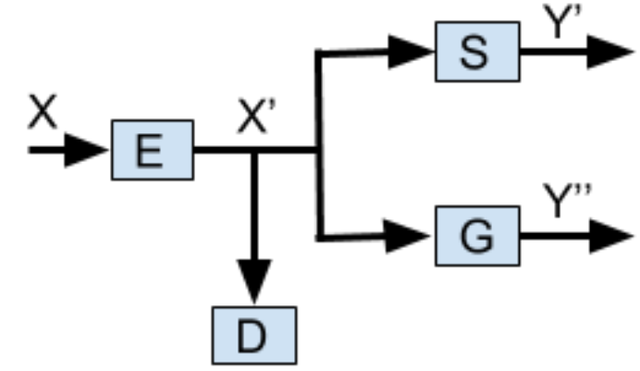
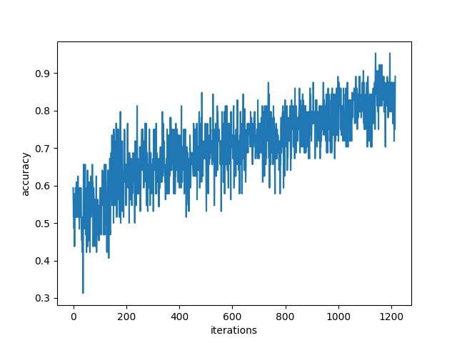
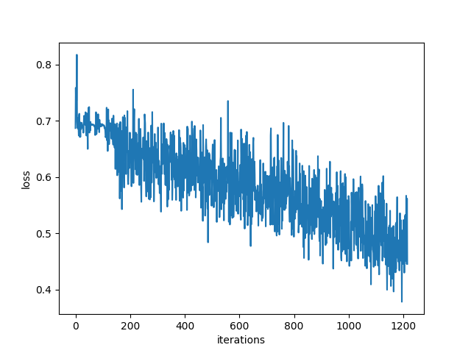
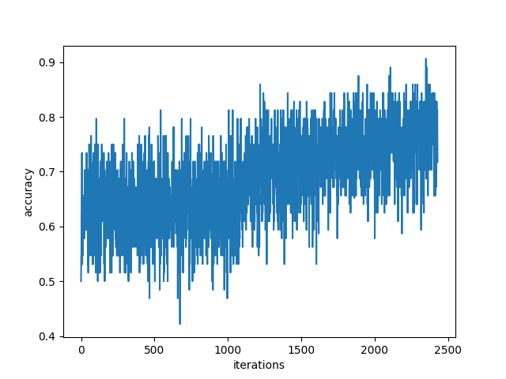
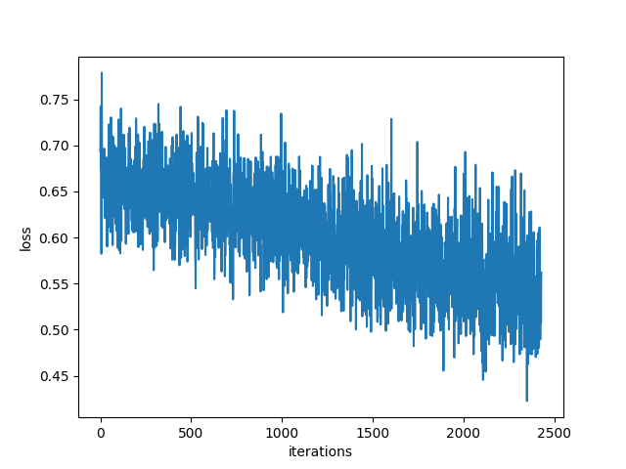
Application Testing of Generative Adversarial Privacy
Nicholas Johnson(nickj@stanford.edu), Stephanie Sanchez(ssanche2@stanford.edu), Vishal Subbiah (svishal@stanford.edu)
Background and Motivation
The Model
Results and Discussion
Machine learning (ML) methods serve many purposes today. The most revered applications of ML are normally coupled with benevolent intentions such as adverting cyber attacks, classifying materials in images for security and health purposes, etc. But ML methods do not necessarily have to be applied for favorable causes. Inference attacks, for instance, are adversary learning methods that can infer private information about public information or data. For this reason it is essential to protect privacy by deterring adversarial machine learning.
Methods:
E,G,S: for encoder, gender classifier, and smile classifier respectively
D: distortion metrc (for further constraints on the encoder function)
GAP architecture: we consider the encoder and classifiers as distinct entities
Shallow Classifiers: a two layer neural network (gender and smile models)
Compressive Encoders: PCA, reconstruct image tensor via the first d principle eigenvectors for each color channel.
Shallow Autoencoders: universal approximation theorem, neural networks can reproduce any function under the appropriate constraints. We are able to back propagate through the architecture of multiple neural networks to appropriately optimize their respective loss functions.
 | All Model | Gender Model | Smile Model
No Train | 0.243421052631578 | 0.418859649122807 | 0.639254385964912
Encoder-PCA | 0.257675438596491 | 0.69078947368421 | 0.360745614035087
The All Model entails Vggnet with 3 sets of 2 convolutional layers with a maxpool layer. The No Training All Model results were computed by a 2 hidden layer network autoencoder. This yielded favorable results to predict the Smile Model while lowering the accuracy of the Gender Model.
Applying a compressive encoder, PCA, to the All Model gave reverse results. This is because features for the Gender Model are more distinct than the Smile Model features. These results would be excellent for reducing the accuracy of the Gender Model while decreasing the accuracy for the Smile Model.
(GAP Architecture)
Gender Accuracy
Gender Loss
Problem Statement
Generative Adversarial Privacy (GAP): to protect the privacy of public data by distorting data.
Goal: to enable the protection of sensitive information by obscuring generative adversarial networks (GANs) inferences of sensitive data and while not affecting the inference of non-sensitive attributes.
Smile Accuracy
Smile Loss
Data Preprocessing
Future Work
References
Reshaped them all to 256 x 256 (avg. size dataset) pixels with 3 color channels
Gender and Smile Data: cleaned labels to be 0 and 1 ({smile, no smile}, {male, female})
Crop the images to 224 x 224 for ResNets or VGG-Net provided by PyTorch
Ari Ekmekji. Convolutional Neural Networks for Age and Gender Classification.
Jihun Hamm. Minimax Filter: Learning to Preserve Privacy from Inference Attacks.
G. Cybenko. Approximation by superpositions of a sigmoidal function.
Jiawei Su, Danilo Vasconcellos Vargas, Sakurai Kouichi. One pixel attack for fooling deep neural networks.
K-means compression algorithm to evaluate all three channels simultaneously.
More complex networks for classification.
Loss function identification, to evaluate the loss function is achieving the true privacy measure desired.
Add random noise to the encoder to make it non-reversible -limits the information to the classifiers.

