Slide 1

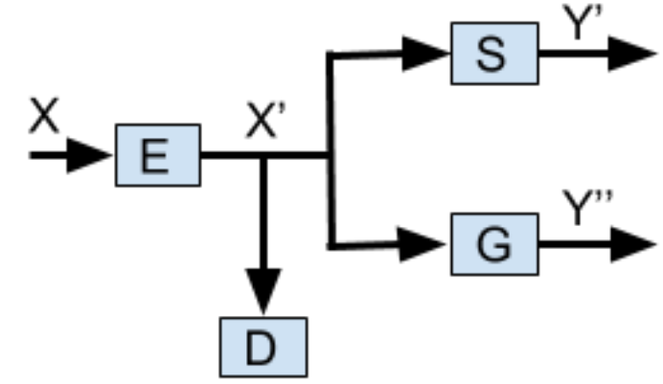
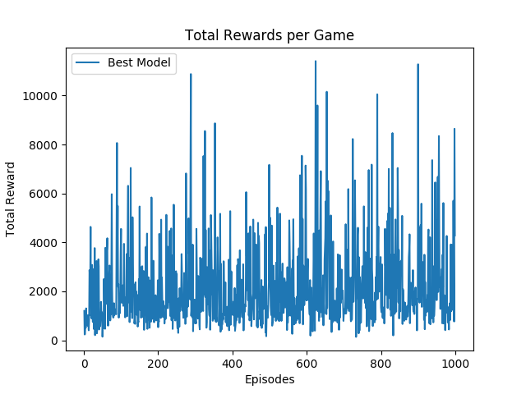
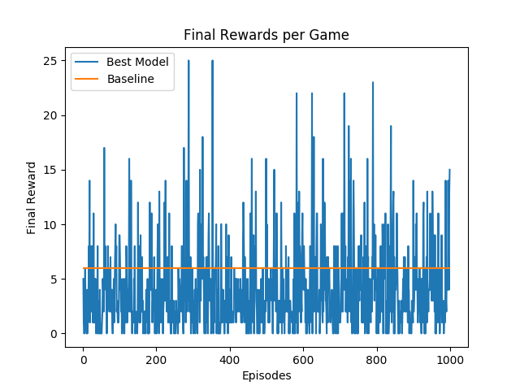
Application Testing of Generative Adversarial Privacy
Nicholas Johnson(nickj@stanford.edu), Stephanie Sanchez(ssanche2@stanford.edu), Vishal Subbiah (svishal@stanford.edu)
Background and Motivation
The Model
Results and Discussion
Machine learning (ML) methods serve many purposes today. The most revered applications of ML are normally coupled with benevolent intentions such as adverting cyber attacks, classifying materials in images for security and health purposes, etc. But ML methods do not necessarily have to be applied for favorable causes. Inference attacks, for instance, are adversary learning methods that can infer private information about public information or data. For this reason it is essential to protect privacy by deterring adversarial machine learning.
Methods:
E,G,S: for encoder, gender classifier, and smile classifier respectively
D: distortion metrc (for further constraints on the encoder function)
GAP architecture: we consider the encoder and classifiers as distinct entities
Shallow Classifiers: a two layer neural network (gender and smile models(
Compressive Encoders: PCA, reconstruct image tensor via the first d principle eigenvectors for each color channel. K-means compression algo. to evaluate all three channels simultaneously
Shallow Autoencoders: universal approximation theorem, neural networks can reproduce any function under the appropriate constraints. We are able to back propagate through the architecture of multiple neural networks to appropriately optimize their respective loss functions.
 | Baseline | Value Iteration | Q-learning | Q-learning (Function Approx.) | Q-learning (Feature Extraction)
Result | N/A | 199/200 | 187/200 | 187/200 | 175/200
(GAP Architecture)
We were able to show why Value Iteration would not do well for the given environment due to randomness in the number of frames per steps (unknown probabilities which this method relies on).
We implemented Q learning (function approximation) which gave an improvement in our performance as compared to our baseline. With the feature extraction we see a significant jump in our performance as compared to previous models.
Problem Statement
Generative Adversarial Privacy (GAP): to protect the privacy of public data by distorting data.
Goal: to enable the protection of sensitive information by obscuring generative adversarial networks (GANs) inferences of sensitive data and while not affecting the inference of nonsensitive attributes.
Data Preprocessing
Future Work
References
Reshaped them all to 256 x 256 (avg. size dataset) pixels with 3 color channels
Gender and Smile Data: cleaned labels to be 0 and 1 ({smile, no smile}, {male, female})
Crop the images to 224 x 224 for ResNets or VGG-Net provided by PyTorch
Ari Ekmekji Convolutional Neural Networks for Age and Gender Classification.
Jihun Hamm Minimax Filter: Learning to Preserve Privacy from Inference Attacks.
G. Cybenko Approximation by superpositions of a sigmoidal function.
Our next steps would be to expand the actions space to all 9 moves from the current 3 we have shortlisted. We are currently running only the first 1000 iterations of the game to train the car in the same terrain. We would like to expand to work on the different terrains. From the limited games we have run we noticed a significant improvement with Q learning and so with enough episodes we should be able to win the race.

