Slide 1
Prototipo Reactor con Metal Hydride
Sebastian Sanchez

Slide 2
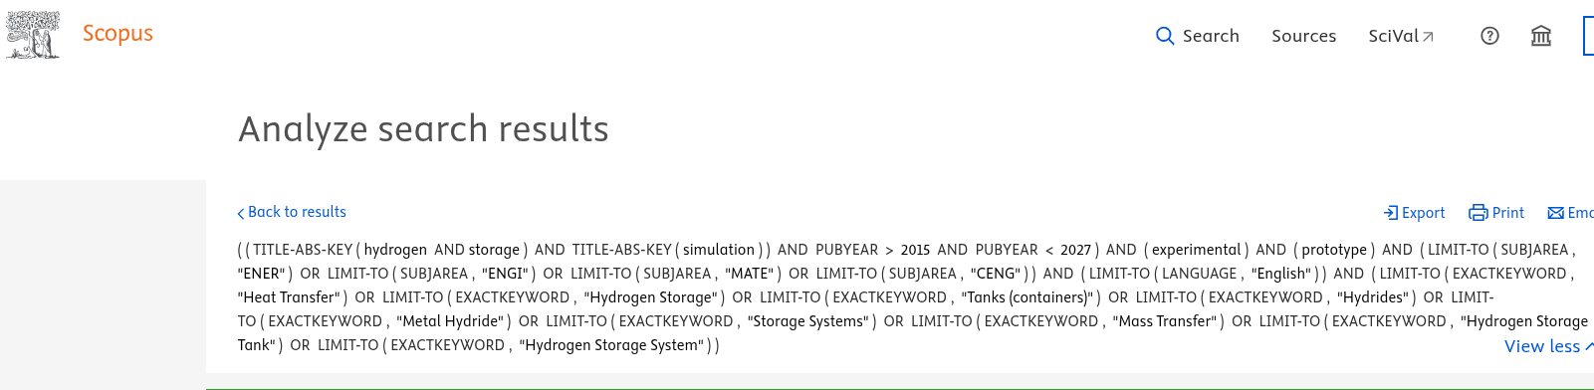
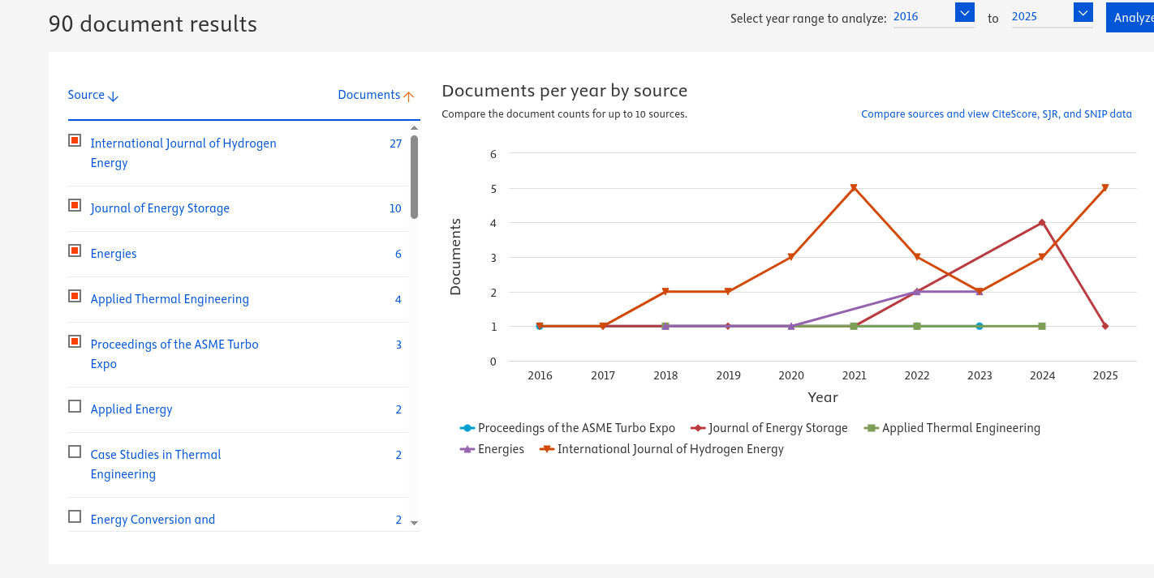

Slide 3
 | Title, | Year
1 | Metal hydrides for solid hydrogen storage: Experimental insights, suitability evaluation, and innovative technical considerations for stationary and mobile applications, | 2025
2 | Review on thermal design and thermal management for metal hydride reactors: Current status and future development, | 2025
3 | Use of PCMs in metal hydride reactors for enhancing hydrogen absorption and desorption: A short recent review, | 2025
4 | Advances in Thermal Management of Integrated Hydrogen Storage Reactors, | 2025
5 | Enhancing Hydrogen Storage Performance of Metal Hydrides in Ships: A Review, | 2025
6 | A review on nanofluid, phase change material and machine learning applications for thermal management of hydrogen storage in metal hydrides, | 2024
7 | A review on research progress in thermal management of metal hydride hydrogen storage reactors | 2024
8 | State of the Art in Development of Heat Exchanger Geometry Optimization and Different Storage Bed Designs of a Metal Hydride Reactor, | 2023
9 | Thermal Management Techniques in Metal Hydrides for Hydrogen Storage Applications: A Review, | 2023
10 | Review of thermal management technology for metal hydride reaction beds, | 2023
11 | Integration of thermal augmentation methods in hydride beds for metal hydride based hydrogen storage systems: Review and recommendation, | 2022
12 | Review on thermal applications for metal hydrides in fuel cell vehicles: Operation modes, recent developments and crucial design aspects, | 2022
13 | A design methodology of large-scale metal hydride reactor based on schematization for hydrogen storage, | 2022
14 | The comprehensive review for development of heat exchanger configuration design in metal hydride bed, | 2022

Slide 4
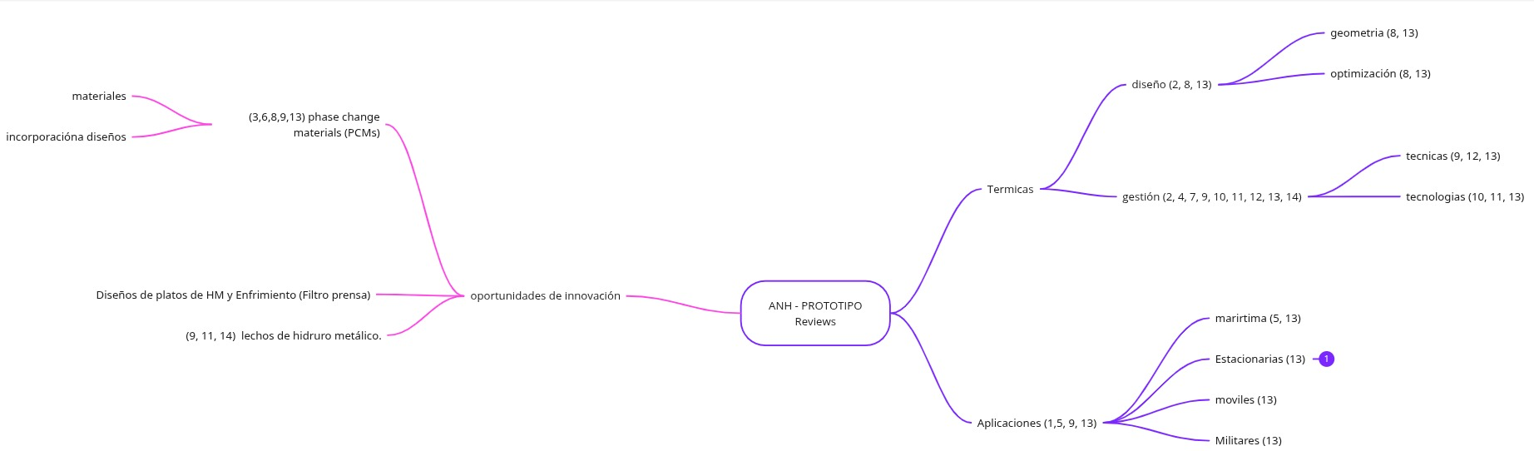

Slide 5
