Slide 1
Auction System for Used Computers and Parts
Problems / Observations
Selling and Buying of used computers is difficult
because buyers and sellers need to negotiate on price.
Large quantity of computers are discarded
after a few years of use due to obsolescene of Operating Systems.
Installing used computers with Linux operating systems
can extend their useful life by many years.

Slide 2
Auction System for Used Computers and Parts
System Objectives :
Reduce electronic waste,
Re-use, and Re-purpose of computers and parts,
Facilitate repairs of faulty computers.

Slide 3
Auction System for Used Computers and Parts
Faulty computers can be repaired and made useful again.
Used computer parts can also be re-purpose
and used in DIY projects.

Slide 4
Auction System for Used Computers and Parts
Why have a dedicated website
for buying and selling of used computers and parts ?
Make it the top serial position website for
people to meet and transact,
where large number of buyers and sellers
can negotiate
and get a win-win price.

Slide 5
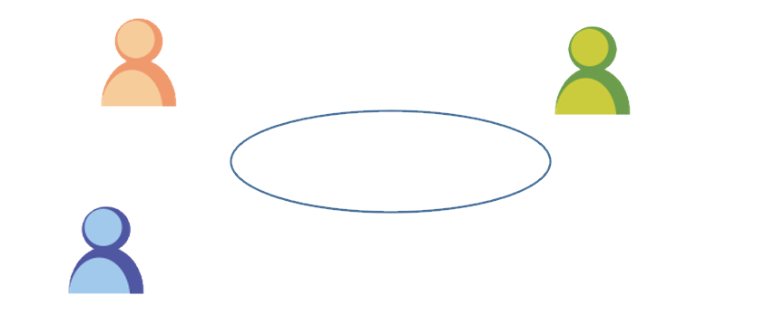
Auction System for Used Computers and Parts
Registered users can be buyers and/or Sellers
Sellers
Sellers
Buyers
Sellers
Computer Auction
Sellers can withdraw items or close sales at any time. Potential buyers can ask Seller for more information.
Public can view items

Slide 6
Auction System for Used Computers and Parts
Technological Solution :
We use Golang to develop the entire system as it is good for programming scalable servers and large software systems.
Go has Ease of use, State-of-the-art productivity, High-level efficiency along with static typing, Advanced performance for networking and Maximises the use of multi-core processors.
Data storage and scaling using MySQL database

Slide 7

Auction System for Used Computers and Parts
Technical Solutions

Slide 8
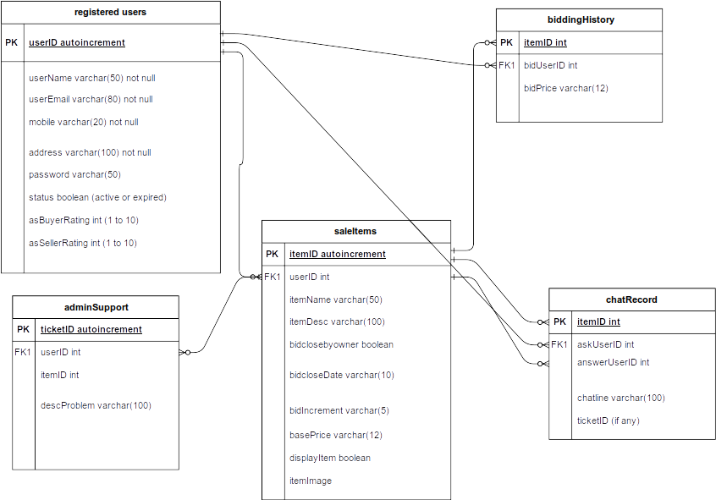

Slide 9
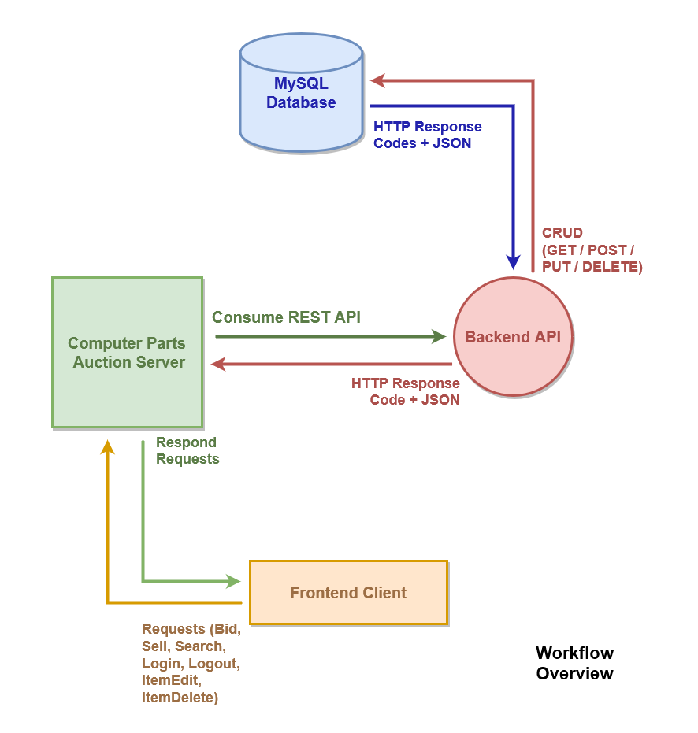

Slide 10
Auction System for Used Computers and Parts
System Features :
Keywords search for items via in-string search
Record of User’s buy and sell items
Chat system for users to interact
Admin Support System for users

Slide 11
Auction System for Used Computers and Parts
Focal Contributions by :
Charles Low : Develop front-end and API processes.
Lim K Y : Develop back-end and API processes.
Andrew Ng : DB design, research resources, technical writing.

Slide 12
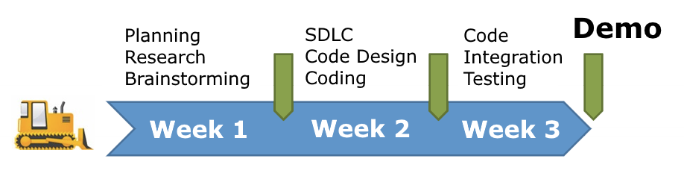
Auction System for Used Computers and Parts
Project Timeline

Slide 13
Auction System for Used Computers and Parts
Demo by Charles Low

Slide 14
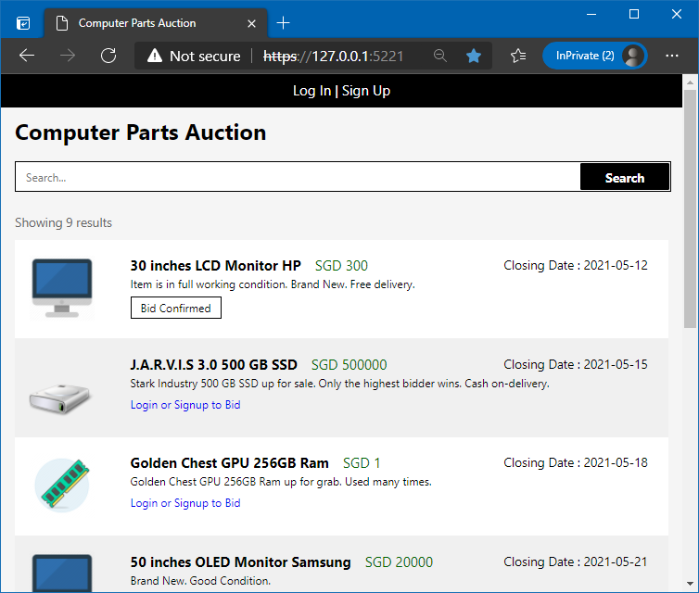
Auction System for Used Computers and Parts
Landing page for all public users (Guests, Buyers, Sellers)
Users must either login or signup to bid and sell items
"Bid Confirmed" status is available for all users to see

Slide 15
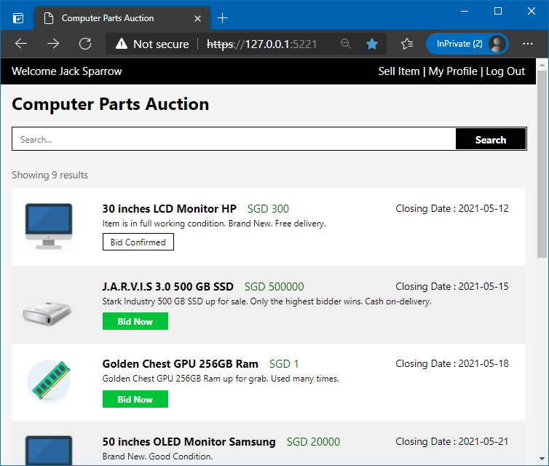
Auction System for Used Computers and Parts
Bid Item
Once login, the user must click on the "Bid Now" button to bid

Slide 16
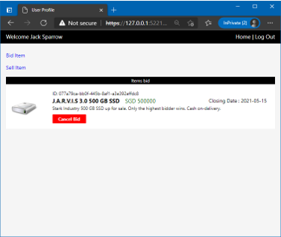
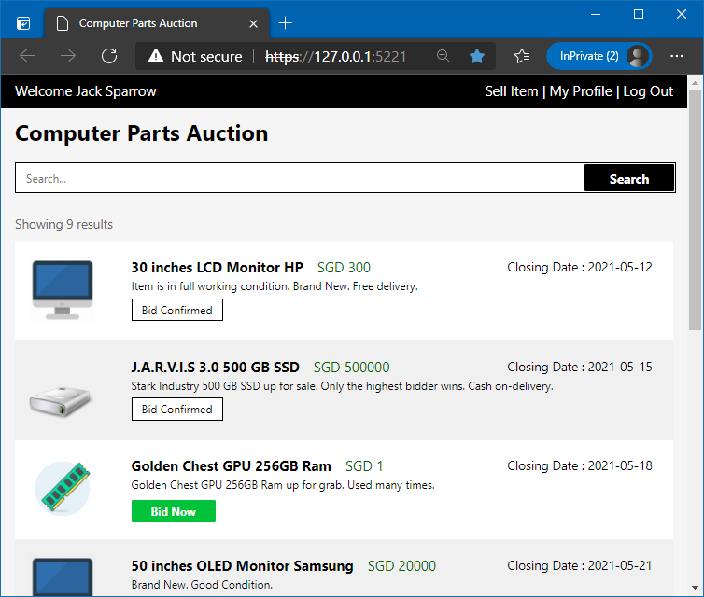
Auction System for Used Computers and Parts
Bid Item
Once the bid was confirmed, the landing page is updated with "Bid Confirmed" status

Slide 17
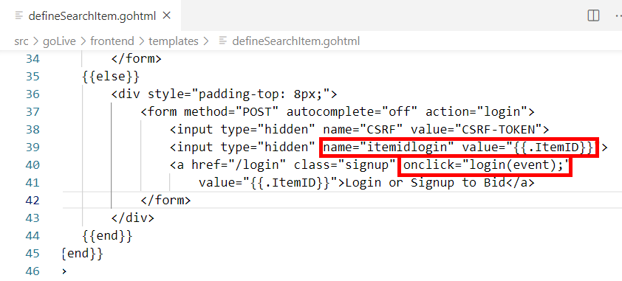
Auction System for Used Computers and Parts
Behind The Scenes
The "Bid" status is controlled by the JavaScript HTML Document Object Model (DOM) onclick event, and redirected to appropriate form's action page to capture that item's ID once the form was submitted

Slide 18
Auction System for Used Computers and Parts
Slides and Demo by Lim KY

