Slide 1

Internship / Professional Practice Presentation on “Recipe App”
Name:
Akash T N
(1RN15CS016)
Guide:
Dr.Kiran P
Associate Prof. Dept. of CSE, RNSIT
Department of Computer Science and Engineering
RNS Institute of Technology
2019-20

Slide 2
CONTENTS
INTRODUCTION
Company Profile
Domain/ Technology (Data Science/Mobile computing/…)
Problem Statement
Existing System/Solution and their Limitations
Proposed Solution
REQUIREMENTS
Functional Requirements (FR)
Non-functional Requirements (NFR)
Specific Hardware & Software Requirements
SYSTEM ARCHITECTURE/BLOCK DIAGRAM
DFD/Sequence diagram/Class diagrams /Flowchart
IMPLIMENTATIONS
Algorithm/Methods/ Pseudo code
Libraries used / API’S
Configuration
RESULT ANALYSIS
Unit testing/system testing
Results
Graphs
Snapshots
CONCLUSION AND FUTURE WORK
Conclusion
Limitations and Future work
REFERENCES

Slide 3

"The Valley Bootcamp" is an intensive coding bootcamp in Bangalore. They teach to code, to solve problems and become great Engineers.
The Full Stack Web Development course is aimed at teaching technologies that are used to build powerful, multi-user web applications.
The technologies covered are React JS on the front-end and NodeJS + MongoDB on the backend. They taught us how a REST API works, how APIs are used all the web today to power multi-platform applications and build a few along the way.

Slide 4
INTRODUCTION
Food listing application displays the list of food recipes on the web page, as requested by the user. To display a list of recipes, we require an Application Program Interface (API) which will fetch all the data from a database which is hosted somewhere else.
The API used in this application is the Food2Fork’s recipe API. Food2Fork offers an API which exposes its powerful recipe discovery functions for the application to use. The API gives access to their ever expanding recipe database, powerful ingredient search function, and social-media based ranking algorithm. Any request will return a maximum of 30 results.

Slide 5
PROBLEM STATEMENT
This system searches for the recipes that are searched by the user either by its name or by the constituent ingredients present in the recipe and returns the list of matches.

Slide 6
REQUIREMENTS
Functional Requirements
View Recipe: The user shall be able to see the recipes posted by other users. In other words, the user shall be able to access the Recipe Forum.
Search for a Recipe: Any user shall able to search for a recipe using the title as a criterion. The search functionality will provide the users with a shortcut to find their targeted recipes if posted earlier.
View Ingredients: The user of the app shall be able to view ingredients of a certain recipe.
Non-functional Requirements
Usability Requirements: The application shall be easy to use and i.e. it shall have a user-friendly interface. GUI shall be simple and clear.
Performance Requirements: The application shall be fast and robust when loading
Space Requirements: The application shall have enough memory space in order to store high number of data.
Reliability Requirements: The application shall not produce an incorrect output.
Portability Requirements: The software shall work in all different platforms.

Slide 7
Software Requirements:
Visual Studio Code Editor
Browser: Chrome,Firefox
NODE JS, REACT JS , EXPRESS API tools must be installed
Mongo DB and Heroku Online Accounts must be created
Hardware Requirements:
A minimum of 6GB RAM .
Minimum of 20 GB available on the hard disk.
Internet connection with speed atleast 4MBPS.
OS: Windows OS 8 and above or Linux

Slide 8
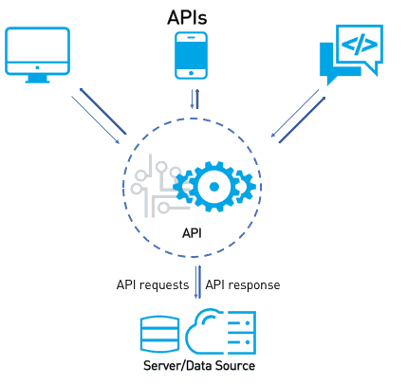
SYSTEM ARCHITECTURE/BLOCK DIAGRAM
A system architecture describes the organization of the system in terms of structure and behaviors by representing the different components and the relationship between them.

Slide 9
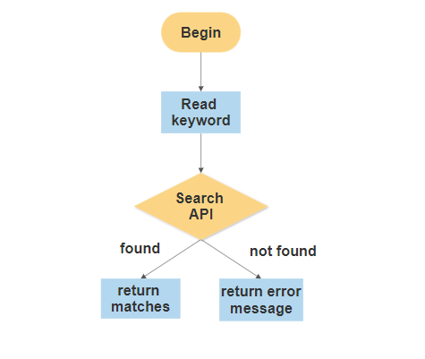
FLOW CHART

Slide 10
IMPLEMENTATION
Clone the repository into your PC, using cd Desktop/react-recipes
Inside the project directory, run the command- create-react-app
Once create-react-app has finished, install the dependencies with:yarn
Open the IDE and start the application.
Update index.js to point to the new path of App.js and remove old imports for files we just deleted.

Slide 11
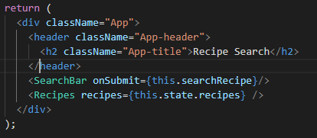
HEADER
The below figure represents the code for the search bar used to type in the food item names.

Slide 12
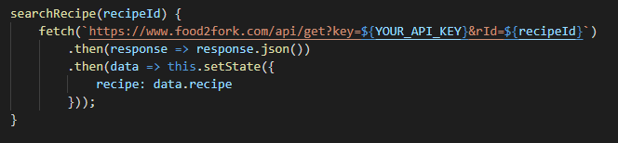
SEARCHING
The API key and the recipe id are the parameters used to search the recipes of a particular food item.

Slide 13
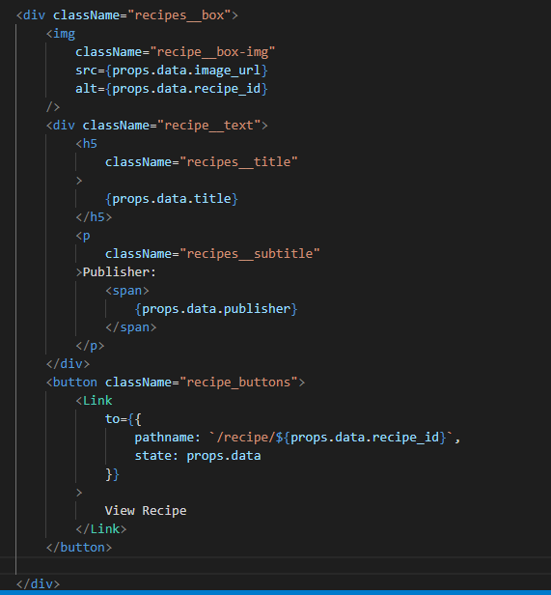
Display
The selected recipes will be displayed on the web page. The details such as recipe title, publisher name are displayed in a box format.
A view recipe link is also included, which when clicked displays the complete detailed information about that particular item.

Slide 14
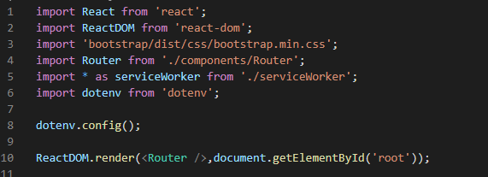
Rendering
ReactDOM is like a library of functions that allows you to use Javascript and convert (or render) it to HTML. Render is like a class or object within ReactDOM to render.

Slide 15
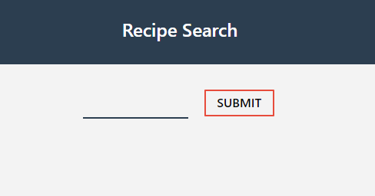
RESULT ANALYSIS
The menu page shown below is the first page that appears when searched for web application which gives user to type the food item for which recipe is to be searched.

Slide 16
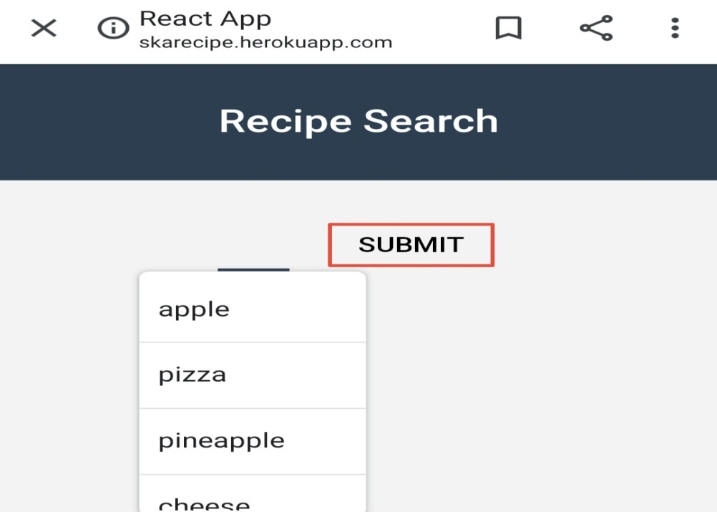
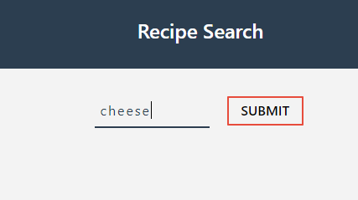
Search
The menu page shown below is the first page that appears when searched for web application which gives user to type the food item for which recipe is to be searched.

Slide 17
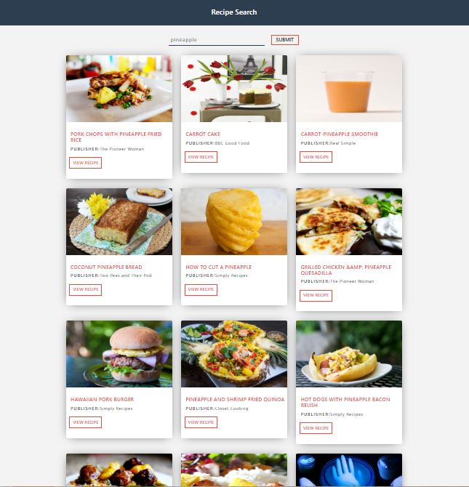
Result of a search
The page shown below shows the result for the particular item for which recipe is searched.

Slide 18
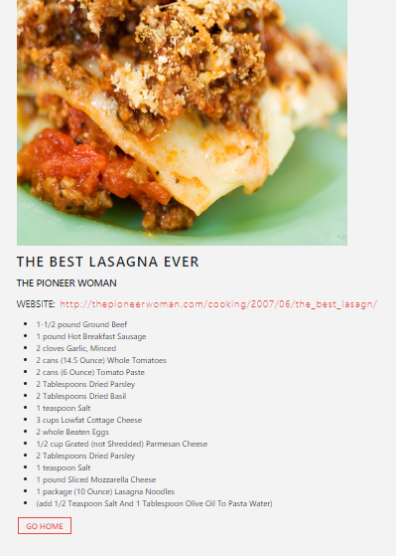
Particular recipe details
The ingredients used for the dish will be displayed when the view recipe button is clicked.

Slide 19
CONCLUSION AND FUTURE WORK
The web Application is helpful to the user where it gives the user list of recipes for the items searched.
The food listing web application can be further enhanced by adding the videos that describe the procedures.
It can also be connected with an online food ordering system and help the customers to view the details of the food item that they are going to order.
The provisions can be made which allows the users to enter their own recipes and also to write their comments and provide ratings to the recipes.
It can also be converted to a mobile application.

Slide 20
REFERENCES
[1] https://www.w3schools.com
[2] https://www.freecodecamp.org
[3] https://www.stackoverflow.com
[4] Fundamentals of web development by Randy cannolly, Ricardo Hoar.

Slide 21
PROJECT SETUP AND DEMONSTRATION
https://akash-recipe.herokuapp.com/

Slide 22
Suggestions….!

Slide 23
Thank You!!!

