Slide 1


Recipe Lists
RNS INSTITUTE OF TECHNOLOGY
BENGALURU - 98
DEPARTMENT OF INFORMATION SCIENCE & ENGINEERING
Presentation on
Internship project
Sri Raksha P
USN: 1RN16IS102
Under the guidance of
Dr. Prakasha S
Asst. Prof, Dept of ISE, RNSIT

Slide 2
ABSTRACT
The Food listing web application is built using reactjs, which is an open source JavaScript library used to build user interfaces.
It displays the list of food recipes on the web page , as requested by the user. For this it makes use of an API which will fetch all the data from a database.
The API used in this application is the food2fork API.
Components in React are useful piece of code that is used in building web apps.
Node js is an open source , cross platform runtime environment for developing server-side and networking applications.

Slide 3

Web development is a broad term for the work involved in developing a web site for the Internet or an intranet. Web development can range from developing the simplest static single page of plain text to the most complex web apps, electronic businesses, and social network services.
The Full Stack Web Development is aimed at the technologies that are used to build powerful, multi-user web applications. We have used React JS on the front-end and NodeJS + MongoDB on the backend. Also demonstrated how a rest api works, how APIs are used all over the web today to power multi-platform applications and build a few along the way.

Slide 4
INTRODUCTION
Food listing application displays the list of food recipes on the web page, as requested by the user. To display a list of recipes, we require an Application Program Interface (API) which will fetch all the data from a database which is hosted somewhere else. A programmer writing an application program can make a request to the Operating System using API (using graphical user interface or command interface). It is a set of routines, protocols and tools for building software and applications.
The API used in this application is the Food2Fork’s recipe API. Food2Fork offers an API which exposes its powerful recipe discovery functions for the application to use. The API gives access to their ever expanding recipe database, powerful ingredient search function, and social-media based ranking algorithm. Any request will return a maximum of 30 results.

Slide 5
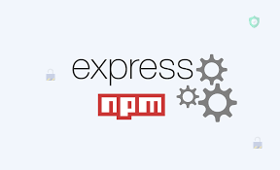



LITERATURE SURVEY
Express-Express is a minimal and flexible Node.js web application framework that provides a robust set of features for web and mobile applications. It is an open source framework developed and maintained by the Node.js foundation.
React-React was originally created by a software engineer at Facebook, and was later open-sourced. It is maintained by Facebook, as well as a community of development companies and individual developers.
Node js-Node.js was initially built for Google Chrome, and later open-sourced by Google in 2008. It is built on Chrome’s V8 JavaScript engine. It’s designed to build scalable network applications, and can execute JavaScript code outside of a browser.
Postman- Postman is a powerful tool for performing integration testing with your API.

Slide 6
LITERATURE SURVEY
International Journal for Research in Applied Science & Engineering Technology (IJRASET) ©IJRASET 2013
FOODIE: An Android Application Rahul Dandekar1 ,SanketGadkari 2 , Mayuri Sadudia3 , Sayali Kamble4 1,2,3,4
Under the Guidance of Prof. ShrikantSanas, Department of Information Technology PadmabhushanVasantdadaPatilPratishthan’s College of Engineering, Mumbai Colby K. M., 1975
Artificial Paranoia: A computer program for the study of natural language communication between man and machine, Communications of the ACM, vol. 9, pp. 36-45.

Slide 7
Requirements
Hardware requirements - 64-bit processor
Internet Connectivity 100 Mbps
8 GB memory
Software requirements - Download npm
Install React
Download and install node.js
Install React CLI
Install yarn
Install SASS
Operating System: Windows 10
VS Code editor

Slide 8
Detailed design - The project Architecture
Clone the repository into your PC, using cd Desktop/react-recipes
Inside the project directory, run the command- create-react-app
Once create-react-app has finished, install the dependencies with:yarn
Open the IDE and start the application.
Update index.js to point to the new path of App.js and remove old imports for files we just deleted.

Slide 9
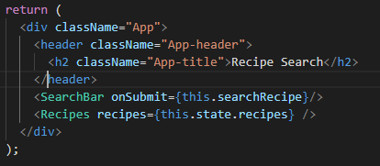
Implementation- Header
The below figure represents the code for the search bar used to type in the food item names.

Slide 10
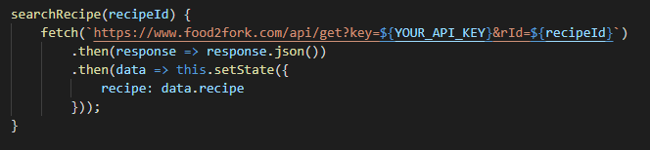
Implementation-searching
The API key and the recipe id are the parameters used to search the recipes of a particular food item.

Slide 11
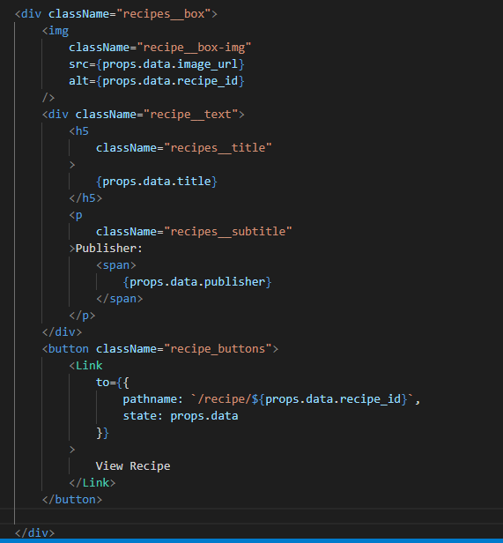
Implementation-Display
The selected recipes will be displayed on the web page. The details such as recipe title, publisher name are displayed in a box format.
A view recipe link is also included, which when clicked displays the complete detailed information about that particular item.

Slide 12
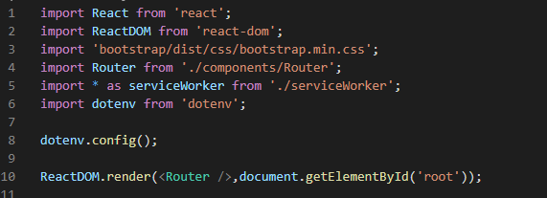
Implementation-Rendering
ReactDOM is like a library of functions that allows you to use Javascript and convert (or render) it to HTML. .render is like a class or object within ReactDOM to render.

Slide 13
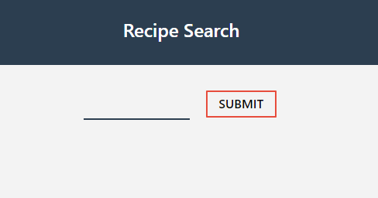
Discussion of results- Menu
The menu page shown below is the first page that appears when searched for web application which gives user to type the food item for which recipe is to be searched.

Slide 14
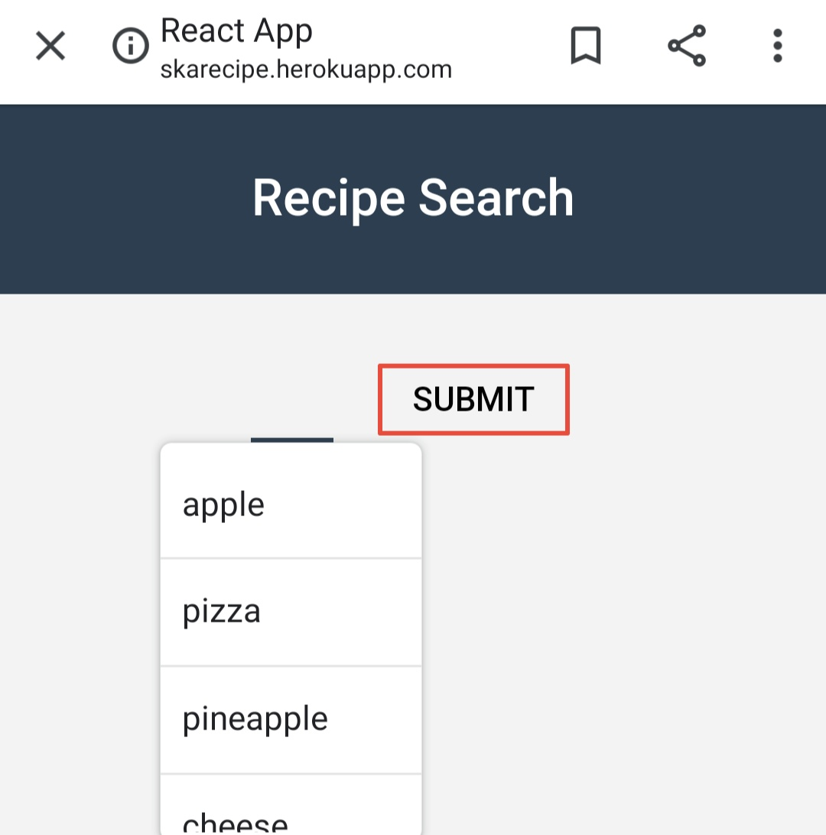
Suggestion for search
The suggestions page shown above are shown on menu page while doing a search for recipe for a particular ingredient.

Slide 15
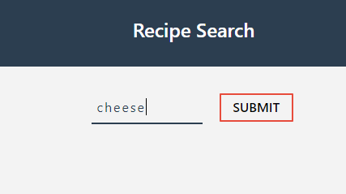
Search
The below figure shows a page where search for recipe is done.

Slide 16
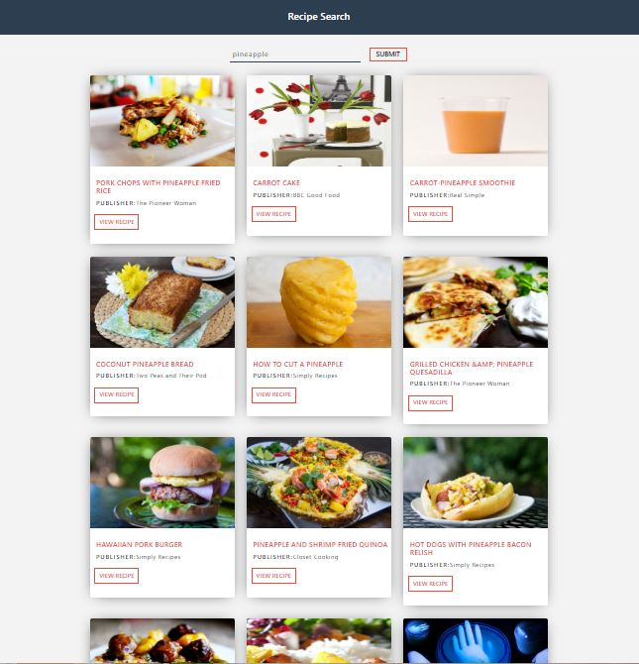
Result of a search
The page shown below shows the result for the particular item for which recipe is searched.

Slide 17
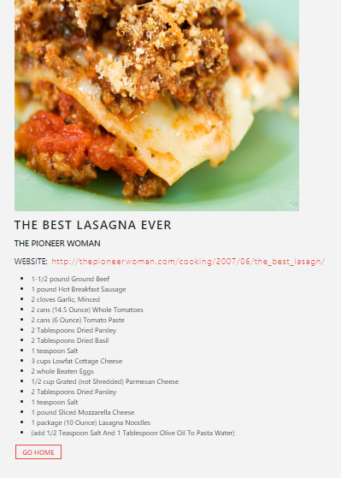
Particular recipe details
The complete ingredients used for the food item will be displayed when the view recipe button is clicked.
On clicking the link that is shown, the user will be redirected to the page where the procedure to prepare the ingredient.

Slide 18
Conclusion and Future Enhancements
The web Application is helpful to the user where it gives the user some of the delicious recipes for the items searched.
The food listing web application can be further enhanced by adding the videos that describe the procedures.
It can also be connected with an online food ordering system and help the customers to view the details of the food item that they are going to order.
The provisions can be made which allows the users to enter their own recipes and also to write their comments and provide ratings to the recipes.
It can also be converted to a mobile application.

Slide 19
REFERENCES
[1] https://www.freecodecamp.org
[2] https://www.w3schools.com
[3] https://www.stackoverflow.com
[4] Fundamentals of web development by Randy cannolly, Ricardo Hoar.

Slide 20


Slide 21


