Slide 1

Bayesian Real-time
Dynamic Programming
Scott Sanner NICTA & ANU
Robby Goetschalckx K.U. Leuven
Kurt Driessens K.U. Leuven
Guy Shani MSR → Ben Gurion Univ.
TexPoint fonts used in EMF.
Read the TexPoint manual before you delete this box.: AAAAAAAAAAAA

Slide 2
Outline
MDPs
  Dynamic Programming (DP)
  Real-time DP
Caveats of RTDP and variants
  Value of information to the rescue!
Results

Slide 3

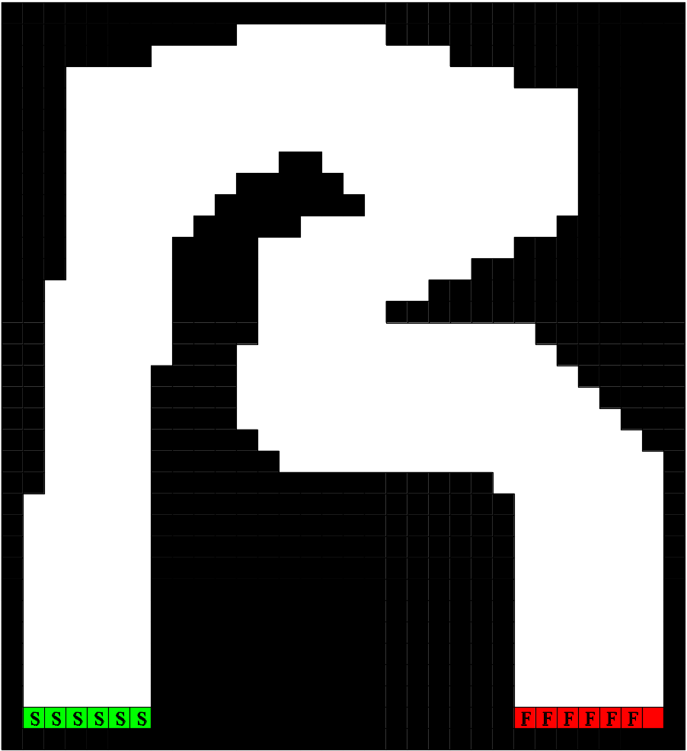
Running Example: Racetrack MDP
State:
  (x,y) position
  (x’,y’) velocity
Action:
  (x’’,y’’) acceleration
Objective:
  Least-cost path
  from start to finish

Slide 4
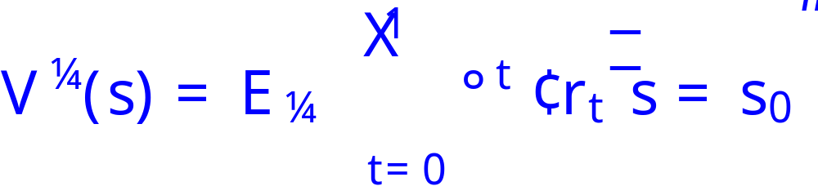
MDP Solution
Find a policy π=π* that maximizes:

Slide 5
MDP Solution
Find a policy π=π* that maximizes:
Solve via dynamic programming (DP)

Slide 6
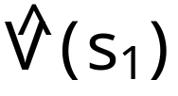

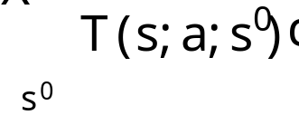
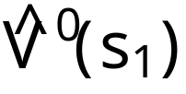
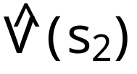


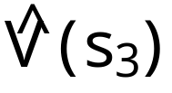
Single DP Backup
Current estimate
Graphical view:
s₁
a₁
s₂
s₁
s₃
a₂
Updated estimate
s₂

Slide 7
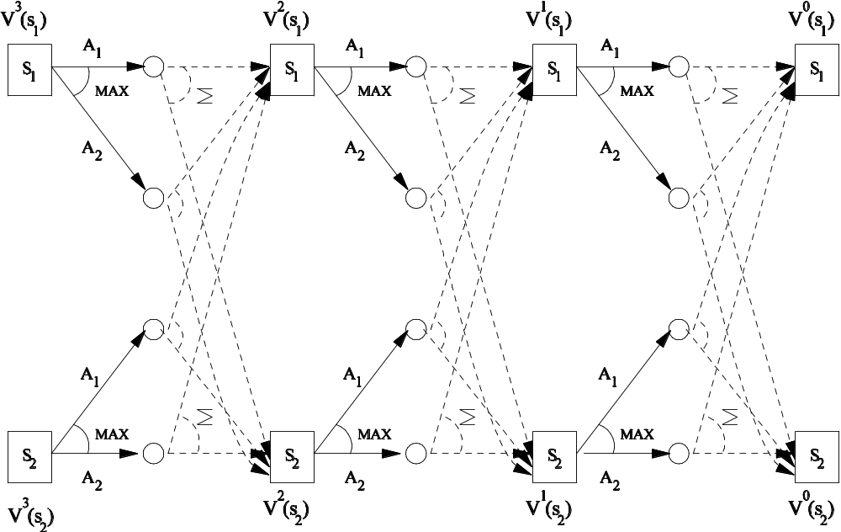
Synchronous DP Updates (VI)

Slide 8
Asynchronous DP Updates
Or… can update states in any order:
Still provably converges!
s₁
a₁
s₂
s₁
s₁
s₁
s₃
a₁
a₂
a₁
s₂
s₂
s₂
s₂
s₁
s₃
s₃
a₂
a₂
s₂
s₂
Question:
how to order updates to converge quickly?

Slide 9
Real-time Dynamic Programming
Reachability and drawbacks of synch. DP (VI)
  Better to think of relevance to optimal policy
RTDP focuses async. updates on relevant states!
S
F

Slide 10
Drawback of RTDP
Focus on states with highest value uncertainty
  i.e., highest bound gap
  RTDP may search where already converged
Unconverged
Converged
S
F

Slide 11
RTDP Improvements
  Labeled RTDP (Bonet & Geffner, 03)
    label states when convergence detected
    don’t update converged states in future!
  Bounded RTDP (McMahon, Likhachev, Gordon, 05)
    prioritize states with highest value uncertainty
    “soft LRTDP”
    “forward prioritized sweeping”
How to compute uncertainty?
Bellman error?

Slide 12
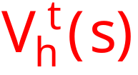
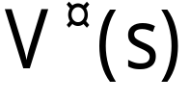
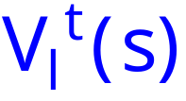
Value Uncertainty via Monotone Bounds
Initialize two value functions
Unlike “local Bellman error”, bound gap is upper bound on value error!
Do DP updates for and
  Provides strict value bounds at all stages!

Slide 13
Bounded RTDP
Focus DP on least converged states
  i.e., highest bound gap
  May search where value unlikely to change
Unconverged
Converged
S
F

Slide 14
Bayesian RTDP
Asychronous DP updates
where they count!

Slide 15
Focusing Async. DP Updates
Examine Q(s,a)
  Q(s,a) = p_{1a}V(s₁) + … + p_{ia}V(s_{i}) + … + p_{ka}V(s_{k}) + R
Plug in V_{l}(s_{i}) and V_{h}(s_{i})
  Get: [Q_{il}(s,a), Q_{ih}(s,a)]
Update state s_{i}?
  No. Why?
Q_{i}(s,a₁)
Q_{i}(s,a₂)
max
0

Slide 16
Harder Cases
Update state s_{i}?
  Maybe.
  Why?
Here?
  Probably.
  Why?
Q_{i}(s,a₁)
Q_{i}(s,a₂)
max
0
Q_{i}(s,a₁)
Q_{i}(s,a₂)
max
0

Slide 17
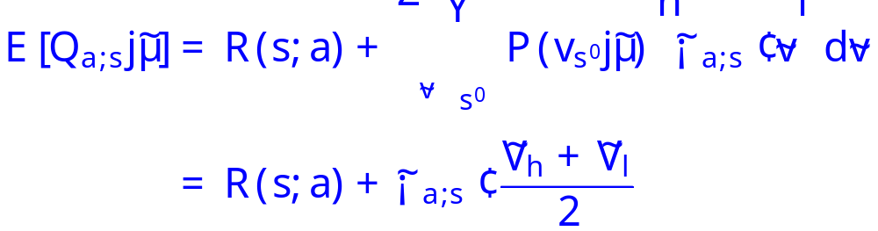
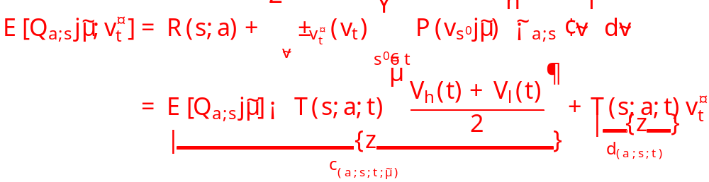
Bayesian Formalization I
Assume uniform belief distribution over bounds
Calculate expected Q-values w.r.t. beliefs

Slide 18
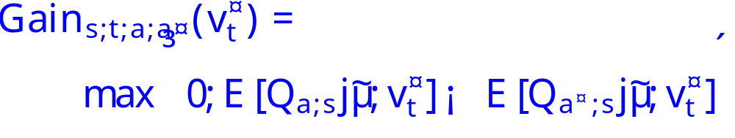
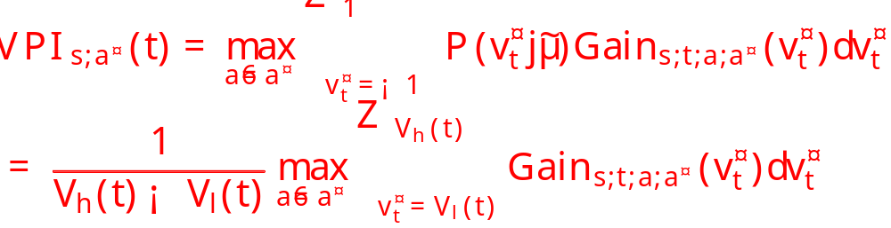
Bayesian Formalization II
What is gain of exactly knowing v_{t}*
EVPI = expected gain of exactly knowing v_{t}*

Slide 19
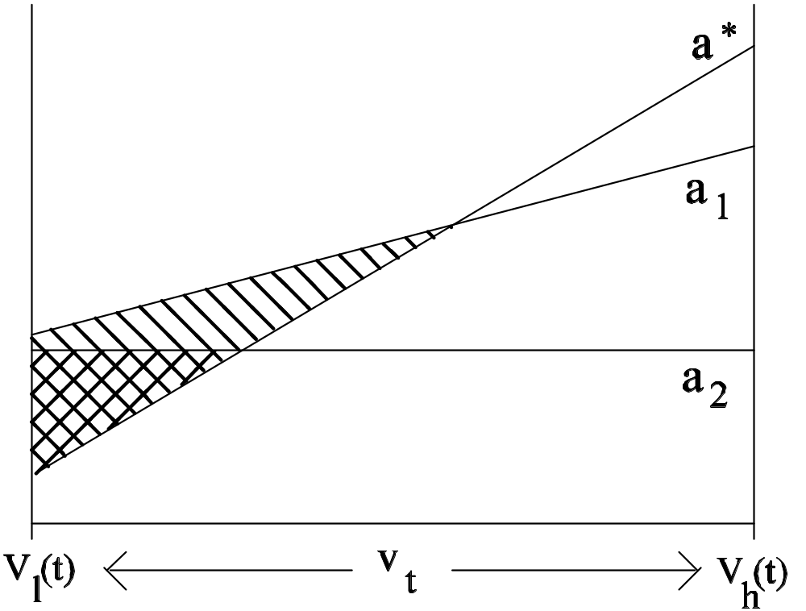
Expected VPI: Graphical View
What is potential gain of knowing v_{t} better?
Q_{t}(s,a)
max VPI
Notes:
Max of loss.

Slide 20
Key Observations
VPI not only important for directing search
Also important for early trial termination
  terminate with some prob. if VPI < threshold
And efficient to compute
  Complexity of Bellman backup to compute VPI for all successor states!

Slide 21
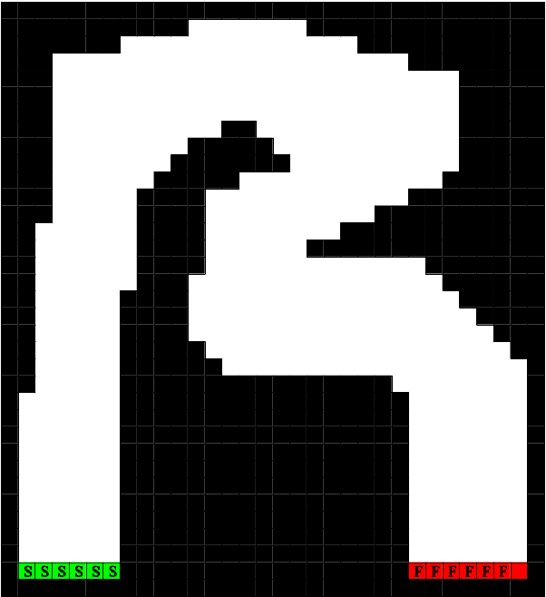
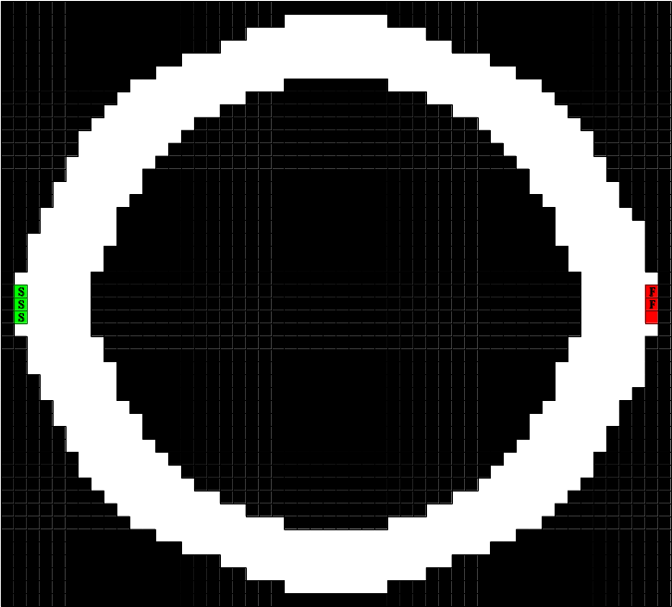

Empirical Evaluation
Used modified Racetrack domains from
(Barto, Bradtke, Singh, 1993; Smith, Simmons, 2006)

Slide 22
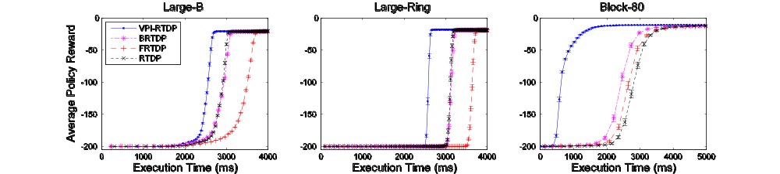
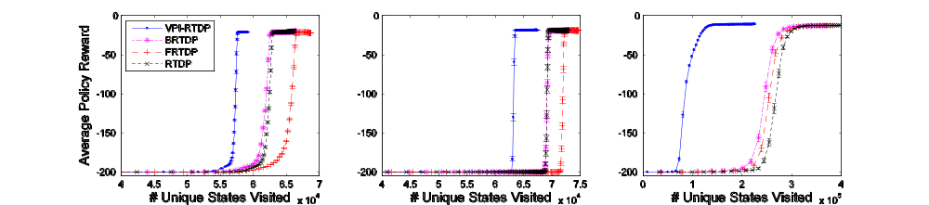
Racetrack Results
better anytime policy performance, fewer visited states

Slide 23
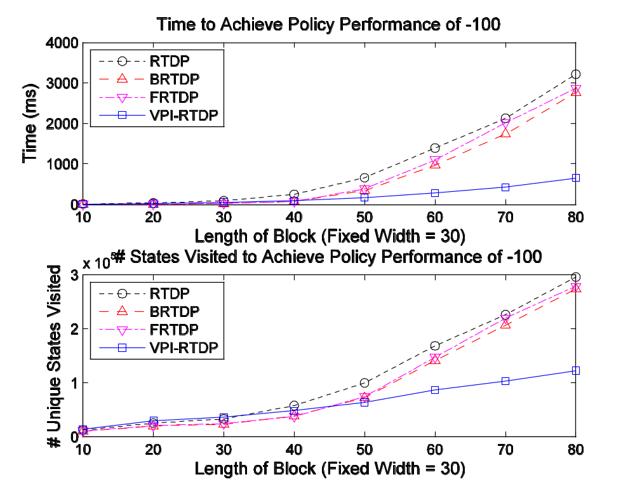
Scaling Performance
performance gap widens as problem size grows

Slide 24
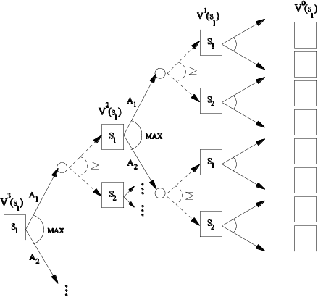
Bayesian RTDP
= more bang for your backup
Thank you!
Any questions?

Slide 25
Additional Slides

Slide 26



Use Empirical Value Distribution?
Sketch of empirical distribution
  Mixture of 3 normal distributions
Distribution is changing over time
  No single distribution seems to improve performance
  (I’ve spent a long time trying)

Slide 27

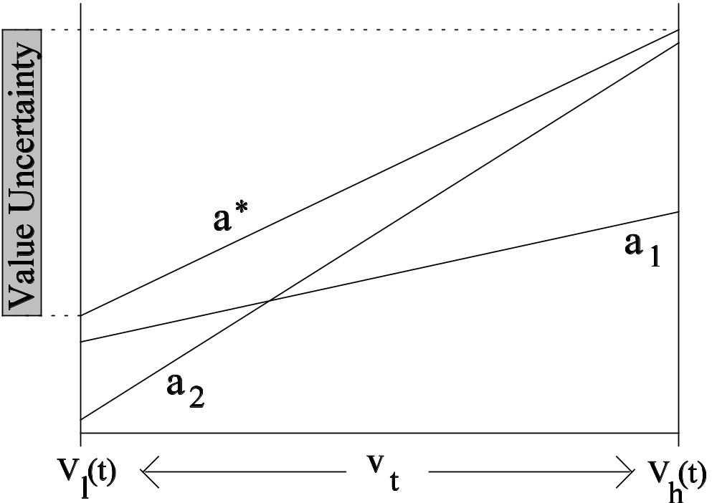
Drawback of Bound Gap Heuristic
Bound gap: commonly used to prioritize search
But value uncertainty may still be high
Q_{t}(s,a)
Potentially high bound gap, but no change in π
Really want value
of information
No point in reducing v_{t} uncertainty, from the perspective of s… it won’t change the policy!
Notes:
Hybrid Bellman error + VPI?
Non-myopic VPI?

Slide 28
Aside
MDPs don’t work
  Don’t confuse model with the solution!
What researchers mean to imply is that…
  “Heuristic search methods often outperform value or policy iteration in specific domains (e.g. PPDDL)”
Async. DP offer best of both worlds (RTDP, LAO*)
  Convergence / optimality in limit!
  Can apply search heuristics
many irrelevant states in these problems

