Slide 1
The ☺ Joy ☺ of
Description Logics
Scott Sanner (ssanner@cs.toronto.edu)
Notes:
Should probably think about adding JTP/DAML reasoning

Slide 2
Talk Outline
Motivations and history
Importance of subsumption and taxonomy
Semantics for conceptual logics
Algorithms for subsumption
Example applications to IR/NLP and Semantic Web
Frontiers for research

Slide 3
Motivations and History
In the beginning (60’s & early 70’s): knowledge representation (KR) focused primarily on semantic networks, e.g.
As pointed out by Woods (1975), what does this semantic net denote?
  If it’s a telephone, it’s black?
  A concept consisting of all black telephones?
  An instance of a black telephone?
Telephone
Black
color

Slide 4
Motivations and History
So all was not well in KR, semantic nets seemed to lack formal semantics, until…
  “What’s in a Link” (Woods, 1975): Provides a logical foundation for semantic networks
  Structured Inheritance Networks (Brachman, 1977): Provides further foundations for structured concepts, subsumption, and automatic taxonomic classification
  Initial KL-ONE Proposal (Woods & Brachman, 1977): Provides first conceptual language based on these ideas

Slide 5
Motivations and History
Ideas from “What’s in a Link”:
  Identifies difference between concept and instance level (i.e. instances are the extension of concepts)
  Points out the need for quantificational import (∀,∃) in concept-level links (i.e. role restrictions)
Concept
Level:
∀x. Dog(x) ⇒ ∃y. lives-in(x,y)^Place(y)
Dog
Place
∃ lives-in
instance-of
instance-of
Instance
Level:
Fido
Toronto
lives-in
Dog(Fido), Place(Toronto), lives-in(Fido, Toronto)

Slide 6
Motivations and History
More ideas from “What’s in a Link”:
  Points out distinctions between assertional (⇒) and structural links (⇔)
Assertional:
Structural:
∀x. Dog(x) ⇒
∃y. lives-in(x,y)^Place(y)
∀x. Dog-with-Spot(x) ⇔
Dog(x) ^ (∃y. has(x,y)^Spot(y) )
∃lives-in.Place
Dog
∃has.Spot
kind-of
conjunction-of
Dog
Dog-with-Spot

Slide 7
Motivations and History
Aside: We now have the foundations for a convenient
concept notation (actually description logic):
English | FOL | DL
Dog with a Spot (DWS) | DWS(x) ⇔ Dog(x) ^ (∃y.has(x,y) ^ Spot(y)) | DWS ⇔ Dog ⎡⎤ ∃has.Spot
Large Dog with a Dark Spot (LDWDS) | LDWDS(x) ⇔ (Dog(x) ^ Large(x)) ^ (∃y.has(x,y) ^ (Spot(y) ^ Dark(y)) | LDWDS ⇔ Dog ⎡⎤ Large ⎡⎤ ∃has.(Spot ⎡⎤ Dark)
*Note that since variables are not explicit in the DL notation, all
relational restrictions are necessarily independent

Slide 8
Motivations and History
Ideas from “Structured Inheritance Networks” and KL-ONE Proposal:
  Proposes idea that structured concepts may subsume each other based on definitional constituents
  Furthermore, this subsumption relation can be used to organize concepts into a taxonomy (i.e. partial order)
TOP
Dark
Spot
Large
Dog
Black
Dog ⎡⎤ Large ⎡⎤ ∃has.Spot
Dog ⎡⎤ ∃has.(Spot ⎡⎤ Dark)
Dog ⎡⎤ Large ⎡⎤ ∃has.(Spot ⎡⎤ Black)

Slide 9
Motivations and History
Subsumption and the related issue of taxonomic classification are perhaps two of the most beautiful and original ideas in knowledge representation
  Semantics for such relationships is criterial and can be inferred from definition
  Provides a mechanism for automatically generating specificity/generality hierarchies
  Because real-world information often represented at differing levels of specificity/generality, leads to many uses in IR, NLP, Information Integration

Slide 10
Motivations and History
Problem:
  Subsumption and taxonomy are important concepts
  But no formally defined semantics for conceptual logics or algorithms for subsumption computation so far
History:
  Semantics critical to the definition of algorithms for subsumption
  Seminal work by Levesque and Brachman (1985) showed that slight alterations in language expressiveness led to extreme changes in computational tractability
Answer:
  There is no single answer for semantics and subsumption algorithm
  Virtually all subsequent work has focused on semantics and computational tractability
  This has led to two major veins of research…

Slide 11
Motivations and History
Two main approaches to conceptual logic semantics and subsumption:
  Extensional Approach:
    Direct subset of FOL model-theoretic semantics
    A subsumes B iff there is no model of B ⎡⎤ ¬A
    Basis for most recent description logic research
  Intensional (Structural) Approach:
    Assumes an intensional definition of concepts
    For conjunctively defined concepts:
    A subsumes B iff every conjunctive constituent of A subsumes some conjunctive constituent of B
    Can provide intensional definitions for disjunction, negation, and restriction subsumption as well…

Slide 12
Summary: A Brief History of Time
Late 90’s, Present: Horrocks & Others:
Description Logics, FACT
Lots of theoretical results and expressive (but complex) sat-based EXP-TIME subsumption algorithms.
1985: Levesque & Brachman: Semantics & Tractability
Formal Model Theoretic Semantics, Tradeoff b/w expressiveness / tractability
Early 1990’s: Europe: Need expressiveness and
extensional completeness
Thus, have to use EXP-TIME tableaux algorithms
Big Bang
Extensional Approach
?
Intensional
Approach
70’s, Early 1980’s:
Logical foundations & KL-One
Ambiguous semantics, undecidable, but fundamental ideas that gave birth to a field
1989: AT&T
Research: Classic
Most expressive, extensionally complete polynomial subsumption language (using structural algorithm)
Early 1990’s: Woods:
Need intensional semantics and efficient taxonomy algorithms
Use structural subsumption (sound w.r.t. extensional semantics) and provide scalable, polynomial tax classification algorithms
Late 90’s, Present:
Sun Research:
Conceptual Indexing
Extremely efficient structural algorithms for building large taxonomies, applied to NLP-based web search

Slide 13
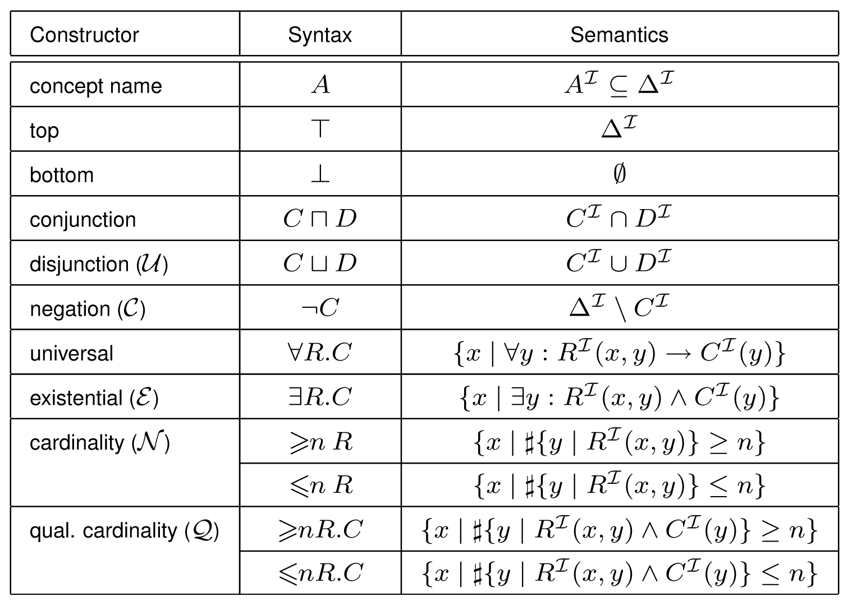
Semantics and Subsumption
Note: Under an interpretation I, concepts
are just sets of satisfying instances!
Extensional Semantics:
Source: http://www.cs.man.ac.uk/~franconi/dl/course/slides/prop-DL/propositional-dl.pdf

Slide 14
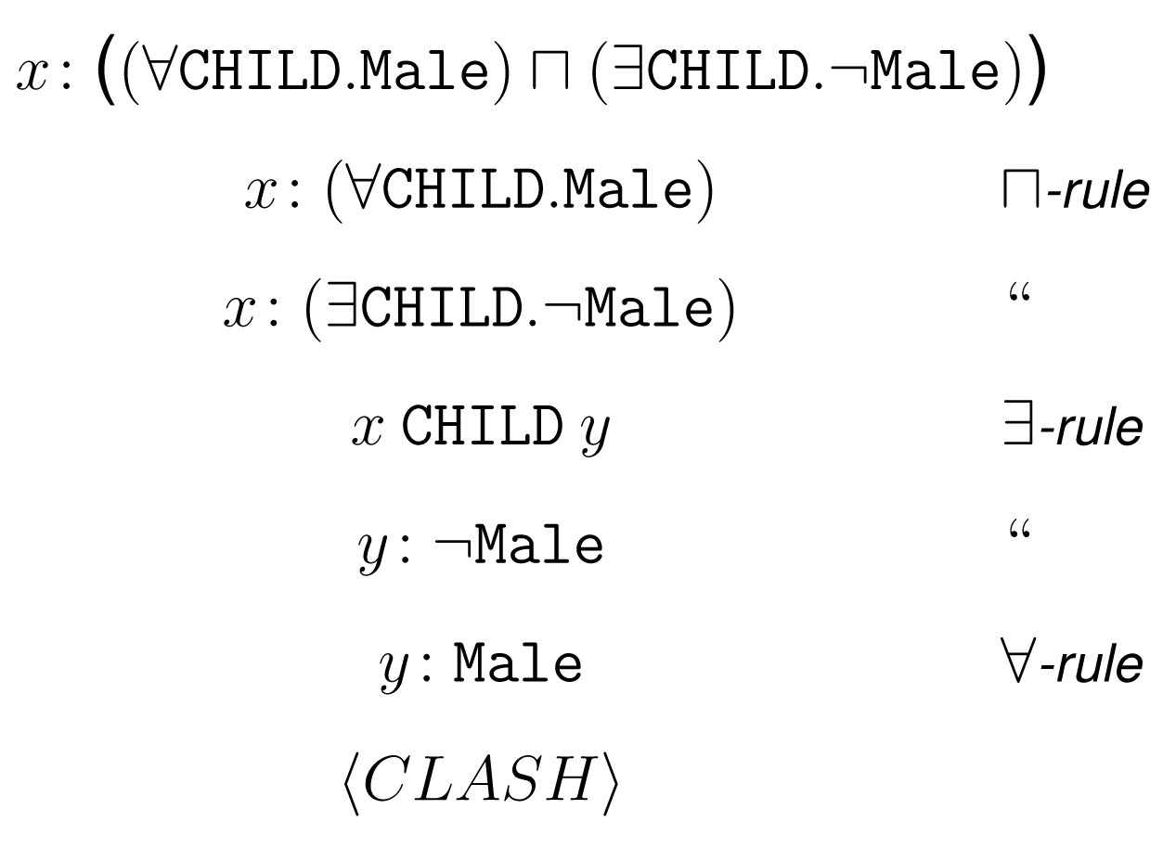
Semantics and Subsumption
Sample tableaux for extensional subsumption
(i.e. unsatisifiability check):
  Does ¬∃CHILD.¬Male subsume ∀CHILD.Male?
  I.e., Does ∀CHILD.Male ⎡⎤ ∃CHILD.¬Male have no model?
Tableaux
Proof:
Source: http://www.cs.man.ac.uk/~franconi/dl/course/slides/prop-DL/propositional-dl.pdf

Slide 15
Semantics and Subsumption
Intensional Approach:
  Avoid model theoretic semantics, reason directly using recursive application of subsumption rule to normalized concept structure:
    Conjunctive Subsumption: A subsumes B iff every conjunctive constituent of A subsumes some conjunctive constituent of B
    Existential Restriction Subsumption: ∃R.C subsumes ∃R’.C’ iff R subsumes R’ and C subsumes C’
    Definitions for other restrictions (Woods, 1991),
    disjunction (Sanner, 2003); various ways to handle complement
  Note the recursive use of the term subsumes
    Base cases: axiomatic and definitional (e.g. conj.) subsumptions
    Recursive cases: structural subsumptions

Slide 16
Semantics and Subsumption
Sample application of intensional (structural) subsumption algorithm:
  General rule covers single subsumption test but can be incorporated into an efficient algorithm for taxonomic classification (Woods, 1991)
TOP
Link Key:
Asserted links:
a – axiom
c – conj. def
o – restriction
object
Inferred links:
s – structural
subsumption
a
a
a
a
Spot
Dark
Large
Dog
o
c
c
c
c
∃has.Spot
Dark ⎡⎤ Spot
c
Dog ⎡⎤ ∃has.Spot
s
o
c
∃has.(Dark ⎡⎤ Spot)
s
c
Dog ⎡⎤ Large ⎡⎤ ∃has.(Dark ⎡⎤ Spot)

Slide 17
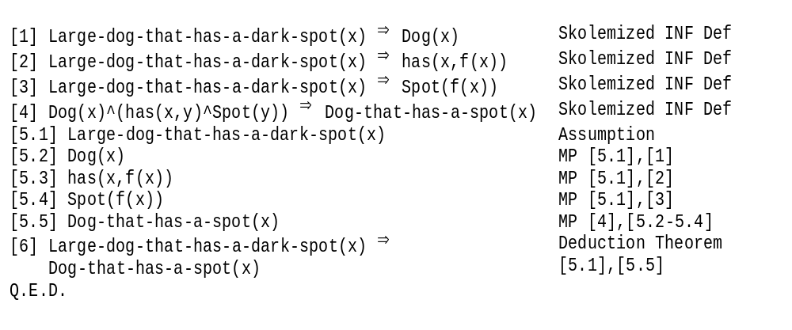
Semantics and Subsumption
Intuition: Structural subsumption akin to a constrained second-order search for first-order logic proofs:
  Previous structural inference can be recast as
  FOL proof:

Slide 18
Semantics and Subsumption
How do extensional and intensional
(i.e. structural) approaches/algorithms compare?
Intensional
(Structural)
Extensional
Sound but incomplete for very expressive languages, however incompleteness often benign
Efficient (poly-time) taxonomy building
Expressiveness no longer
an issue with recent research
Captures important
subsumptions
Ex: Nova (Sun)
JTP (KSL)
Can be extensionally sound & complete using structural algorithm
⇒ Polynomial inference, but limited expressiveness
Ex: Classic
(AT&T)
Complete inference for expressive languages
Intractable
(EXP-TIME) subsumption & taxonomy
building
Ex: FaCT
(Horrocks)

Slide 19
Applications to IR and NLP
Nova Conceptual Search Engine (Sun Microsystems Research Labs)
  Converts phrases parsed from natural language documents into conceptual logic descriptions
  Organizes these descriptions in a taxonomy using highly optimized structural classification algorithms
  Answers queries by returning all concepts equivalent to or more specific than query, e.g.
    Given query: ‘wash an automobile’, will return a document containing the phrase: ‘washing a car with a hose’
    Given query: ‘run a farm’, will return a document containing the phrase: ‘operating a large dairy’

Slide 20
Applications to IR and NLP
Example Nova taxonomy generated from Sun catalog:
(ADD MEMORY)
|-k- (ADDITIONAL MEMORY)
| |-k- (ADDITIONAL A MEMORY)
| |-k- (ADDITIONAL G MEMORY)
| |-k- (ADDITIONAL K MEMORY)
| |-k- (ADDITIONAL STORAGE)
| | |-k- (ADDITIONAL DISK)
| | |-k- (ADDITIONAL DISKS)
| | | |-k- (TWO ADDITIONAL HARD DISKS)
| | |
| | |-k- (ADDITIONAL MULTI-DISK)
| | |-k- (ADDITIONAL 4.2-GB MULTI-DISK)
| | |
| | |-k- (ADDITIONAL SMCC MULTI-DISK)
| |
| |-k- (PURCHASE ADDITIONAL MEMORY)
|
|-k- (ECONOMICALLY ADDING LOCAL STORAGE)
|-k- (SOLDERED-IN MEMORY)
Source: http://research.sun.com/knowledge/examples.html

Slide 21
Applications to IR and NLP
For More Information…
  Core algorithms are proprietary but publicly available research information can be found at:
    Nova Project Home Page:
      http://research.sun.com/knowledge/index.html
    Sub Labs Tech Report:
      William A. Woods (1997). “Conceptual Indexing: A Better Way to Organize Knowledge.” SMLI-TR-97-61.

Slide 22
Applications to the Semantic Web
JTP DAML+OIL Reasoner (Knowledge Systems Lab, Stanford University)
  Taxonomic reasoning extremely useful for determining relationships between concepts in distributed kb’s
  Problem: Have a general purpose theorem prover in the form of JTP (Java Theorem Prover)
    Capable of loading DAML+OIL knowledge bases from Semantic Web
    However, inference of a taxonomy by theorem proving is too inefficient
  Solution: Build in a special purpose reasoner for DAML+OIL taxonomic classification
    Use structural subsumption techniques augmented with rules for for expressive languages (e.g. since disjunction important)

Slide 23
Applications to the Semantic Web
Example taxonomy built by JTP special purpose reasoner for a DAML+OIL kb:
|- TOP
|- http://.../dogs.daml#::Thing
| |- TOP [*]
|- http://.../dogs.daml#::AnimalOrDarkFur
|- http://.../dogs.daml#::Animal
| |- http://.../dogs.daml#::AnimalOrDarkFur [*]
| |- http://.../dogs.daml#::DogOrBrownFurOrBlackFur
|- http://.../dogs.daml#::DogOrBrownFur
| |- ...
|- http://.../dogs.daml#::DogOrBrownFurOrBlackFur [*]
|- http://.../dogs.daml#::Dog
| |- [_GEN_ <_MOD_>]
|- [_EXISTS_ <http://.../dogs.daml#::mod,
| http://.../dogs.daml#::Big,1>]
| |- http://.../dogs.daml#::DogOrBrownFur [*]
|- http://.../dogs.daml#::BigDogOrBrownFur
http://.../dogs.daml#::BigDog
|- http://.../dogs.daml#::BigDogWithDarkFur
|- http://.../dogs.daml#::BigDogWithBrownFur
|- BOTTOM
Source: http://www.cs.toronto.edu/~ssanner/papers/ksl0301.pdf

Slide 24
Applications to the Semantic Web
For More Information…
  JTP and the DAML+OIL special purpose reasoner are freely available, see the following web page and extensive technical report:
    JTP Project Home Page:
      http://www.ksl.stanford.edu/software/JTP/
    KSL Tech Report:
      Scott P. Sanner (2003). “Towards Practical Taxonomic Classification for Description Logics on the Semantic Web.” KSL-03-01.

Slide 25
Frontiers of Description Logics
Extensional / Description Logics
  Can the average case for subsumption be competitive with structural approaches (depends on algorithms /distributions of concept constructors used)?
  Can taxonomic classification be performed more efficiently by reusing subsumption information?
Intensional / Structural Logics
  How to characterize incomplete subsumption?
  Are we sure these missed subsumptions don’t matter? (e.g. is inconsistency useful for some applications?)
  Further research in efficient subsumption, algorithms and data structures (disk-based) for scalable tax. construction

Slide 26
References
Ronald J. Brachman (1977). “A Structural Paradigm for Representing Knowledge”. Ph.D. Thesis, Harvard University. Note: Structured inheritance networks proposed here.
Hector J. Levesque and Ronald J. Brachman (1985). “A Fundamental Tradeoff in Knowledge Representation and Reasoning”. In R. J. Brachman and H. J. Levesque, editors, Readings in Knowledge Representation, pages 41-70. Morgan Kaufmann, Inc. 1985.
Scott P. Sanner (2003). “Towards Practical Taxonomic Classification for Description Logics on the Semantic Web”. Stanford University Knowledge Systems Lab Techical Report: KSL-03-01.
William A. Woods (1975). “What’s in a Link: Foundations for Semantic Networks”. In R. J. Brachman and H. J. Levesque, editors, Readings in Knowledge Representation, pages 41-70. Morgan Kaufmann, Inc. 1985.
William A. Woods and Ronald J. Brachman (1977). “Research in Natural Language Understanding, Quartly Technical Progress Report No. 1”. Bolt, Beranek, and Newman Techical Report: 3742. Cambridge, MA. Note: Initial KL-ONE proposal.
William A. Woods (1991). “Understanding Subsumption and Taxonomy: A framework for progress”. In John Sowa (editor) Principles of Semantic Networks: Explorations in the Representation of Knowledge. San Mateo, US.
William A. Woods (1997). “Conceptual Indexing: A Better Way to Organize Knowledge”. Sun Microsystems Research Labs Technical Report: SMLI-TR-97-61.

