Slide 1

catboost
The New generation of gradient boosting
Srđan šantić, PRINCIPAL DATA SCIENTIST, logikka

Slide 2

catboost

Slide 3
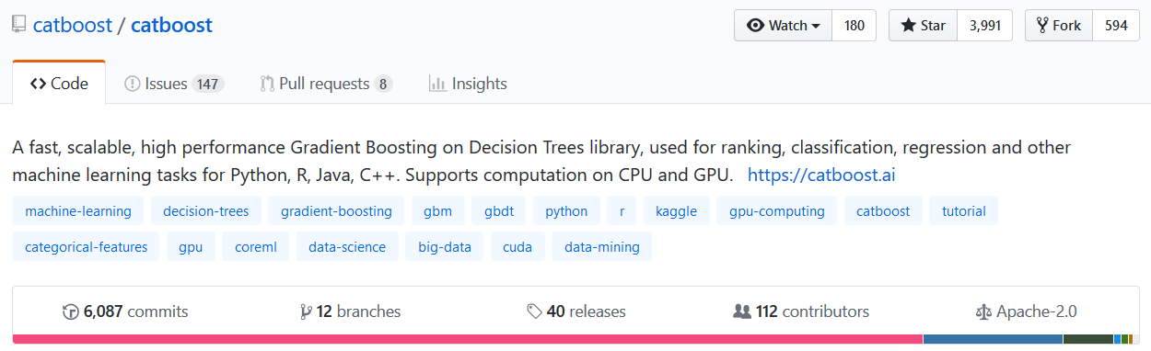
catboost

Slide 4
Gradient Boosting
Best solution for heterogenous data
Easy to use
Works well for small datasets as well
Applications:
Medicine
Industry
Finance
Recommendation Systems
Sales prediction

Slide 5
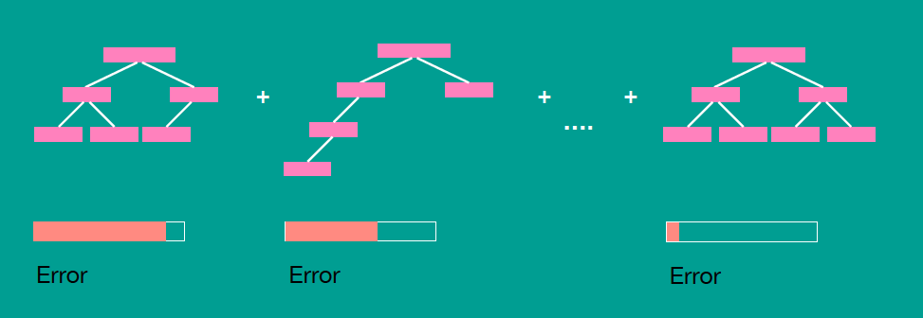
Gradient Boosting

Slide 6
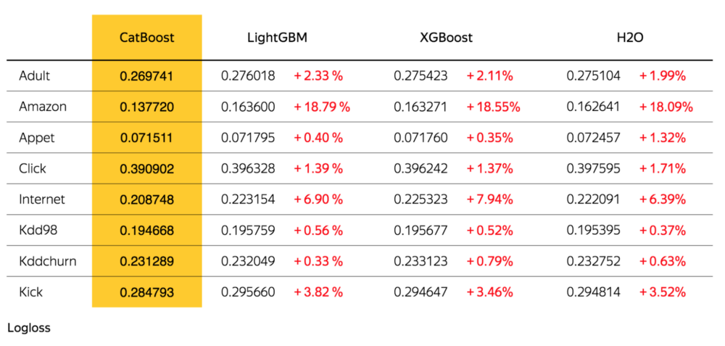
catboost: Algorithm Comparison

Slide 7
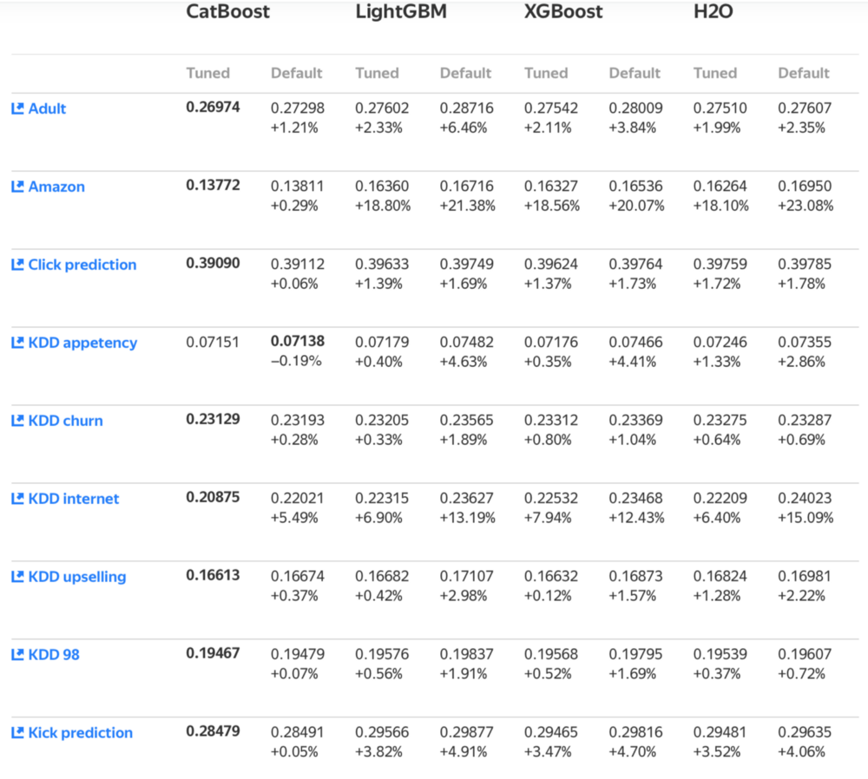
catboost: Algorithm Comparison

Slide 8
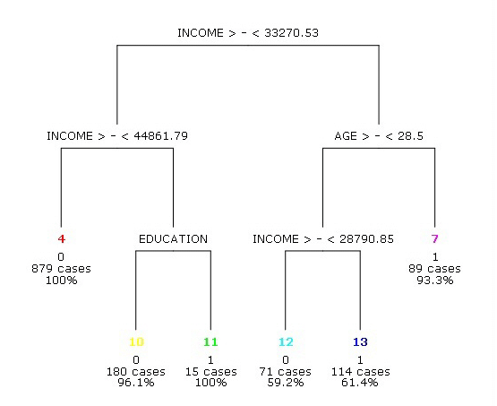
Numerical data is easy to work with

Slide 9

Categorical Features

Slide 10
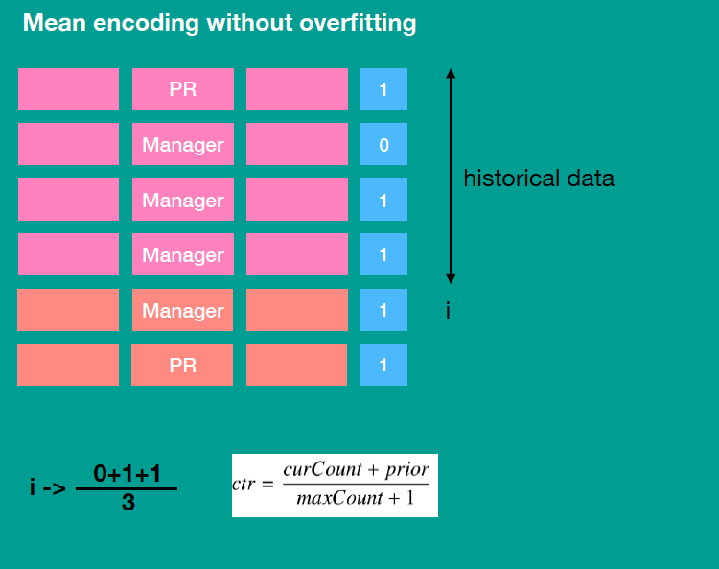
catboost: Categorical Features Support
Statistics based on category and category plus label value
Usage of several permutation
Greedy constructed feature combinations
One-hot encoding not needed

Slide 11
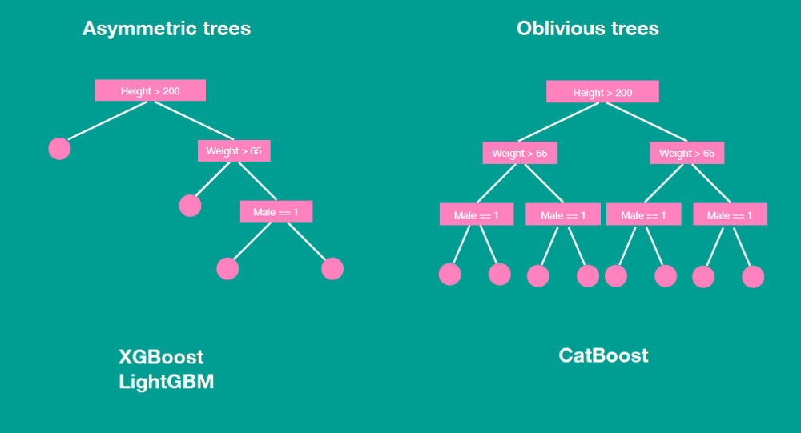
Classical vs. Ordered Boosting

Slide 12
CPU Training Time
Parameters:
128 bins, 64 leaves, 400 iterations
Higgs:
800 features, 4M samples
Epsilon
2000 features, 4000 Samples

Slide 13
CPU Training Time
Parameters:
128 bins, 64 leaves, 400 iterations
Higgs:
800 features, 4M samples
Epsilon
2000 features, 4000 Samples

Slide 14
Prediction time

Slide 15
Ways to explore your data
Feature importance
Feature interaction
Per Object Feature Importance (SHAP)
Influential Documents
New feature evaluation

Slide 16
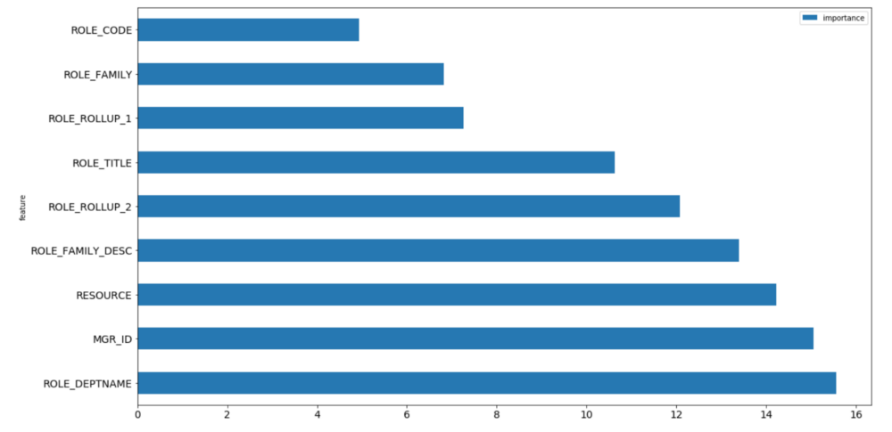
catboost: Feature Importance

Slide 17
Ways to explore your data
Feature importance
Feature interaction
Per Object Feature Importance (SHAP)
Influential Documents
New feature evaluation

Slide 18
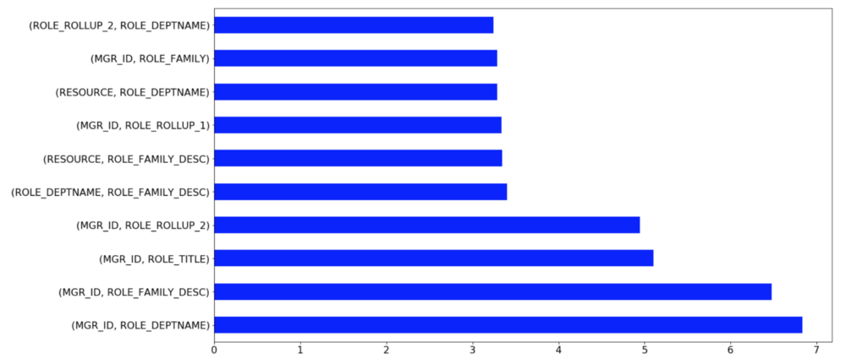
catboost: Feature Interaction

Slide 19
Ways to explore your data
Feature importance
Feature interaction
Per Object Feature Importance (SHAP)
Influential Documents
New feature evaluation

Slide 20
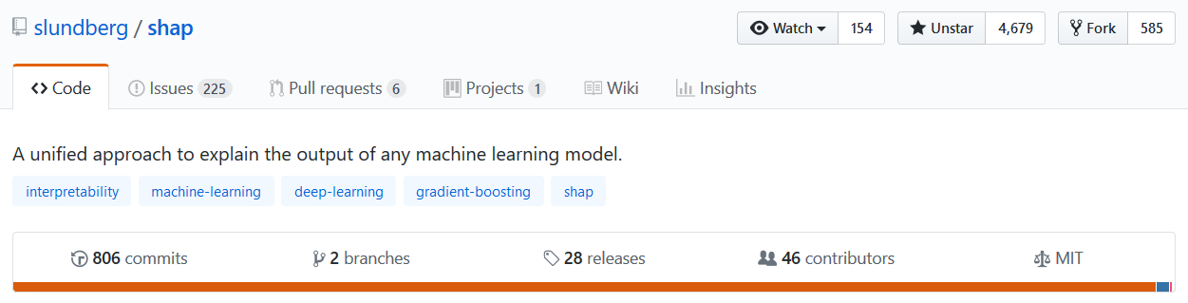
SHAP

Slide 21
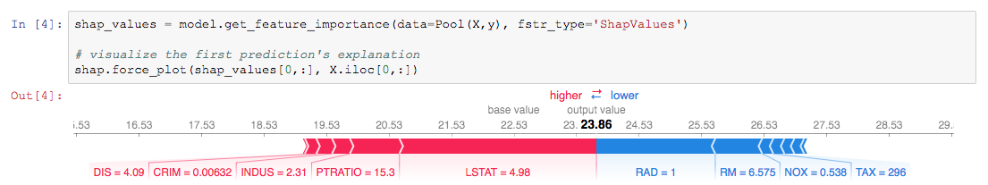
SHAP Values

Slide 22
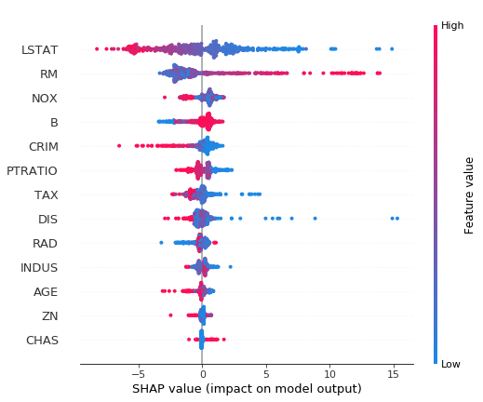
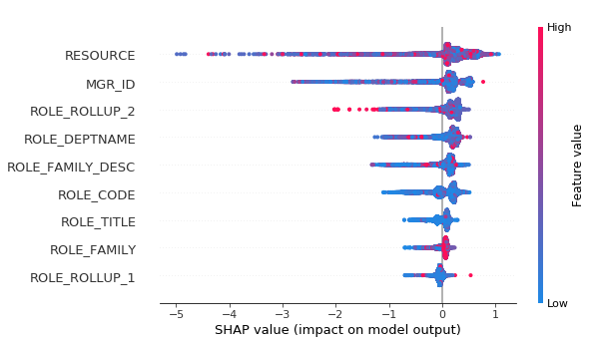
SHAP Values

Slide 23
Ways to explore your data
Feature importance
Feature interaction
Per Object Feature Importance (SHAP)
Influential Documents
New feature evaluation

Slide 24
Useful catboost features
Overfitting detector
Metric evaluation during training
Missing values support
Cross Validation
staged_predict + metric evaluation on dataset

Slide 25
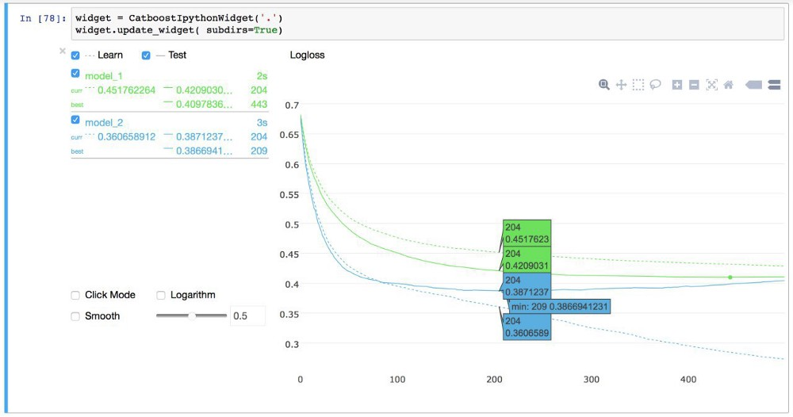
Catboost Viewer

Slide 26
Useful catboost features
Overfitting detector
Metric evaluation during training
Missing values support
Cross-Validation
staged_predict + metric evaluation on dataset

Slide 27
catboost: Algorithm Parameters
learning_rate + iterations
depth (default = 6)
L2_regularization
bagging_temperature
random_strength

Slide 28
Literature
http://learningsys.org/nips17/assets/papers/paper_11.pdf
https://arxiv.org/abs/1706.09516
https://arxiv.org/abs/1705.07874 (SHAP)

