Slide 1
Frogger
Team GSJ
Grace Cook, Sam Santomartino, John O’Brien

Slide 2
Background
Released in 1981
Developed by Japanese video game company, Konami and published by Sega
Originated in the form of arcade machines
After its release, developers began releasing versions on home computers\
https://www.youtube.com/watch?v=Dj3kXXIw02s
Notes:
https://www.youtube.com/watch?v=7FaVdO6aYYM
https://www.youtube.com/watch?v=a-FbktgqCqY

Slide 3
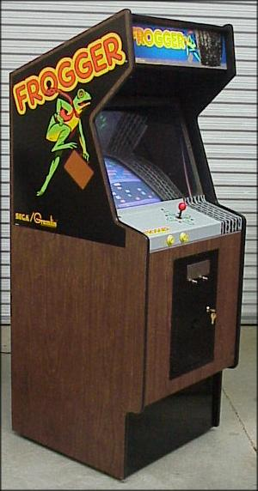
Problem & Motivation
Get the frog across the road and the river safely!
It’s a game → solving boredom (:
Get 5 frogs across on all of the lily pads
get 500 point bonus
Motivation → get highest score

Slide 4

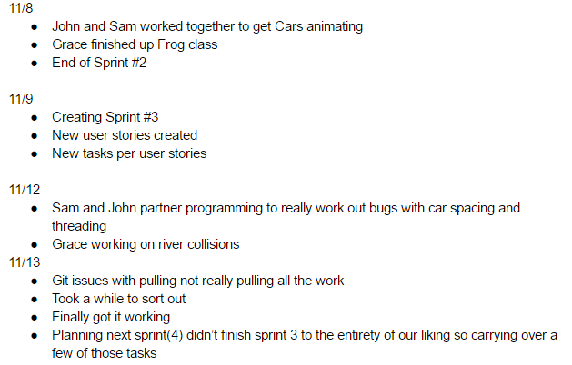
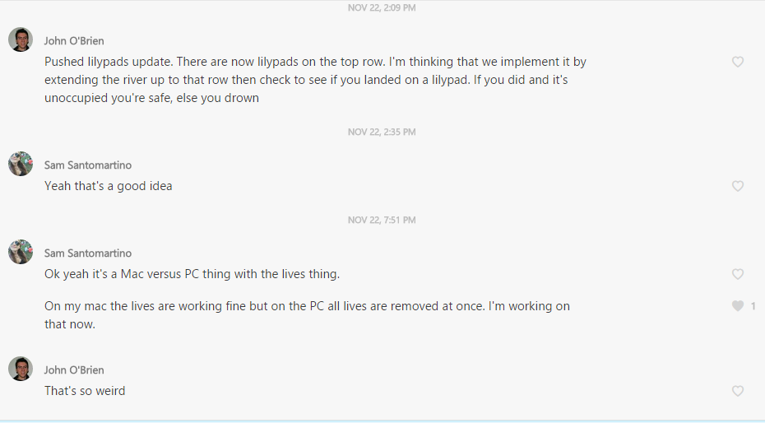
Scrum
Scrum Master → Sam
Product Owner → Grace
Team Member → John
Notes:
**pic of us at scrum meeting

Slide 5
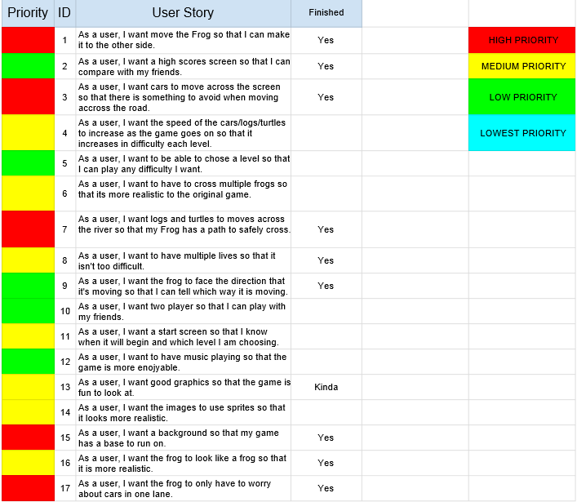
Step One: Product Backlog
Product Backlog (in progress)

Slide 6
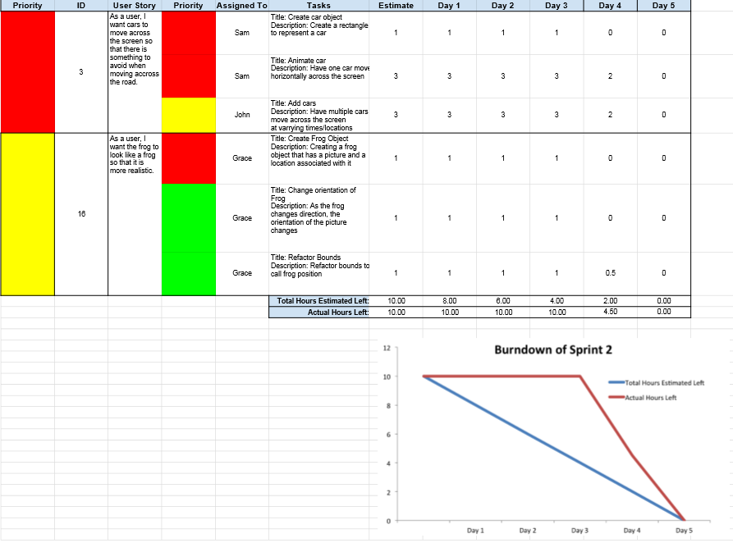
Sprint Backlogs
Sprint Backlog 2

Slide 7
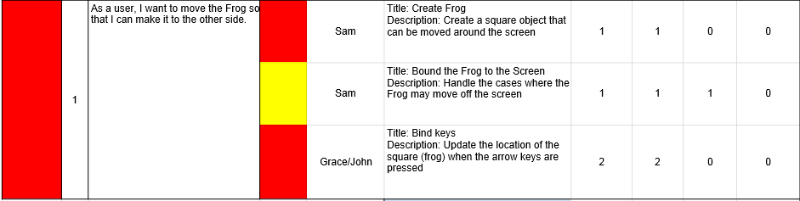
User Stories
As a user, I want to move the Frog so that I can make it to the other side
Part of Sprint Backlog 1
Notes:
All worked together, finished it before the end of the sprint

Slide 8
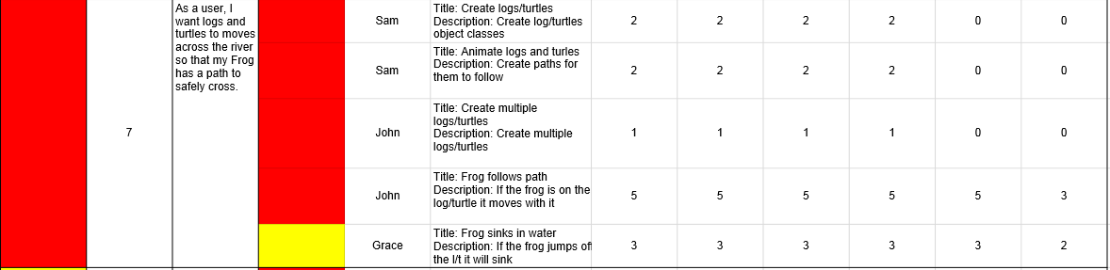
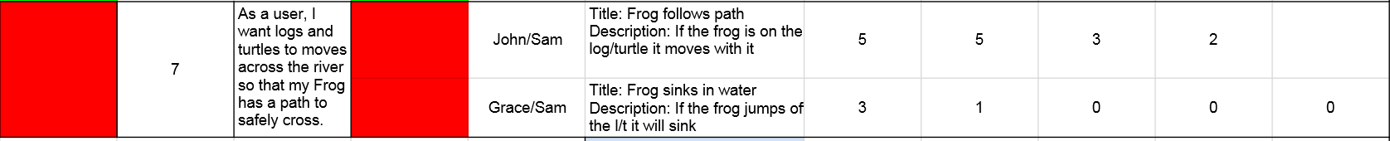
User Stories
As a user, I want logs and turtles to move across the river so that my Frog has a path to safely cross.
Part of Sprint Backlog 3
0
Part of Sprint Backlog 4
Notes:
Strengths: Each thinking of different ways to do things. One river → multiple rivers → each river created for and by the path
Threading → originally each river and road created a thread, then changed to only the one with the frog in it
-took more than one sprint
Weaknesses: started all working on each others tasks with the other person, but this helped
-good communication (as we showed with the group messages)
What would we do differently on our next agile project?
-use scrum software rather than excel

Slide 9
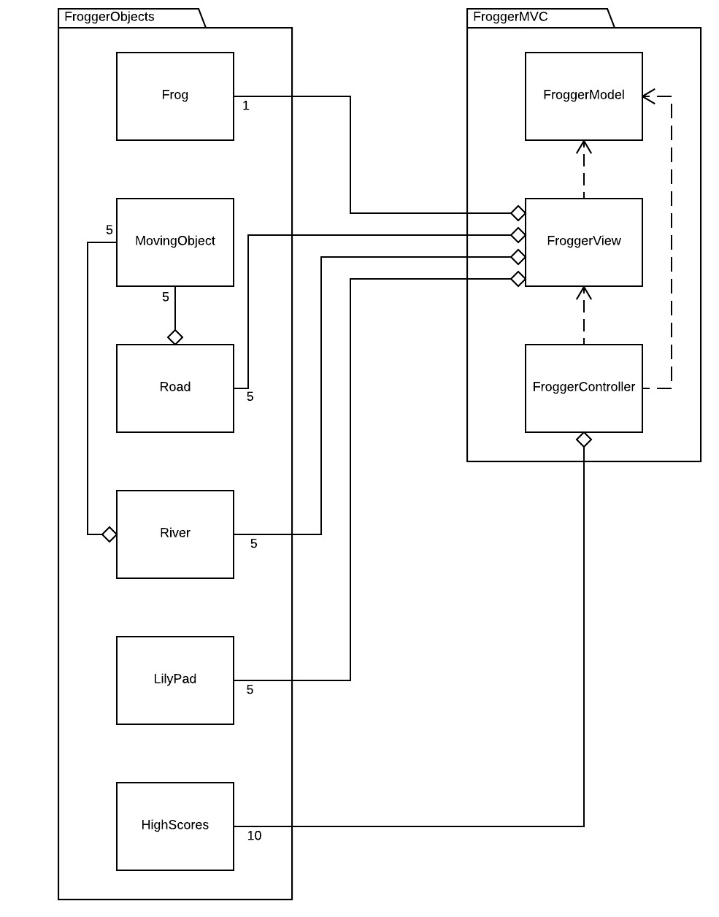
Object
Oriented
Design

Slide 10

GUI

Slide 11
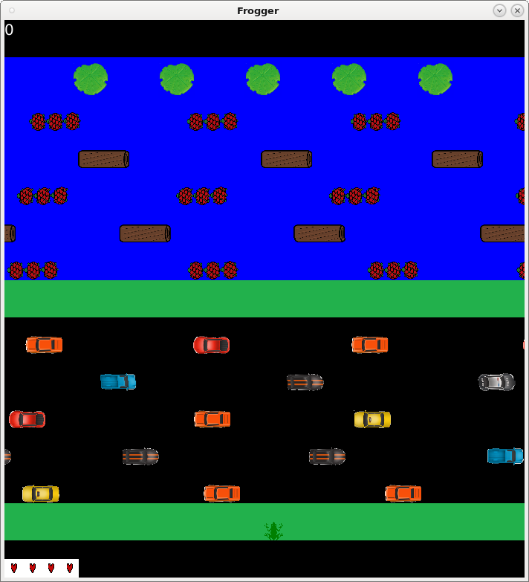
GUI
Score
Lily Pads
Logs and Turtles on the river
Safe Space
Cars
Frog
Lives

Slide 12
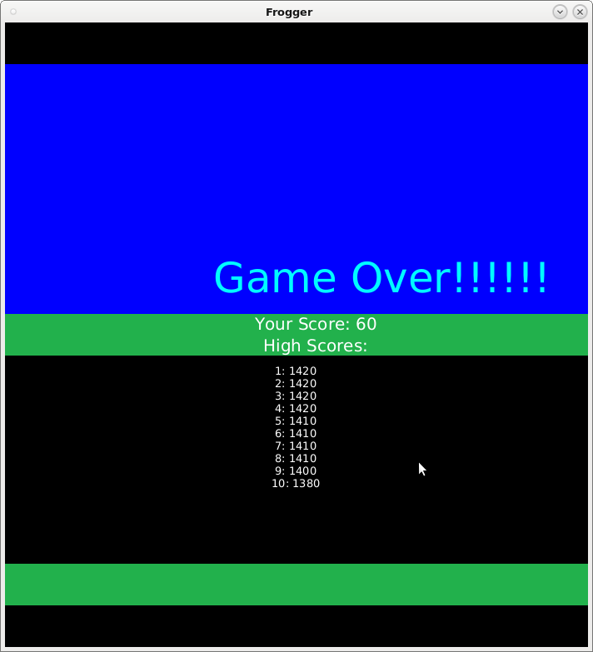
GUI

Slide 13
Demonstration

Slide 14

Conclusion
Challenges
Threading
Moving frog with logs and turtles
Version 2.0
Sprites
Sound effects
Multiplayer
Speeding up Cars/Logs/Turtles with level
Move all animations to threading
Lessons
Threading
How to use Git (effectively)
Scrum
Notes:
Think of challenges to talk about

Slide 15
Questions?

Slide 16
Presentation Sources
http://arcadeclassics.net/80s-game-videos/frogger/
http://www.twoop.com/games/frogger.html

