Slide 1
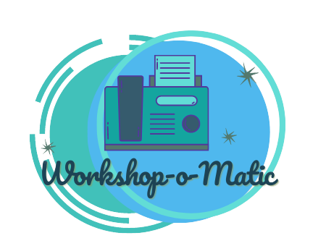
Introducing the workshop-o-matic
Scaling via workshops

Slide 2
What are we trying to accomplish?
Cloud Advocates on the Next Generation team produce large quantities of high-quality technical training content
We also are tasked with skilling large numbers of students

Slide 3
Together, we skill communities
Let's join forces!
Partner with us to learn the skills of Developer Advocacy

Slide 4
The concept:
Create a sustainable, repeatable system to shape content into workshops for delivery by MLSAs and others
Introducing the workshop-o-matic!

Slide 5
A trainer's journey
Delivering a workshop

Slide 6

Trainers:
1. Clone this repo: https://github.com/microsoft/workshop-library
2. Follow the steps in the cheat-sheet:
Planning phase – pick a workshop from the workshop library
Logistics phase – invite your participants, prepare for workshop delivery
Delivery phase – plan and deliver the workshop via MLSA tools
Feedback phase – give us feedback and stats about your experience and gather feedback for us from your workshop attendees
Images: Pablo Stanley

Slide 7
An author's journey
Creating a workshop

Slide 8

Authors:
1. Copy this template repo to your account: https://github.com/microsoft/workshop-template
2. Design your workshop using the workshop-designer document
3. Build the workshop as an addition to the workshop library
Add the solution files
Write the README.md file
PR your workshop folder with all files to https://github.com/microsoft/workshop-library and a Cloud Advocate will review and help shape the workshop for production. Thank you for contributing!
Images: Pablo Stanley

Slide 9

Calling all trainers!
Check out the first workshop: https://aka.ms/workshopomatic courtesy of Christopher Harrison!
Join the TTT session with Christopher and Jen next week!

