Slide 1
Avenue
Anupal Mishra(14BCE0575)
Sumit Sardana(14BCB0031)
Tarang Gujar(14BCE0219)
Aditya Srivastava(14BCE0022)

Slide 2
Problem Introduction
While giving presentations teachers often have to walk to and fro between the podium and projector’s screen in order to control the ppt.
The remote normally used to manually change slides is often expensive and can be easily lost.

Slide 3
Scope Statement
To provide a simple android application for users to remotely control presentations on the desktop.

Slide 4
Objectives
Simple and easy to use interface
Minimal time to set up
Cross platform support across desktops
Flexible and reliable
Low latency and low data loss

Slide 5
Process Model
We are planning to use Rapid Application Development(RAD) for development of the product.
We have limited time constraints as well as clearly defined problem parameters and requirements.

Slide 6
WBS With Milestones and Deliverables
Milestones and Deliverables-
Requirement and Planning(description of the problem,determining objectives)
UI design
UI implementation
Server-Client interface
Automation Libraries
Integration
Testing
Deployment

Slide 7
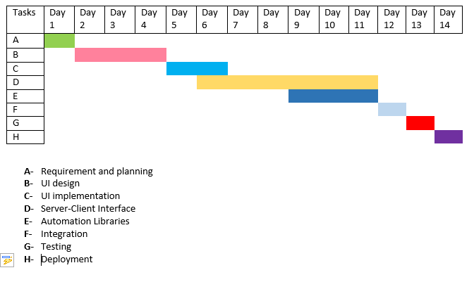
Schedule

Slide 8
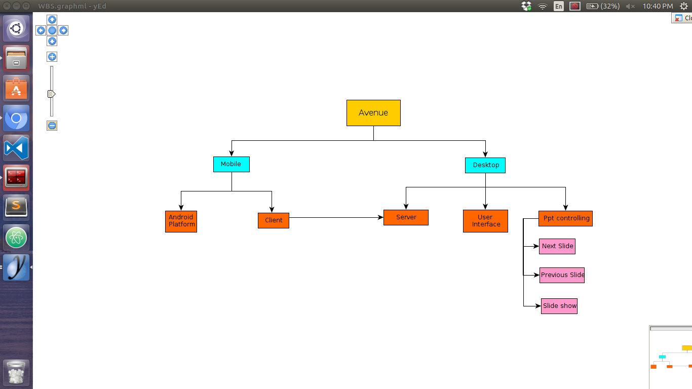
Work Breakdown Structure

Slide 9
Stake Holders
Faculty
Developer
Stake Holders
Faculty/Teachers
Developer

Slide 10
Requirements w.r.t Stake Holders
Developer(functional, non-functional)
Improve User Interface.
Provide connectivity for various types of devices
Improve upon User’s feedback
Add more powerpoint related functionalities
Fix bugs, error.

Slide 11
Requirements w.r.t Stake Holders
Faculties(f and non-f)
Real-time signal delivery from Mobile application to Desktop application.
Faculties are provided with important functionalities to control ppt.
Regular updates.
Give feedbacks upon usage for further improvement.

Slide 12
Viewpoint
Decision of Viewpoint with justification

Slide 13
Architecture
Illustration of Suitable architectural pattern with Justification

Slide 14
System Model
Suitable System Model (Traditional or OOD)

Slide 15
Implementation_Module

Slide 16
Test Cases
Unit Test cases for any one module

