Slide 1

Phishing and Spear Phishing
CSRA • 2016 Cyber Security and Privacy Awareness Training
Notes:
This presentation will briefly cover the topic of phishing and spear phishing - cyber security threats that are affecting CSRA contractors. It will define terms, give a personal incident of a recent spear phishing attack, explore effects, and explain mandatory protocol for CSRA contractors.
Note: The following details are referenced and summarized from Section 1 - Common Security Threats, of the 2016 Cyber Security and Privacy Awareness Training course.

Slide 2
Common Cyber Threats
Phishing – a cyber attack to obtain personal information through email or text message
Spoofed message
Contains links to web pages or attachments
Targets a group of people
Prompts personal information i.e. login, password, name, social security, or credit card number
Makes a threat, usually with adverse consequences, or gives a time restraint
Spear Phishing – a targeted cyber attack using personal information to make a phishing attack appear authentic and trigger a response from recipients
Email is sent to you
Message contains your name or personal information
Message appears to be authentic
Notes:
Terms
Phishing – a cyber attack to obtain personal information through email or text message.
Spear Phishing – a targeted cyber attack using personal information to make a phishing attack appear authentic and trigger a response from recipients.
Spoofing – refers to a fraudulent or malicious message sent from an unknown source; however, it appears as a legitimate and known source to the recipient. It is a tactic used in phishing because people are likely to open and respond to an email if it seems like a legitimate source.
General statistics on phishing
• Phishing is the number one delivery method for malicious software
• 91% of cyber attacks begin with a phishing email
• Phishing websites increased 250% by the first quarter of 2016

Slide 3
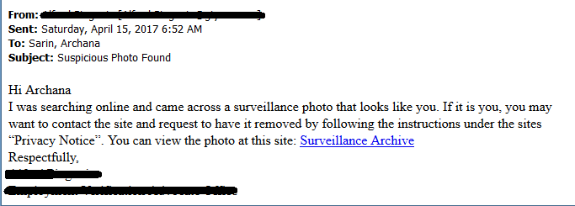
example of a Spear Phishing Email
Notes:
This is a personal example of an spear phishing email that I received on April 15, 2017.
How do I know this is a spear phishing email?
Includes my name
Has an invoking subject line
Suggests to be “following the instructions”
Includes a link to an unknown web page

Slide 4
Effects
Introduces malware, ransomware, viruses, and malicious software to your computer or personal device
Results in financial or personal data loss
Causes company or personal information to become stolen and/or leaked

Slide 5
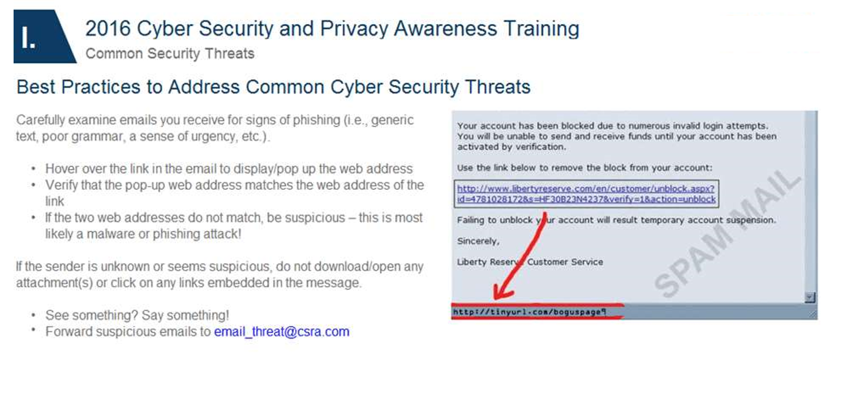

Slide 6
CSRA Protocol
Report suspicious email to the ITS SOC by immediately forwarding the suspicious e-mail to the SOC at email_threat@csra.com
Do NOT click on any attachment or link embedded in the message body

