Slide 1

Executive Presentation
Instructor: Shirley Vanison • Course: IFSM 201-6986 • Date: 03/21/2017

Slide 2


Agenda for Today's Meeting
Introduction/Overview
Hardware Devices
System Unit Components
Productivity Software
Internet Connectivity and Web Services
Summary of Recommendations
Notes:
The agenda for this presentation will start with the purpose and overview, followed by a description of the hardware devices, system unit components, productivity software, and a summary of recommendations of a specific computer. The following slides address the capabilities the Company’s Director has defined that the PCs will need to have, to ensure optimal performance.

Slide 3
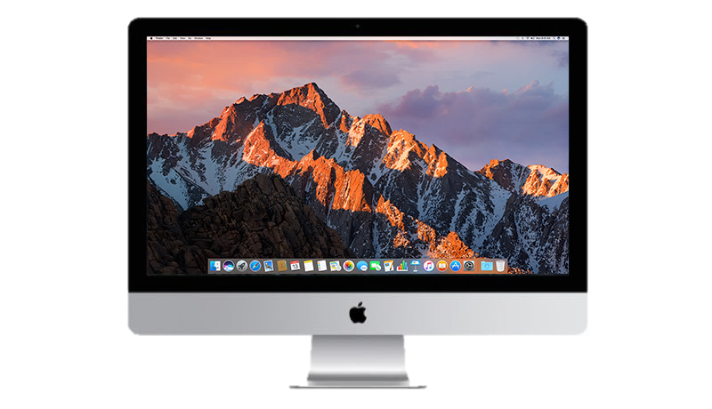
Purpose of Presentation and Overview
To company director and employees
Technical specifications
Apple iMac 27’ All-in-one Desktop Computer
Overview
Hardware. system unit components, and productivity software
Internet connectivity and web services
Summary of recommendations
Notes:
The purpose of this presentation is to provide the technical specifications of the Apple iMac All-in-one Desktop Computer (Retina 5k, 27-inch, Mid 2015). The presentation will cover the hardware components, system unit components, productivity software, and summary of recommendations. This following PC machine specifications are recommended to the Director of the [Company Name] for the assistance to its employees and overall business, with regards to the thirteen specifications e.g. printing documents to include photo quality color printing, creating small databases to manage all audio, video and photo data, and so on. The Apple iMac desktop computer has many features which will function exceptionally well in a business environment and it is a versatile and reliable product for the business.

Slide 4
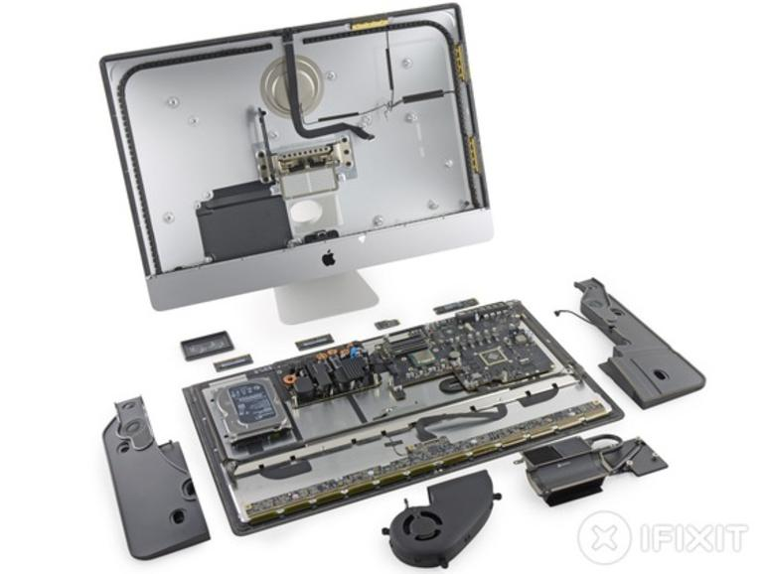
Hardware Devices
Input
Video conferences, web courses, and forums
Output
Print documents (photo quality color)
Communications and storage
Transfer and store data
Peripheral devices
Protect from dirty electrical power
Scan photos and videos
Notes:
Looking at the hardware technical specifications the iMac 27’ desktop computer either includes or is compatible with the following devices. It contains a HD Camera (Built-in FaceTime HD Camera. Supports full native resolution on the built-in display and up two 4096-by-2160 external displays or one 5120-by-2880 dual-cable external display. (Retina 5k model)) to participate in online video conferences, web courses and forums. It comes with a Apple Magic wireless keyboard (Bluetooth Interface. Localization and language: English. Full-size keyboard with 78 (U.S.) or 79 (ISO) keys, 12 function keys, 4 arrow keys), mouse (Laser Technology. Bluetooth Interface. Multi-touch feature) , and an Apple iMac audio input (Dual microphones). It has Apple iMac audio output stereo speakers (2 x right / left channel. 176.4 kHz and 192 kHz), and a LED-IPS Display Monitor. 27’’, widescreen, LED-backlit screen, with a Native Resolution of 5120 x 2880 (5K), for high quality resolution viewing. It is also compatible with the HP PageWide Pro 477dw Multifunction Printer, a professional-quality color printer, with 2400 by 2400 color resolution dpi. In addition, the computer functions with the Apple Thunderbolt 2 Cale which helps connect all required peripheral devices to the system unit and the MagSafe power adapter and G-Technology 500GB G-DRIVE slim SSD USB-C Portable Drive, for storage, which helps transfer information (audio, video and photos) between PC machines. The peripheral device CyberPower AVR UPS - CP685AVR. (PowerPanel® Personal Edition) protects the PC and all components from dirty electrical power including under voltage (brownout or blackout) and overvoltage (power surge or spike) and the Apple MD564ZM/A USB 2.0 SuperDrive. (External Optical Drive) supports CDs and DVDs and assists when scanning and editing photos and videos and manipulate/edit various image and video formats. These peripheral devices can be connected to the system unit.

Slide 5
System Unit Components and System Software
Processor and RAM
Quick multi-tasking, editing, and file manipulation
Graphics processor and video memory
High quality digital photos and videos storage
Adapter cards (SD, SDHC, SDXC)
Transfer and store data
Ports and storage devices
Storage capacity of 3TB (configurable) and 1TB hard drive
Apple – Mac OS X 10.12 Sierra
Utility Programs
Internet protection: Gatekeeper, FileVault 2, Privacy, iCloud Keychain
Notes:
This computer has a 3.2 GHz quad-core, Intel Core i5/i7 CPU (Turbo Boost up to 3.6 GHz) processor which will facilitate in processing database files with faster speeds. Additionally, it has a random access memory (RAM) of 8GB / 32 GB (max) of 1867Mhz DDR3 memory; four SO-DIMM 204-pin slots, which will allow for faster multi-tasking, editing, access, and manipulation of audio and video files. This PC also had a AMD Radeon R9 M390 graphics processor with 2GB of video memory GDDR5 SDRAM. These will be used to store high quality, high resolution digital photos and videos. This computer also has SD(4MB-2GB) /SDHC(4GB-32GB)/SDXC(4GB-2TB) Memory Cards to transfer and store information from devices to the PC.
Additionally, the PC has the following ports:
Audio ports: a 3.5mm Headphone jack (1/8-inch) stereo combo and a S/PDIF optical output channel.
Storage port: SDXC card slot (32GB capacity) and Four USB 3 ports (compatible with USB 2)
Security slot: Kensington lock slot (For theft/intrusion protection)
Ethernet cable port: 10/100/1000BASE-T Gigabit Ethernet (RJ-45 connector)
Display port: Mini DisplayPort output (Support for DVI, VGA, and dual-link DVI adapters)
Connector ports: Two Thunderbolt 2 ports
The PC has the following hard drive: Hybrid Type. 1 x 1TB (7200-rpm) hard drive. SATA interface. Configurable up to 3TB Fusion Drive or 256 GB or 512Gb of flash storage (SSD). Also, it runs Apple – Mac OS X 10.12 Sierra.
This PC also has many utility programs which manage and protect the system, data, and information while working on the Internet including scanning all incoming emails, email attachments, and files downloaded from Web-based sources; firewall, virus and spyware (security) protection; and checking websites for phishing and fraudulent activities e.g. Gatekeeper, FileVault 2, Privacy, and iCloud Keychain.

Slide 6
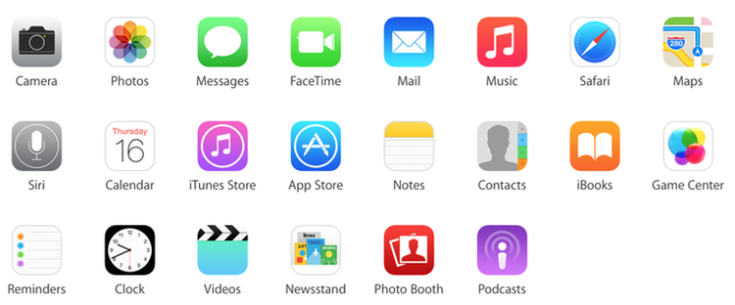
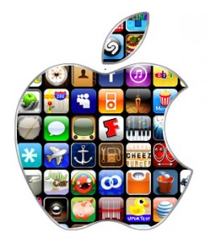
Productivity Software
FileMaker
Manage audio, video and photo data (databases)
Apple Numbers, Keynote, Finder, and Mail
Documents, spreadsheets, presentations, and send/receive email
Apple iMovie, Messages, Photo Booth, and Final Cut Pro X
Share, manipulate, and edit audio and video
Apple Calendar and Reminders
Calendar and day planner
Wondershare PDFelement
Manipulate pdf files
Safari
Browsing, banking, research, and editing
Notes:
This PC comes with many downloadable applications. FileMaker (15.0.3 by FileMaker Inc.‎, an Apple Subsidiary. Mac OS X v10.10 or newer) can benefit the director by creating small databases to manage all audio, video and photo data. Additionally, Apple Numbers (Mac OS X v10.4 or newer), Keynote (Mac OS X v10.8.5 or later), Finder (Mac OS, Version 10.12.3 / December 13, 2016), and Mail (Mac OS. Version 10.2) can be used to create documents, spreadsheets, presentations, and send and receive email. Apple iMovie and Messages (Mac OS. Version 10.1.4) helps create and edit audio and video files and share video and audio files via emails, instant messaging, and in chat rooms via mobile devices. Apple Photo Booth (Mac OS. Version 8.0 / August 23, 2015) and Final Cut Pro X (Apple Mac OS X v10.11‎, ‎macOS 10.12. Version 10.3.2) both help to take high quality digital photos and videos and download them to the PC as well as scan and edit the photos and videos, as well as, manipulate/edit various image and video formats. Apple Photo Booth assists with photo editing: 1) Display a custom backdrop, similar to a green screen effect. 2) Allows effects such as; Pop Art, Mirror, and Sepia on images. Final Cut Pro X assists with video editing: 1) Roll Trim between two adjacent connected clips. 2) Cinematic 3D title templates with built-in backgrounds and animations. Apple Calendar and Reminders (Apple Mac OS. Version 9.0) will help manage the Director’s schedule by using an online calendar and day planner. Wondershare PDFelement is used to manipulate pdf files, including editing pdfs, conversion from pdf to Word and vice versa. Lastly, Safari can be used to access the internet to make online purchases, conduct banking services and research new audio, video and photo editing.

Slide 7
Internet Connectivity and Web Services
Bluetooth 4.0 wireless technology
802.11ac Wi-Fi wireless networking
Internet service provider
Verizon (1 Mbps download & 384 Kbps upload)
OS X Web Services Core framework
Notes:
Internet service provider: Verizon (Internet connectivity. 1 Mbps download & 384 Kbps upload.)
Web services: XML-RPC (OS X Web Services Core framework can be used to make SOAP calls and parse the responses from networks and database.)
Wi-Fi: 802.11ac Wi-Fi wireless networking; IEEE 802.11 a/b/g/n compatible.
Bluetooth 4.0 wireless technology.

Slide 8
Summary of Recommendations
Apple iMac 27’ All-in-one desktop computer
Technical specs meet Directors requirements
Hardware
System unit components and software
Productivity software
Internet connectivity and web services
Notes:
This PC meets the requirements the Director has defined and its tasks and systems are sufficient to meet the office’s requirements.
The hardware section covered the requirements on participating in online video conferences, web courses, and forums, printing documents to include photo quality color printing, scanning photos and videos, transferring information between PC machines, and protecting the PC components from dirty electrical power.
The system unit components and software section covered the requirements on storing high quality digital photos and videos, transferring information between PC machines, internet protection, storage and file manipulation.
The productivity software section covered the requirements on creating small databases to manage all audio, video and photo data, creating documents, spreadsheets, presentations, and send and receive email, creating, share, manipulate, and edit audio and video, managing an online calendar and day planner, manipulating pdf files, and using the internet for browsing, banking, research, and editing.
The internet connectivity and web services section covered the Wi-Fi, Bluetooth, and ISP.

Slide 9
Questions & Next Steps

Slide 10
References
http://images.clipartlogo.com/files/images/32/327568/business-presentation_f.jpg
http://www.clker.com/cliparts/0/7/d/3/11971011581570976801shokunin_businessman.svg.hi.png
http://www.psdgraphics.com/file/red-business-graph.jpg
http://zdnet2.cbsistatic.com/hub/i/r/2014/10/28/d7fa2f8b-5e4a-11e4-b6a0-d4ae52e95e57/resize/770xauto/dcc9236579b1aca2b4ef07cda43b74eb/2014-10-2012-29-47.jpg
https://i1.wp.com/www.kirkville.com/wordpress/wp-content/uploads/default-apps.png?zoom=1.5&resize=653%2C271
http://www.6gadgets.com/wp-content/uploads/2016/07/ios-apps.jpg
https://support.apple.com/content/dam/edam/applecare/images/en_US/imac/featured-section-new-to-imac_2x.jpg

