Slide 1
Memory Mapping
“I never commit to memory anything that can easily be looked up in a book”
- Albert Einstein
By: Surtej Sarin

Slide 2
Topics covered
Storage
Number bases
Data types
Memory management
Garbage collection
Java Virtual Machine
Memory allocation
Stack and heap
Memory address
Method calls
Copying objects
Wrapper classes

Slide 3
Storage
Memory is stored on a computer by a binary digit – a unit called bit.
A bit is the smallest unit of data that a computer uses and it has two states, 0 and 1 (Off/On).
A byte is a structure of eight consecutive bits, as shown below.
A kilobyte (KB) is 1,000 bytes, roughly one paragraph of text.
A megabyte (MB) is 1,000 kilobytes and it is often referred to when looking at a large file.
A gigabyte (GB) is 1,000 megabytes and it is often referred to when looking at disk or storage space.
And the list goes on to include: terabyte, petabyte, exabyte, zettabyte, yottabyte, brontobyte, and geopbyte.
Additional information:
An average computer nowadays has 4 GB of memory, whereas the first computer had only 3 KB!
An average computer nowadays has 250 GB of hard drive, which is enough to store over 30,000 pictures or songs!
http://www.usatoday.com/story/tech/columnist/komando/2012/11/30/komando-computer-storage/1726835/
1 | 1 | 0 | 1 | 1 | 0 | 0 | 1

Slide 4
Binary notation
Each number system utilizes digits in order to form all of the numbers that can be contained within a system.
Binary notation is the interpretation of bits and the representation of a number using base-2 notation.
A computer stores data in memory by using the binary digits, 0 and 1.
The following is an example of a binary number being converted to decimal notation.
128 64 32 16 8 4 2 1
1 | 1 | 0 | 1 | 1 | 0 | 0 | 1
1 x 1 = 1
0 x 2 = 0
0 x 4 = 0
1 x 8 = 8
1 x 16 = 16
0 x 32 = 0
1 x 64 = 64
1 x 128 = 128

Slide 5
Decimal notation
Decimal notation is the representation of a number using base-10 notation.
A human uses the decimal number system, 0, 1, 2, 3, 4, 5, 6, 7, 8, and 9.
Looking at the previous example, 1 + 0 + 0 + 8 + 16 + 0 + 64 + 128 = 217.
11011001 in binary notation is equal to 217 in decimal notation.
Binary to Decimal: 11011001₂ = 217₁₀
Subscripts are used for the base.

Slide 6
Octal and Hexadecimal notation
A programmer uses the octal and hexadecimal number base notations.
Like binary, these notations are used to translate numbers from the individual bits.
Octal notation is the representation of a number using base-8 notation.
Hexadecimal notation is the representation of a number using base-16 notation. It uses the first ten digits, followed by the first six letters.
From the previous example, 11011001₂ = 217₁₀
Splitting the binary number in two sections, we have:
1101: 8 + 4 + 1 = 13
1001: 8 + 1 = 9
Looking at the hexadecimal table, 13 is represented by the letter D
Decimal to Hexadecimal: 217₁₀ = D9₁₆
A | 10
B | 11
C | 12
D | 13
E | 14
F | 15

Slide 7
Data types
In Java, there are two data types, primitive types and reference types.
A primitive type variable has a primitive value. It is stored in the same memory location assigned to the variable, in the stack. This includes the types boolean, returnAddress, float, double, byte, short, int, long, and char.
A reference type variable has a reference value. The reference value refers to the memory address of the stored object, not the object itself. It is stored on the heap. This includes the types class, interface, and array.
Passing a primitive variable to a method will have no effect on the argument, however for objects, changes made to the reference variable of that object are permanent.
It is important to note that passing an object by reference to a method will pass its reference not its value.
https://docs.oracle.com/javase/specs/jvms/se7/html/jvms-2.html

Slide 8
Memory management
One main function of computer’s operating system is to perform memory management.
Allocating memory
Deciding the recipient program and amount of memory
Keeping status of memory location (used or free)
According to Oracle’s website, “memory management is the process of allocating new objects and removing unused objects to make space for those new object allocations.”
https://docs.oracle.com/cd/E13150_01/jrockit_jvm/jrockit/geninfo/diagnos/garbage_collect.html
In Java, garbage collection is the process of reclaiming unused memory in order to create space for new objects by removing objects without a reference in the heap.
Java programs, like other applications, take up some space in memory on a computer. For example, an object might use up to 8 bytes in memory.
http://www.javaworld.com/article/2077496/testing-debugging/java-tip-130--do-you-know-your-data-size-.html
https://docs.oracle.com/javase/8/docs/technotes/guides/vm/

Slide 9
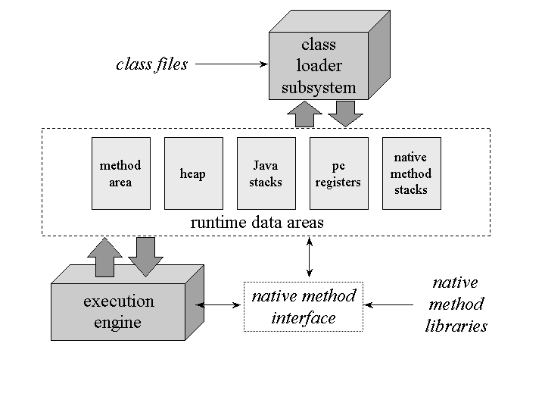
Java Virtual Machine (JVM)
Java is designed with its own operating system, called the Java Virtual Machine (JVM).
It is an abstract computing machine that has three notions: specification, implementation, and instance.
The JVM allows a computer to run a Java program.
A thread is a path followed when executing in a program. Every thread has priority and the JVM allows for threads to run concurrently.
The JVM has to store bytecode and data extracted from instantiated objects, loaded classes, method parameters, local variables and return values.
In order to run a program and store data, the JVM needs memory.
Internal architecture of the JVM organizes the memory needed to execute a program into different runtime memory areas, including: the method area, heap, Java stacks, pc registers, run-time constant pools, and native method stacks.
https://www.artima.com/insidejvm/ed2/jvmP.html
https://en.wikipedia.org/wiki/Java_virtual_machine
https://www.artima.com/insidejvm/ed2/images/fig5-1.gif

Slide 10
Memory allocation
The JVM runtime memory areas are divided in two major categories:
Managed per-thread:
This is when the memory area is unique for every new thread. It is initialized when a thread starts and ends once the thread is complete.
The JVM stack is used to store JVM frames. The memory size of the stacks can be managed as fixed or dynamic and it is created and managed for every thread.
The PC register has a pointer to the current statement being executed in the thread. A PC register is created every time a new thread is created.
The native method stacks are used for native methods and are also created per thread. The memory size is managed similar to the JVM stack.
Shared among all threads:
This is when the memory area is shared and is accessed by all the threads. It is initialized when JVM starts and ends once the JVM is shutdown.
The runtime constant pool is created when either a class or interface is created and it contains literal values.
The method area stores the run-time constant pool and contains data from fields, methods, and constructors.
The heap stores the method area and runtime constant pool and it contains objects and classes.
https://docs.oracle.com/javase/specs/jvms/se7/html/jvms-2.html
http://javapapers.com/core-java/java-jvm-run-time-data-areas/

Slide 11
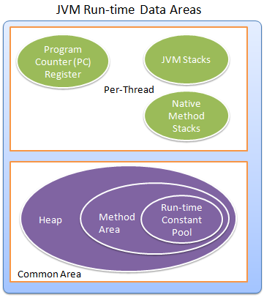
http://javapapers.com/wp-content/uploads/2013/11/JVM-Run-time-Data-Areas.png

Slide 12
The stack and heap
The stack memory is used for storing primitive data types and function calls. The stack memory is much smaller in size than the heap memory. It is referenced using the Last-in-First-Out order, where elements are either inserted onto the stack ("push") or removed from the stack ("pop") from the top. It is used for the execution of a thread. When there is no memory left to allocate in the stack, to store a function call or local variable, the JVM will throw the exception: java.lang.StackOverFlowError.
https://docs.oracle.com/javase/7/docs/api/java/lang/StackOverflowError.html
The heap memory, managed at Java runtime by the JVM, dynamically allocates memory to objects and classes. When an object is created in Java, it will always be automatically stored in the heap. However, in C++ in order to allocate memory on the heap, you must explicitly use the methods malloc() or calloc(). Heap memory is used to allocate a large block of memory. For example, a data structure like an Array or ArrayList, that can dynamically change size. Also, it has a garbage collection feature. When there is no memory left to allocate in the heap, to create an object, the JVM will throw the exception: java.lang.OutOfMemoryError: Java Heap Space.
https://docs.oracle.com/javase/7/docs/api/java/lang/OutOfMemoryError.html
The main difference between the two is, stack memory is used to store local variables and call functions, while heap memory is used to store objects.

Slide 13
Stack-heap diagram
Example 1: showing the stack and heap
public void calendar() {
int x = 0;
Date day1, day2, day3;
day1 = new Date(1,1,2016);
day2 = day1;
day3 = new Date(8,30,1996);
}
Stack
Heap
day3
day2
day1
x | 0
Day: 1
Month: 1
Year: 2016
Day: 8
Month: 30
Year: 1996

Slide 14
Memory address
The memory address is where an object is stored in memory.
Every byte in the primary memory of a computer has an address.
Suppose that we want to compare two objects. If we were to use the double equal sign operator and print the object, we would end up with a symbol that looks like this: A@190dll, which is the name of the object and its System.identityHashCode(). This represents the initial memory address of the object.
There is no way to determine the current memory address of the object because the JVM can relocate the object.
The following example is a Java program on this topic.

Slide 15
References to objects
A reference to an object is the address of the object’s memory location.
For example:
String b = new String(“abc”);
The heap allocates memory for the new String object.
Suppose this object is stored in the memory address 1010.
Here is what it would look like memory:
Stack
Heap
1010
abc
1010
p

Slide 16
Method calls
When a method is called, it requires memory to store information.
A call stack is the memory allocated to hold a return address and the local variables.
A stack frame is storage on the call stack that is generated at when a method is called.
A call sequence describes the process of calling a method

Slide 17
The steps of a call sequence
Argument lists are evaluated from left-to-right
An expression must be evaluated before the call is made and this excludes variable or literals.
A new stack frame is pushed on the call stack
A parameter and local variable is stored and is reserved in the stack frame.
Method returns are saved automatically.
Parameters are initialized
Evaluated arguments are assigned to local parameters in the called method.
Method execution
Once the stack frame has been initialized the method starts to execute.
A method may make a call to another method. If so, this will push and pop its stack frames on the call stack.
Method return
This happens when the method is completed or a return statement is encountered.
Methods that are not void return a value, which is passed back to the calling method.
The stack frame storage for the called method is then “popped” off the call stack. In other words, a pointer is moved to the previous stack frame and now the current stack frame can be called by other methods.
The calling method continues to execute from the spot where the method was called.
http://www.fredosaurus.com/JavaBasics/methods/methods-25-calls.html

Slide 18
Stack-heap diagram
Example 2: function calls on a stack frame
public static void main(String[] args)
{
int a = 0;
String b = new String(“abc");
String c = b;
String d = new String(b);
foo(a, b, c, d);
}
public void foo(int e, String f, String g, String h) {
System.exit(1);
}
Stack
Heap
h
g
f
e | 0
d
c
b
a | 0
foo
“abc”
“abc”
main

Slide 19
Array allocation
In Java, an array stores either a primitive value or a reference to an object.
Arrays are treated the same way in memory as objects.
When an array is declared, it is not assigned a memory address. The array reference is automatically assigned the value null, meaning that the identifier is not associated with a memory address. It is important to note, an array does not explicitly need to be assigned null.
int [ ] arr;
int [ ] arr = null;
When an array is defined using the keyword new, memory is allocated on the heap and the array reference obtains a memory address.
int [ ] arr = new int [20];
In the example above, arr has a memory address, however, since it is uninitialized, each element of arr has the value of 0, because it is an integer array. Similarly, the default value of a double would be the 0.0, boolean would be false, char would be the null code point '\u0000‘, and String would be null.
Providing values for elements in an array is also known as populating the array.
int [ ] arr = {1, 2, 3, 4, 5};
http://www.programcreek.com/2013/04/what-does-a-java-array-look-like-in-memory/
Java Programming. Farrell, J. 9781305480537. https://books.google.com/books?id=bzp-BAAAQBAJ. 2015, Cengage Learning. Pages: 400-401.

Slide 20
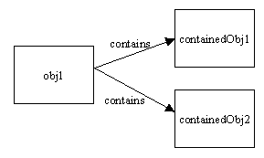
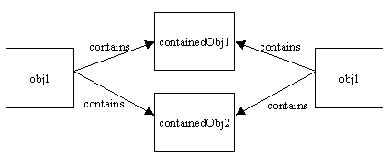
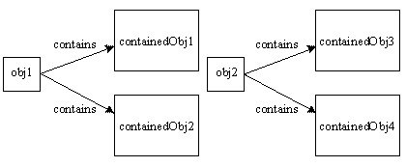
Copying an object in memory
There are two main ways to copy an object in memory: shallow and deep copy.
Image 1 is an object that contains two objects.
Image 2 is the shallow copy of image 1.
Image 3 is the deep copy of image 2.
http://stackoverflow.com/questions/869033/how-do-i-copy-an-object-in-java
For the following examples, suppose an array of Dog objects, called puppies is passed as an argument to the method from the main in a class called Pound, i.e., private Dog[] puppies = new Dog [5];
Image1: http://i.stack.imgur.com/ZK4pQ.gif
Image2: http://i.stack.imgur.com/xhF9B.gif
Image3: http://i.stack.imgur.com/mtNjt.gif

Slide 21
Reference copy
Reference copy - where the reference to the original object is returned.
It is technically not considered a copy
public class Pound {
…
public Dog[] referenceCopy (Dog[] puppies) {
return puppies;
}
}
Stack
Heap
puppies

Slide 22
Shallow copy
Shallow copy - where a new object is created that points to the same reference address of the original object.
public class Pound {
…
public Dog[] shallowCopy(Dog[] puppies) {
Dog[] copy = new Dog[puppies.length];
for (int i = 0; i < copy.length; i++)
{
copy[i] = puppies[i];
}
return copy;
}
}
Another Java example of a shallow copy.
Stack
Heap
copy
puppies

Slide 23
Deep copy
Deep copy - where a new object is created (from the original object) and it points to a different reference address. Must use the keyword “new”.
public class Pound {
…
public Dog[] deepCopy(Dog[] puppies) {
Dog[] copy = new Dog[puppies.length];
for (int i = 0; i < copy.length; i++) {
copy[i] = new Dog(puppies[i]);
}
return copy;
}
}
Another Java example of a deep copy.
Stack
Heap
copy
puppies

Slide 24
Wrapper class
A wrapper class is an object that is a part of the java.lang package.
It is used to “wrap” each of the primitive data types into an object of their own class.
For example, we can use wrapper classes to convert a String of integers to an int.
int number = Integer.parseInt("1234");
The following example shows the storage of a primitive vs. an object.
int a = 10;
Integer b = new Integer(a);
boolean | Boolean
char | Character
byte | Byte
short | Short
int | Integer
long | Long
float | Float
double | Double
Stack
Heap
b
a | 10
10

