Slide 1

Ruby on Rails
PennApps XVII

Slide 2
Outline
What You’ll Need
Ruby
HTTP & MVC
Ruby on Rails
Rails Demo

Slide 3
What you’ll need

Slide 4
Text Editor, Command Line & Web Browser
Text Editor:
Sublime Text
https://www.sublimetext.com/3
Atom
https://atom.io/
Vim/Emacs
Command Line:
Required to run Ruby programs
Required for most Rails commands
Web Browser

Slide 5
Installing Ruby & Rails
Visit tiny.cc/FH18rails for more detailed instructions
Mac OS/Linux:
Install Ruby Version Manager (RVM)
Not required, but highly recommended
https://rvm.io/
Install Ruby 2.4.1 through rvm
rvm install 2.4.1
Install Ruby on Rails
gem install rails -v 5.1.3
Windows users: bit.ly/vmRoR

Slide 6
Ruby

Slide 7
Printing in Ruby
You can output data in Ruby in 3 different ways
I generally use:
p outputs and returns the value
I will use #=> to denote output
p 'Hello World' #=> "Hello World"
Notes:
- P = method
Prints
Returns value as well

Slide 8
Variables
Ruby is dynamically typed
Variables do not need to be initialized
They can be assigned & re-assigned to objects of different types
Variable names should be in snake_case
my_var = 'This is my var'
p my_var #=> "This is my var"
my_var = 15
p my_var #=> 15

Slide 9
Commonly Used Objects
Numerics
Integers & Floats are the most common
Strings
Represented with either single or double quotes
Booleans
true & false
Nil
Represents ‘nothingness’
Arrays
Holds data of any type
Hashes
Mapping of keys to values
Notes:
Numerics:
You can perform simple algebra with addition, subtraction, multiplication, division, modulo, etc.
If you start with integers, you’ll get an integer back
If one of the numbers is a float, you’ll get back a float
Strings:
Can be represented with single or double quotes
You can concatenate strings with +
You can use string interpolation, which is preferred to concatenation in almost all cases
Booleans:
In Ruby, true and false are themselves classes
One thing to note is that every object in Ruby has a boolean state
The boolean state of an object will almost always be true
The only objects with a boolean state of false are nil and false itself
Nil:
Represents nothingness
Nil is itself an object
Arrays:
Used to hold data
Can contain data of any type
0-indexed, can access any data type
Access elements in arrays using [ ] notation
Hashes:
Maps keys of any type to data of any type
One thing to note is that almost everything in Ruby is an object. All of these things listed here are classes & any instance of these classes are objects.

Slide 10
Iterators
Always use iterators instead of for loops in Ruby
[0, 1, 2].each do |num|
p num
end
#=> 012
Notes:
while condition do
end

Slide 11
Flow Control
if 3.even?
p 'Three is even'
elsif 3.odd?
p 'Three is odd'
else
p "I don't know what 3 is"
end
#=> 'Three is odd'
p 'Three is odd' if 3.odd? #=> "Three is odd"
p 'Three is not even' unless 3.even? #=> "Three is not even"
p 3.even? ? 'Three is even' : 'Three is odd' #=> "Three is odd"

Slide 12
Methods
def hello_world
'Hello World'
end
p hello_world #=> "Hello World"
def hello(name)
"Hello #{name}"
end
p hello 'Jackie' #=> "Hello Jackie"
def goodnight(name = 'Moon')
"Goodnight #{name}"
end
p goodnight 'Jackie' #=> "Goodnight Jackie"
p goodnight #=> "Goodnight Moon"

Slide 13
Classes
Class names should be in PascalCase
class MyClass
end
my_instance = MyClass.new
p my_instance.class #=> MyClass

Slide 14
Methods in Classes
class MyClass
def self.class_method
'This is a class method'
end
def instance_method
'This is an instance method'
end
end
p MyClass.class_method #=> "This is a class method"
p MyClass.new.instance_method #=> "This is an instance method"

Slide 15
Ruby Resources
Ruby Lang Documentation
https://www.ruby-lang.org/en/documentation/

Slide 16
Gems
Ruby libraries are called gems
The general command to install them is gem install gem_name
Ruby programs use a Gemfile to manage the list of gems for a specific project
You can install all gems in a Gemfile by running:
gem install bundler (Only the first time)
bundle install

Slide 17
HTTP & MVC

Slide 18
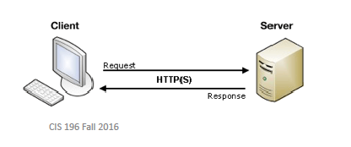
HTTP
Stands for Hypertext Transfer Protocol
A client sends a request to a server
The server receives the request and sends back a response
The response is generally in the form of a webpage (i.e. HTML) or data (i.e. XML or JSON)
Notes:
- My laptop -> facebook

Slide 19
HTTP Verbs
Types of HTTP requests:
GET
Default type of request
Should only be used to get data
POST
Used to send data from client to server
More secure than a GET request
PUT/PATCH
Used to update something on the server
DELETE
Used to delete something on the server
Notes:
PUT vs PATCH:
PUT updates an entire record
PATCH updates just part of a record

Slide 20
MVC (Model-View-Controller)
Stands for Model View Controller
It’s an architectural pattern -> way for code to be organized
Rails implements this architectural pattern
Notes:
Modular
maintainable

Slide 21
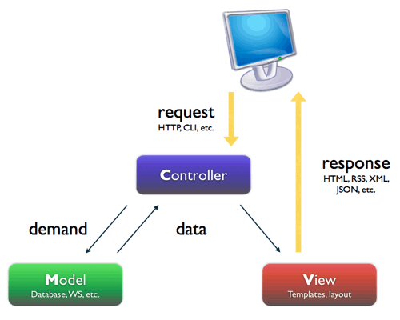
MVC Layers
Model:
Most logic is here
Main place where database is accessed
View:
What the user sees
Controller:
Depending on what route (think: URL) you’re on, the controller does 2 things
Grabs information from the model
Renders an HTML view that will contain this information
1 model has 1 controller and several view files

Slide 22
Ruby on Rails

Slide 23
Ruby on Rails
Ruby on Rails (RoR) is a very popular web framework built on the Ruby language

Slide 24
Creating a Rails app
Run rails new app_name
This creates a directory with the name of your app & all of the directories & files common to a Rails app
This also installs all of the gems in the Gemfile

Slide 25
Starting up
rails server (or rails s for short)
This starts the server on port 3000 by default
You can visit the app by going to http://localhost:3000 in a web browser

Slide 26
Rails App Directory Structure
app
Organizes application components
3 important sub-directories here:
Models
Each model gets a separate .rb file here
The .rb file contains a class named after the model
Views
Each model is assigned a subdirectory here containing html.erb files here
Index, new, edit, show
Controllers
Each model is assigned a subdirectory here containing 1 controller file (just another .rb file)

Slide 27
Rails Generators
rails g scaffold helped make Rails famous
Generates controllers, views, routes, models
rails g scaffold model_name column1:type column2:type
Once you’ve created all your models, the following commands in this order:
rake db:drop
rake db:create
rake db:migrate
Notes:
<div class="field"> <%= form.label :hacker %> <%= f.collection_select(:author_id, Author.all, :id, :name, :prompt => 'Select author') %> </div>

Slide 28
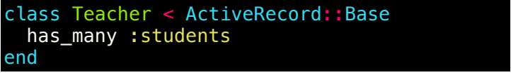
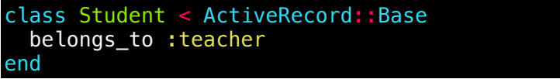
Associations
Associations are what they sound like; they make it easy to form relationships between models
Important ones are has_many and belongs_to
Notes:
<div class="field"> <%= form.label :hacker %> <%= f.collection_select(:author_id, Author.all, :id, :name, :prompt => 'Select author') %> </div>

Slide 29
REST (REpresentational State Transfer)
A set of conventions to expose certain HTTP endpoints
Convenient for CRUD (Create-Read-Update-Delete) apps
The below example is for a model representing hackers:
Name | Path | Verb | Usage
Index | /hackers | GET | Show a list of hackers
New | /hackers/new | GET | Show a form to create a new hacker
Create | /hackers | POST | Create a new hacker
Show | /hackers/:id | GET | Show info on a specific hacker
Edit | /hackers/:id/edit | GET | Show a form to update an existing hacker
Update | /hackers/:id | PUT/PATCH | Update an existing hacker
Destroy | /hackers/:id | DELETE | Delete an existing hacker
Notes:
<div class="field"> <%= form.label :hacker %> <%= f.collection_select(:author_id, Author.all, :id, :name, :prompt => 'Select author') %> </div>

Slide 30
Reference
These slides and demo code will be at this link:
tiny.cc/FH18rails

