Slide 1

Team Name : INCOGNITO
TEAM MEMBERS
Name : Bhuva Raj
En. No.: 180760107007
Name : Shingala Jaydeep
En No.: 180760107056
Name : Rathod Rahul
En No.: 180760107053
Name : Ranpariya Rinkesh
En No.: 180760107050

Slide 2

Problem Statement
FinTech
The FinTech industry in India has grown exponentially. At 87%, India has emerged as a leader in FinTech adoption, as per Global FinTech Adoption Index 2019 reports. This sector has grabbed attention of not only start ups but also established companies
along with public and private sector banks.

Slide 3
Technology Stacks
General
Python
HTML, CSS
JAVA script
SQL
Python Data Science And Visualization Library like,
Pandas
Numpy
Matplotlib
Seaborn

Slide 4
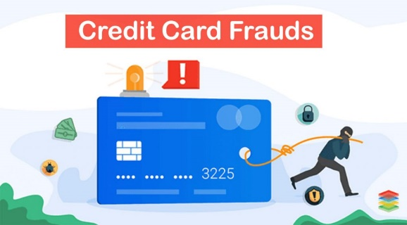
Solution
First of all we have to monitor the transaction of customer by Transaction monitoring. Transaction Monitoring?
A process of reviewing customer transactions and matching them against customer risk profile & usual transaction pattern. Subsequently, perform a focused examination of transactions and identification of Suspicious transactions.
Transactions may include transfers, deposits and withdrawalsbjective :
To protect bank/FI from Any transactions that may lead to money laundering and terrorist Financing
Regulatory fines/penalties for not identifying such transactions.

Slide 5

Transaction Monitoring Rules
Find Out below Pattern in the transactional DATA
Consolidation of transactions close to threshold
Overall increase in transaction volume
Suspicious spend behaviour
High Volume of transactions
Payment made with some IP address
Low buyer diversity
Change in Customer profile before large transactions
Frequency of withdrawal and deposits
High transactions count from new Users
By this analysis we can make machine learning model to predict the fraud transaction and other Terrorist activities,

Slide 6

Transaction Monitoring | Key Red Flags
Customer, who is a public official, opens account in the name of a family member who begins making large deposits not consistent with the known sources of legitimate family income.
Transactions that involve depositing large amounts of cash inconsistent with the normal and expected activity of the customer.
Customer who is a student, uncharacteristically transfers or exchanges large sums of money.
Account shows high velocity in the movement of funds, but maintains low beginning and ending daily balances.
Transaction involves offshore institutions whose names resemble those of well-known legitimate financial institutions.

Slide 7
Transaction Monitoring process
Suspicious Transaction alert is generated
Consolation of customer profile information
Search previous Transaction alert or SAR against customer
Transaction review & analyse usual Transaction pattern
Detailed investigation on alerted Transaction & identify Source
Understand relation between customer & party making transaction
Decision on the Suspicious transaction alert

