Slide 1

SplicR for the
Varmus lab
A549 LKB1 screens, revisited
Sahaj Satani, Pranav Mettu, Ishaan Samantray
Cornell students
01
Notes:
Sahaj Satani, Pranav Mettu and Ishaan Samantray are Cornell students who built SplicR. This is a discussion of the lab's published A549 LKB1 CRISPR data and an actual deployed reanalysis. The Cornell affiliation identifies the students and does not imply institutional endorsement. Paper: https://doi.org/10.1073/pnas.2403685121.

Slide 2


The paper’s biological question
How does LKB1 restrain lung cancer cell growth in spheroids?
The screen points to the PIKFYVE complex.
Follow-up experiments connect it to how cells take in growth signals.
SplicR examines the CRISPR evidence behind that story.
Ferrarone et al., PNAS 2024, Fig. 4. Published experiment, not a SplicR output.
02
Notes:
Ferrarone et al., PNAS 2024, https://doi.org/10.1073/pnas.2403685121. Full title: Genome-wide CRISPR screens in spheroid culture reveal that the tumor suppressor LKB1 inhibits growth via the PIKFYVE lipid kinase. LKB1 is a tumor suppressor. In this study restoring LKB1 restrains growth more strongly in spheroid culture. The screen and follow-up experiments implicate the PIKFYVE complex and growth factor receptor trafficking. The image is the authors' complete, unmodified Figure 4, used here to discuss their experiments. Red fluorescence reports internalized EGF, not a SplicR prediction. Panels D–F concern a mouse tumor cell line, not the uploaded A549 CRISPR count tables. Copyright 2024 the authors, CC BY-NC-ND 4.0. Keep the attribution with the image.

Slide 3
The screen design
A549 cells, TKOv3 knockout library, day 21
Culture | LKB1-null (EV) | LKB1-restored (WT)
2D monolayer | a and b | a and b
3D spheroid | a and b | a and b
One shared plasmid library reference
Eight endpoint samples. The plasmid reference is not a biological replicate.
03
Notes:
Paper: https://doi.org/10.1073/pnas.2403685121. Dataset: https://doi.org/10.7910/DVN/8DEPIT. A549 is a human lung adenocarcinoma cell line. EV is the empty-vector, LKB1-null arm. WT restores wild-type LKB1. Both culture conditions have two day-21 endpoint samples per arm, labeled a and b. The count tables share one identical plasmid library reference. It is neither a biological replicate nor a cellular day-zero sample. Two separate culture analyses do not establish a formal culture-by-genotype interaction. The TKOv3 library is Addgene 90294.

Slide 4
The deposited files pass identity checks
Both original downloads match Harvard Dataverse V1
70,116
18,049
observed guides in each table
genes after guide-ID annotation
104 date-like gene labels corrected per file
Original counts remain unchanged. The analysis uses TKOv3 annotations keyed by guide ID.
04
Notes:
Source manifest and original archive metadata are in source-manifest.json and dataverse-metadata.json. MD5 and file sizes match Harvard Dataverse V1 exactly for both user downloads. The two tables contain the same 70,116 unique guide IDs and identical plasmid counts. Every observed guide matches the TKOv3 reference. The reference has 71,090 guides, so 974 reference guides are absent from these deposited tables. SplicR retains all deposited guide rows and does not fabricate missing rows. Each table contains 104 rows whose Gene label resembles an Excel date conversion. Joining exact guide IDs to TKOv3 restores reference gene labels, yielding 18,049 observed target labels. Those are the library's historical annotations, not a claim of current HGNC harmonization. Archive: https://doi.org/10.7910/DVN/8DEPIT.

Slide 5
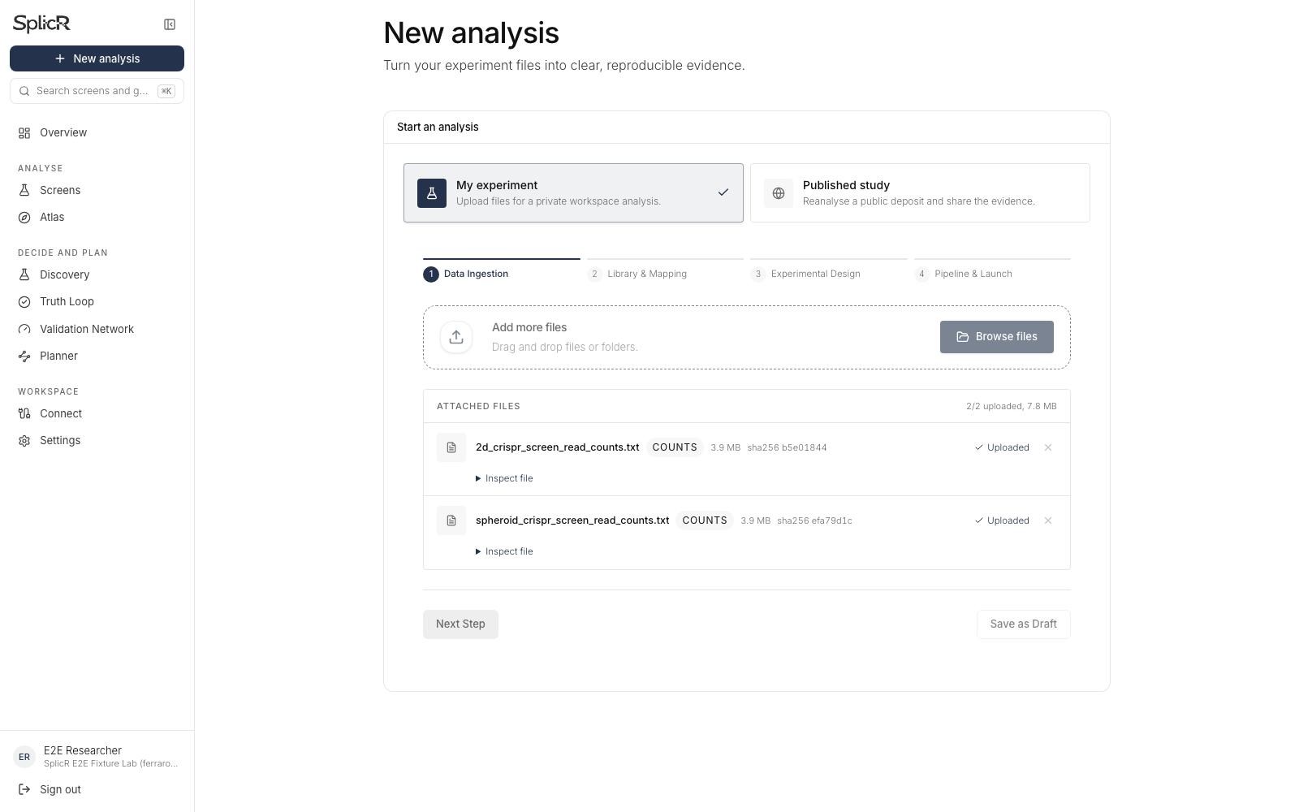
Upload the original count tables
Two files.
No FASTQ download is needed for this count-table demo.
05
Notes:
Actual production upload at https://www.splicr.org. Sources: https://doi.org/10.7910/DVN/8DEPIT. Download URLs: https://dataverse.harvard.edu/api/access/datafile/7440985 (2D) and https://dataverse.harvard.edu/api/access/datafile/7440983 (spheroid). The prepared ZIP contains the two original files with their bytes unchanged. The archive also contains eight FASTQ files. Reprocessing those would be a separate sequencing alignment analysis, requiring the original trimming/alignment settings and plasmid reference information. Upload inspection does not dispatch an analysis job. No new analysis was launched while capturing these screenshots.

Slide 6
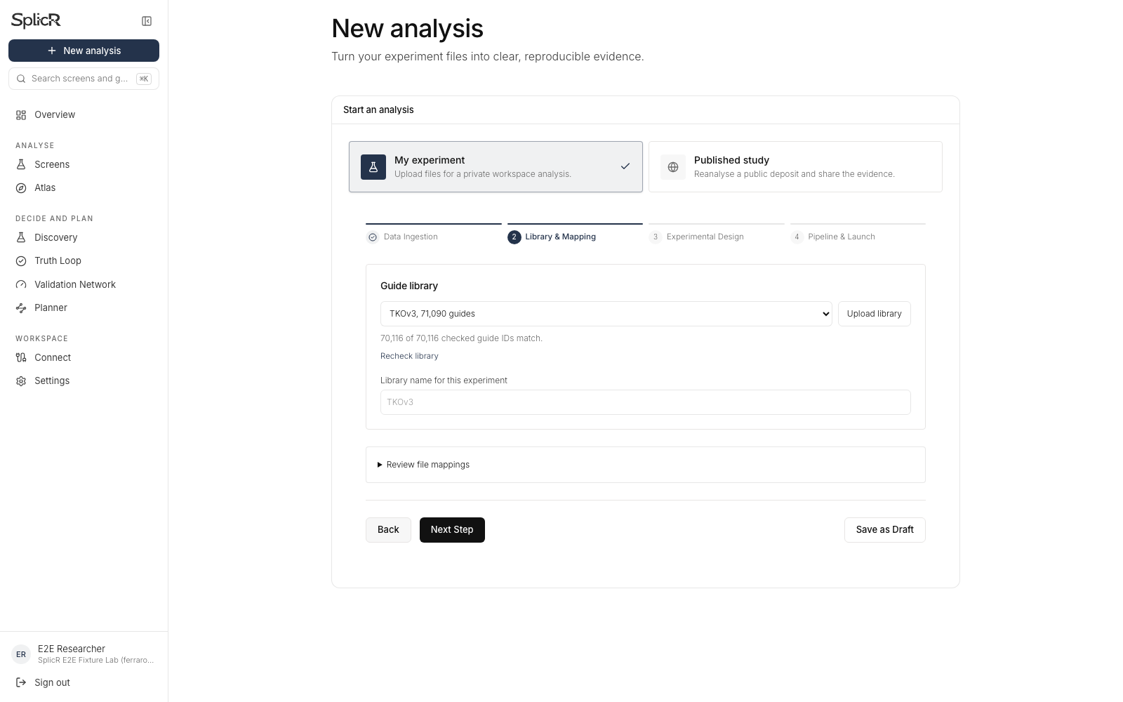
SplicR identifies the guide library
All observed guide IDs match TKOv3.
The mapping stays visible for review.
06
Notes:
Actual production screenshot. The intake matches guide IDs against hosted TKOv3. Canonical library membership and complete row checks matter more than file-name guesses. The exact Ferrarone profile additionally requires both source checksums, the exact sample schemas and 70,116 rows. A renamed or modified file does not inherit this verified study profile. For other files, library candidates use evidence from guides or sampled sequences and ambiguous mappings require review. All 70,116 observed guide IDs match; 974 library reference guides are not in the deposited count files.

Slide 7
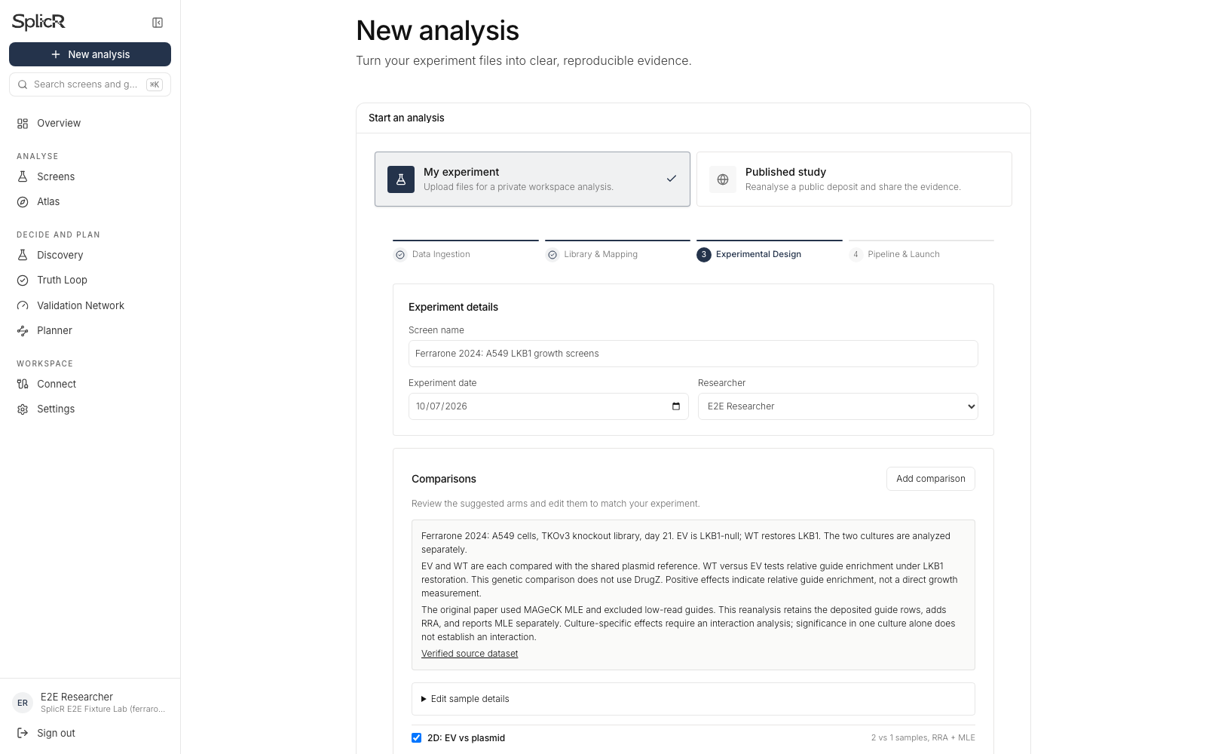
Six comparisons, ready to review
EV versus plasmid.
WT versus plasmid.
WT versus EV.
Separately for each culture.
07
Notes:
Actual production screenshot. The intake suggests six independent comparisons from the verified study profile. The two plasmid contrasts per culture are loss-of-function fitness comparisons. WT versus EV is a genotype contrast, not a drug contrast. The profile disables DrugZ for this experiment and does not pool 2D with spheroid samples. Researchers can edit names, selected samples and comparison definitions before launching. Culture-specific significance alone is not a formal interaction test. These comparisons are an explicitly declared reanalysis, not a recovery of unpublished original command lines.

Slide 8
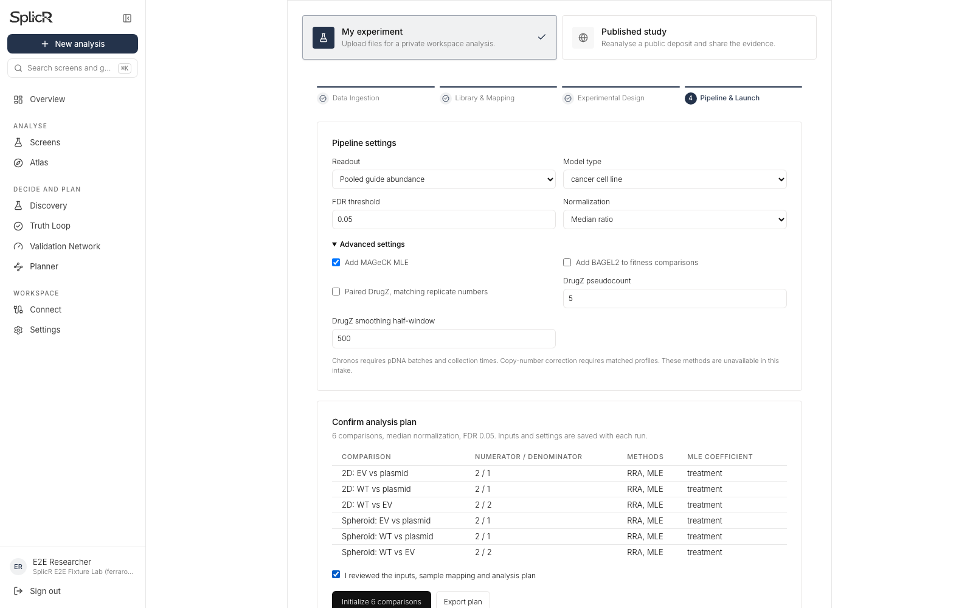
Researchers control the analysis
Median normalization.
FDR threshold 0.05.
RRA with optional MLE.
The reviewed plan travels with the run.
08
Notes:
Actual configuration screenshot shows the default reviewed RRA+MLE plan. The completed demonstration results in later slides are a separate RRA-only validation batch. The existing full MLE batch is still computing at capture time. MLE uses a valid explicit baseline/treatment design, seed 0 and 10 permutation rounds in MAGeCK 0.5.9.5. The UI permits normalization and FDR customization, explicit MLE matrices and coefficients, optional BAGEL2 for compatible fitness comparisons and paired DrugZ for matched drug arms. BAGEL2, DrugZ, Chronos and copy-number correction are not part of this completed RRA demo. TKOv3 has no annotated non-targeting controls, so control-guide normalization requires an explicit suitable reference set.

Slide 9
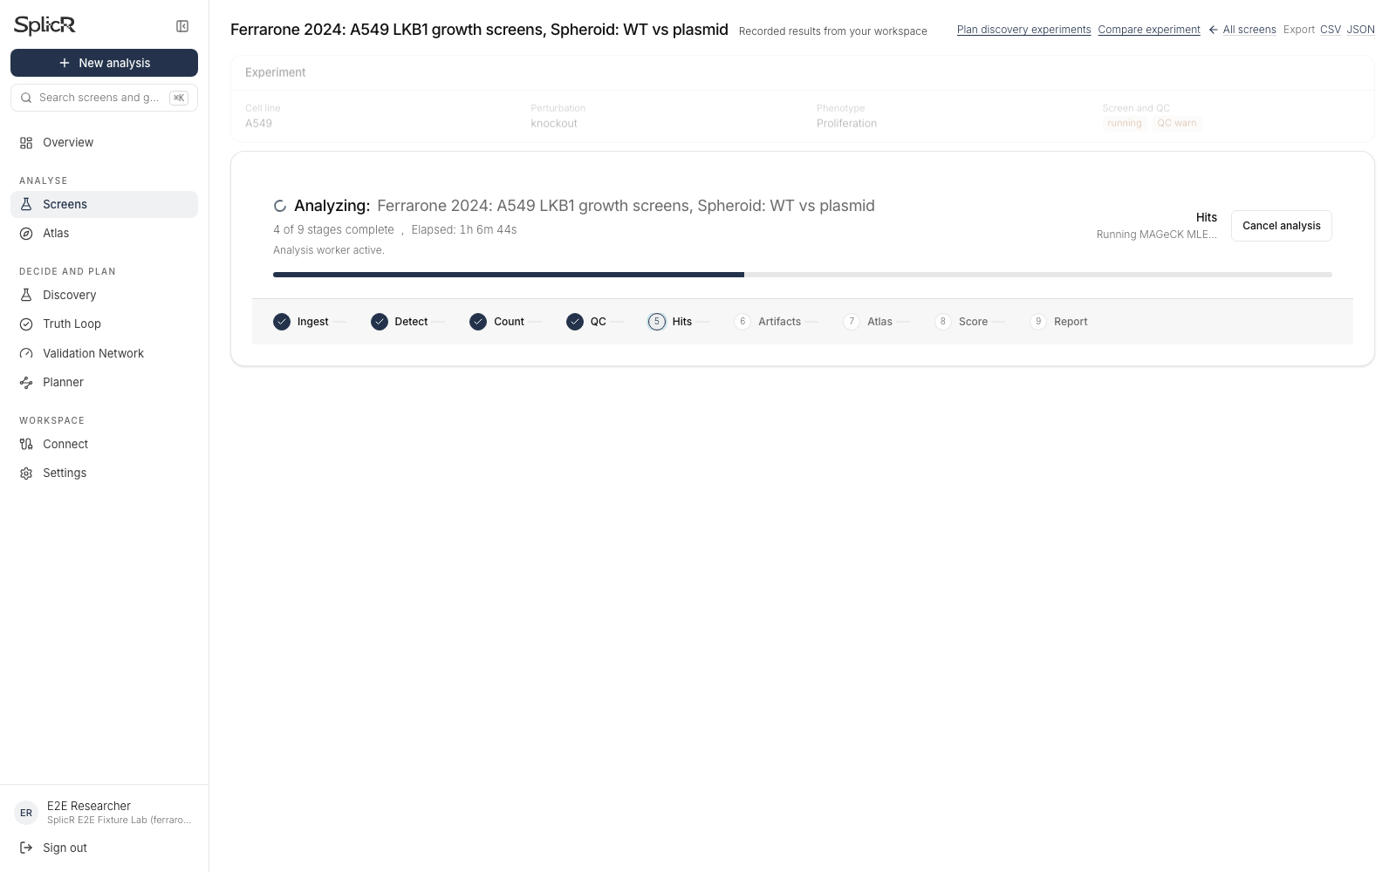
Live progress follows recorded stages
Completed stages and elapsed time come from the run.
The current job is fitting MLE.
09
Notes:
Actual production screenshot captured during an existing full-genome MLE run, with four of nine stages complete and an active hit-calling stage. The progress bar represents completed stages, not percentage of compute time or a promised finish time. Modal worker heartbeats continue. Frontend realtime events and a five-second polling fallback read Supabase run and stage records. Cloudflare R2 stores the input objects, Supabase stores workspace metadata and results, and Modal executes analysis. The screenshot is a dated snapshot, not a fabricated progress animation. No new job was queued for this presentation.

Slide 10
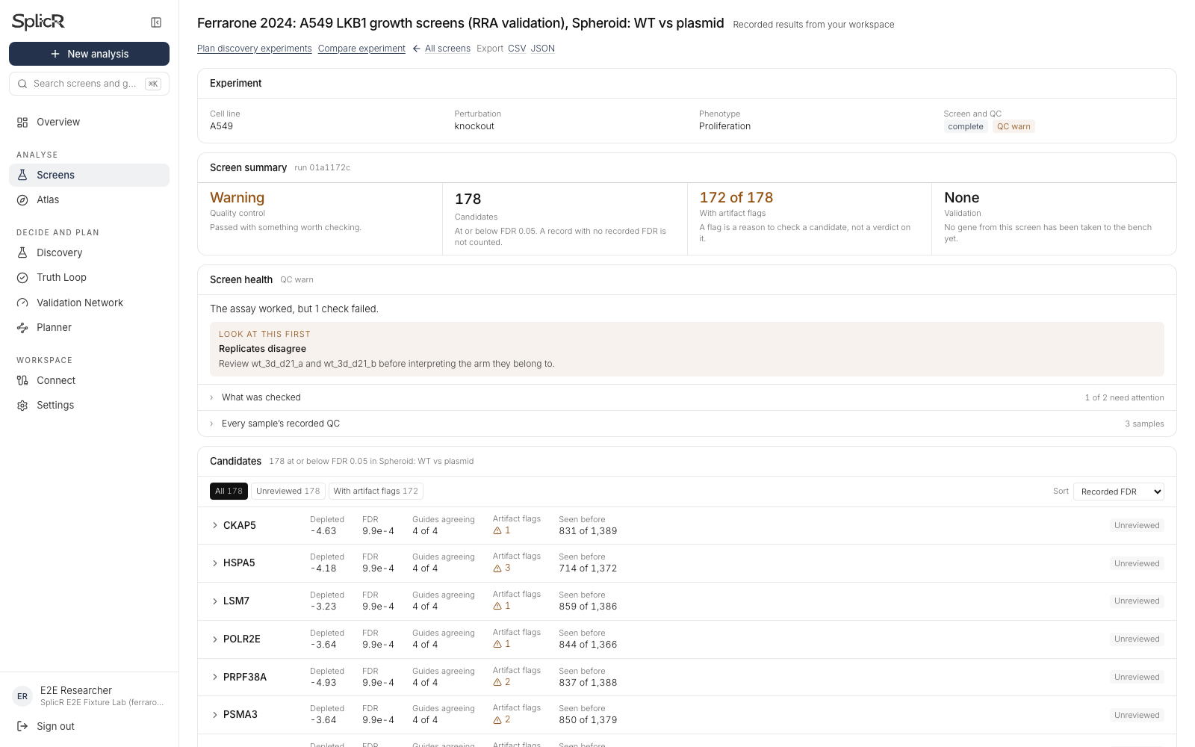
A completed report exposes uncertainty
Spheroid WT versus plasmid, RRA validation batch
178 candidates. 172 have artifact flags. The report retains the quality warning.
10
Notes:
Actual production RRA-only report for spheroid WT versus plasmid. 18,049 genes have recorded statistics. 178 pass the SplicR two-direction FDR threshold 0.05, of which 172 have at least one artifact flag. Flags prompt inspection and do not automatically disprove a gene. QC warns about replicate disagreement and count skew. No gene has recorded bench validation in this workspace. Numerical completion is not biological validation. All six completed RRA reports passed live API and browser export checks.

Slide 11
Results across the six comparisons
RRA candidates at the declared two-direction FDR threshold of 0.05
Each report covers 18,049 genes. These RRA counts do not reproduce the paper’s MLE figure.
11
Notes:
Data: rra-cloud/comparison-summary.csv. Each comparison scores 18,049 genes. Counts at SplicR's two-direction FDR <= 0.05 are 205,271,0,159,178,0 in the displayed order. SplicR preserves both MAGeCK directional FDRs and reports min(1,2*min(q_depleted,q_enriched)) as a conservative union bound. This differs from independently counting either native directional FDR below 0.05. The chart is a result of the declared RRA configuration, not a reproduction of the authors' MLE beta-score figure. All six reports carry QC warnings. Zero significant genes in a WT versus EV comparison does not establish absence of a biological effect.

Slide 12
The paper’s genes deserve a careful read
Spheroid WT versus plasmid
Gene | log₂ fold change | Native enrichment FDR
FIG4 | +3.14 | 1.000
VAC14 | +4.96 | 0.889
PIKFYVE | +0.41 | 1.000
Positive fold changes do not establish significance
The completed RRA batch does not call these genes significant. The paper used MLE and follow-up experiments.
12
Notes:
Source: rra-cloud/reference-gene-statistics.csv, spheroid WT versus plasmid. FIG4 has median gene LFC 3.1413, native enrichment FDR 1.0 and union FDR 1.0. VAC14 LFC 4.9627, native enrichment FDR 0.889219 and union FDR 1.0. PIKFYVE LFC 0.40606, native enrichment FDR 1.0 and union FDR 1.0. Values rounded only for presentation. FIG4 and VAC14 show positive fold changes, but this RRA batch does not call them significant. The authors used MAGeCK MLE and wet-lab follow-up. Their paper says PIKFYVE sgRNAs did not enrich in WT spheroids and tests the complex pharmacologically with apilimod. We cannot claim that this completed batch reproduces the paper's central statistical findings or improves them. The full MLE comparison remains open until completed and reconciled with the authors' filtering/design. Paper: https://doi.org/10.1073/pnas.2403685121.

Slide 13
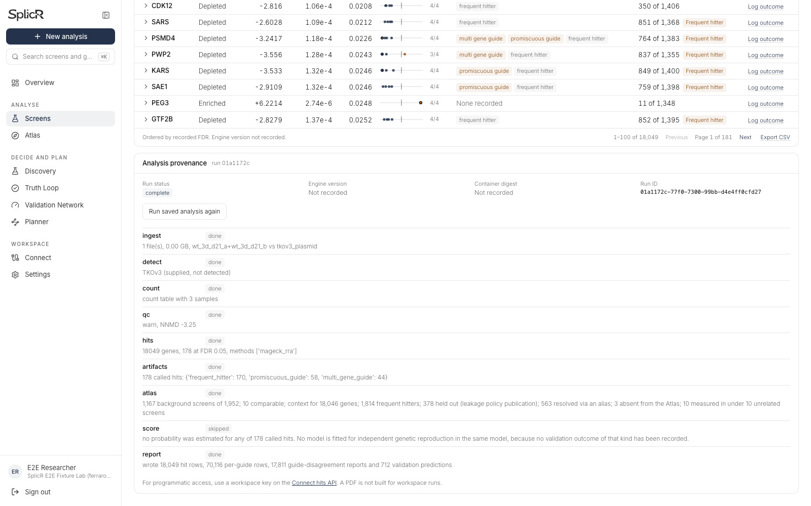
The export keeps the underlying evidence
CSV for analysis. JSON and receipts for reproducibility.
18,049 gene rows
per comparison
Inputs, settings and
quality warnings remain
attached to the run.
The demo includes the actual downloaded CSV and complete receipts for all six RRA runs.
13
Notes:
Actual screenshot of the recorded report's provenance and export controls. The CSV was downloaded by clicking the production UI, and its contents include all 18,049 gene rows with source/run metadata and separate RRA and MLE fields. In this RRA-only batch the MLE fields are blank, not zero. JSON exposes sample_data=false, workspace source, untruncated rows, settings and stages. The downloadable results bundle includes six CSVs, six receipts, original-source checksums, independent agreement and a reference-gene audit. This is a saved analysis package, not a final claim of biological validity.

Slide 14
Measured runtime and reproducibility
Completed RRA batch, original deposited count tables
6 min 2 sec
First worker start to last worker finish across six comparisons
97–126 sec per worker
Local and cloud primary statistics agree exactly
RRA only. Upload time excluded. Numerical agreement does not establish biological accuracy.
14
Notes:
Cloud receipts record six RRA jobs with worker durations 123.091,107.553,107.435,96.616,126.319,110.712 seconds. The first worker started 2026-10-07T16:22:43.148Z and the final worker finished 16:28:45.299Z, giving 362.151 seconds (6 minutes 2 seconds after rounding). This is elapsed worker cohort time and excludes upload/inspection and pre-start waiting. These jobs used the count-table pipeline, not raw FASTQ alignment, and excluded MLE. Existing full MLE jobs took longer and remained running at capture. Independent local RRA matched cloud LFC, both native directional FDRs and union FDR across all 18,049 genes in every comparison with maximum absolute difference 0. This establishes numerical reproducibility for the declared inputs/configuration, not accuracy against biological truth. The authors do not report a comparable compute runtime, so no speed multiple against them is claimed.

Slide 15
SplicR alongside Broad Apron
Apron already offers a strong guided analysis workflow
This study | Broad Apron guide | SplicR demonstration
Starting files | PoolQ counts and annotations Other inputs need formatting | Original deposited count tables
Design setup | User defines references and data configurations | Six editable suggestions from verified source identity
Gene statistics | Control-set z-scores and empirical null | MAGeCK RRA Optional separate MLE
Extra study context | Guide describes QC and analysis exports | Guide-ID annotation repair Publication-held-out Atlas context
Documented workflow comparison. No head-to-head accuracy or runtime benchmark.
15
Notes:
Primary sources checked 2026-10-07: Broad's post-screen page https://portals.broadinstitute.org/gpp/public/resources/post-screen and Apron guide https://docs.google.com/document/d/14ry2-S3zWCwJVZzxS2QLSdNGqyl6QaFK7rhkcyh7jXU/preview. Apron is a guided web app with QC, replicate exploration, plots and downloadable gene lists. It is optimized for PoolQ counts with .chip annotations and supports other formatted inputs. Its documented target aggregation uses Stouffer z-scores and an empirical null from control constructs. Its guide supports manual reference and replicate definitions and multiple data configurations. SplicR's tested Ferrarone flow adds exact source identification, guide-ID annotation repair and automatic six-comparison suggestions. SplicR uses MAGeCK RRA plus optional MLE, preserving separate statistics. These are workflow differences, not an experimentally measured accuracy or usability victory. We did not run Apron on these files or benchmark its runtime. The Broad GPP page documents CRISPRko/a/i with Cas9/Cas12a for single-gene constructs, broader than the Cas9 knockout evidence in this particular demo.

Slide 16
Other tools and SplicR’s role
Established methods remain the statistical foundation
Tool | Established strength | SplicR’s role in this demo
MAGeCK | RRA and MLE Explicit experimental designs | Guided setup, hosted compute and reviewable reports
PinAPL-Py | Web analysis, custom libraries Automated read extraction | Shared workspace context and source-linked run receipts
Broad Apron | Guided QC and control-set gene aggregation | Verified study intake and guide-ID annotation repair
SplicR has no demonstrated universal accuracy advantage over these methods.
16
Notes:
Sources: official MAGeCK documentation https://sourceforge.net/p/mageck/wiki/usage/ and the original PinAPL-Py paper https://www.nature.com/articles/s41598-017-16193-9. MAGeCK offers mature RRA/MLE analysis and explicit design matrices via command line. PinAPL-Py already offers a web interface, automated adapter-based guide extraction, custom libraries, QC and adjustable ranking. The comparison describes those published capabilities and does not establish that their hosted services are currently operational. SplicR's implemented role is a shared research workflow around established statistical methods with source recognition, reviewable configuration, guide-level evidence and saved receipts. Interface convenience, model prediction, statistical significance and biological validation are different dimensions. No head-to-head performance or accuracy ranking was performed.

Slide 17
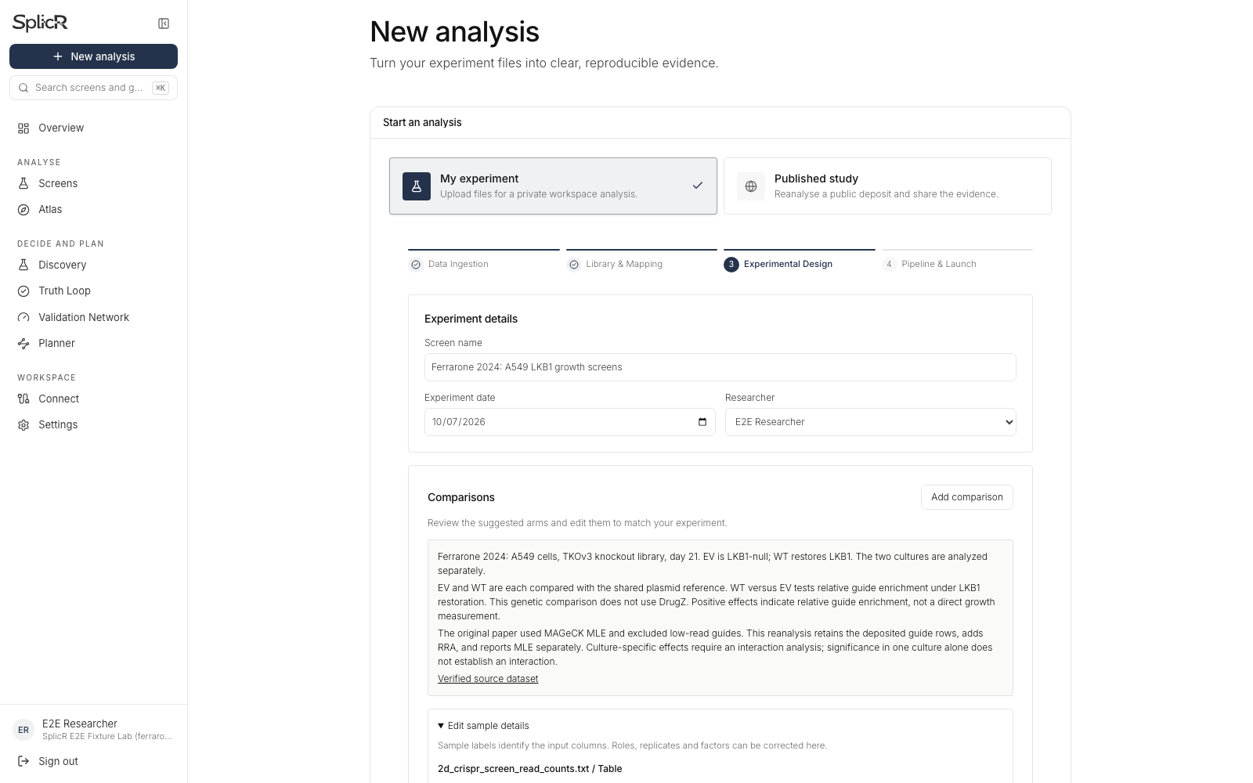
A reusable workflow for other labs
Researchers can change sample roles, replicates and factors.
Their experiment determines the configuration.
17
Notes:
Actual editable sample-metadata screenshot. Tested customization includes custom uploaded guide libraries, correction of selected count columns, donors, replicate labels, dates, researcher attribution, saved draft resumption and FASTQ reads with adapter prefixes. Backend validation checks treatment/control selections, matched replicate requirements for paired DrugZ, normalization controls, MLE design rank and selected coefficients. The exact Ferrarone profile is a special verified study profile, while the generic intake uses evidence-based suggestions and review. This demonstration validates human Cas9 knockout pooled abundance counts; it does not validate every organism, modality or assay. Base editing, multi-gene combinatorial perturbations, single-cell readouts and spatial assays need dedicated models and separate validation. Chronos and copy-number correction are unavailable in this intake because required metadata/profiles are not supplied.

Slide 18
A pilot with the Varmus lab
A reproducible starting point
for the next screen
Agree on the reference analysis.
Review differences together.
Test candidate genes in the lab.
Sahaj Satani, Pranav Mettu, Ishaan Samantray
18
Notes:
Proposed next step for discussion, not a commitment from the lab. Ask the investigators to confirm original normalization, guide filtering, MLE design, permutation settings and complete output tables. Compare a frozen SplicR run to a frozen reference workflow on agreed genes and statistics. Evaluate whether differences are expected methodological effects or defects. Measure analyst time and review burden directly rather than estimating historical authors' work. Choose one new screen with known positive/negative controls and a small follow-up validation set. Prospective validation, not a polished dashboard, determines scientific benefit. No investigator was emailed and no new analysis job was queued for this deck.

Slide 19
Methods and scientific limits
Appendix for scientific discussion
Completed evidence
Open scientific work
Original counts and verified guide annotations
Six RRA reports with separate directional statistics
Independent numerical reproduction
Reconcile MLE with the authors’ settings
Fit a formal culture interaction if required
Validate candidates experimentally
Validation probabilities remain unavailable without a fitted outcomes cohort.
19
Notes:
Sources: https://doi.org/10.1073/pnas.2403685121, https://doi.org/10.7910/DVN/8DEPIT, https://sourceforge.net/p/mageck/wiki/usage/. Reanalysis uses deposited count tables, exact TKOv3 guide-ID annotation, MAGeCK 0.5.9.5, median normalization, RRA union FDR threshold 0.05. It retains all deposited guide rows and does not recreate the authors' Cutadapt/Bowtie processing or unspecified implementation of the read-count <30 filter. Authors' methods describe that filter but not which samples define it. MLE runs use explicit baseline-first design, seed 0, 10 permutation rounds and grouped permutations. We did not reduce permutation rounds to claim a faster run. Copy-number correction, Chronos, BAGEL2 and DrugZ are off in this study's completed RRA cohort. Core essential separation supports count-table fitness QC, but replicate disagreement and skew remain warnings. Count tables cannot establish sequencing mapping efficiency. Atlas comparison excludes the query publication to limit leakage. The validation network has no fitted outcomes cohort on this deployed worker and refuses probabilities with a reason. Missing predictions and absent methods must stay unavailable. Separate WT/EV culture tests do not establish a culture interaction.

Slide 20
Sources and demo files
Appendix for follow-up
Paper
10.1073/pnas.2403685121
CRISPR data
10.7910/DVN/8DEPIT
SplicR-Ferrarone-demo.zip
Two original count tables
SplicR-Ferrarone-results.zip
Six complete RRA result packages
splicr.org
Primary references and full provenance appear in the speaker notes and the accompanying guide.
20
Notes:
Primary research: Ferrarone et al., PNAS 2024, https://doi.org/10.1073/pnas.2403685121. Harvard Dataverse CRISPR dataset V1: https://doi.org/10.7910/DVN/8DEPIT. 2D download https://dataverse.harvard.edu/api/access/datafile/7440985. Spheroid download https://dataverse.harvard.edu/api/access/datafile/7440983. Broad post-screen page: https://portals.broadinstitute.org/gpp/public/resources/post-screen. Apron primary user guide: https://docs.google.com/document/d/14ry2-S3zWCwJVZzxS2QLSdNGqyl6QaFK7rhkcyh7jXU/preview. MAGeCK official usage: https://sourceforge.net/p/mageck/wiki/usage/. PinAPL-Py original publication: https://www.nature.com/articles/s41598-017-16193-9. Local proof: source-manifest.json, gene-annotation-audit.csv, rra-cloud/cloud-verification.json, rra-cloud/independent-cloud-agreement.json, comparison-summary.csv, reference-gene-statistics.csv, production browser screenshots. SplicR production: https://www.splicr.org. Published Figure 4: Copyright 2024 the authors, CC BY-NC-ND 4.0, original complete figure retained for discussion. Do not treat the image as a SplicR-generated result.

