Slide 1
Data Storytelling & Statistical Validation
Data Analyst Internship
Prepared by: Sathya Prakash S
ApexPlanet Pvt Ltd.

Slide 2
Business Objective
Analyze customer sales data to identify business trends and patterns.
Discover top-performing products, categories, and cities.
Understand monthly sales performance.
Present insights through data visualization to support business decisions.

Slide 3
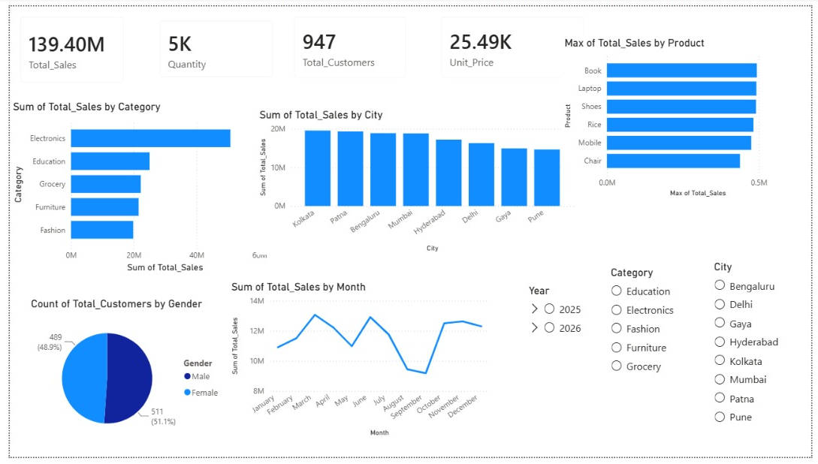
Key Insights & Dashboard
Total Sales: 139.40M
Total Customers: 947
Total Quantity Sold: 5K
Average Unit Price: 25.49K
Top Category: Electronics
Top City: Kolkata
Peak Sales Months: March, June, October & November
Conclusion: The dashboard indicates strong business performance, with Electronics leading sales across categories and Kolkata emerging as the highest-performing city. Seasonal patterns show increased sales during March, June, October, and November, supporting data-driven business decisions.

Slide 4
Statistical Validation & Business Recommendations
Hypothesis Testing
STATISTICAL VALIDATION
• Electronics recorded the highest sales among all product categories.
• Sales peaked during March, June, October, and November.
• Customer distribution between male and female customers is nearly balanced.
• The dashboard reveals meaningful business trends that support data-driven decision-making.
H₀ (Null Hypothesis)
There is no significant difference in sales across product categories.
H₁ (Alternative Hypothesis)
There is a significant difference in sales across product categories.

Slide 5
BUSINESS RECOMMENDATIONS & CONCLUSION
Increase inventory for Electronics products to meet customer demand and maximize sales.
Launch promotional campaigns during peak sales months (March, June, October, and November).
Strengthen marketing strategies for lower-performing product categories to improve overall sales.
Expand successful sales strategies from top-performing cities to other regions.
Continuously monitor sales trends and customer behavior to support data-driven business decisions.
Conclusion:
The analysis confirms strong business performance, with Electronics emerging as the top-performing category and Kolkata leading in city-wise sales. Seasonal demand patterns indicate higher sales during March, June, October, and November. These insights support strategic decisions in inventory planning, marketing, and business growth.

