Slide 1
NLP Tutor
Visvesvaraya National Institute of Technology (VNIT), Nagpur
Mtech- AAI
Subject : NLP - Mini Project
By –
Saurabh Sharma – MT23AAI018
Sadashiv Nayak A – MT23AAI039
Dated – 20/06/2025
Visvesvaraya National Institute of Technology (VNIT), Nagpur

Slide 2
Problem Statement
Visvesvaraya National Institute of Technology (VNIT), Nagpur
https://chatgpt.com/c/67https://chatgpt.com/c/674af965-dc48-8011-b67a-5327fce0e2c9#:~:text=Need%20for%20Automation,exacerbates%20this%20challenge.4af965-dc48-8011-b67a-5327fce0e2c9#:~:text=Need%20for%20Automation,exacerbates%20this%20challenge.
Manual PDF reading is time-consuming and inefficient.
Users struggle to find relevant information in long documents.
Need for an intelligent, conversational assistant to understand documents.
Visvesvaraya National Institute of Technology (VNIT), Nagpur

Slide 3
Proposed Solution
Visvesvaraya National Institute of Technology (VNIT), Nagpur
Developed a Streamlit-based chatbot for interactive PDF querying.
Leverages NLP, embeddings, and LLMs for context-aware answers.
Provides YouTube recommendations related to user queries.
Visvesvaraya National Institute of Technology (VNIT), Nagpur

Slide 4
Technology Stack
Visvesvaraya National Institute of Technology (VNIT), Nagpur
Frontend: Streamlit
Backend: Python, LangChain, FAISS
Embeddings: sentence-transformers/all-MiniLM-L6-v2
LLM: LLaMA 3 via Groq API
YouTube integration: yt_dlp
Visvesvaraya National Institute of Technology (VNIT), Nagpur

Slide 5
System Architecture
Visvesvaraya National Institute of Technology (VNIT), Nagpur
PDF Upload → Text Extraction → Chunking
Embedding with MiniLM → FAISS Vector Storage
User Query → Contextual Retrieval → LLaMA3 Response
Chat History and YouTube Video Suggestions
Visvesvaraya National Institute of Technology (VNIT), Nagpur

Slide 6
Key Features
Visvesvaraya National Institute of Technology (VNIT), Nagpur
Chat with documents using natural language
Automatic document chunking and embedding
Context-aware QA via LangChain
Persistent session management with caching
YouTube video recommendations
Visvesvaraya National Institute of Technology (VNIT), Nagpur

Slide 7
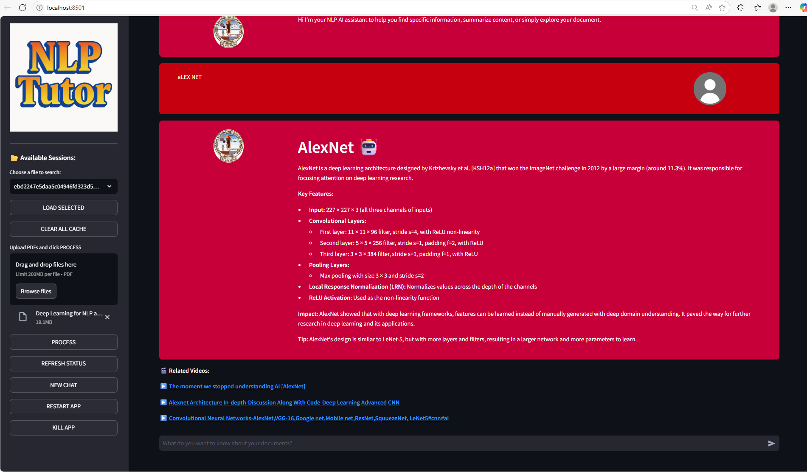
GUI
Visvesvaraya National Institute of Technology (VNIT), Nagpur
Visvesvaraya National Institute of Technology (VNIT), Nagpur

Slide 8
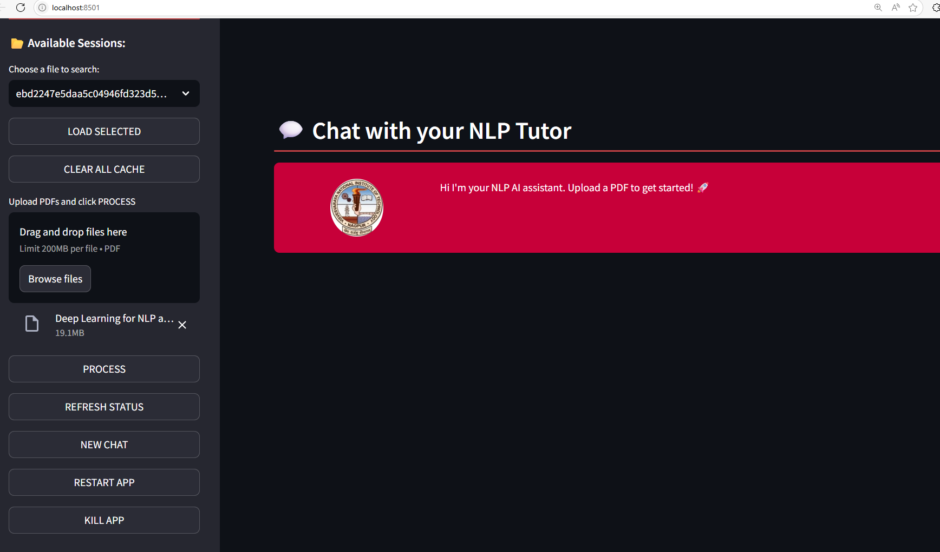
GUI
Visvesvaraya National Institute of Technology (VNIT), Nagpur
Visvesvaraya National Institute of Technology (VNIT), Nagpur

Slide 9
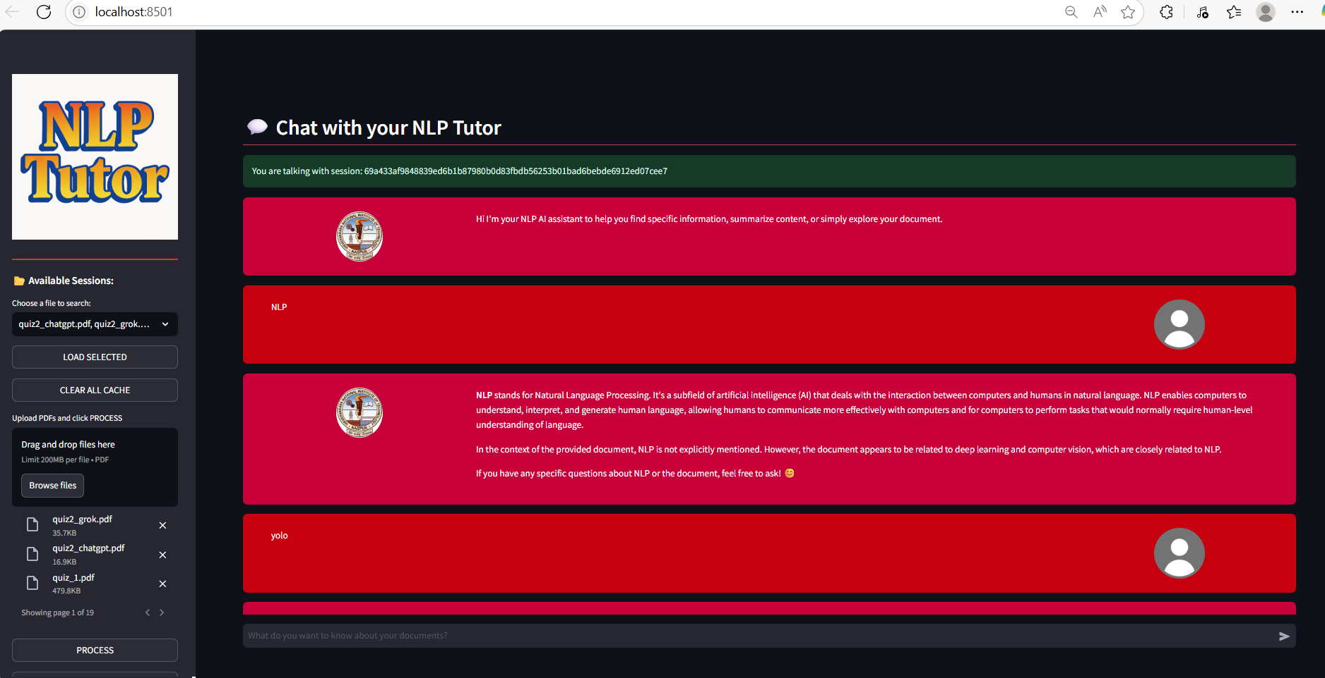
GUI
Visvesvaraya National Institute of Technology (VNIT), Nagpur
Visvesvaraya National Institute of Technology (VNIT), Nagpur

Slide 10
Code Modules
Visvesvaraya National Institute of Technology (VNIT), Nagpur
app.py – Streamlit interface, PDF handling, threading
functions.py – PDF processing, embedding, RAG pipeline
models.py – LLaMA3 model setup from Groq
html_template.py – Custom chat styling templates
Visvesvaraya National Institute of Technology (VNIT), Nagpur

Slide 11
Demo Flow
Visvesvaraya National Institute of Technology (VNIT), Nagpur
Upload PDF files via UI
Process and embed documents (background thread)
Ask questions in chat box
Get AI-generated answers and video suggestions
Manage sessions via cache and reload buttons
Visvesvaraya National Institute of Technology (VNIT), Nagpur

Slide 12
Challenges Faced
Visvesvaraya National Institute of Technology (VNIT), Nagpur
Handling large PDFs efficiently
Maintaining vector consistency across sessions
Managing multithreading in Streamlit
Model API rate limits and token management
Visvesvaraya National Institute of Technology (VNIT), Nagpur

Slide 13
Conclusion
Visvesvaraya National Institute of Technology (VNIT), Nagpur
https://chatgpt.com/c/67https://chatgpt.com/c/674af965-dc48-8011-b67a-5327fce0e2c9#:~:text=Need%20for%20Automation,exacerbates%20this%20challenge.4af965-dc48-8011-b67a-5327fce0e2c9#:~:text=Need%20for%20Automation,exacerbates%20this%20challenge.
Successfully built a conversational Subject Tutor/PDF assistant.
Applied advanced NLP and vector search techniques.
Real-time, scalable, and user-friendly tool.
Visvesvaraya National Institute of Technology (VNIT), Nagpur

