Slide 1
NLP Tutor
Visvesvaraya National Institute of Technology (VNIT), Nagpur
Mtech- AAI
Subject : NLP - Mini Project
By –
Saurabh Sharma – MT23AAI018
Sadashiv Nayak A – MT23AAI039
Dated – 20/06/2025
Visvesvaraya National Institute of Technology (VNIT), Nagpur

Slide 2
Problem Statement
Visvesvaraya National Institute of Technology (VNIT), Nagpur
https://chatgpt.com/c/67https://chatgpt.com/c/674af965-dc48-8011-b67a-5327fce0e2c9#:~:text=Need%20for%20Automation,exacerbates%20this%20challenge.4af965-dc48-8011-b67a-5327fce0e2c9#:~:text=Need%20for%20Automation,exacerbates%20this%20challenge.
Manual PDF reading is time-consuming and inefficient.
Users struggle to find relevant information in long documents.
Need for an intelligent, conversational assistant to understand documents.
Visvesvaraya National Institute of Technology (VNIT), Nagpur

Slide 3
Proposed Solution
Visvesvaraya National Institute of Technology (VNIT), Nagpur
Developed a Streamlit-based chatbot for interactive PDF querying.
Leverages NLP, embeddings, and LLMs for context-aware answers.
Provides YouTube recommendations related to user queries.
Visvesvaraya National Institute of Technology (VNIT), Nagpur

Slide 4
Technology Stack
Visvesvaraya National Institute of Technology (VNIT), Nagpur
Frontend: Streamlit
Backend: Python, LangChain, FAISS
Embeddings: sentence-transformers/all-MiniLM-L6-v2
LLM: LLaMA 3 via Groq API
YouTube integration: yt_dlp
Visvesvaraya National Institute of Technology (VNIT), Nagpur

Slide 5
System Architecture
Visvesvaraya National Institute of Technology (VNIT), Nagpur
PDF Upload → Text Extraction → Chunking
Embedding with MiniLM → FAISS Vector Storage
User Query → Contextual Retrieval → LLaMA3 Response
Chat History and YouTube Video Suggestions
Visvesvaraya National Institute of Technology (VNIT), Nagpur

Slide 6
Key Features
Visvesvaraya National Institute of Technology (VNIT), Nagpur
Chat with documents using natural language
Automatic document chunking and embedding
Context-aware QA via LangChain
Persistent session management with caching
YouTube video recommendations
Visvesvaraya National Institute of Technology (VNIT), Nagpur

Slide 7
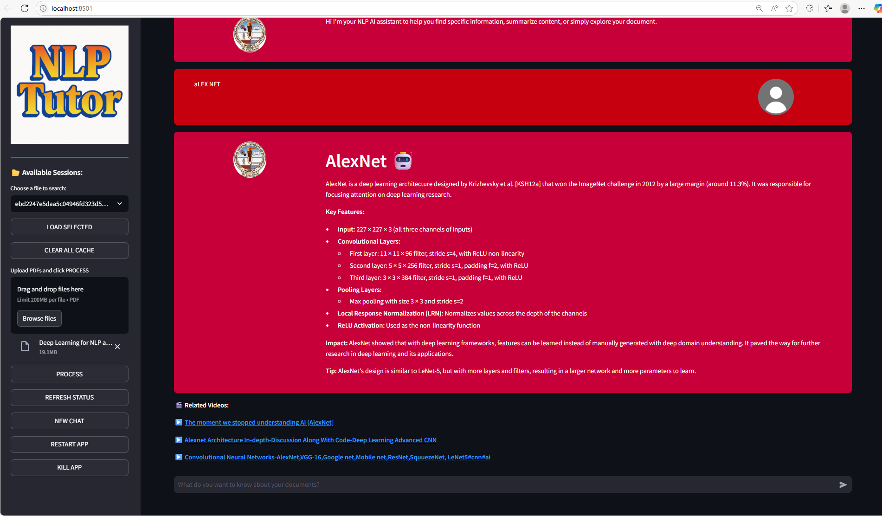
GUI
Visvesvaraya National Institute of Technology (VNIT), Nagpur
Visvesvaraya National Institute of Technology (VNIT), Nagpur

Slide 8
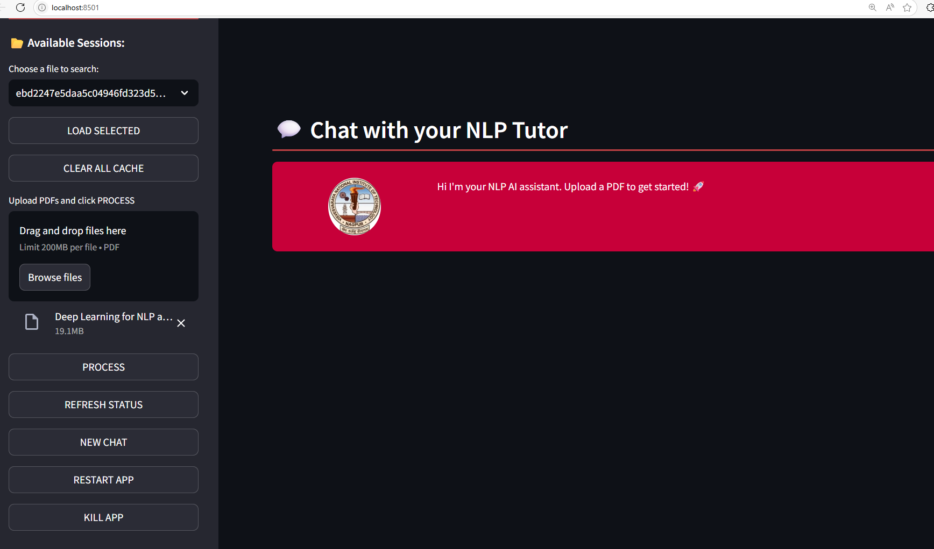
GUI
Visvesvaraya National Institute of Technology (VNIT), Nagpur
Visvesvaraya National Institute of Technology (VNIT), Nagpur

Slide 9
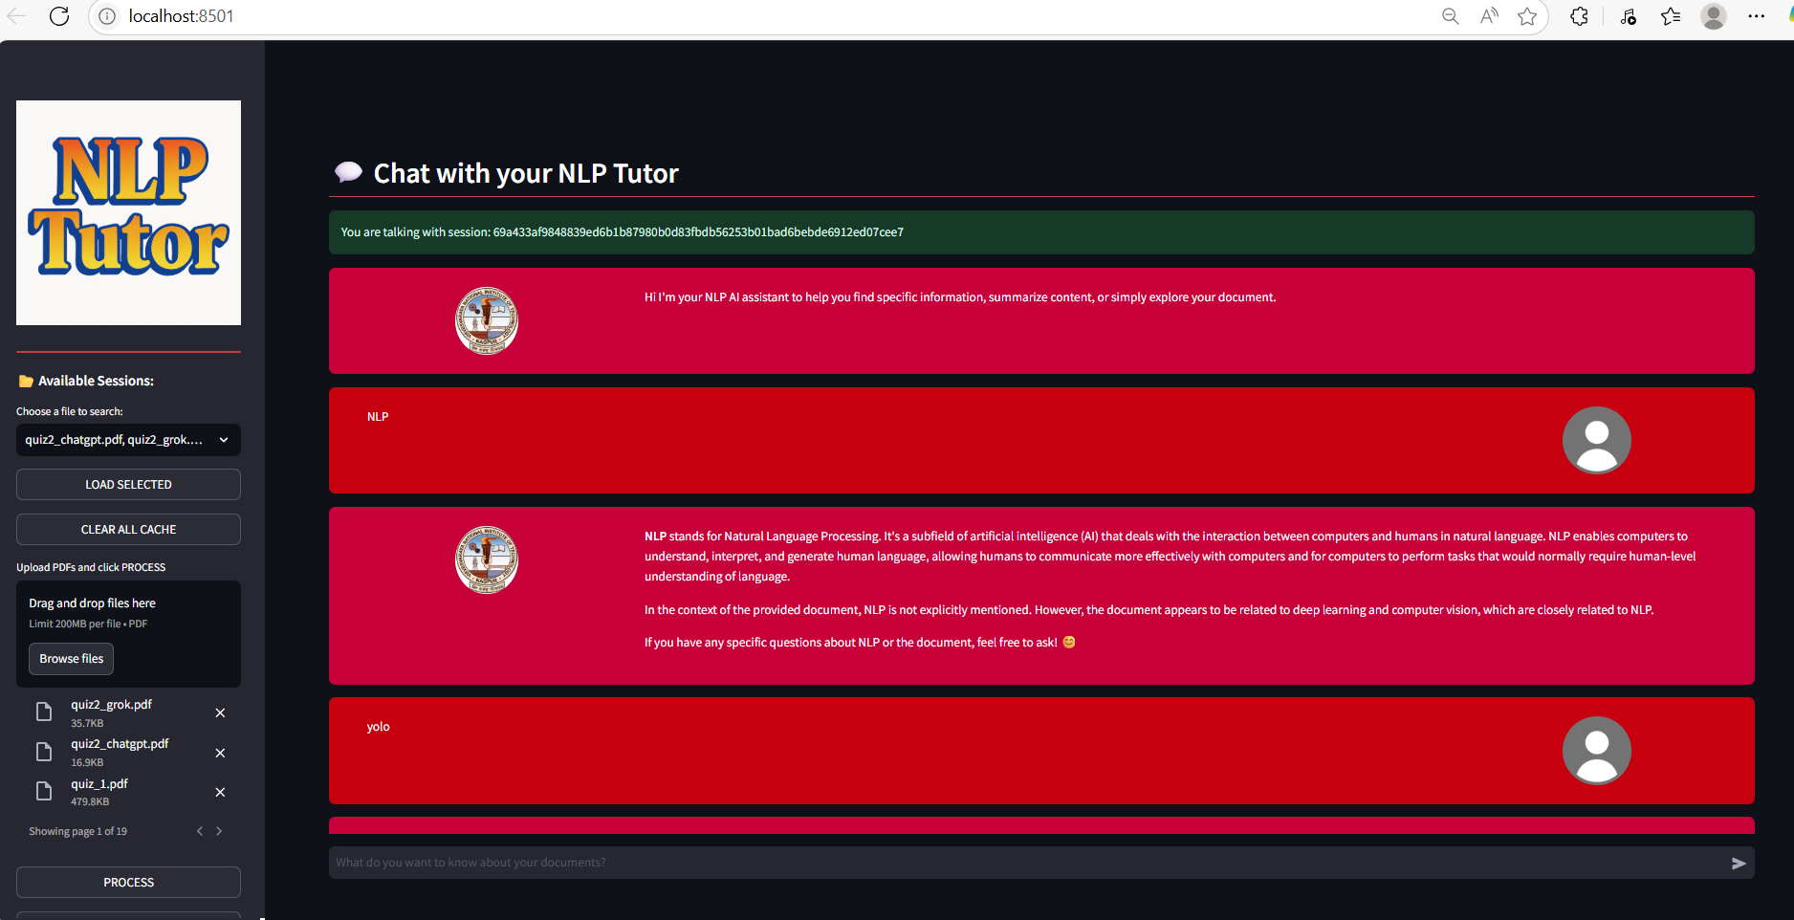
GUI
Visvesvaraya National Institute of Technology (VNIT), Nagpur
Visvesvaraya National Institute of Technology (VNIT), Nagpur

Slide 10
Code Modules
Visvesvaraya National Institute of Technology (VNIT), Nagpur
app.py – Streamlit interface, PDF handling, threading
functions.py – PDF processing, embedding, RAG pipeline
models.py – LLaMA3 model setup from Groq
html_template.py – Custom chat styling templates
Visvesvaraya National Institute of Technology (VNIT), Nagpur

Slide 11
Demo Flow
Visvesvaraya National Institute of Technology (VNIT), Nagpur
Upload PDF files via UI
Process and embed documents (background thread)
Ask questions in chat box
Get AI-generated answers and video suggestions
Manage sessions via cache and reload buttons
Visvesvaraya National Institute of Technology (VNIT), Nagpur

Slide 12
Challenges Faced
Visvesvaraya National Institute of Technology (VNIT), Nagpur
Handling large PDFs efficiently
Maintaining vector consistency across sessions
Managing multithreading in Streamlit
Model API rate limits and token management
Visvesvaraya National Institute of Technology (VNIT), Nagpur

Slide 13
Conclusion
Visvesvaraya National Institute of Technology (VNIT), Nagpur
https://chatgpt.com/c/67https://chatgpt.com/c/674af965-dc48-8011-b67a-5327fce0e2c9#:~:text=Need%20for%20Automation,exacerbates%20this%20challenge.4af965-dc48-8011-b67a-5327fce0e2c9#:~:text=Need%20for%20Automation,exacerbates%20this%20challenge.
Successfully built a conversational Subject Tutor/PDF assistant.
Applied advanced NLP and vector search techniques.
Real-time, scalable, and user-friendly tool.
Visvesvaraya National Institute of Technology (VNIT), Nagpur

Slide 14
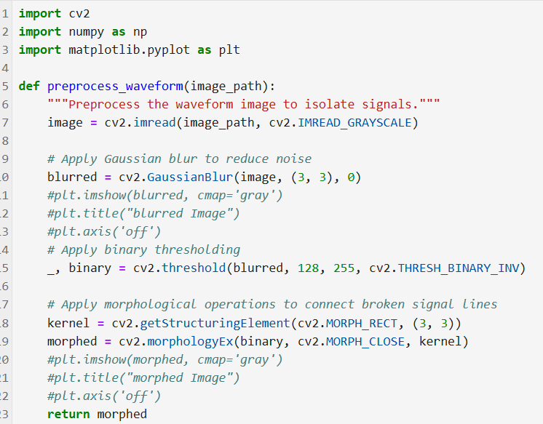
Preprocessing
Visvesvaraya National Institute of Technology (VNIT), Nagpur
Goal: Enhance the image to isolate the signals for analysis.
Steps:
Convert the image to grayscale.
Apply Gaussian blur to reduce noise
and smooth the image.
Perform binary thresholding to separate
the signal from the background.
Apply morphological operations
to connect any broken signal lines using
the cv2.MORPH_CLOSE function.
Visvesvaraya National Institute of Technology (VNIT), Nagpur

Slide 15
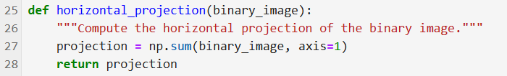
Horizontal Projection
Visvesvaraya National Institute of Technology (VNIT), Nagpur
Goal: Identify regions with signal activity.
Steps:
Concept - Compute the sum of pixel values for each row in the binary image.
The result is a 1D array, where each element corresponds to the total activity (brightness) of a row.
Visvesvaraya National Institute of Technology (VNIT), Nagpur

Slide 16
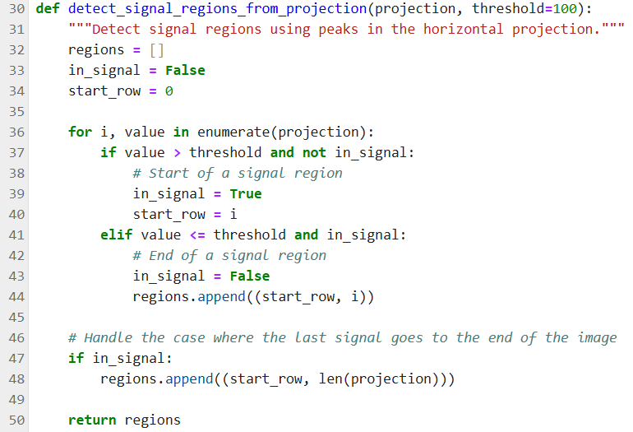
Signal Region Detection
Visvesvaraya National Institute of Technology (VNIT), Nagpur
Goal: Locate vertical signal regions using the horizontal projection.
Approaches:
Method 1: Directly analyze projection
values above a threshold to determine
the start and end rows of signal regions.
Method 2: Use np.where to identify
rows with significant activity and group
them into contiguous regions.
Visvesvaraya National Institute of Technology (VNIT), Nagpur

Slide 17
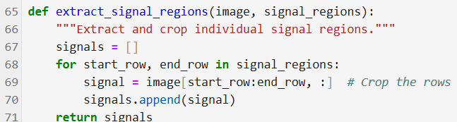
Signal Extraction
Visvesvaraya National Institute of Technology (VNIT), Nagpur
Goal: Crop individual signal regions from the original image.
Steps:
Extract rows corresponding to detected signal regions.
Store each cropped signal as a separate image for further analysis.
Visvesvaraya National Institute of Technology (VNIT), Nagpur

Slide 18
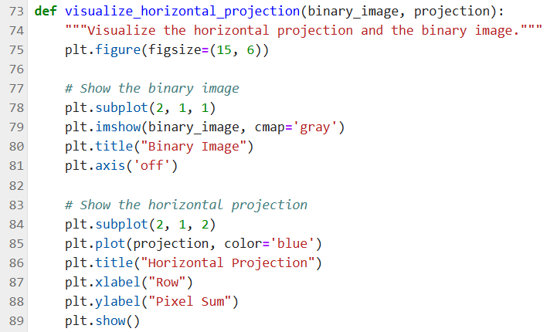
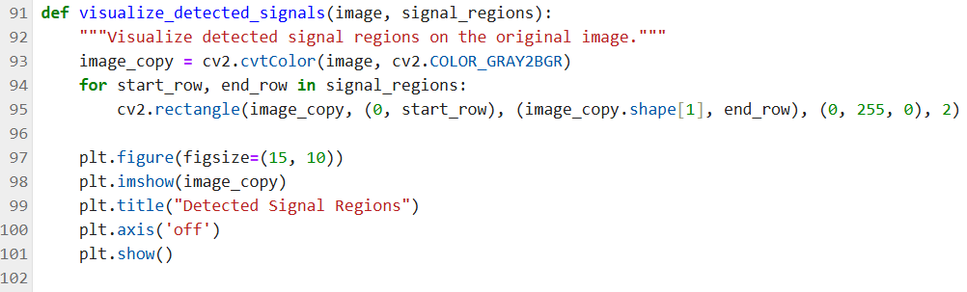
Visualization
Visvesvaraya National Institute of Technology (VNIT), Nagpur
Horizontal Projection Visualization:
Plot the binary image and its horizontal projection side by side to explain how regions are detected.
Signal Region Visualization:
Overlay rectangles on the original image to highlight detected signal regions.
Visvesvaraya National Institute of Technology (VNIT), Nagpur

Slide 19
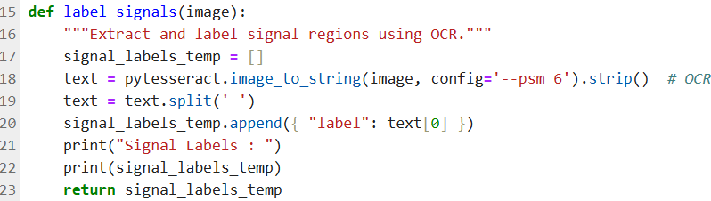
Signal Labeling
Visvesvaraya National Institute of Technology (VNIT), Nagpur
Goal: Identify and label each signal using Optical Character Recognition (OCR).
Steps:
Use easyocr to extract textual information from each signal region.
If OCR fails, fallback to a default label like "Signal_X."
Visvesvaraya National Institute of Technology (VNIT), Nagpur

Slide 20
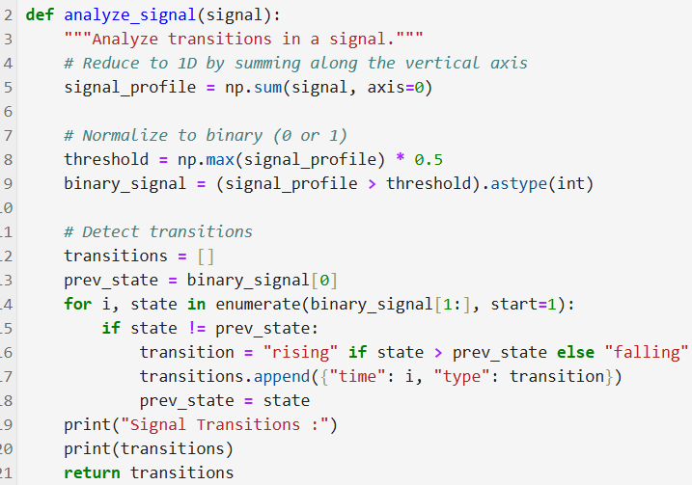
Signal Transition Analysis
Visvesvaraya National Institute of Technology (VNIT), Nagpur
Goal: Identify transitions (rising or falling edges) in the signal waveform.
Steps:
Convert each signal to a 1D array by
summing pixel values along columns.
Normalize the signal to binary and
detect transitions based on changes in
value.
Visvesvaraya National Institute of Technology (VNIT), Nagpur

Slide 21
Signal Transition Analysis
Visvesvaraya National Institute of Technology (VNIT), Nagpur
Goal: Identify transitions (rising or falling edges) in the signal waveform.
Problems:
Unable to properly detect the transitions from the processed signal image Using CV based methods
Alternate Approaches proposed –
Use a Pretrained Edge Detection Model (e.g., HED - Holistically-Nested Edge Detection)
Convolutional Neural Network (CNN) for Signal Segmentation- Train or use a pretrained CNN to segment the timing diagram into signal regions (high and low states). This can be adapted from models used for image segmentation (e.g., U-Net).
Apply a wavelet transform to the signal row to detect the edges of the square wave. Wavelet transforms are effective for analyzing periodic signals and can identify transition points without extensive preprocessing.
Visvesvaraya National Institute of Technology (VNIT), Nagpur

Slide 22
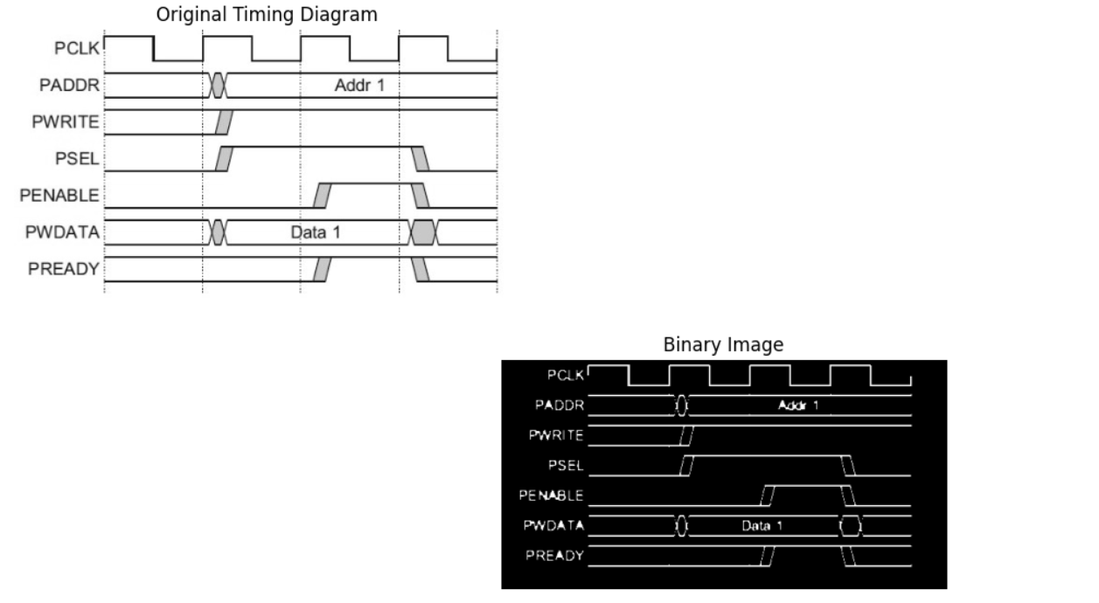
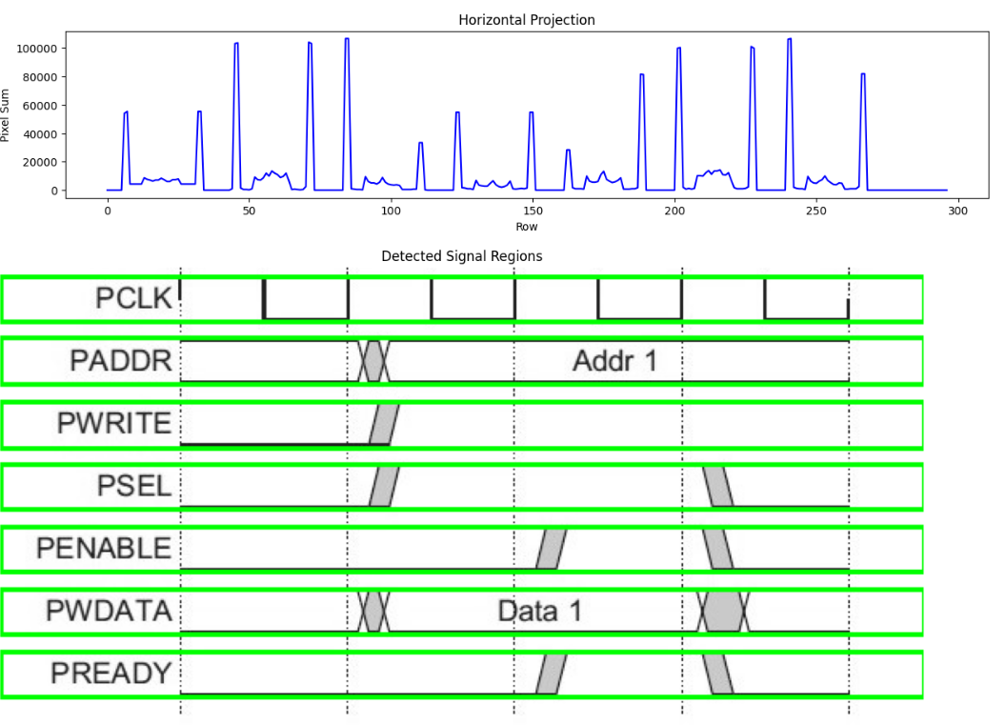
Output/Results
Visvesvaraya National Institute of Technology (VNIT), Nagpur
Visvesvaraya National Institute of Technology (VNIT), Nagpur

Slide 23
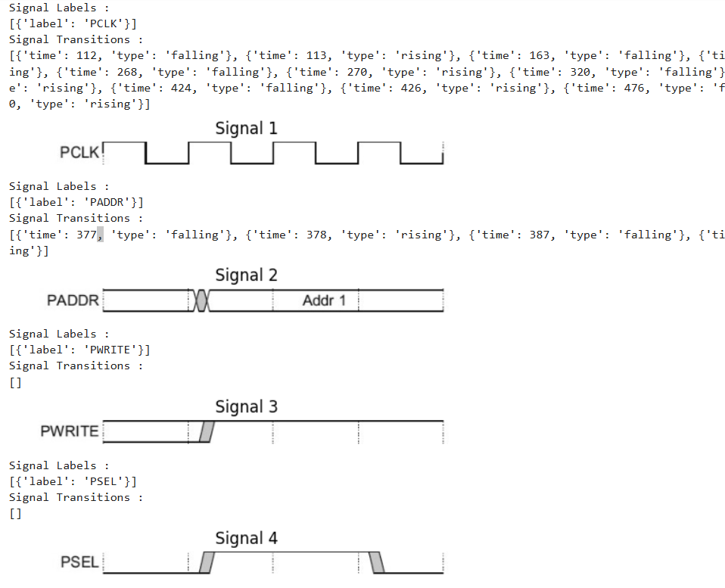
Output
Visvesvaraya National Institute of Technology (VNIT), Nagpur
Visvesvaraya National Institute of Technology (VNIT), Nagpur

Slide 24
Conclusion
Visvesvaraya National Institute of Technology (VNIT), Nagpur
Results:
Individual signal regions from timing diagram extracted.
Successfully extracted signal names from timing diagram using OCR
Recorded the transitions of the signals
Challenges Faced:
OCR inaccuracies with noisy or unclear signal labels.
Handling noisy or incomplete timing diagram/waveform
Inaccurate pixel values in an image with some blanks.
Scalability for timing diagrams with many signals.
Future Scope Of Work:
Expand to more complex timing diagrams.
Generating Assertions automatically
Protocol specification(Natural language specification) doc to SVA conversion using LLM
Extract constraints
Extract timing relationships between signals from spec.
Visvesvaraya National Institute of Technology (VNIT), Nagpur

Slide 25
End
Visvesvaraya National Institute of Technology (VNIT), Nagpur
Thank You
Visvesvaraya National Institute of Technology (VNIT), Nagpur

