Slide 1
CHAPTER 10
Interest Rate Swaps

Slide 2
Fixed vs variable interest rate
A fixed interest rate:
  is determined at the time the loan is written,
  does not change over the term of the loan.
A variable interest rate:
  is adjusted periodically to reflect market conditions,
  is usually expressed as an index (e.g., the prime rate, or the London Inter-Bank Offered Rate)
  plus a spread.

Slide 3
Interest rate swaps
An interest rate swap is a contractual agreement
between two parties (the counterparties) in which
each party makes periodic interest payments to the other
over a specified period (the swap term or swap tenor)
based on a specific principal amount (the notional amount).

Slide 4
The transaction
One party (the payer) pays the swap rate (fixed).
The other party (the receiver) pays a variable rate.

Slide 5
Timing of payments
The specific times at which payments are made (the settlement dates) are usually equally spaced (daily, weekly, monthly, quarterly, annually).
The time between settlement dates is known as the settlement period.
The first settlement period usually begins at time 0.
A swap that starts at a later date is a deferred swap.

Slide 6
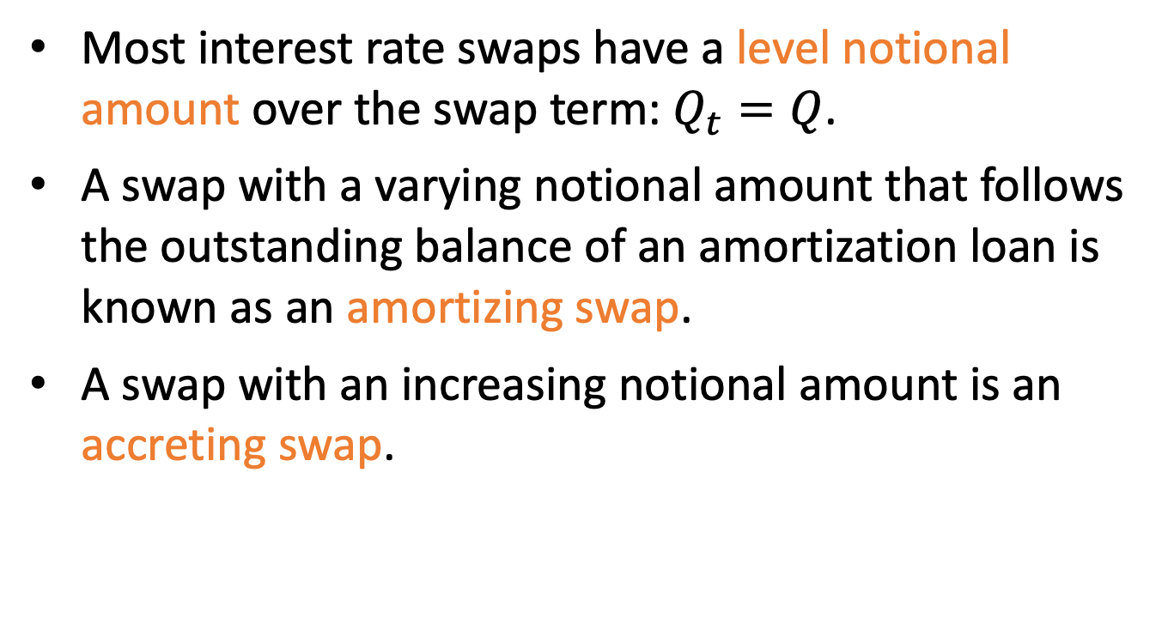
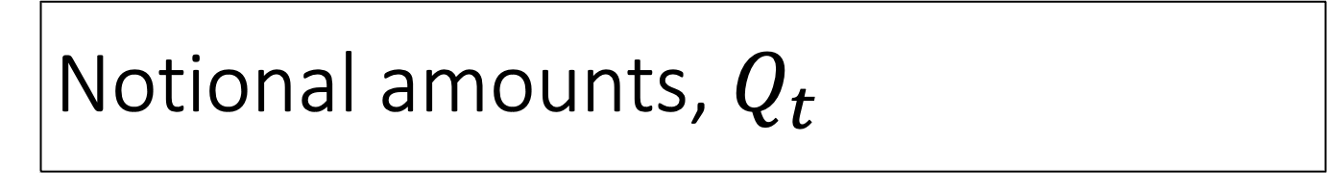
Notional amounts, $Q_{t}$
Most interest rate swaps have a level notional amount over the swap term: $Q_{t}=Q$.
A swap with a varying notional amount that follows the outstanding balance of an amortization loan is known as an amortizing swap.
A swap with an increasing notional amount is an accreting swap.

Slide 7
Uses of interest rate swaps
Hedging → reducing risk associated with an existing obligation
  If a company has an obligation to pay a variable rate (e.g., on a loan) but would prefer to pay a fixed rate (e.g., because their income is fixed)
  If a company has an obligation to pay a fixed rate but would prefer to pay a variable rate (e.g., because income is interest-sensitive)
Speculation → making a bet in search of a reward

Slide 8
Example 10.1
ABC Corp has borrowed $500,000 for the next 2 years at a variable interest rate. Under this loan, ABC will pay interest at the end of year 1 and the end of year 2. The amount of the interest is based on the one-year spot rate at the start of year 1 and year 2, respectively.
0 1 2

Slide 9
Example 10.1, continued
Suppose the current spot rates are an annual effective interest rate of 5% for a one-year period and an annual effective interest rate of 6% for a two-year period. Find the implied one-year forward rate.
0 1 2

Slide 10
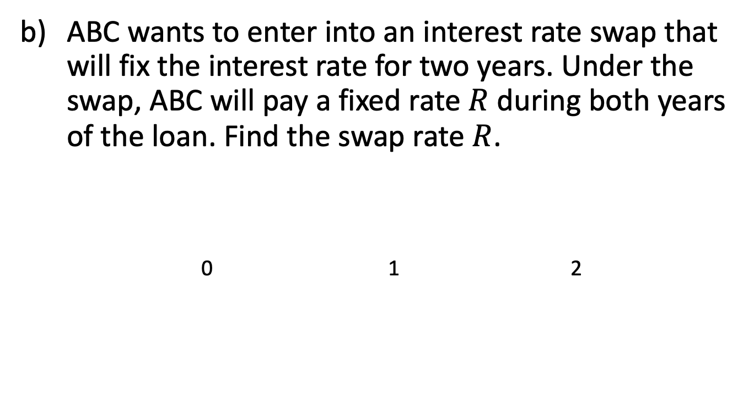
Example 10.1, continued
ABC wants to enter into an interest rate swap that will fix the interest rate for two years. Under the swap, ABC will pay a fixed rate $R$ during both years of the loan. Find the swap rate $R$.
0 1 2

Slide 11
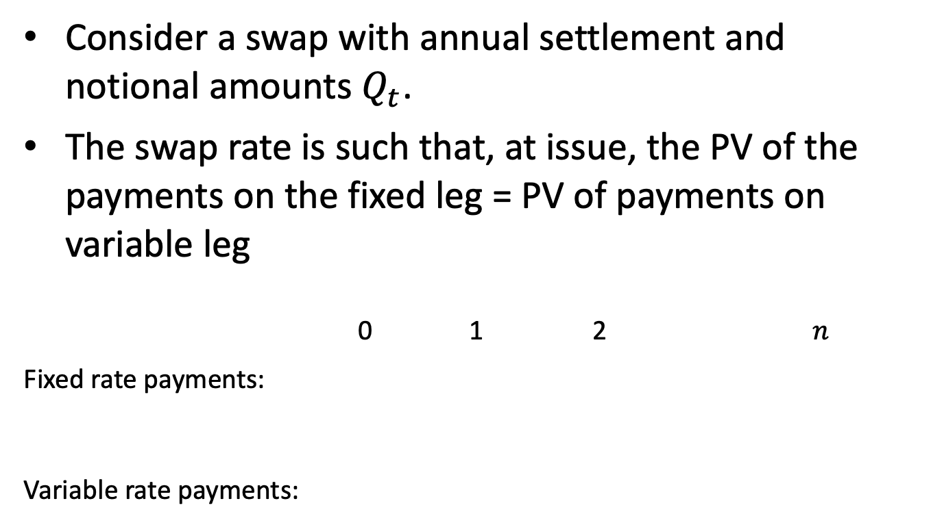
General formula for swap rate
Consider a swap with annual settlement and notional amounts $Q_{t}$.
The swap rate is such that, at issue, the PV of the payments on the fixed leg = PV of payments on variable leg
0 1 2 $n$
Fixed rate payments:
Variable rate payments:

Slide 12
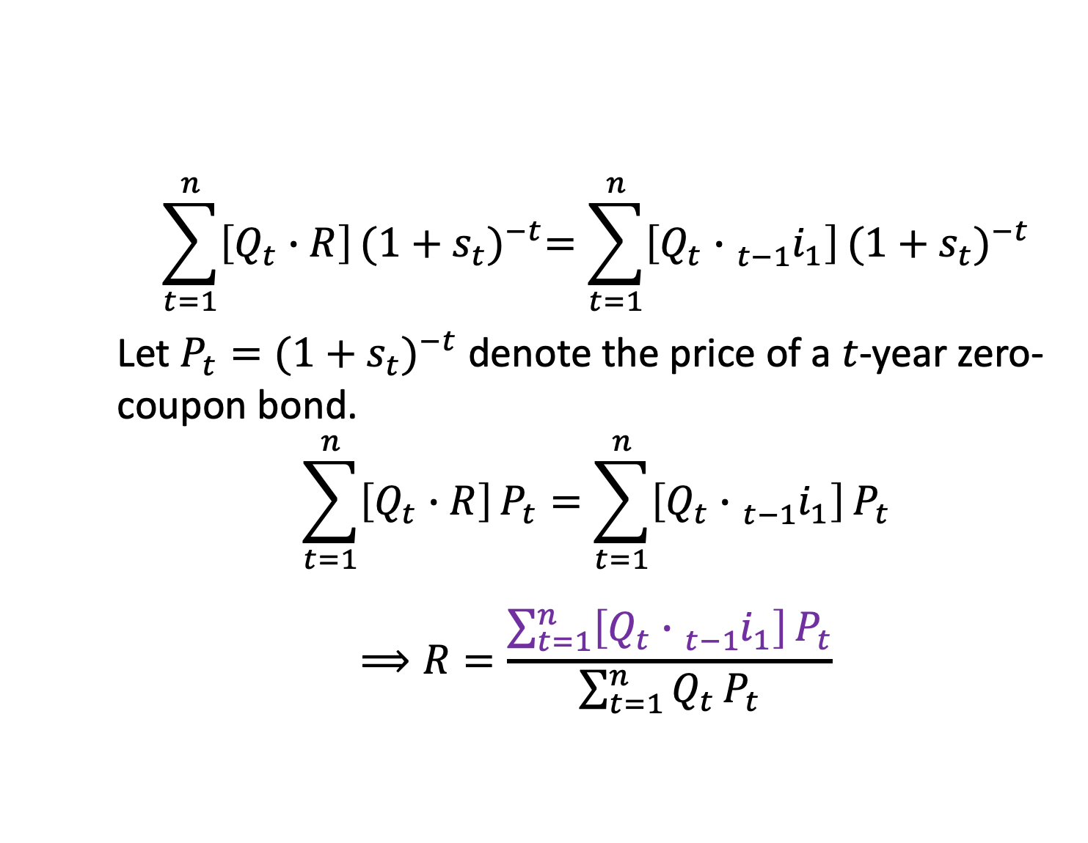
General formula for swap rate, cont’d
$$\sum_{t=1}^{n}{\left[Q_{t}∙R\right]}{(1+s_{t})}^{−t}=\sum_{t=1}^{n}{\left[Q_{t}∙{}_{t−1}^{ }{i_{1}}\right]}{(1+s_{t})}^{−t}$$
Let ${P_{t}=(1+s_{t})}^{−t}$ denote the price of a $t$-year zero-coupon bond.
$$\sum_{t=1}^{n}{\left[Q_{t}∙R\right]}P_{t}=\sum_{t=1}^{n}{\left[Q_{t}∙{}_{t−1}^{ }{i_{1}}\right]}P_{t}$$
$$⟹R=\frac{\sum_{t=1}^{n}{\left[Q_{t}∙{}_{t−1}^{ }{i_{1}}\right]}P_{t}}{\sum_{t=1}^{n}{Q_{t}}P_{t}}$$

Slide 13
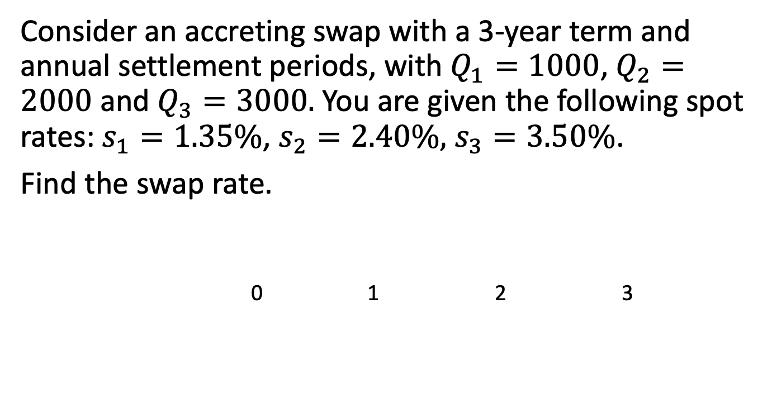
Example 10.2
Consider an accreting swap with a 3-year term and annual settlement periods, with $Q_{1}=1000$, $Q_{2}=2000$ and $Q_{3}=3000.$You are given the following spot rates: $s_{1}=1.35\%$, $s_{2}=2.40\%,$ $s_{3}=3.50\%$.
Find the swap rate.
0 1 2 3

Slide 14
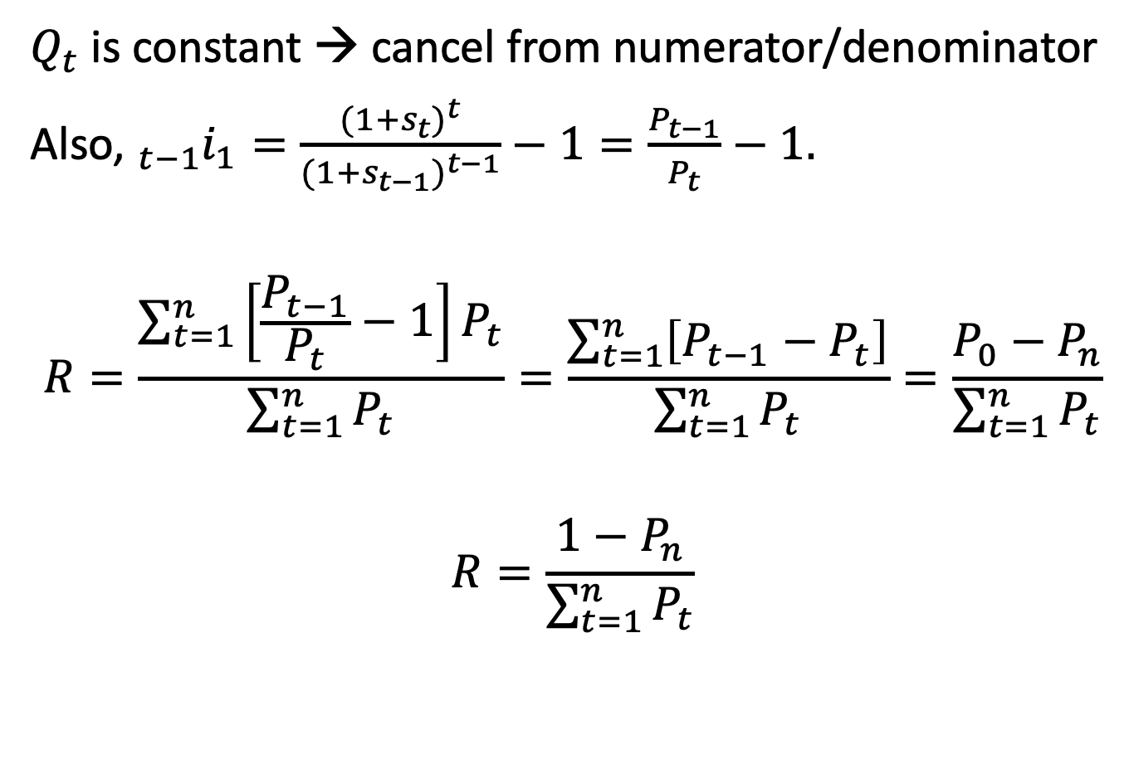
Level notional amount
$Q_{t}$ is constant → cancel from numerator/denominator
Also, ${}_{t−1}^{ }{i_{1}}=\frac{{(1+s_{t})}^{t}}{{(1+s_{t−1})}^{t−1}}−1=\frac{P_{t−1}}{P_{t}}−1.$
$$R=\frac{\sum_{t=1}^{n}{\left[\frac{P_{t−1}}{P_{t}}−1\right]}P_{t}}{\sum_{t=1}^{n}{P_{t}}}=\frac{\sum_{t=1}^{n}{\left[P_{t−1}−P_{t}\right]}}{\sum_{t=1}^{n}{P_{t}}}=\frac{P_{0}−P_{n}}{\sum_{t=1}^{n}{P_{t}}}$$
$$R=\frac{1−P_{n}}{\sum_{t=1}^{n}{P_{t}}}$$

Slide 15
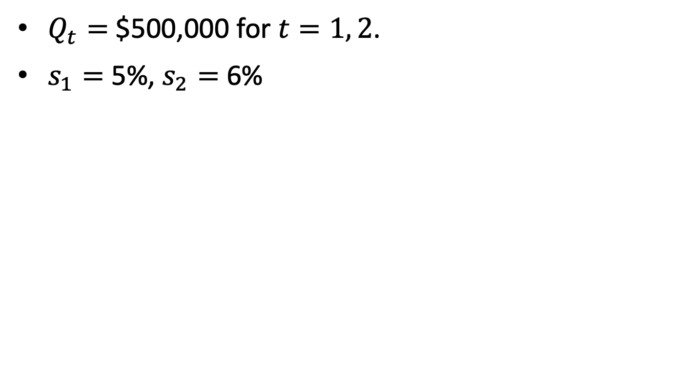
Example 10.1, revisited
$Q_{t}=$ $500,000 for $t=1, 2$.
$s_{1}=$ 5%, $s_{2}=$ 6%

Slide 16
Net swap payments
Under an interest rate swap, the payments are netted: only the difference between the payments (the net swap payment) is made by one party to the other.
Example 10.1, continued: Suppose ABC enters into the swap with DEF Ltd. Find the net swap payments.
0 1 2
Fixed rate payment:
Variable rate payment:
Net swap payment:

Slide 17
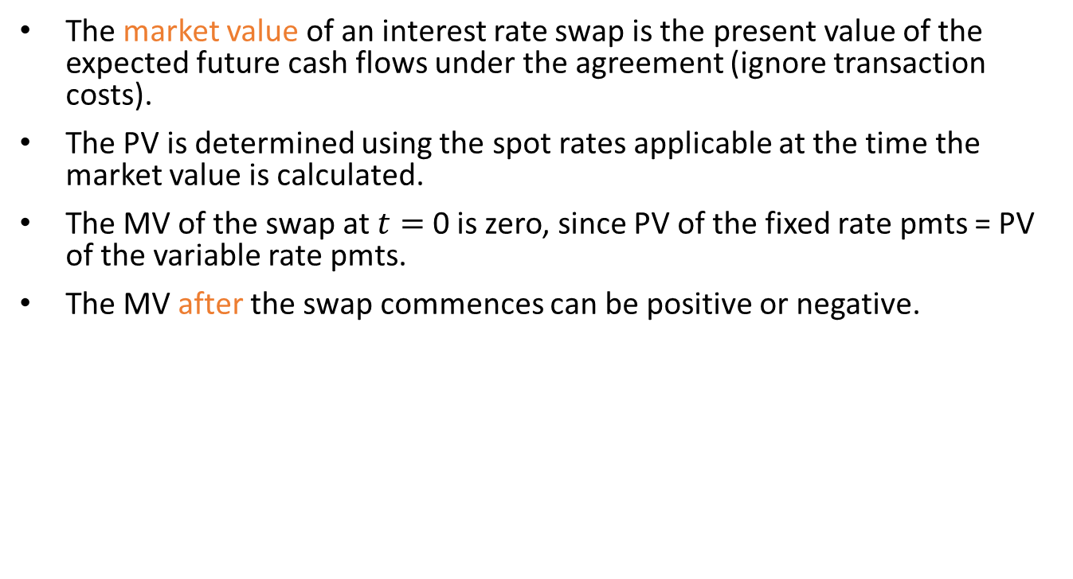
Market value of a swap
The market value of an interest rate swap is the present value of the expected future cash flows under the agreement (ignore transaction costs).
The PV is determined using the spot rates applicable at the time the market value is calculated.
The MV of the swap at $t=$ 0 is zero, since PV of the fixed rate pmts = PV of the variable rate pmts.
The MV after the swap commences can be positive or negative.

Slide 18
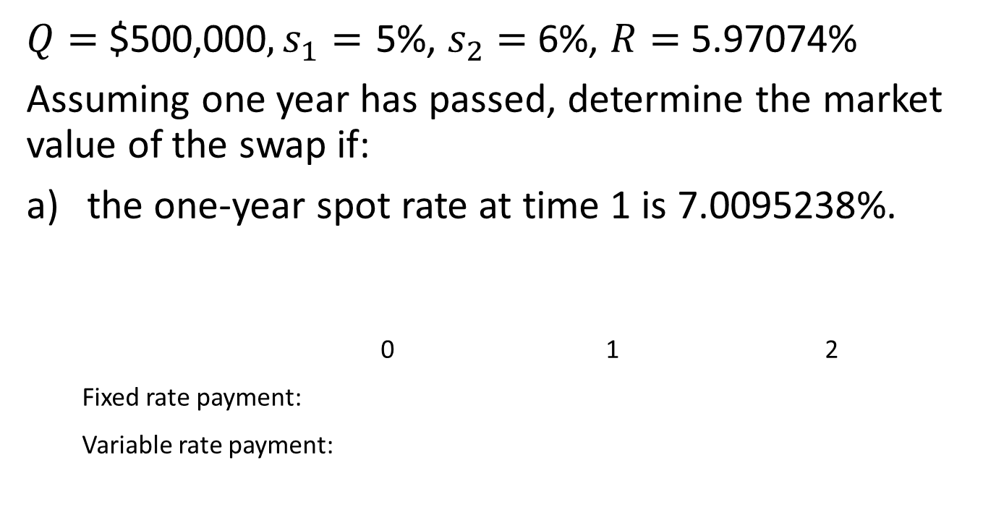
Example 10.1, continued
$Q=$ $500,000$, s_{1}=$ 5%, $s_{2}=$ 6%, $R=$ 5.97074%
Assuming one year has passed, determine the market value of the swap if:
the one-year spot rate at time 1 is 7.0095238%.
0 1 2
Fixed rate payment:
Variable rate payment:

Slide 19
Example 10.1, continued
the one-year spot rate at time 1 is 5%.
0 1 2
Fixed rate payment:
Variable rate payment:

