Slide 1
ACMA 201
Spring 2025

Slide 2
1.1 Definitions
Principal (P): | The amount of money (capital) we start with
Accumulated value (S): | The amount of money at the end of a defined period of time, without adding/withdrawing any capital
Amount of interest (I): | The difference between the accumulated value and the principal

Slide 3
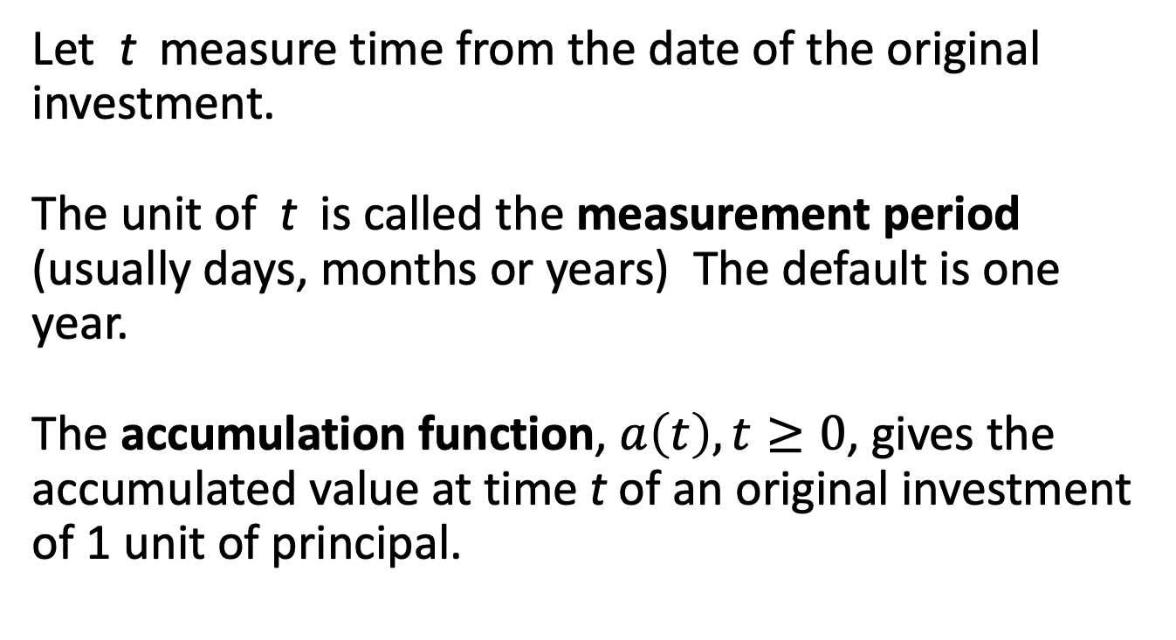
Accumulation Function
Let t measure time from the date of the original investment.
The unit of t is called the measurement period (usually days, months or years) The default is one year.
The accumulation function, $a\left(t\right), t≥0$, gives the accumulated value at time t of an original investment of 1 unit of principal.

Slide 4
Accumulation Function, Examples

Slide 5
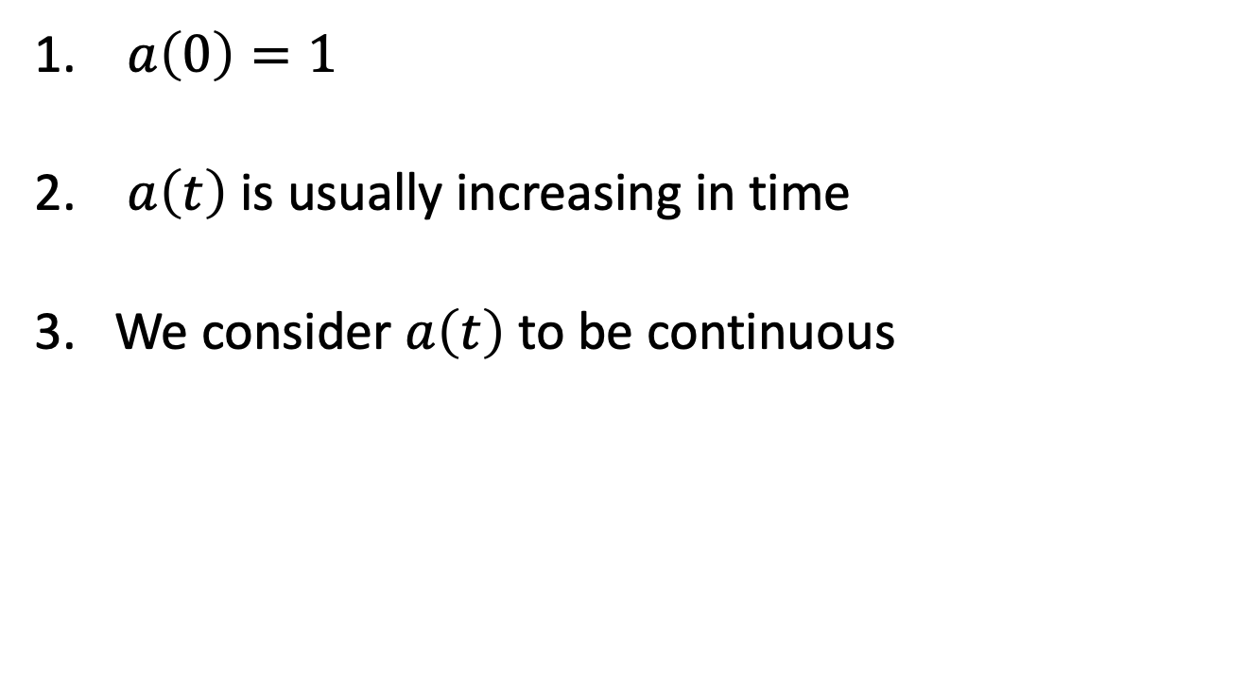
Accumulation Function, Properties
$a\left(0\right)=1$
$a\left(t\right)$ is usually increasing in time
We consider $a\left(t\right)$ to be continuous

Slide 6
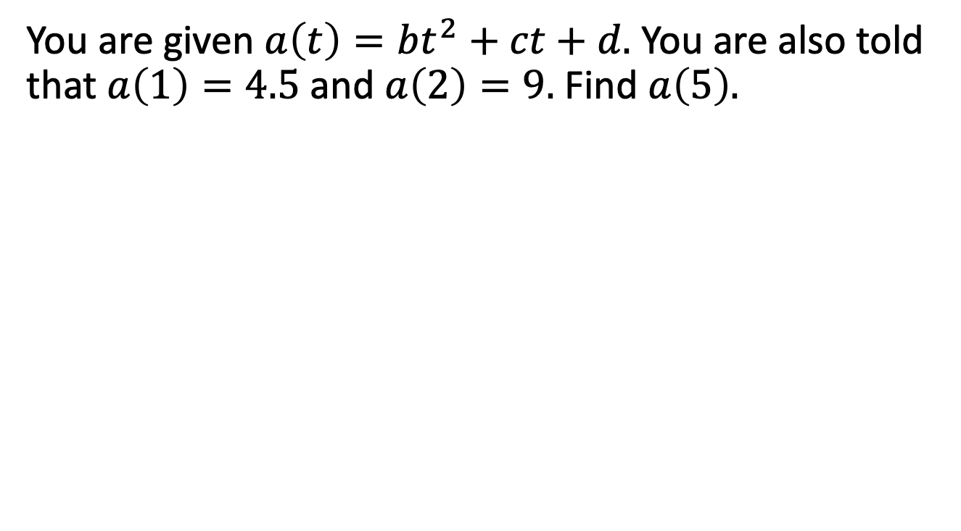
Example 1.1
You are given $a\left(t\right)=bt^{2}+ct+d.$ You are also told that $a\left(1\right)=4.5$ and $a\left(2\right)=9.$ Find $a\left(5\right).$

Slide 7
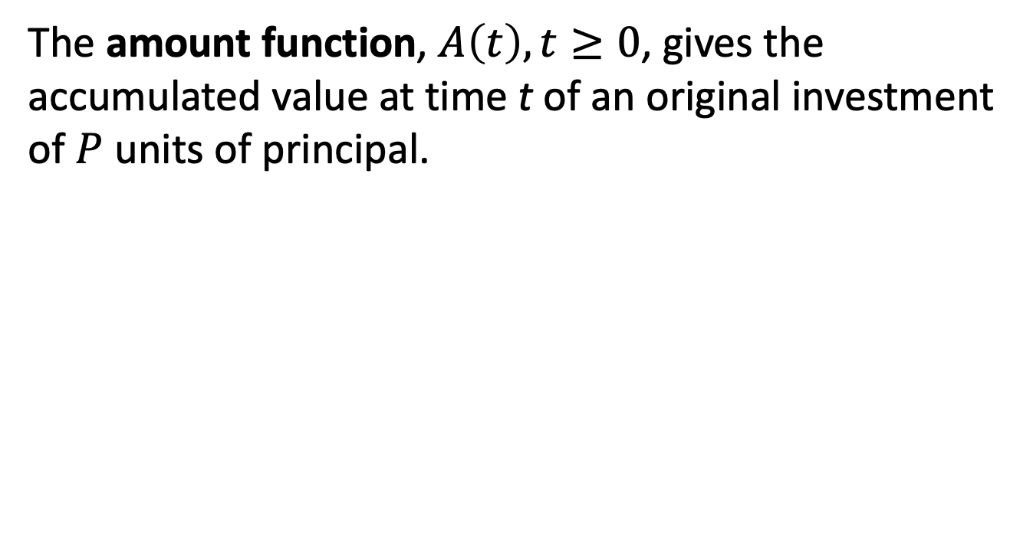
Amount Function
The amount function, $A\left(t\right), t≥0$, gives the accumulated value at time t of an original investment of $P$ units of principal.

Slide 8
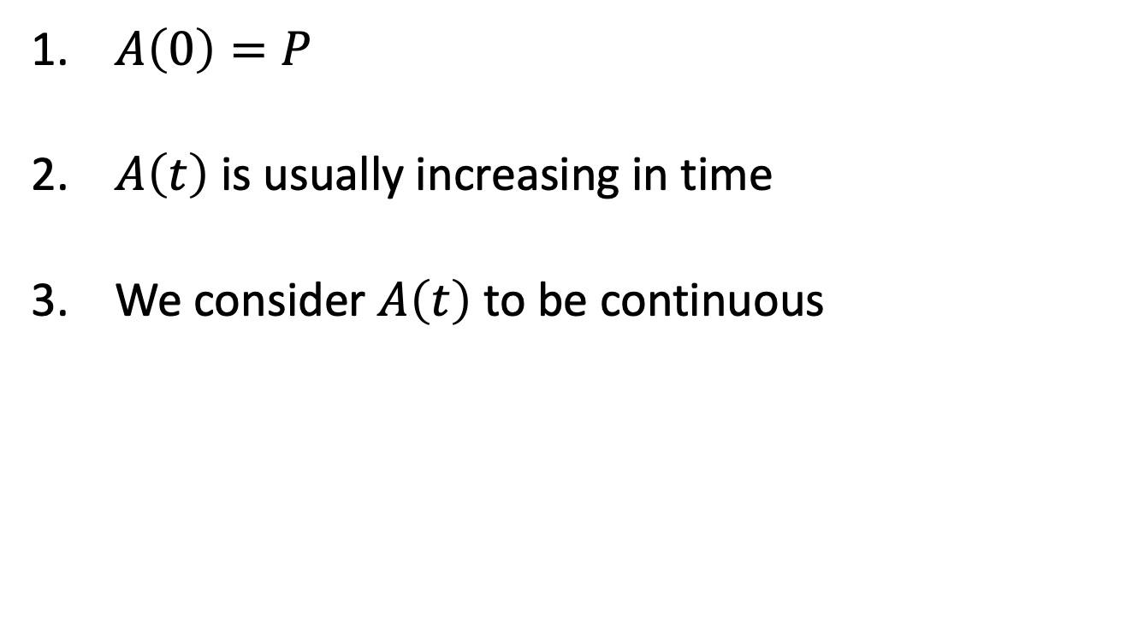
Amount Function, Properties
$A\left(0\right)=P$
$A\left(t\right)$ is usually increasing in time
We consider $A\left(t\right)$ to be continuous

Slide 9
Example 1.2
Use the same accumulation function as in Example 1.1. If $200 is invested at time 0, what is the accumulated value at time 7?

Slide 10
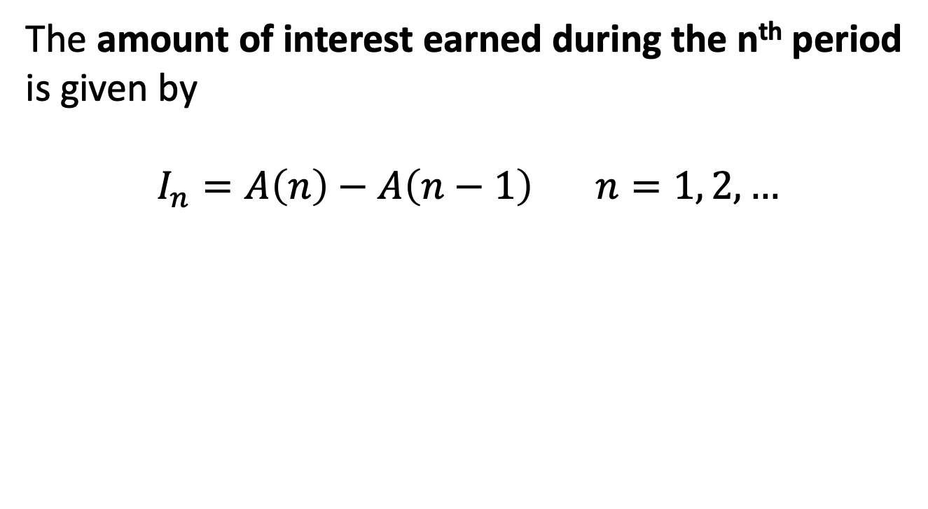
Interest Earned
The amount of interest earned during the n^{th} period is given by
$$I_{n}=A\left(n\right)−A\left(n−1\right) n=1, 2, …$$

Slide 11
Example 1.2, continued
How much interest is earned between times 5 and 7 on our initial investment of $200?

Slide 12
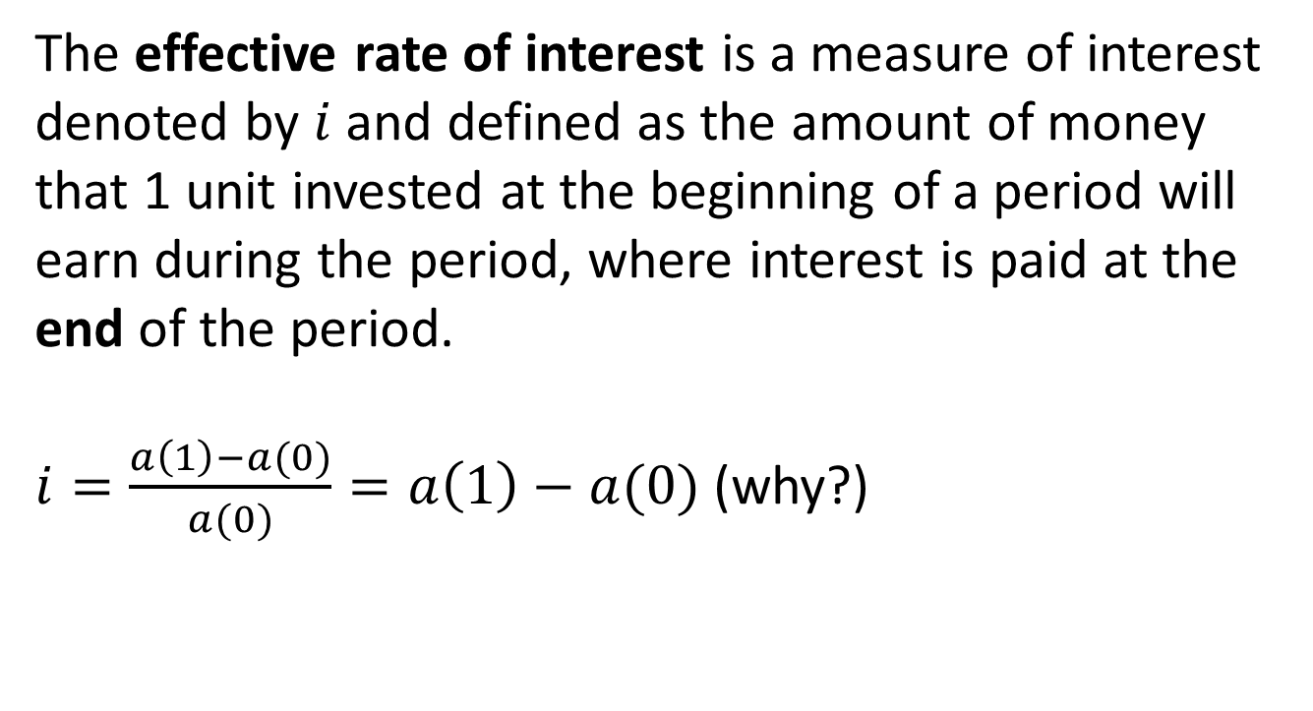
1.2 Effective Rate of Interest
The effective rate of interest is a measure of interest denoted by $i$and defined as the amount of money that 1 unit invested at the beginning of a period will earn during the period, where interest is paid at the end of the period.
$i=\frac{a\left(1\right)−a(0)}{a(0)}=a\left(1\right)−a(0)$ (why?)

Slide 13
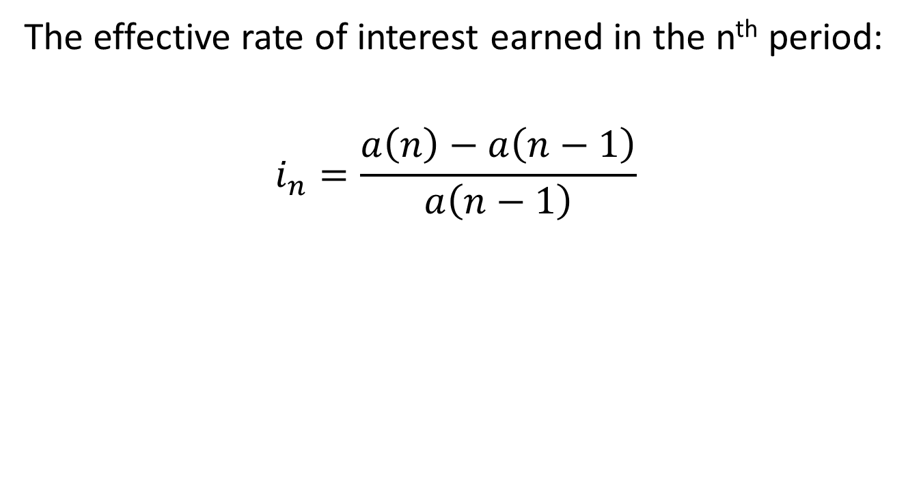
Effective Rate of Interest, cont’d
The effective rate of interest earned in the n^{th} period:
$$i_{n}=\frac{a\left(n\right)−a\left(n−1\right)}{a\left(n−1\right)}$$

Slide 14
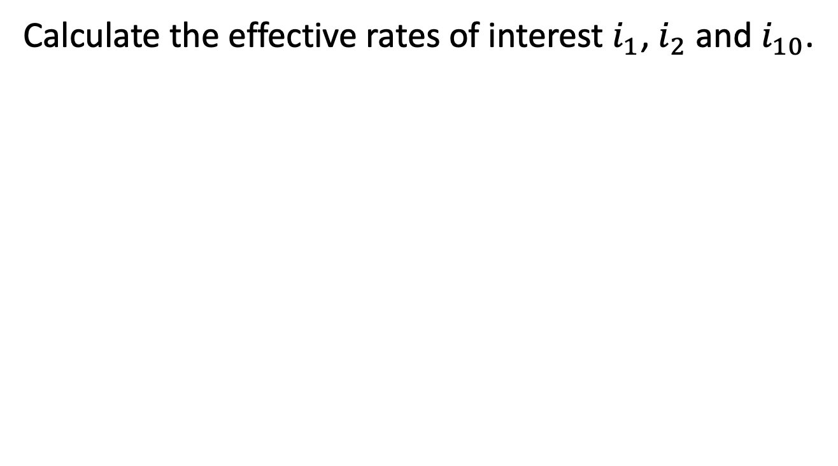
Example 1.2, continued
Calculate the effective rates of interest $i_{1}$, $i_{2}$ and $i_{10}$.

