Slide 1
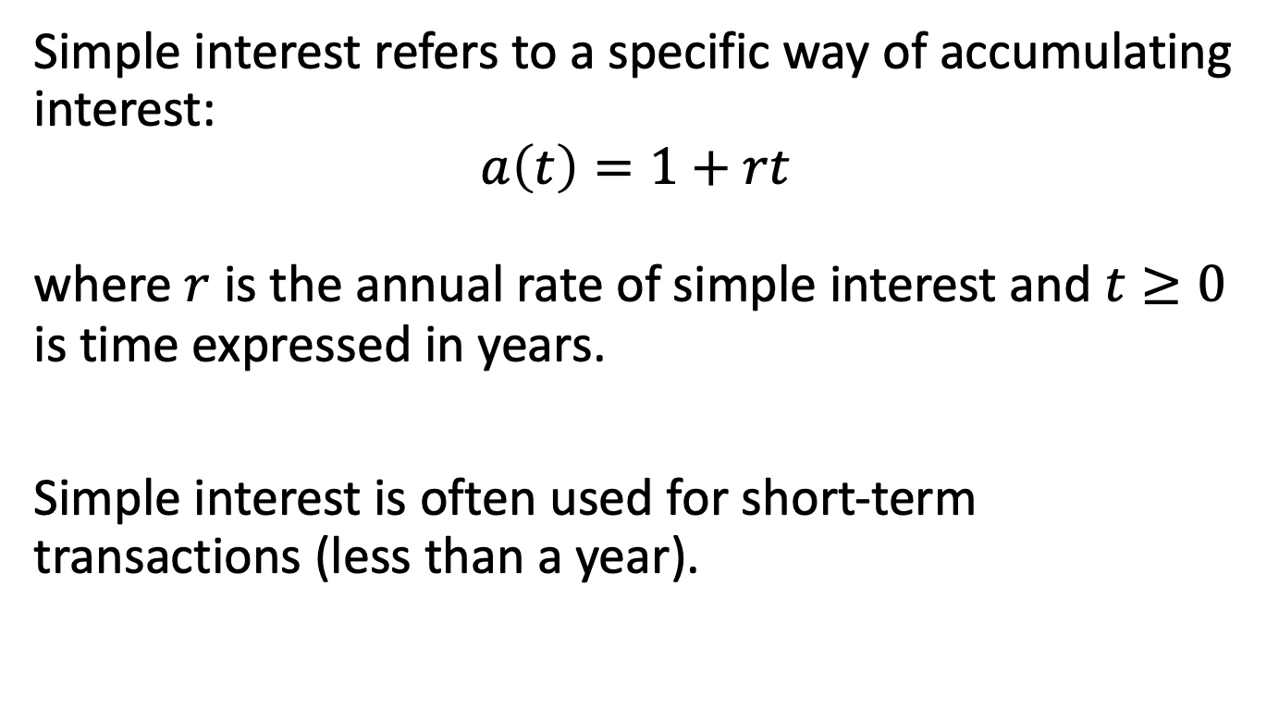
1.3 Simple Interest
Simple interest refers to a specific way of accumulating interest:
$$a\left(t\right)=1+rt$$
where $r$ is the annual rate of simple interest and $t≥0$ is time expressed in years.
Simple interest is often used for short-term transactions (less than a year).

Slide 2
Calculating t
The time period in question may be stated:
In years (“a loan for half a year”)
In months (“an investment for 5 months”)
Using actual dates (“Mar 12 to Sep 25, 2022”)

Slide 3
Calculating t, continued
Three different conventions when dates are given:
Actual/actual (exact interest)
Actual/360 (Banker’s rule)
30/360 (ordinary interest)
numerator = (D2-D1)+30(M2-M1)+360(Y2-Y1)

Slide 4

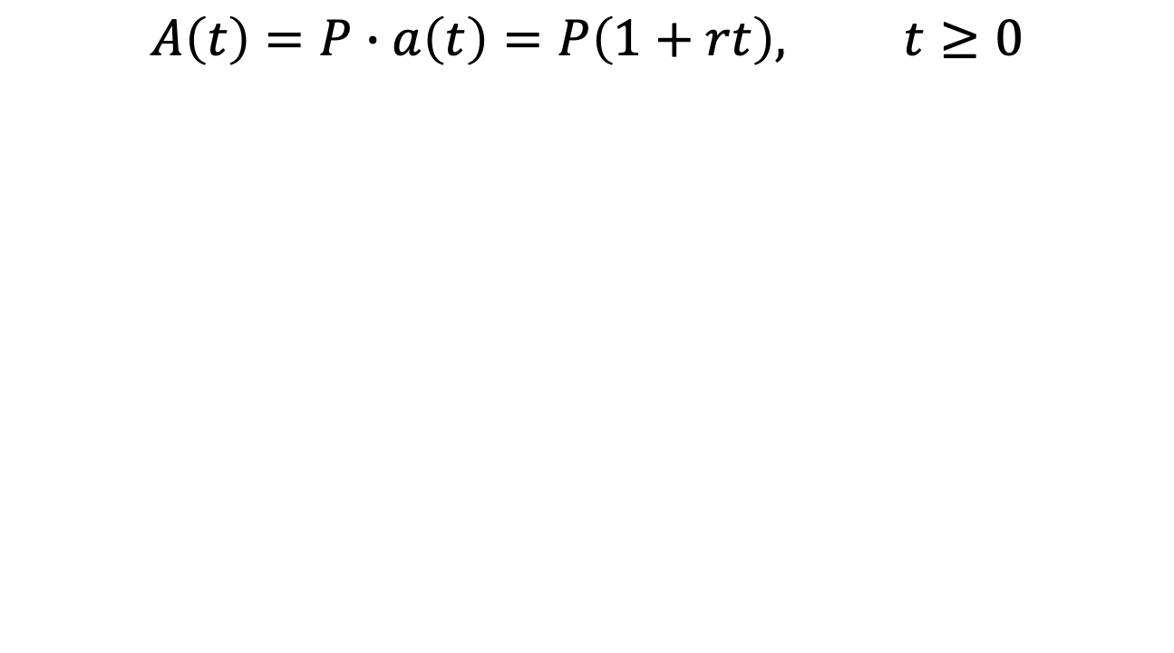
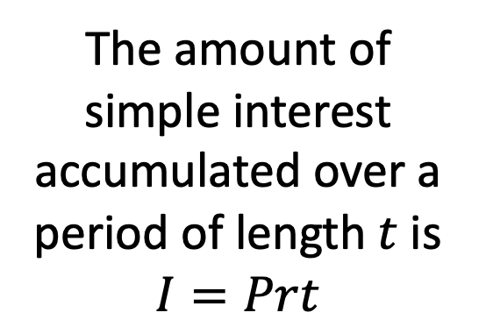


A(t) for simple interest
$$A\left(t\right)=P∙a\left(t\right)=P\left(1+rt\right), t≥0$$
$$A(t)$$
The amount of simple interest accumulated over a period of length $t$ is $I=Prt$
$$P$$
$$t$$

Slide 5
Example 1.3
You invest $500 at 7% simple interest. What is the accumulated value of your investment after 30 days?
What is it after 2 years?

Slide 6
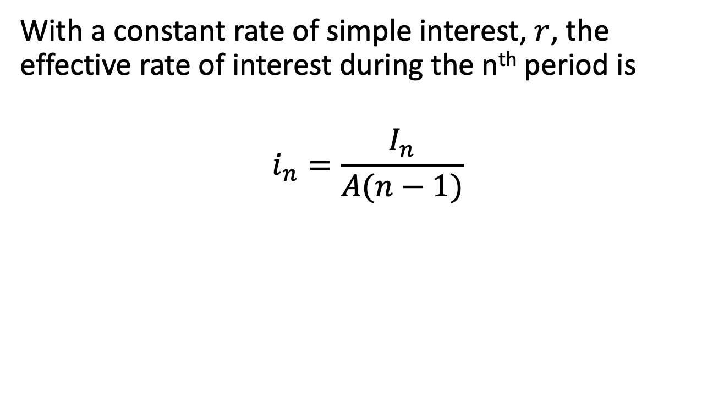
Effective rate under simple interest
With a constant rate of simple interest, $r$, the effective rate of interest during the n^{th} period is
$$i_{n}=\frac{I_{n}}{A(n−1)}$$

Slide 7
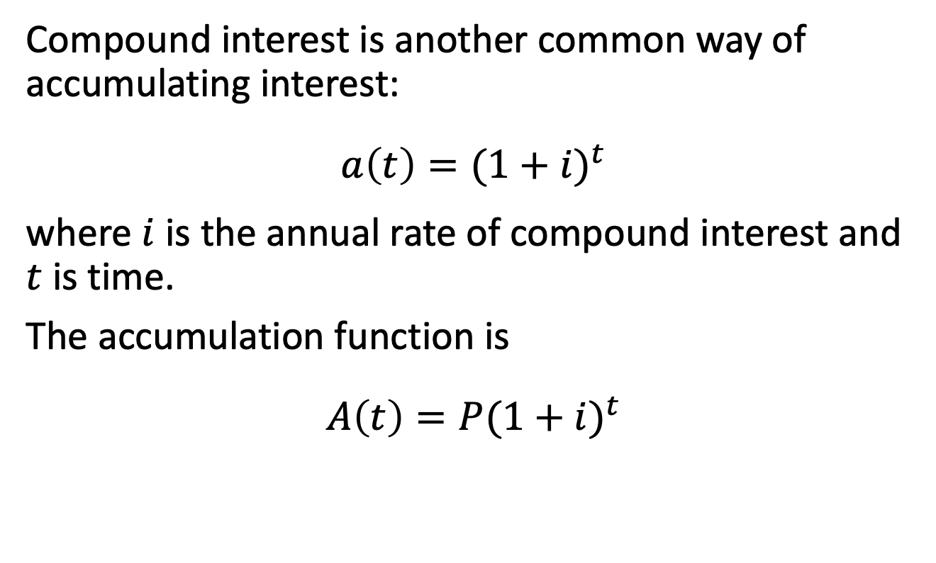
1.4 Compound Interest
Compound interest is another common way of accumulating interest:
$$a\left(t\right)={(1+i)}^{t}$$
where $i$ is the annual rate of compound interest and $t$ is time.
The accumulation function is
$$A\left(t\right)={P(1+i)}^{t}$$

Slide 8
Example 1.4
You invest $500 at 7% compound interest. What is the accumulated value of your investment after 3 months?
After 2 years?
Compare your answers to Example 1.3.

Slide 9
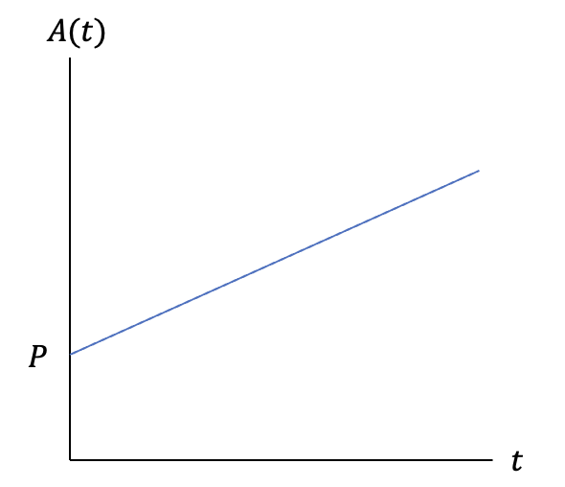

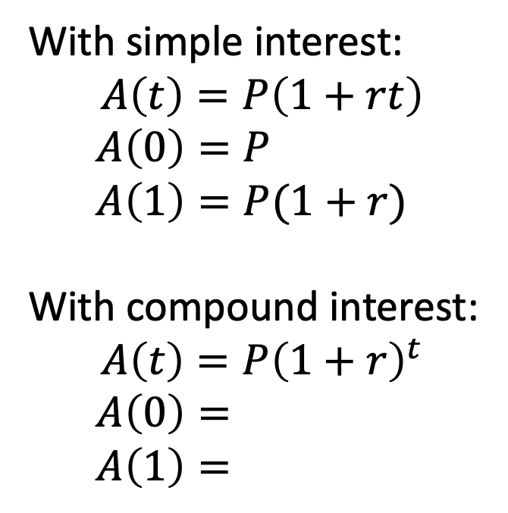
Simple vs. compound interest
With simple interest:
$$A\left(t\right)=P\left(1+rt\right)$$
$$A\left(0\right)=P$$
$$A\left(1\right)=P(1+r)$$
With compound interest:
$$A\left(t\right)=P{\left(1+r\right)}^{t}$$
$A\left(0\right)=$
$A\left(1\right)=$
$$P(1+r)$$
1

Slide 10
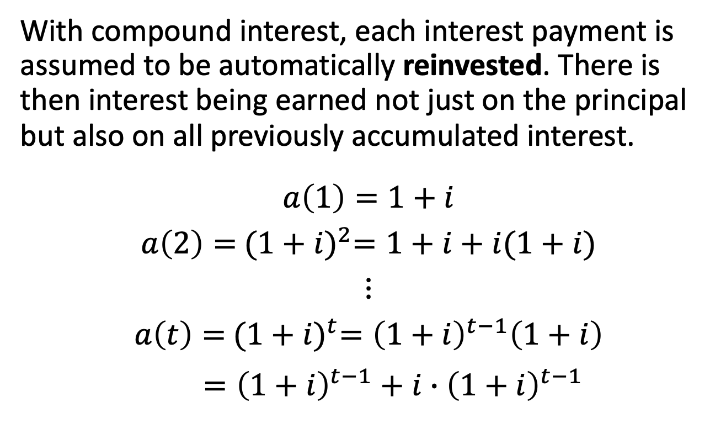
Interest on interest
With compound interest, each interest payment is assumed to be automatically reinvested. There is then interest being earned not just on the principal but also on all previously accumulated interest.
$$a\left(1\right)=1+i$$
$$a\left(2\right)={ (1+i)}^{2}=1+i+i(1+i)$$
$$⋮$$
$$a\left(t\right)={ (1+i)}^{t}={\left(1+i\right)}^{t−1}\left(1+i\right)$$
$={\left(1+i\right)}^{t−1}+i{∙\left(1+i\right)}^{t−1}$

Slide 11
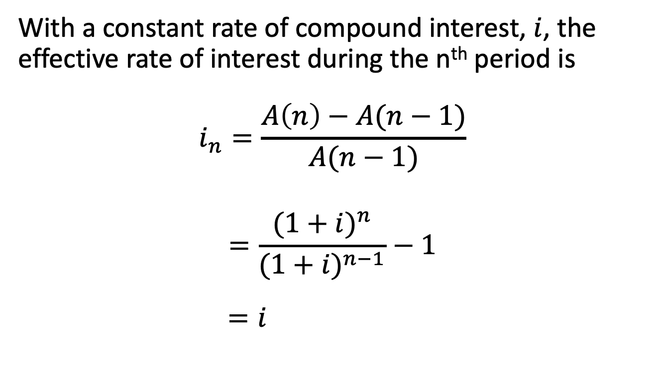
Effective rate under compound interest
With a constant rate of compound interest, $i$, the effective rate of interest during the n^{th} period is
$$i_{n}=\frac{A\left(n\right)−A(n−1)}{A(n−1)}$$
$$=\frac{{(1+i)}^{n}}{{(1+i)}^{n−1}}−1$$
$=i$

Slide 12

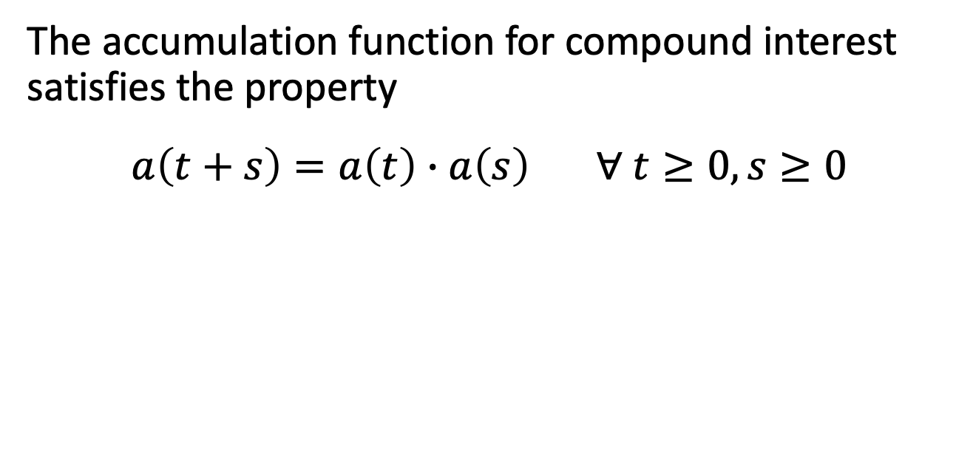

Special property of compound interest
The accumulation function for compound interest satisfies the property
$$a\left(t+s\right)=a\left(t\right)∙a\left(s\right) ∀ t≥0, s≥0$$
0
$$t$$
$$t+s$$
This is a useful property unique to compound interest.

Slide 13

1.5 Present Value
The accumulation function connects the value of an investment today to its value at some future date.
But what if we want to target a particular amount at a specific future date? How much should we set aside today?
0
$$t$$

Slide 14

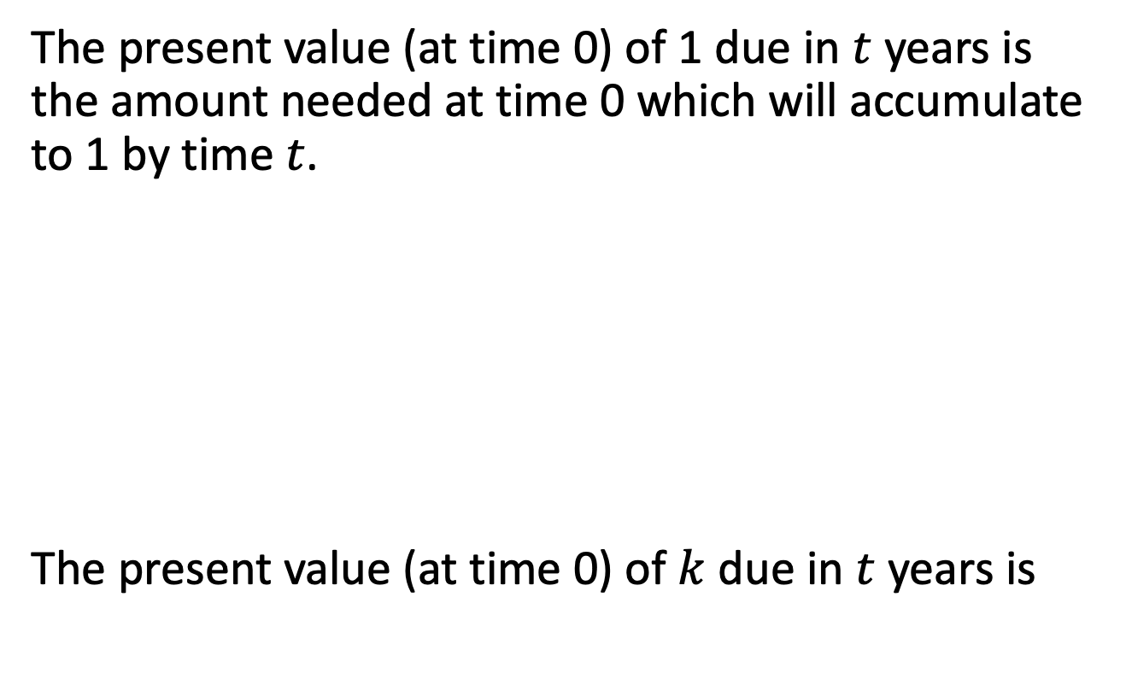
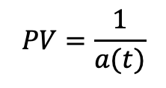
Definition of present value
The present value (at time 0) of 1 due in $t$ years is the amount needed at time 0 which will accumulate to 1 by time $t$.
The present value (at time 0) of $k$ due in $t$ years is
$$PV=\frac{1}{a(t)}$$
1
0
$$t$$

Slide 15

Example 1.5
(a) What is the present value of $600 due in 5 years
assuming simple interest at 10% per year?
0
$$5$$

Slide 16
Example 1.5, continued
(b) What is the present value of $600 due in 5 years
assuming compound interest at 10% per year?
0
$$5$$

Slide 17
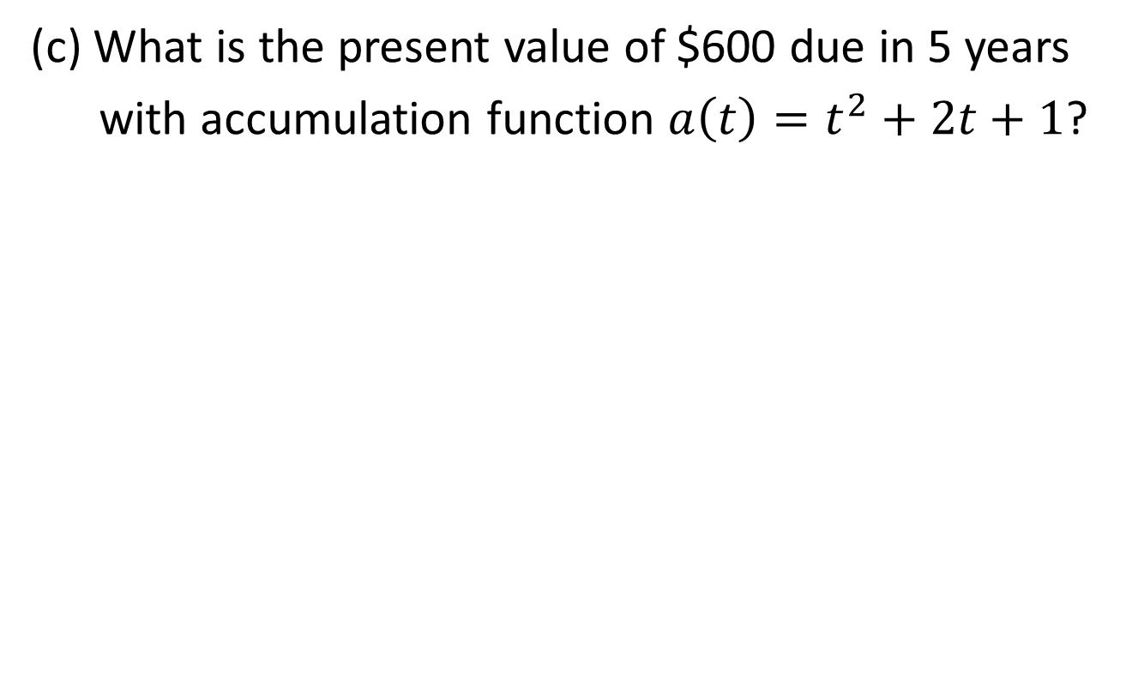
Example 1.5, continued
(c) What is the present value of $600 due in 5 years
with accumulation function $a\left(t\right)=t^{2}+2t+1$?

Slide 18
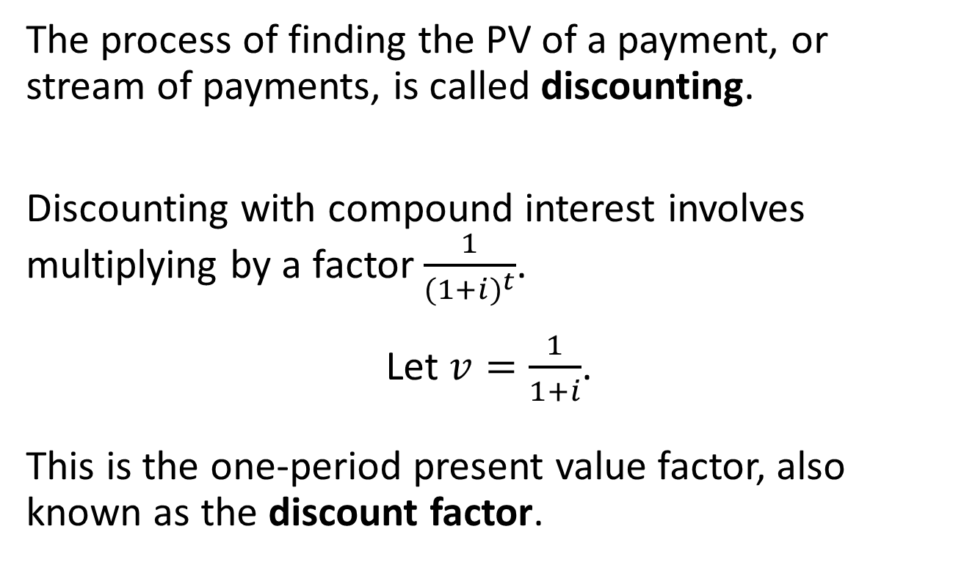
Discounting
The process of finding the PV of a payment, or stream of payments, is called discounting.
Discounting with compound interest involves multiplying by a factor $\frac{1}{{(1+i)}^{t}}$.
Let $v=\frac{1}{1+i}$.
This is the one-period present value factor, also known as the discount factor.

Slide 19
Properties
As the interest rate increases, the present value
0
$$5$$

Slide 20
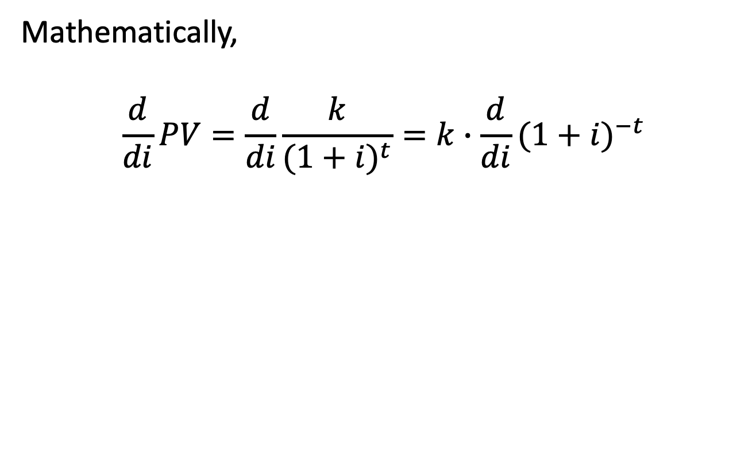
Properties, continued
Mathematically,
$$\frac{d}{di}PV=\frac{d}{di}\frac{k}{{(1+i)}^{t}}=k∙\frac{d}{di}{(1+i)}^{−t}$$

Slide 21

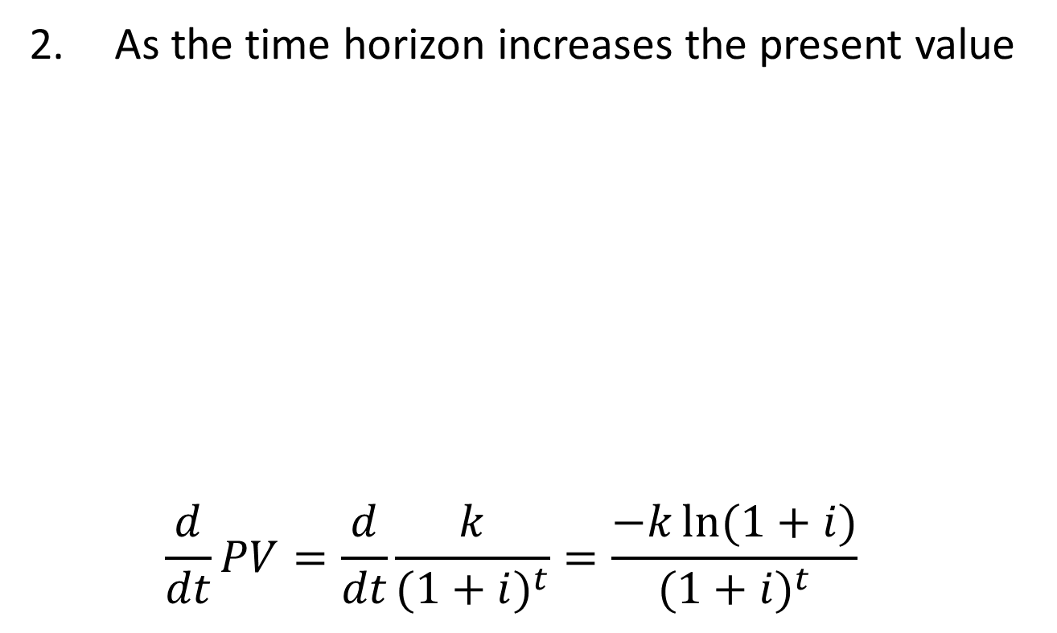

Properties, continued
As the time horizon increases the present value
$$\frac{d}{dt}PV=\frac{d}{dt}\frac{k}{{(1+i)}^{t}}=\frac{−k\ln{(1+i)}}{{(1+i)}^{t}}$$
0
$$5$$
$$8$$

