Slide 1
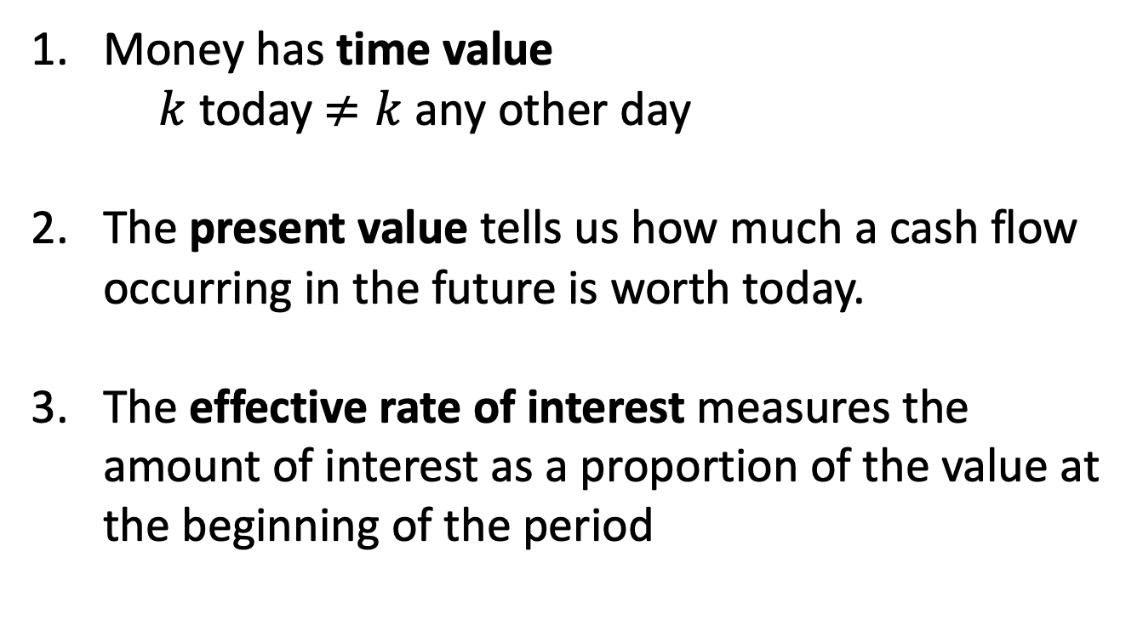
Key concepts from week 1
Money has time value
$k$ today $≠k$ any other day
The present value tells us how much a cash flow occurring in the future is worth today.
The effective rate of interest measures the amount of interest as a proportion of the value at the beginning of the period

Slide 2
1.6 Discount rates
Interest is like rent: it is the fee the borrower pays for the opportunity to use someone else’s money.
Suppose you want to borrow $100 for a year. Bank A offers you a loan at 10% effective rate of interest.
Borrow:
Pay:
100
110

Slide 3
Interest payable up front
Bank B offers you a loan with similar terms but it wants the $10 interest to be paid up front.
Borrow:
Pay:
Face value: the amount to be repaid
Proceeds: the amount that the borrower receives
Bank discount: the interest charged up front
100
10
100

Slide 4
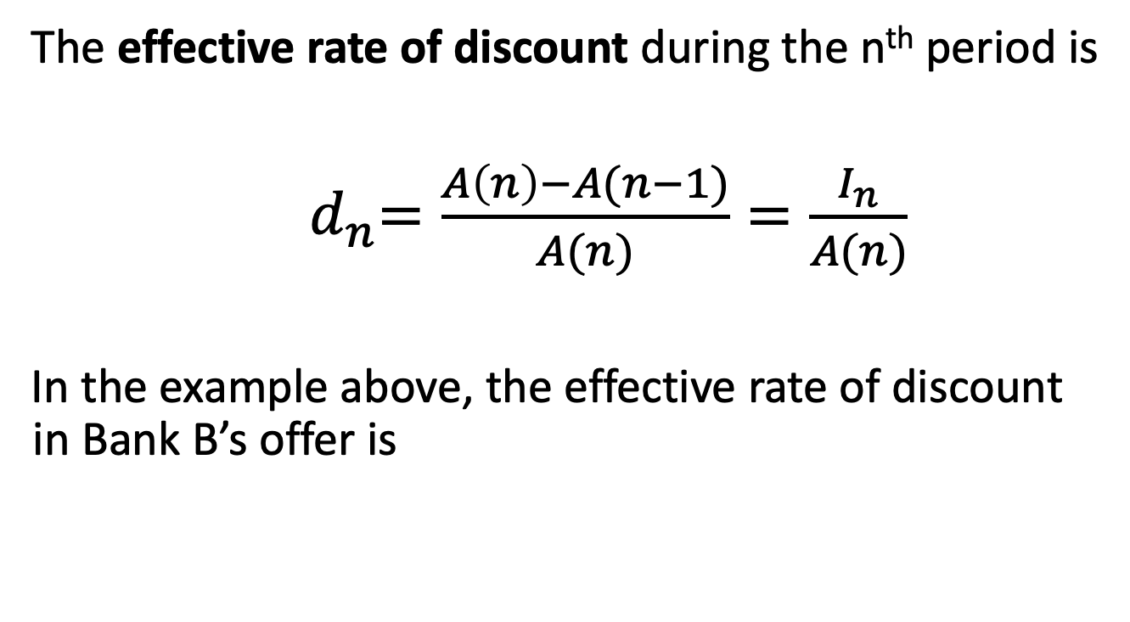
Effective rate of discount
The effective rate of discount during the n^{th} period is
${ d}_{n}=\frac{A\left(n\right)−A(n−1)}{A(n)}=\frac{I_{n}}{A(n)}$
In the example above, the effective rate of discount in Bank B’s offer is

Slide 5
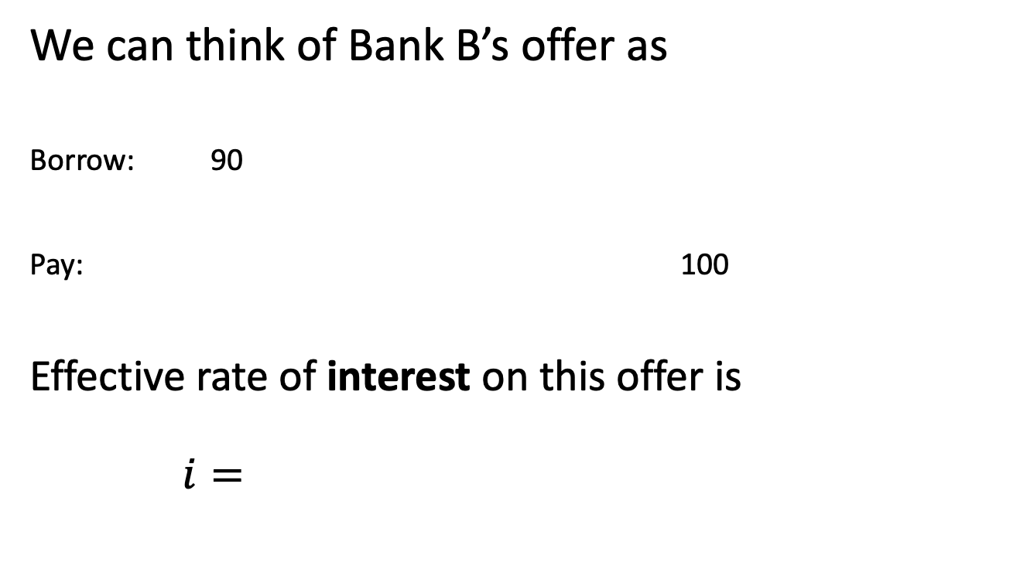
Comparing interest and discount
We can think of Bank B’s offer as
Borrow: 90
Pay: 100
Effective rate of interest on this offer is
$i=$

Slide 6
Comparing interest and discount
Bank B wants your business and is willing to match Bank A’s offer but needs the interest up front. What rate of discount would be equivalent to Bank A’s offer (i.e., borrower indifferent between options)?
Borrow:
Pay:
Effective rate of discount:

Slide 7
Equivalence of interest & discount
An effective rate of interest of 10% and an effective rate of discount of 9.0909% are equivalent in the sense that
they produce the same net cash flows
the interest amounts are the same in present value terms

Slide 8
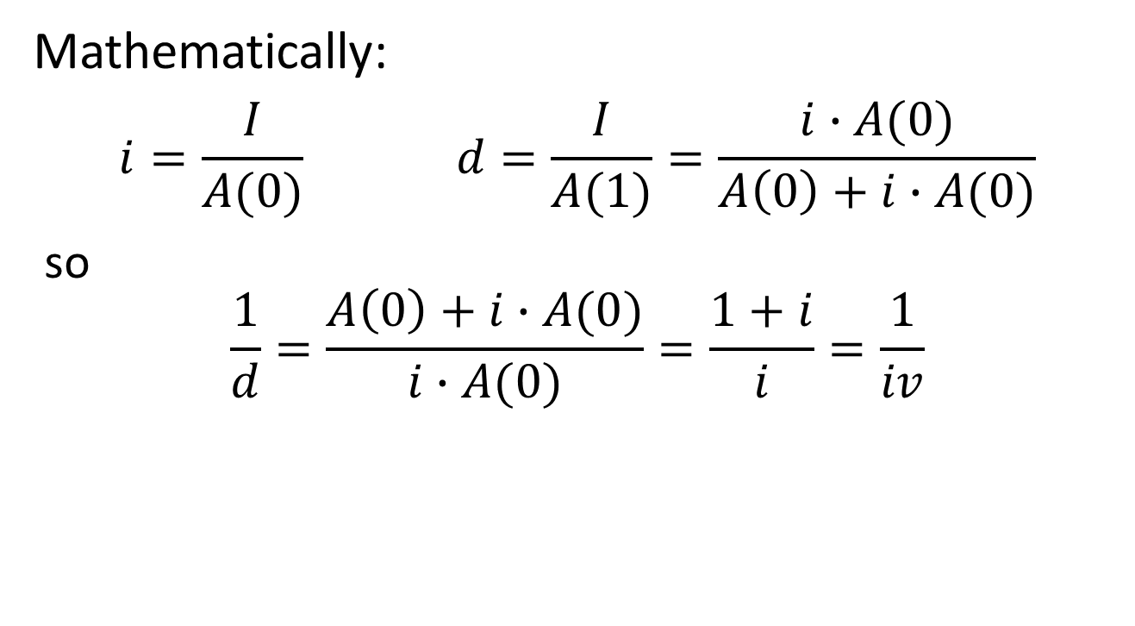
Equivalence of interest & discount
Mathematically:
$$i=\frac{I}{A(0)} d=\frac{I}{A(1)}=\frac{i∙A(0)}{A\left(0\right)+i∙A(0)}$$
so
$$\frac{1}{d}=\frac{A\left(0\right)+i∙A(0)}{i∙A(0)}=\frac{1+i}{i}=\frac{1}{iv}$$

Slide 9
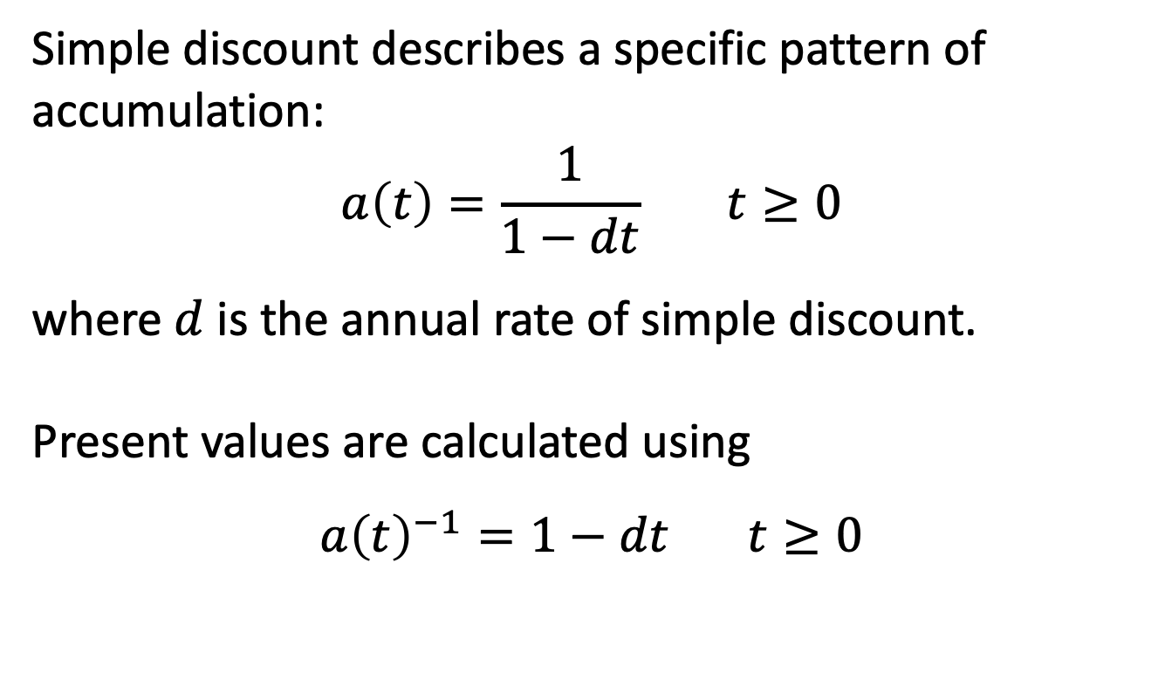
Simple discount
Simple discount describes a specific pattern of accumulation:
$$a\left(t\right)=\frac{1}{1−dt} t≥0$$
where $d$ is the annual rate of simple discount.
Present values are calculated using
$${a\left(t\right)}^{−1}=1−dt t≥0$$

Slide 10
Simple discount, example
Example: A bank issues a simple discount note with face value $4000 due in 3 months. The annual discount rate is 12%. Find the bank interest and the proceeds.

Slide 11
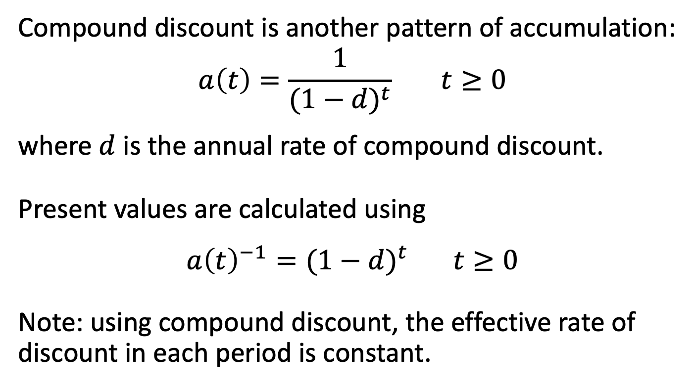
Compound discount
Compound discount is another pattern of accumulation:
$$a\left(t\right)=\frac{1}{{(1−d)}^{t}} t≥0$$
where $d$ is the annual rate of compound discount.
Present values are calculated using
$${a\left(t\right)}^{−1}={(1−d)}^{t} t≥0$$
Note: using compound discount, the effective rate of discount in each period is constant.

Slide 12
Compound discount, example
Example: A loan is issued with $10,000 face value due in 3 years. If the loan is subject to a 12% annual rate of compound discount, find the proceeds to the borrower.

Slide 13
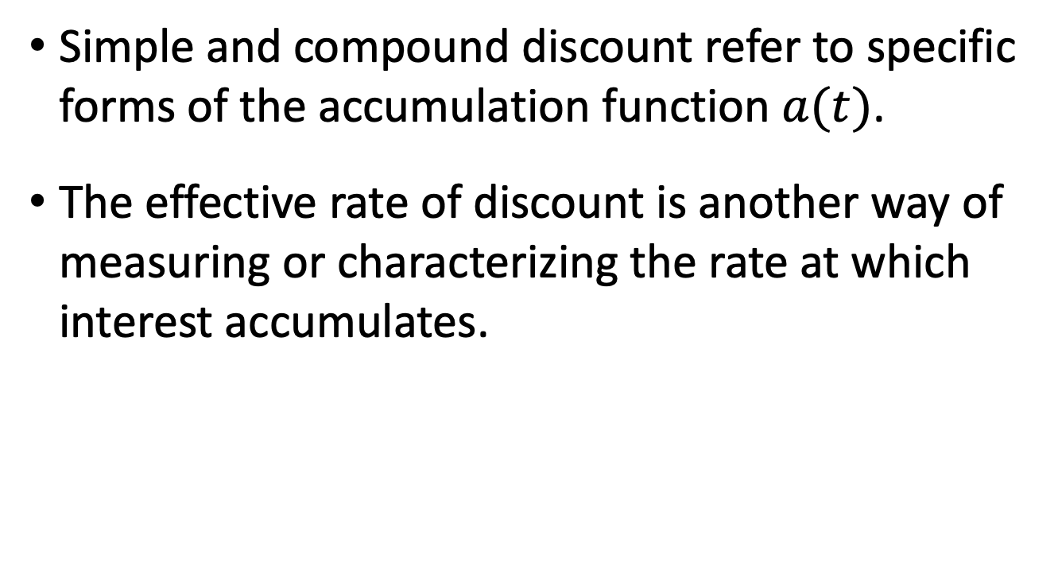
Summary
Simple and compound discount refer to specific forms of the accumulation function $a(t)$.
The effective rate of discount is another way of measuring or characterizing the rate at which interest accumulates.

Slide 14
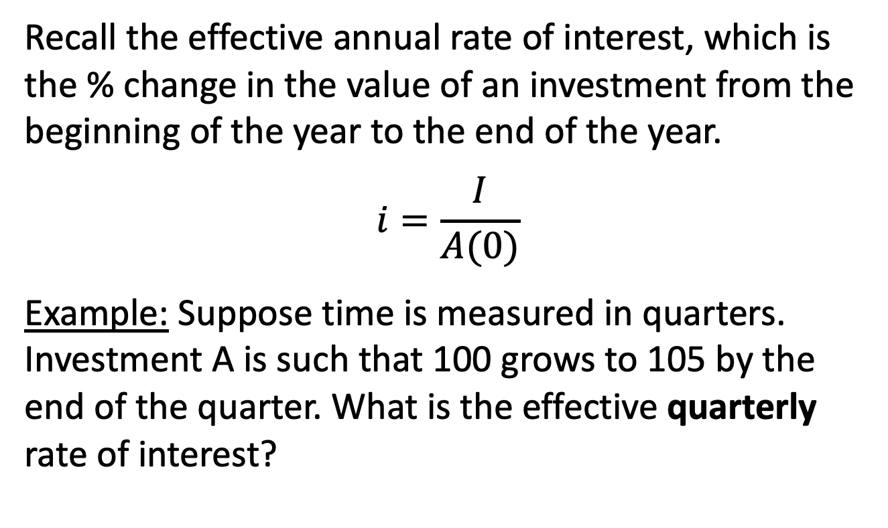
1.7 Nominal Rates
Recall the effective annual rate of interest, which is the % change in the value of an investment from the beginning of the year to the end of the year.
$$i=\frac{I}{A(0)}$$
Example: Suppose time is measured in quarters. Investment A is such that 100 grows to 105 by the end of the quarter. What is the effective quarterly rate of interest?

Slide 15
Comparing rates
Which of the following two options is better for an investor?
Effective annual rate of interest of 16%, or
Effective quarterly rate of interest of 4%?
Which of the following two options is better for an investor?
Effective annual rate of interest of 16%, or
Effective quarterly rate of interest of 3.9%?

Slide 16
Different compounding periods
How do you compare?
Pick some time period
Find the accumulated value at the end of that period under both rates
Compare accumulated values

Slide 17
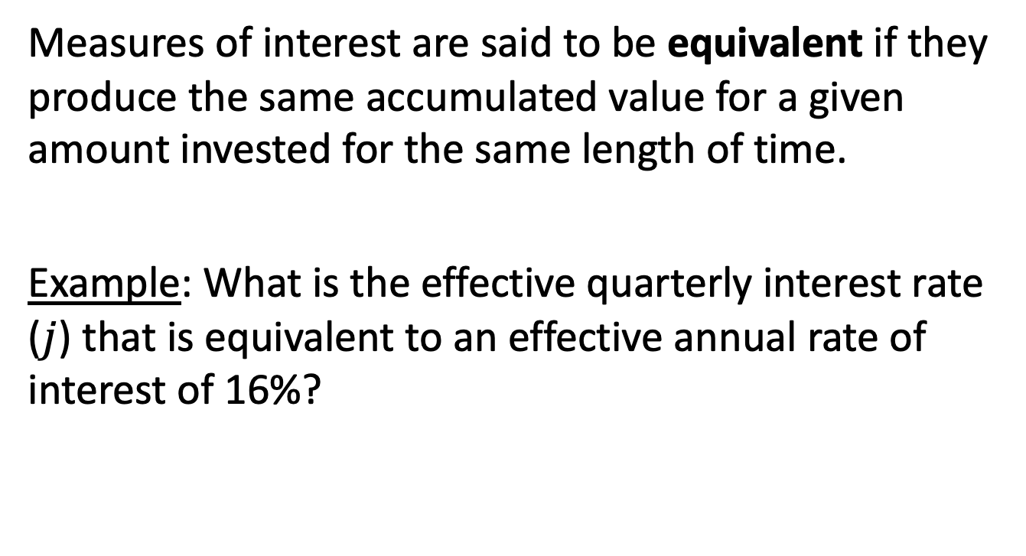
Equivalent measures of interest
Measures of interest are said to be equivalent if they produce the same accumulated value for a given amount invested for the same length of time.
Example: What is the effective quarterly interest rate ($j$) that is equivalent to an effective annual rate of interest of 16%?

Slide 18
Nominal rate of interest
We could also express this pattern of accumulation as a nominal annual rate of interest, compounded quarterly:
The measurement period is annual, and “nominal” refers to interest being compounded more often than once per measurement period.

Slide 19
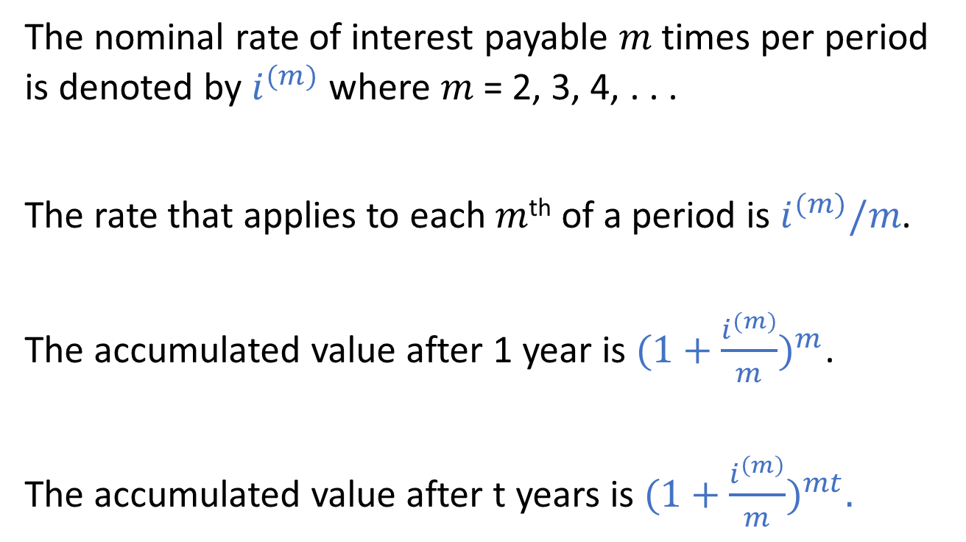
Nominal rate of interest
The nominal rate of interest payable $m$ times per period is denoted by $i^{(m)}$ where $m$ = 2, 3, 4, . . .
The rate that applies to each $m$^{th} of a period is $i^{(m)}/m$.
The accumulated value after 1 year is $(1+\frac{i^{(m)}}{m})^{m}$.
The accumulated value after t years is $(1+\frac{i^{\left(m\right)}}{m})^{mt}.$

Slide 20
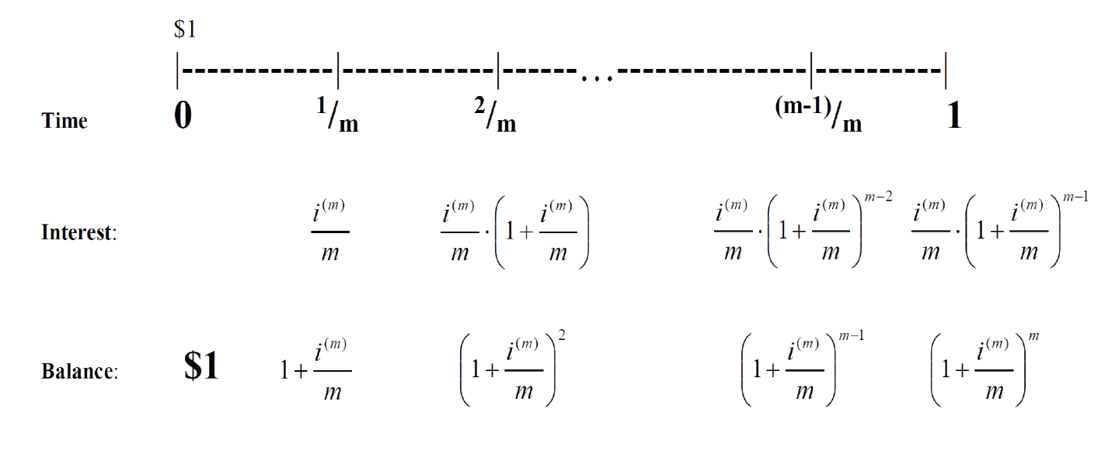
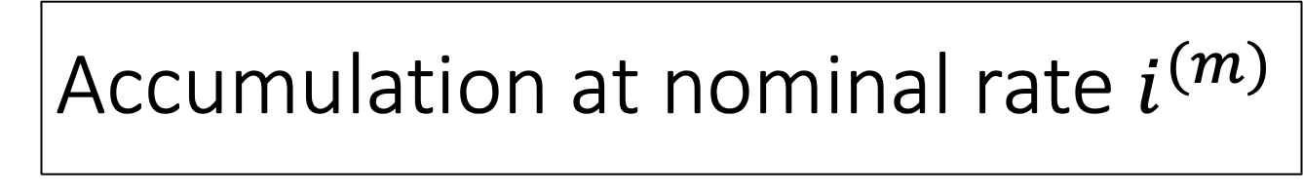
Accumulation at nominal rate $i^{(m)}$

Slide 21
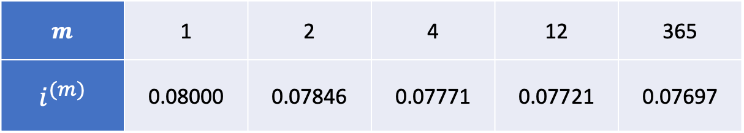
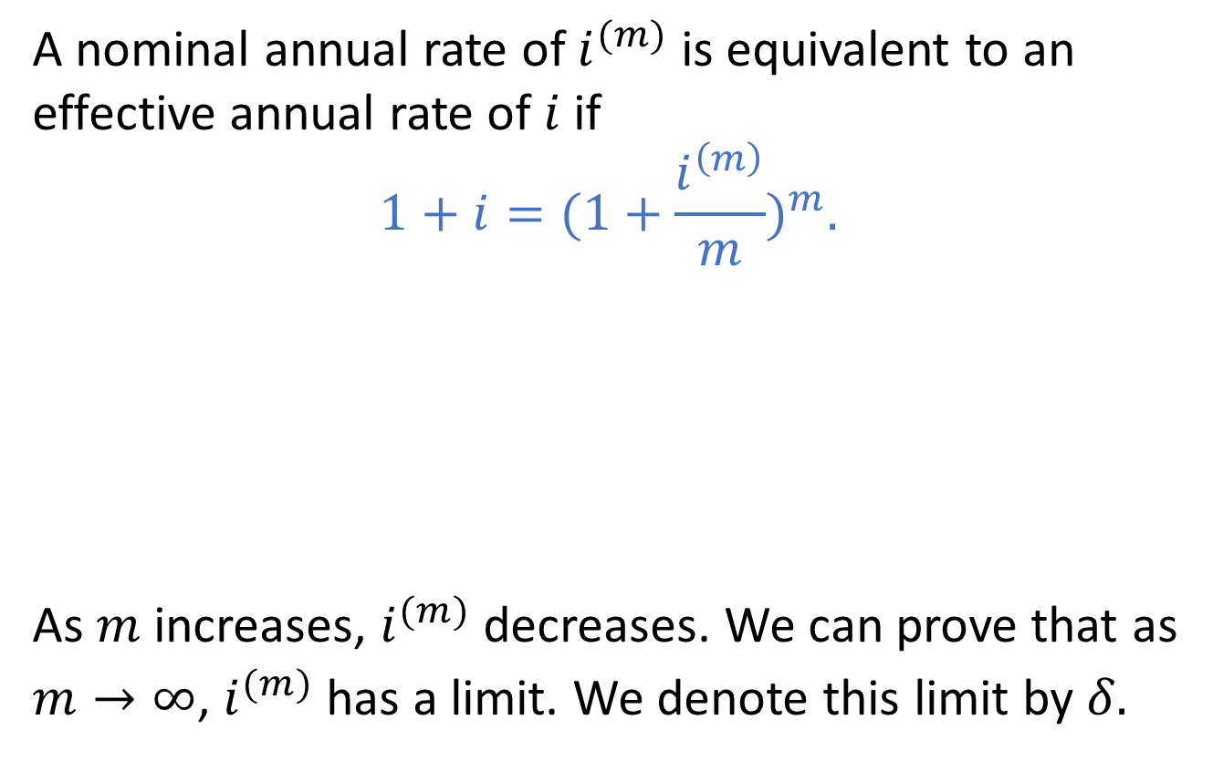
Equivalence of nominal rates
A nominal annual rate of $i^{(m)}$ is equivalent to an effective annual rate of $i$ if
$$1+i=(1+\frac{i^{\left(m\right)}}{m})^{m}.$$
As $m$ increases, $i^{(m)}$ decreases. We can prove that as $m→∞$, $i^{(m)}$has a limit. We denote this limit by $δ.$
$$m$$ | 1 | 2 | 4 | 12 | 365
$$i^{(m)}$$ | 0.08000 | 0.07846 | 0.07771 | 0.07721 | 0.07697

Slide 22
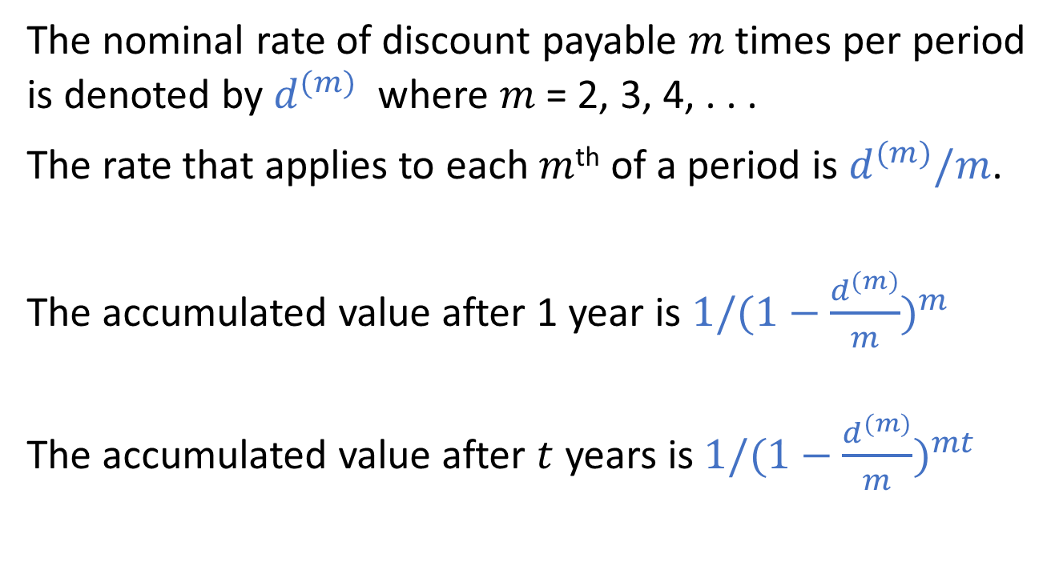
Nominal rate of discount
The nominal rate of discount payable $m$ times per period is denoted by $d^{(m)}$ where $m$ = 2, 3, 4, . . .
The rate that applies to each $m$^{th} of a period is $d^{(m)}/m$.
The accumulated value after 1 year is $1/(1−\frac{d^{(m)}}{m})^{m}$
The accumulated value after $t$ years is $1/(1−\frac{d^{(m)}}{m})^{mt}$

Slide 23
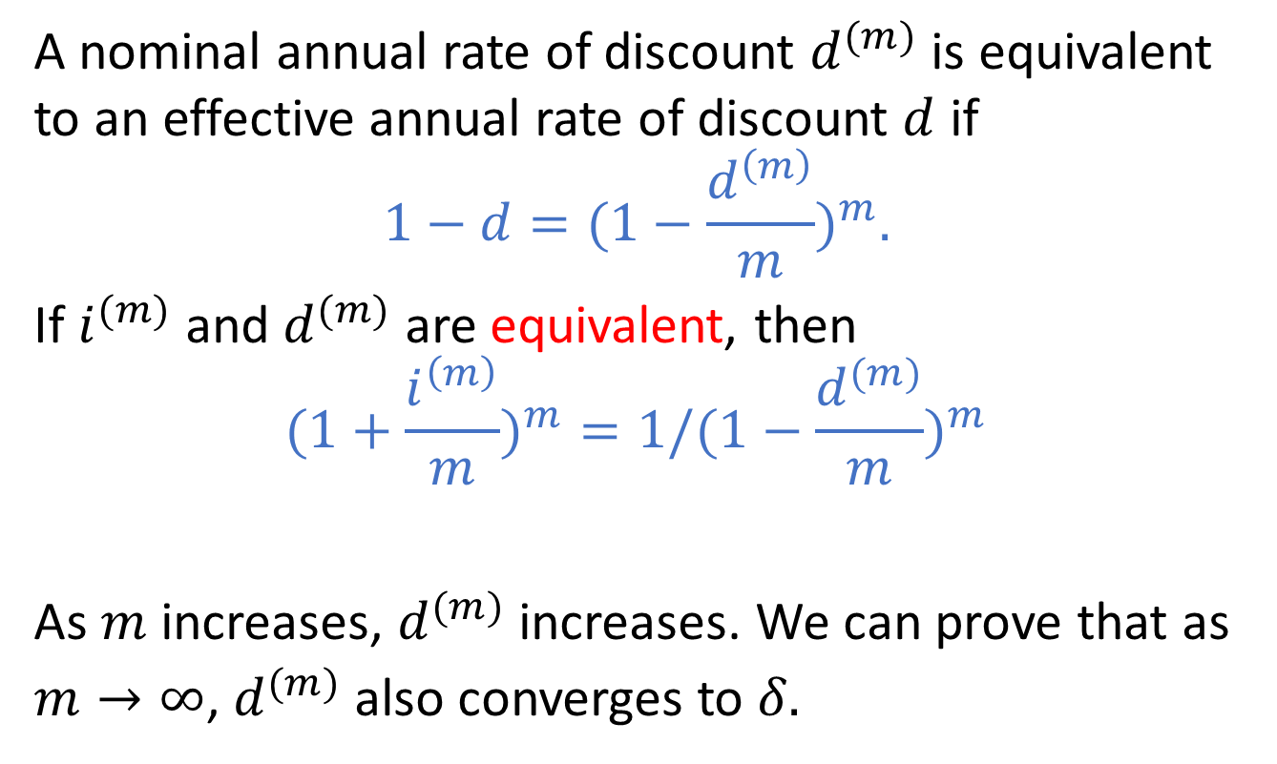
Equivalence of nominal rates
A nominal annual rate of discount $d^{(m)}$ is equivalent to an effective annual rate of discount $d$ if
$$1−d=(1−\frac{d^{\left(m\right)}}{m})^{m}.$$
If $i^{(m)}$ and $d^{(m)}$ are equivalent, then
$$(1+\frac{i^{\left(m\right)}}{m})^{m}=1/(1−\frac{d^{(m)}}{m})^{m}$$
As $m$ increases, $d^{(m)}$ increases. We can prove that as $m→∞$, $d^{(m)}$also converges to $δ.$

Slide 24
Example
You want to invest $100 for a period of 3 years. Bank A offers a nominal rate of interest of 12% convertible quarterly and Bank B offers a nominal rate of discount of 10% convertible semi-annually.
Where should you invest your $100?

Slide 25
Example, continued
In fact, we could compare accumulated values at any common compounding points:
After 2 years:
After 6 months (2 quarters):

Slide 26
Example, continued
What nominal rate of discount convertible twice a year is equivalent to Bank A’s offer?

