Slide 1
CHAPTER 2
Equivalence Equations

Slide 2
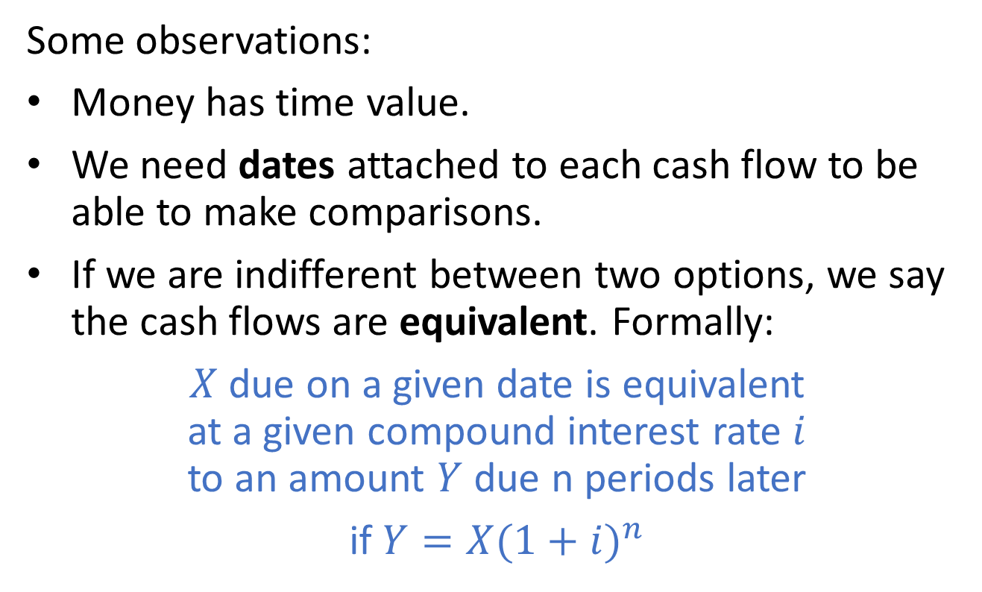
2.1 Equations of value
Some observations:
Money has time value.
We need dates attached to each cash flow to be able to make comparisons.
If we are indifferent between two options, we say the cash flows are equivalent. Formally:
$X$ due on a given date is equivalent
at a given compound interest rate $i$
to an amount $Y$ due n periods later
if $Y=X{(1+i)}^{n}$

Slide 3
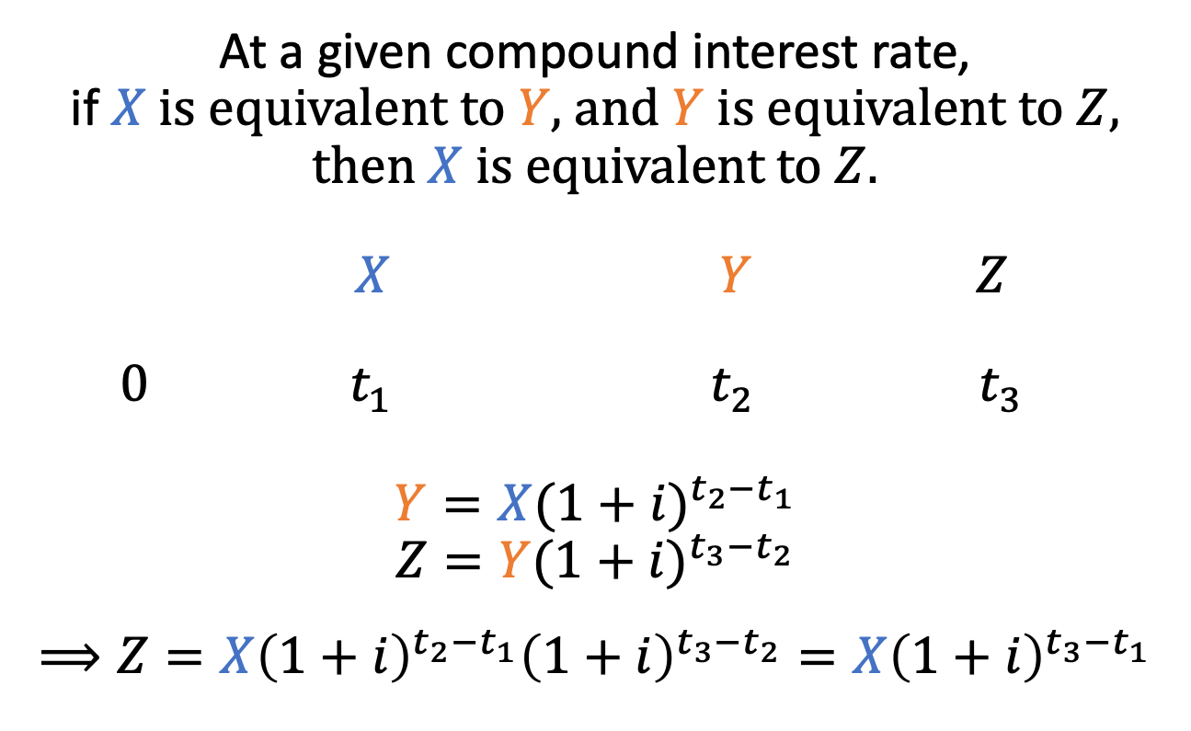
Transitivity under compound interest
At a given compound interest rate,
if $X$ is equivalent to $Y$, and $Y$ is equivalent to $Z$, then $X$ is equivalent to $Z$.
$X$ $Y$ $Z$
0 $t_{1}$ $t_{2}$ $t_{3}$
$$Y=X{(1+i)}^{t_{2}−t_{1}}$$
$$Z=Y{(1+i)}^{t_{3}−t_{2}}$$
$$⟹Z=X{\left(1+i\right)}^{t_{2}−t_{1}}{\left(1+i\right)}^{t_{3}−t_{2}}=X{\left(1+i\right)}^{t_{3}−t_{1}}$$

Slide 4
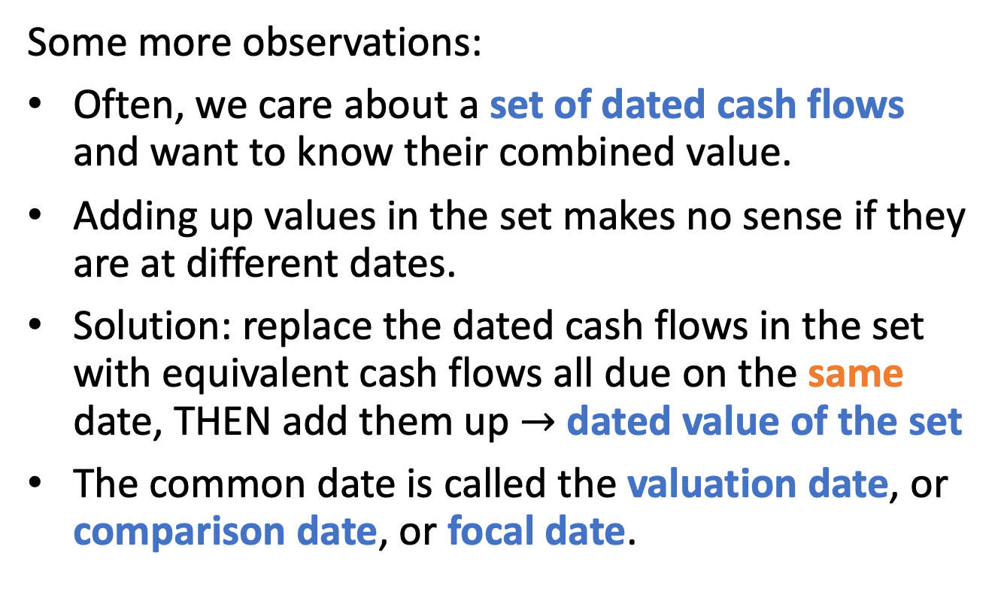
Sets of cash flows
Some more observations:
Often, we care about a set of dated cash flows and want to know their combined value.
Adding up values in the set makes no sense if they are at different dates.
Solution: replace the dated cash flows in the set with equivalent cash flows all due on the same date, THEN add them up $→$ dated value of the set
The common date is called the valuation date, or comparison date, or focal date.

Slide 5
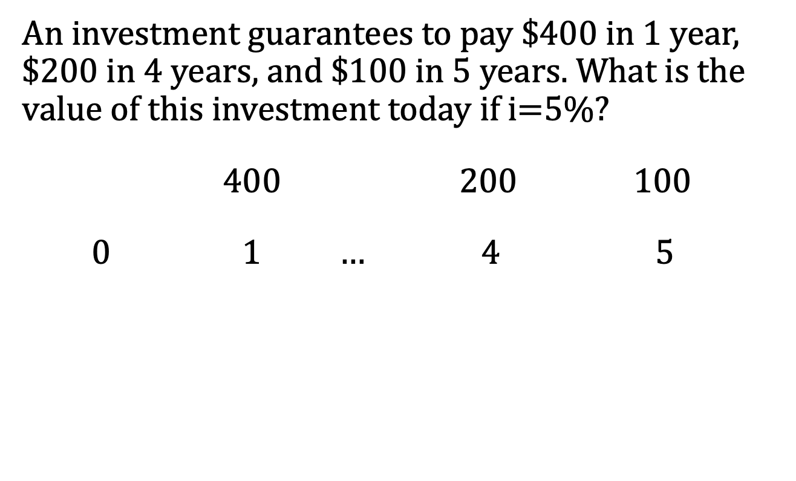
Example
An investment guarantees to pay $400 in 1 year, $200 in 4 years, and $100 in 5 years. What is the value of this investment today if i=5%?
400 200 100
0 $1$ … 4 $5$

Slide 6
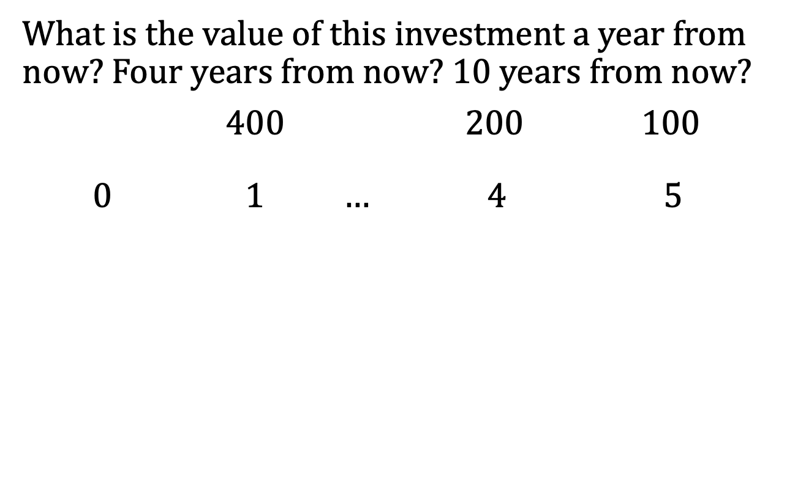
Example, continued
What is the value of this investment a year from now? Four years from now? 10 years from now?
400 200 100
0 $1$ … 4 $5$

Slide 7
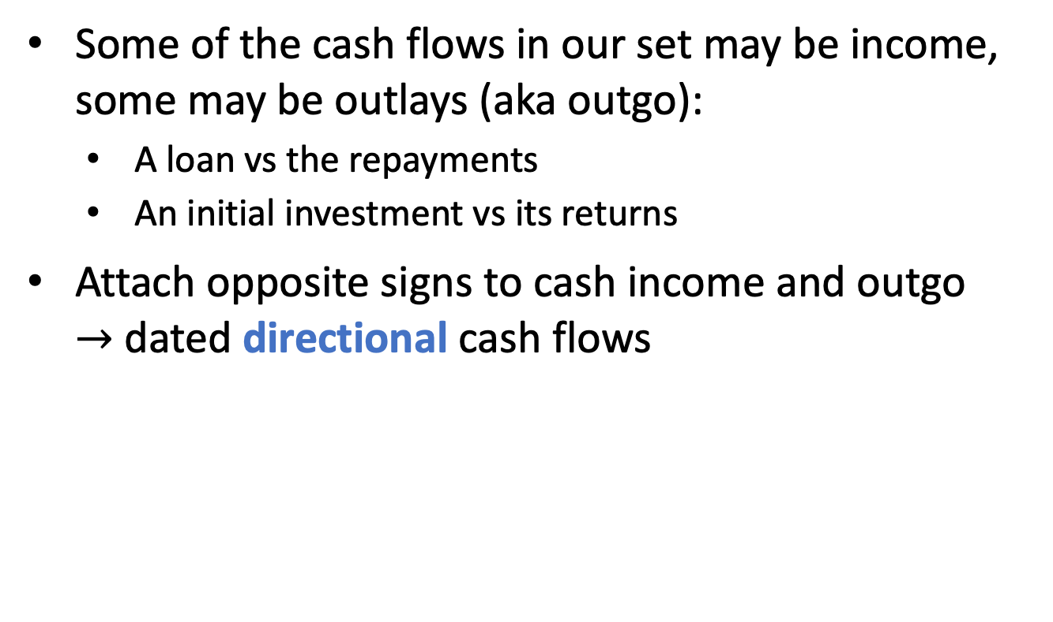
Keeping track of cash in and out
Some of the cash flows in our set may be income, some may be outlays (aka outgo):
  A loan vs the repayments
  An initial investment vs its returns
Attach opposite signs to cash income and outgo
$→$ dated directional cash flows

Slide 8
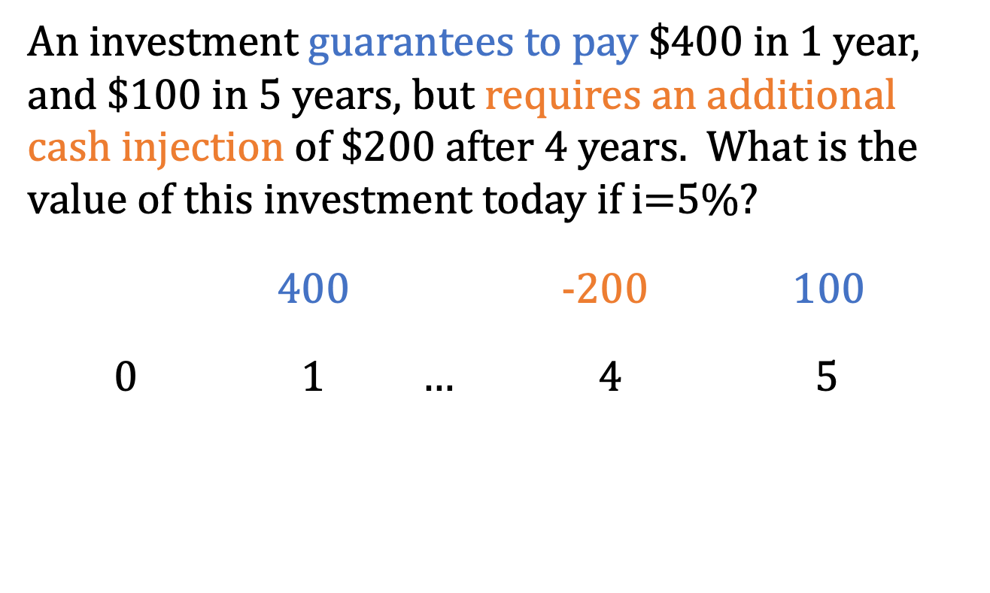
Example
An investment guarantees to pay $400 in 1 year, and $100 in 5 years, but requires an additional cash injection of $200 after 4 years. What is the value of this investment today if i=5%?
400 -200 100
0 $1$ … 4 $5$

Slide 9
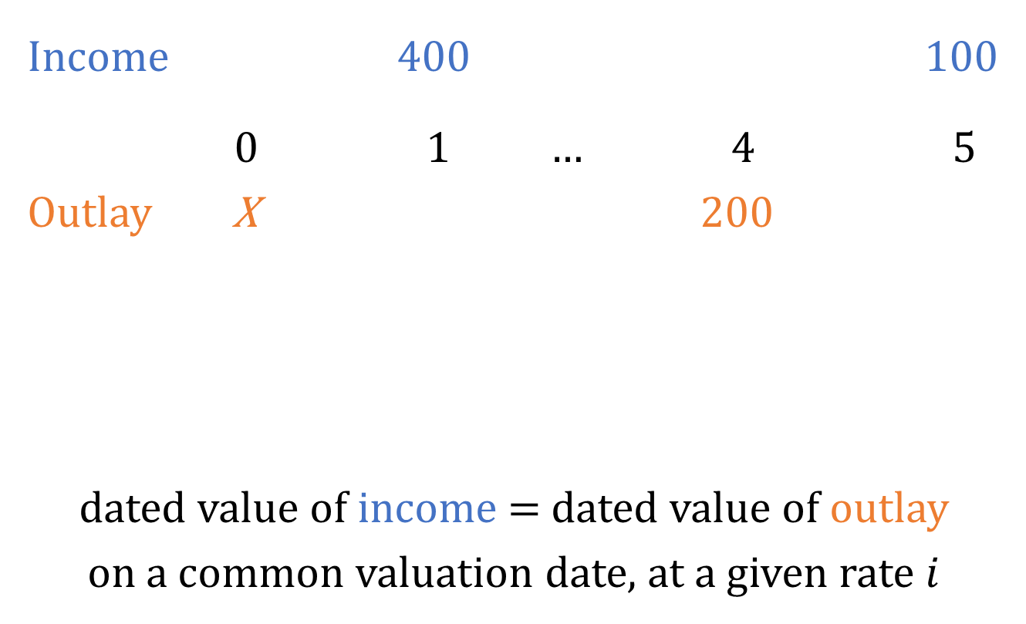
Example, continued
Income 400 100
0 $1$ … 4 $5$
Outlay X 200
dated value of income = dated value of outlay
on a common valuation date, at a given rate $i$

Slide 10
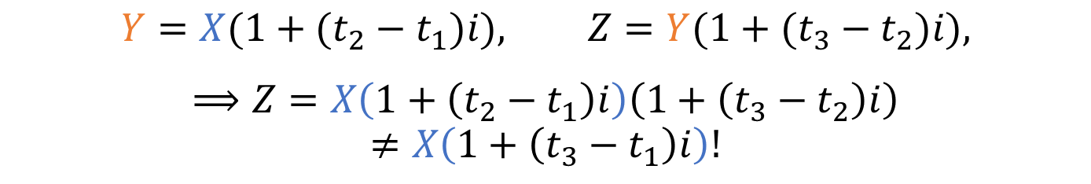
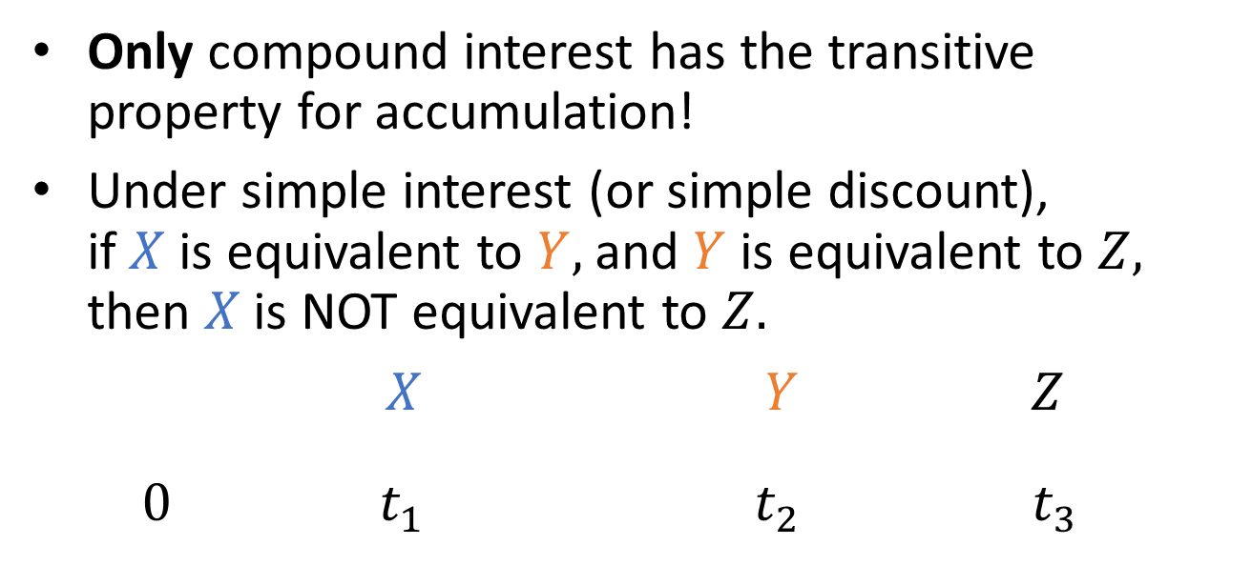
Simple interest & simple discount
Only compound interest has the transitive property for accumulation!
Under simple interest (or simple discount),
if $X$ is equivalent to $Y$, and $Y$ is equivalent to $Z$, then $X$ is NOT equivalent to $Z.$
$X$ $Y$ $Z$
0 $t_{1}$ $t_{2}$ $t_{3}$
$$Y=X(1+(t_{2}−t_{1})i), Z=Y(1+(t_{3}−t_{2})i),$$
$$⟹Z=X\left(1+\left(t_{2}−t_{1}\right)i\right)\left(1+\left(t_{3}−t_{2}\right)i\right)$$
$$≠X\left(1+\left(t_{3}−t_{1}\right)i\right)!$$

Slide 11
Types of problems
Given | Find | Technique | Example
Two or more streams of payments, interest rate, times of payments | Preferred stream of payments | Choose valn date Value all cash flows Compare | 1.10.A17
Amounts of some payments, interest rate, times of payments | Missing payment(s) that make cash flows equivalent | Choose valn date Equate value of all cash flows at that date Solve for missing payment(s) | 2.1.A15

Slide 12
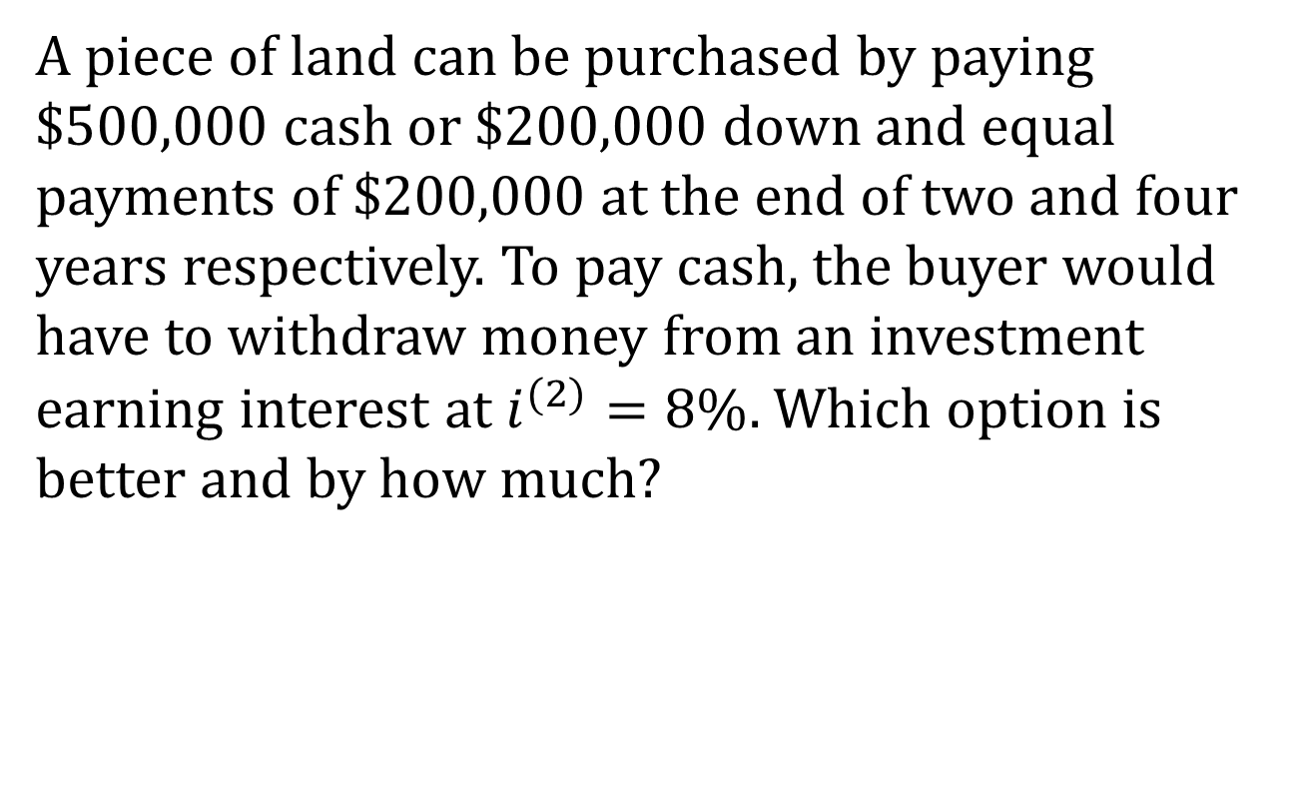
Example 1.10.A17
A piece of land can be purchased by paying $500,000 cash or $200,000 down and equal payments of $200,000 at the end of two and four years respectively. To pay cash, the buyer would have to withdraw money from an investment earning interest at $i^{(2)}=8\%$. Which option is better and by how much?

Slide 13
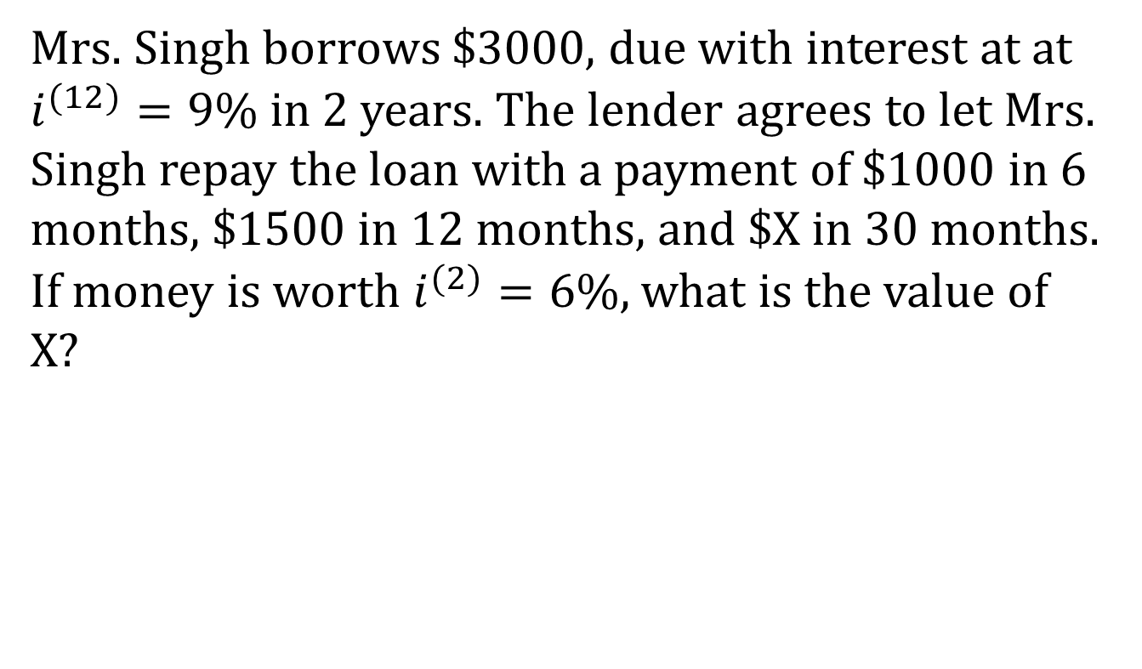
Example 2.1.A15
Mrs. Singh borrows $3000, due with interest at at $i^{(12)}=9\%$ in 2 years. The lender agrees to let Mrs. Singh repay the loan with a payment of $1000 in 6 months, $1500 in 12 months, and $X in 30 months. If money is worth $i^{(2)}=6\%$, what is the value of X?

Slide 14
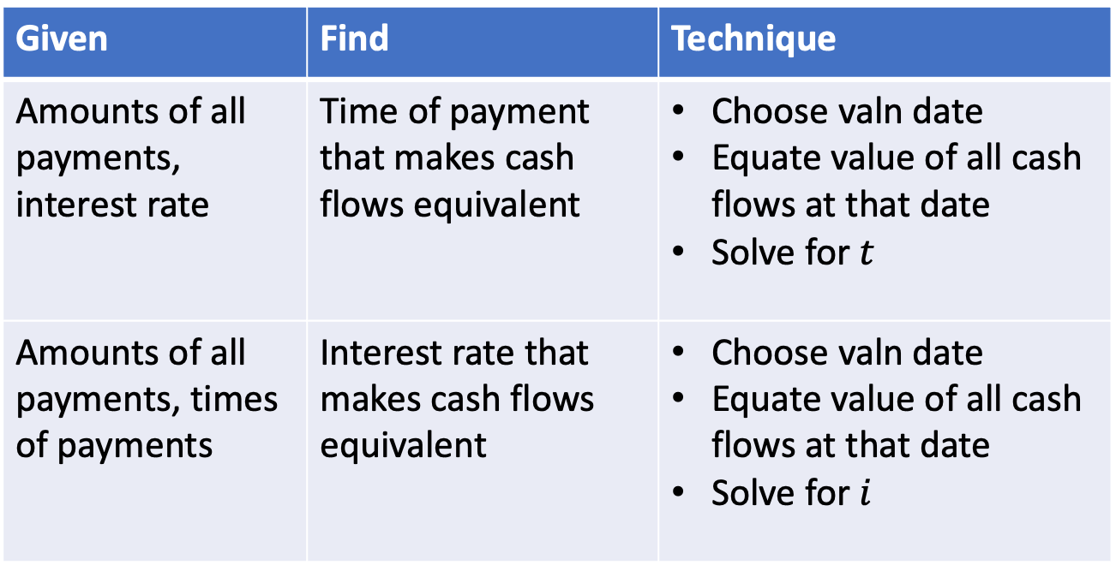
2.2 Determining rate and time
Given | Find | Technique
Amounts of all payments, interest rate | Time of payment that makes cash flows equivalent | Choose valn date Equate value of all cash flows at that date Solve for $t$
Amounts of all payments, times of payments | Interest rate that makes cash flows equivalent | Choose valn date Equate value of all cash flows at that date Solve for $i$

Slide 15
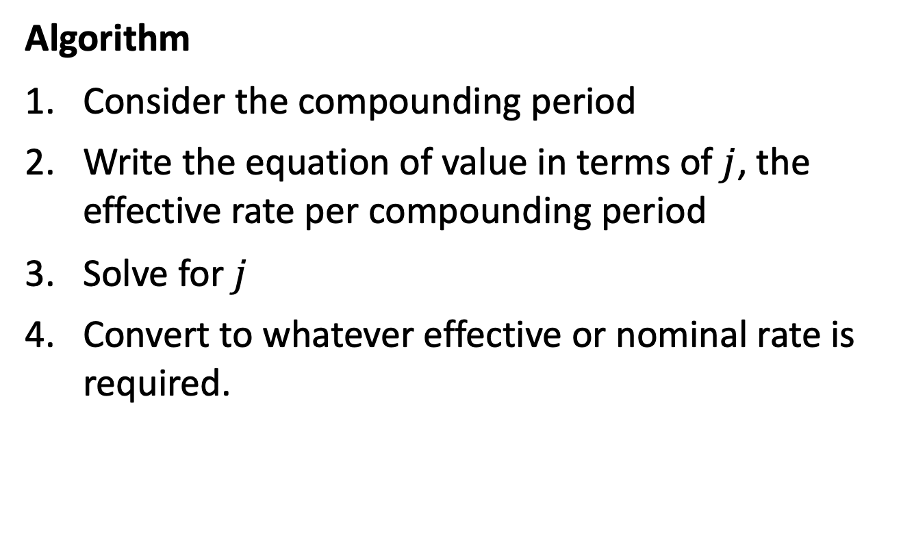
Finding the interest rate
Algorithm
Consider the compounding period
Write the equation of value in terms of $j$, the effective rate per compounding period
Solve for $j$
Convert to whatever effective or nominal rate is required.

Slide 16
Finding the interest rate
On your financial calculator
N = the number of compounding periods
PV = - present value
FV = future value
PMT = periodic payments (zero in this context)
CPT I/Y (interest rate per compounding period)
NOTE: The rate will be given as a %, not a decimal

Slide 17
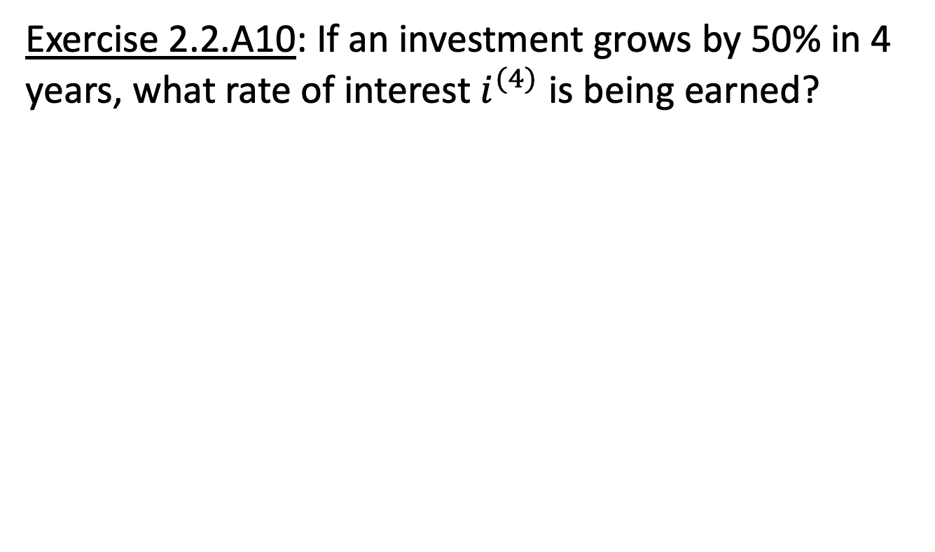
Example
Exercise 2.2.A10: If an investment grows by 50% in 4 years, what rate of interest $i^{(4)}$ is being earned?

Slide 18
Exercise 2.2.A10
On your financial calculator
N = 16
PV = -100
FV = 150
PMT = 0
CPT I/Y

Slide 19
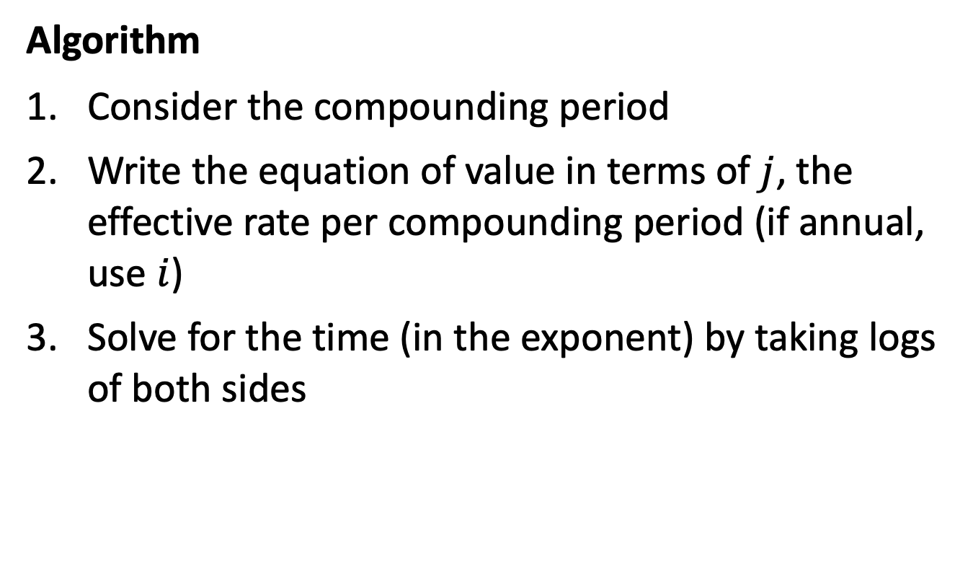
Finding the time
Algorithm
Consider the compounding period
Write the equation of value in terms of $j$, the effective rate per compounding period (if annual, use $i$)
Solve for the time (in the exponent) by taking logs of both sides

Slide 20
Finding the time
On your financial calculator
PV = - present value
FV = future value
PMT = periodic payments (zero)
I/Y = interest rate per compounding period (%)
CPT N (the number of compounding periods)

Slide 21
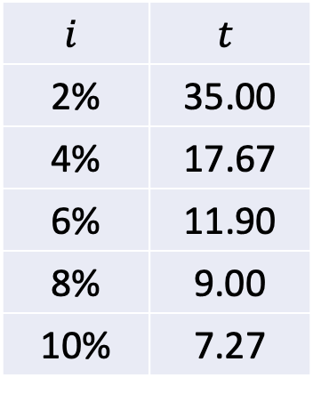
Example
How long does an investment take to double at a given rate of compound interest?
$$i$$ | $$t$$
2% | 35.00
4% | 17.67
6% | 11.90
8% | 9.00
10% | 7.27

Slide 22
Rule of 72
On your financial calculator
PV = -100
FV = 200
PMT = 0
I/Y = 2, 4, 6, 8, 10, …
CPT N

Slide 23
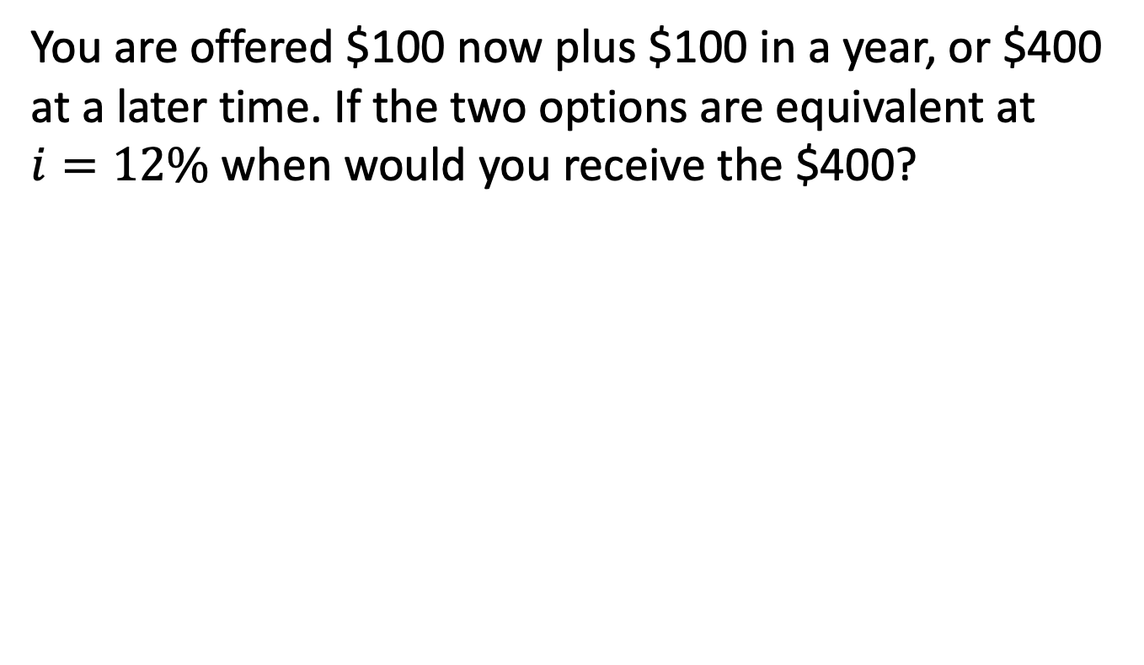
Example
You are offered $100 now plus $100 in a year, or $400 at a later time. If the two options are equivalent at $i=12\%$ when would you receive the $400?

