Slide 1
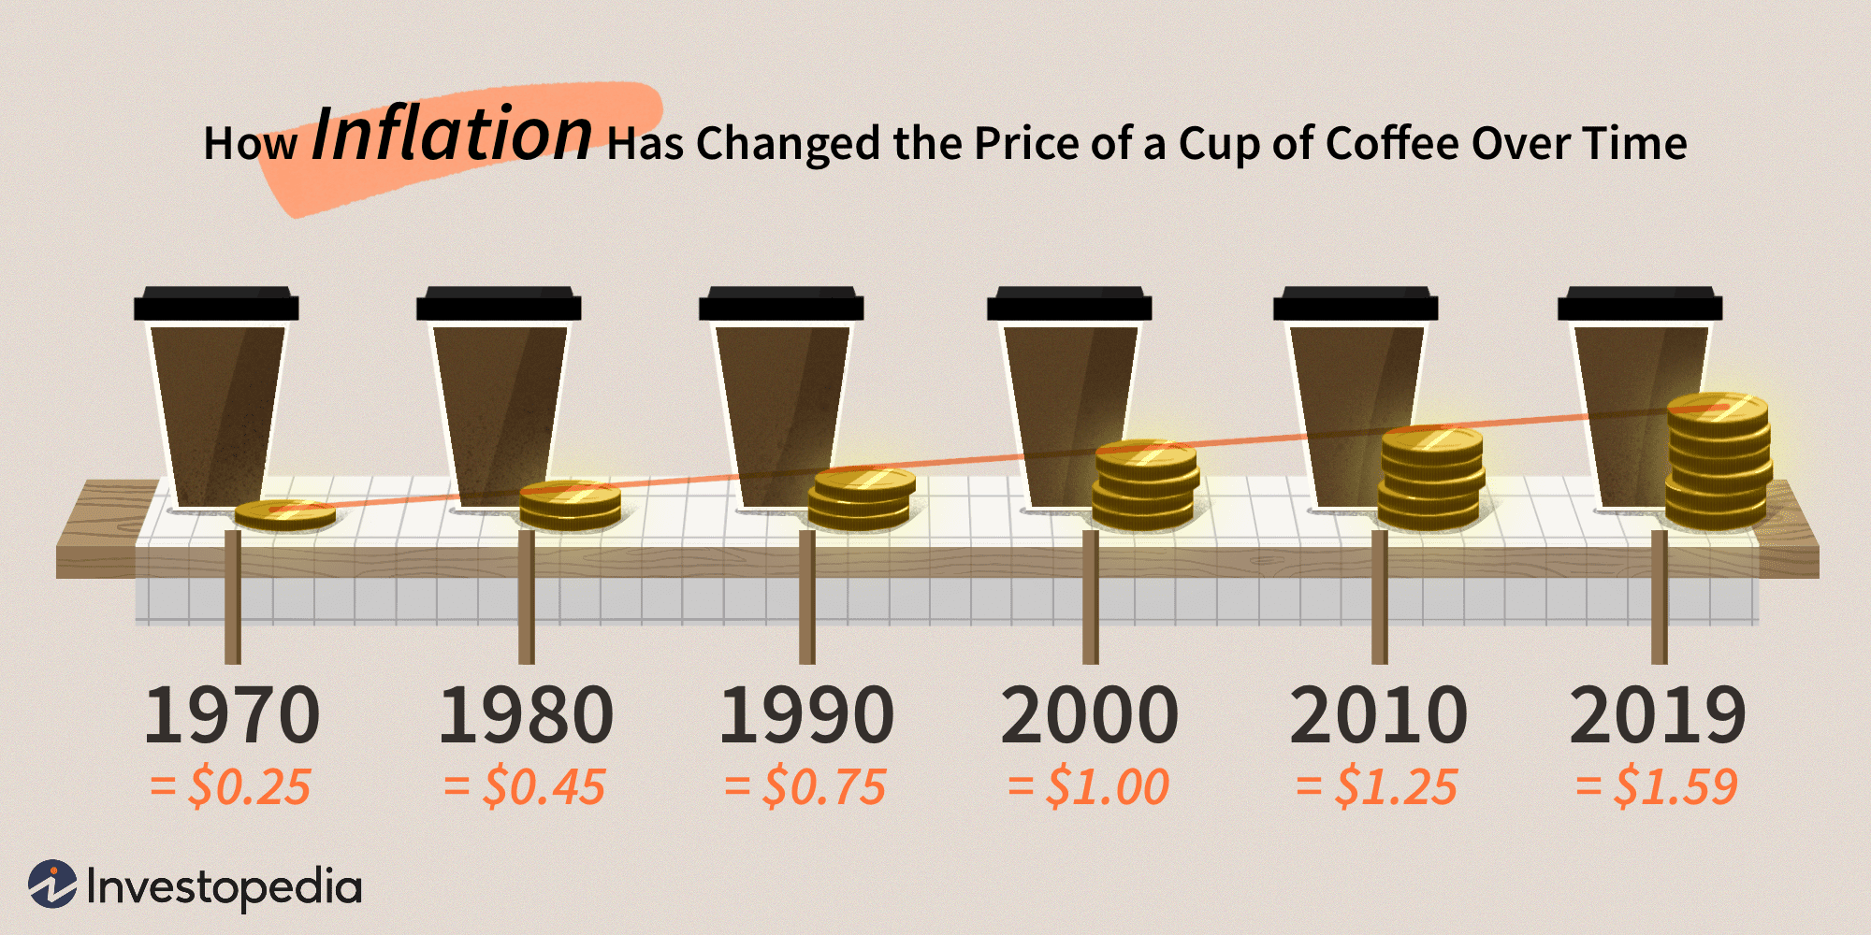
2.3 Inflation & real rates of interest
Inflation refers to the general increase in the price of goods over time.
Inflation erodes the purchasing power of money.

Slide 2
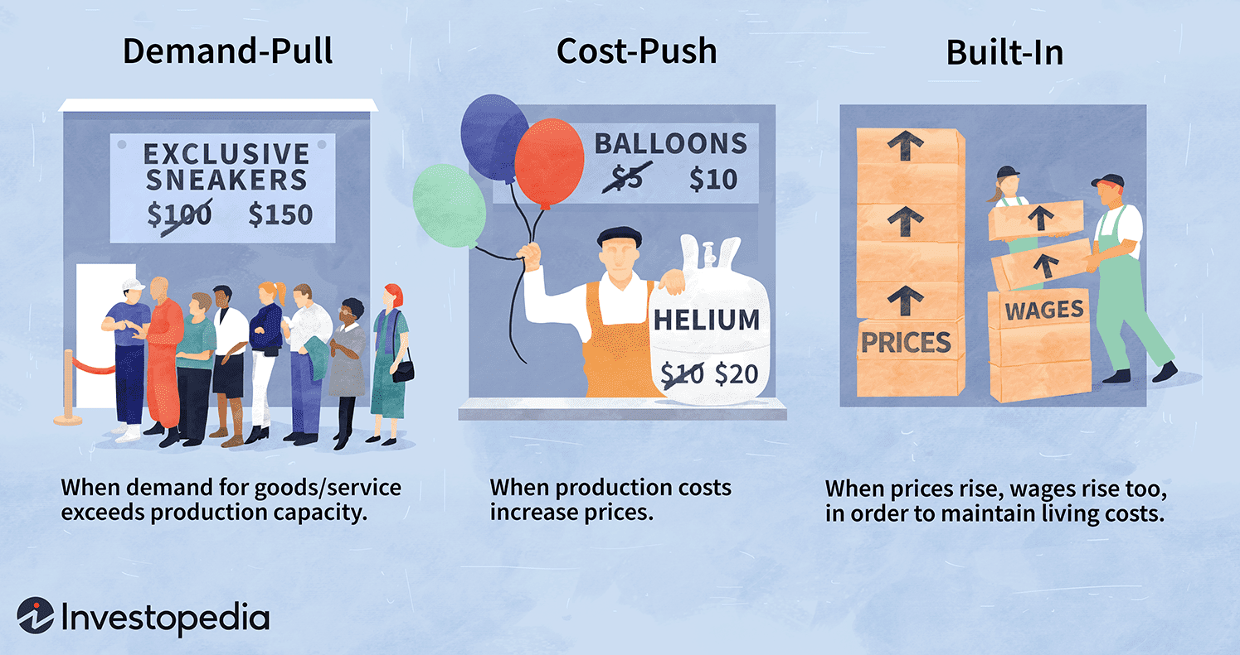
Why do we have inflation?

Slide 3
Inflation rate
The inflation rate is the (annualized) rate of change in the prices of consumer goods.
Price of milk (4L) in Dec 2021: $5.07
Price of milk (4L) in Nov 2022: $6.27
Price of milk (4L) in Nov 2024: $6.63!
For specific goods, see Statistics Canada.

Slide 4
The Consumer Price Index (CPI)
Inflation is measured by reference to an index that captures the average price of a specified basket of goods at different points in time.
Inflation can be specific to a segment or sector of the economy.
A widely used index is the Consumer Price Index (CPI).
Statistics Canada constructs and estimates the Canadian CPI. See here to learn how.
For information about the CPI in 2021, see here.

Slide 5
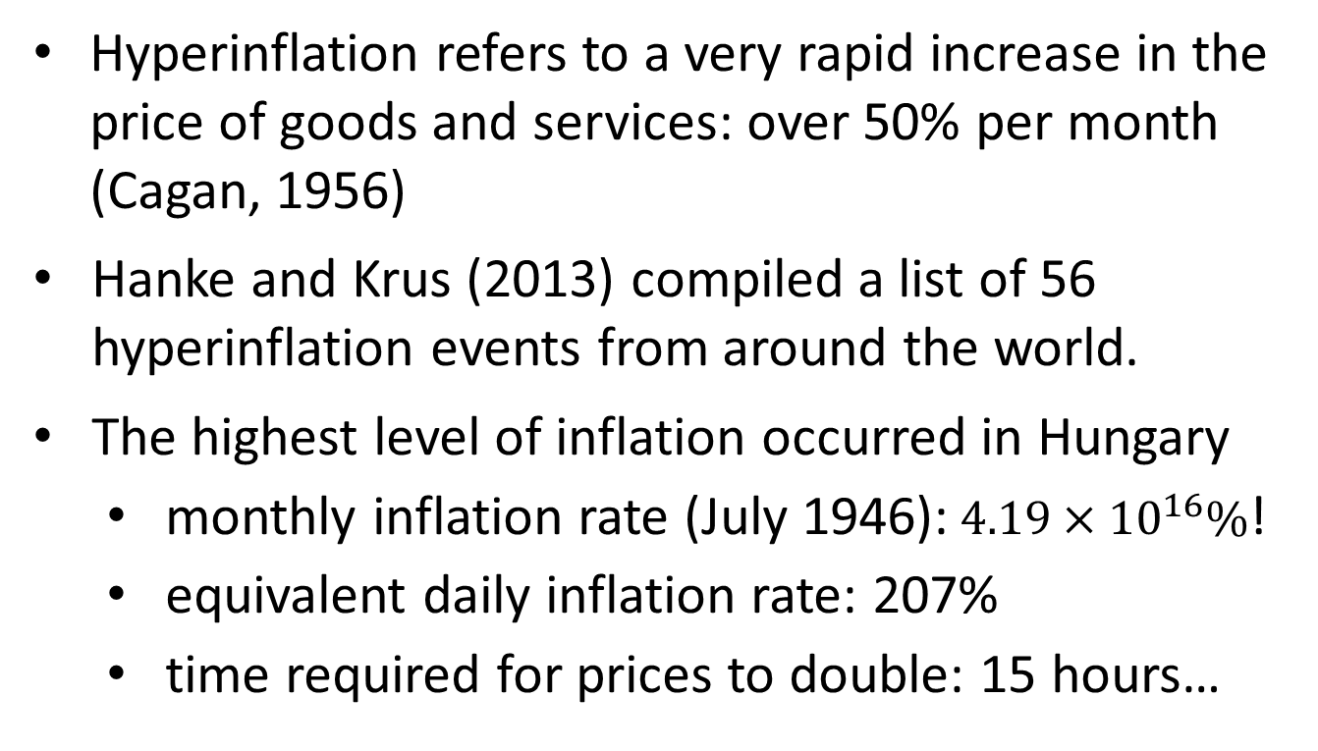
Hyperinflation
Hyperinflation refers to a very rapid increase in the price of goods and services: over 50% per month (Cagan, 1956)
Hanke and Krus (2013) compiled a list of 56 hyperinflation events from around the world.
The highest level of inflation occurred in Hungary
  monthly inflation rate (July 1946):$4.19×{10}^{16}\%$!
  equivalent daily inflation rate: 207%
  time required for prices to double: 15 hours…

Slide 6
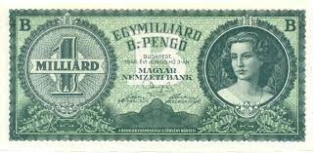
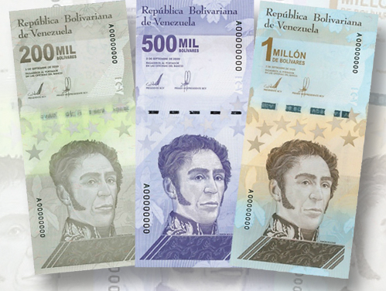
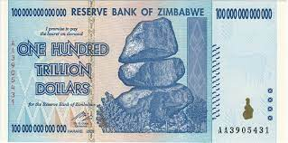
Hyperinflation
1 billion trillion = 1,000,000,000,000,000,000,000

Slide 7
Inflation and interest rates
Inflation counteracts investment growth.
Example: You have $1000 today and inflation is 5% per year. What is the relative purchasing power of your $1000 after one year (if not invested)?
You invest your $1000 at i=12%. What is the relative purchasing power of the accumulated value at the end of the year?

Slide 8
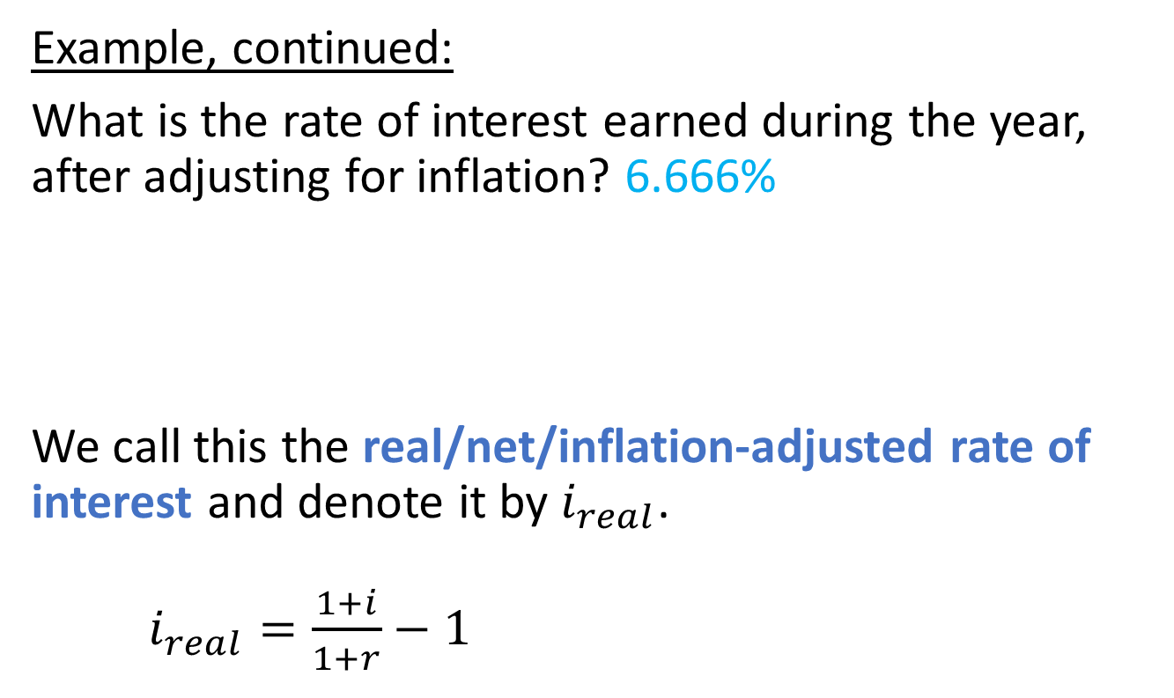
The real interest rate
Example, continued:
What is the rate of interest earned during the year, after adjusting for inflation? 6.666%
We call this the real/net/inflation-adjusted rate of interest and denote it by $i_{real}$.
$i_{real}=\frac{1+i}{1+r}−1$

Slide 9
Another “nominal” interest rate
The interest rate that has not been adjusted for inflation is called the nominal interest rate.
Note that “nominal” here means something different than in Section 1.7!

Slide 10
Example
Amy expects to receive four annual scholarship payments. The first payment (due now) is $10,000. Each successive payment is adjusted for inflation so that in real terms the payments remain level. Inflation is 3% per year and the effective interest rate is 6% a year. Find the present value of Amy’s scholarship.

Slide 11
Finding the present value
On your financial calculator
N = the number of compounding periods
I/Y (real interest rate per compounding period)
FV = future value (how much?)
PMT = periodic payments
CPT PV = - present value

Slide 12
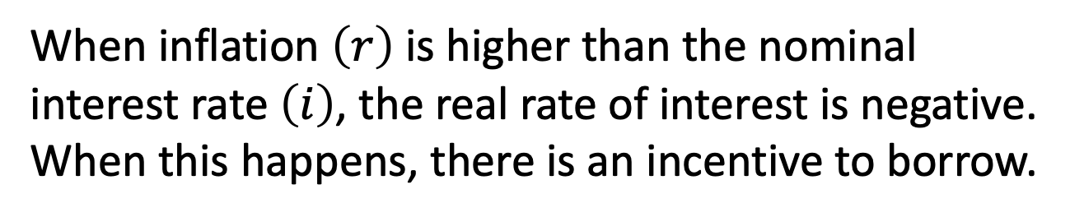
Negative real rates of interest
When inflation $\left(r\right)$is higher than the nominal interest rate $\left(i\right)$, the real rate of interest is negative. When this happens, there is an incentive to borrow.
Example: You borrow $1000 for one year. Interest is charged at 2% and inflation is 4%. How much do you have to pay back at the end of the year
in nominal terms?
in real terms?

Slide 13
References
Cagan, P. (1956). ‘The monetary dynamics of hyperinflation’, in Friedman, M. (ed.) Studies in the Quantity Theory of Money. Chicago, IL: University of Chicago Press.
Hanke, S.H. and Krus, N. (2013) ‘World hyperinflations’, in Parker, R.E. and Whaples, R.M. (eds.) In Routledge Handbook of Major Events in Economic History. Routledge.

