Slide 1
CHAPTER 3
Simple Annuities

Slide 2
3.1 Definitions
An annuity is a series of payments made at regular intervals of time.
The payment period is the interval between annuity payments.
An annuity-certain is an annuity where the payments are sure to be made for a fixed period of time (the term of the annuity).
A contingent annuity is an annuity where the payments depend on one or more contingent events.

Slide 3
Types of annuities
Ordinary annuity | Payments made at the end of each payment period
Annuity due | Payments made at beginning of each payment period
Deferred annuity | First payment at a later date
Simple annuity | Payment interval and compounding period are the same (Ch 3)
General annuity | Payment interval and compounding period are different (Ch 4)

Slide 4
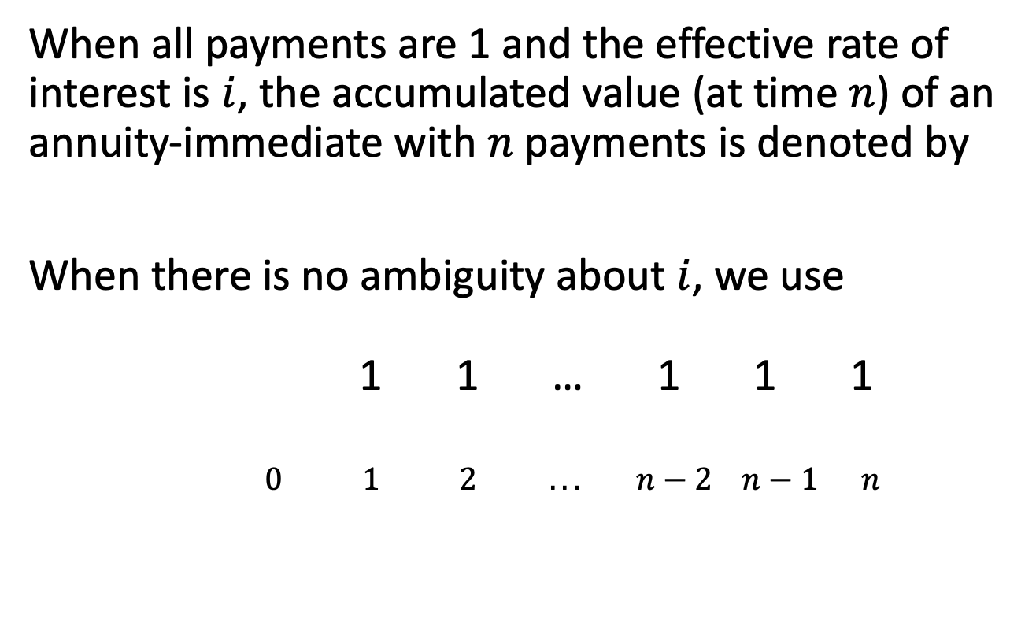
3.2 AV of an ordinary annuity
When all payments are 1 and the effective rate of interest is $i$, the accumulated value (at time $n$) of an annuity-immediate with $n$ payments is denoted by
When there is no ambiguity about $i$, we use
1 1 … 1 1 1
$0 1 2 ... n−2 n−1 n$

Slide 5
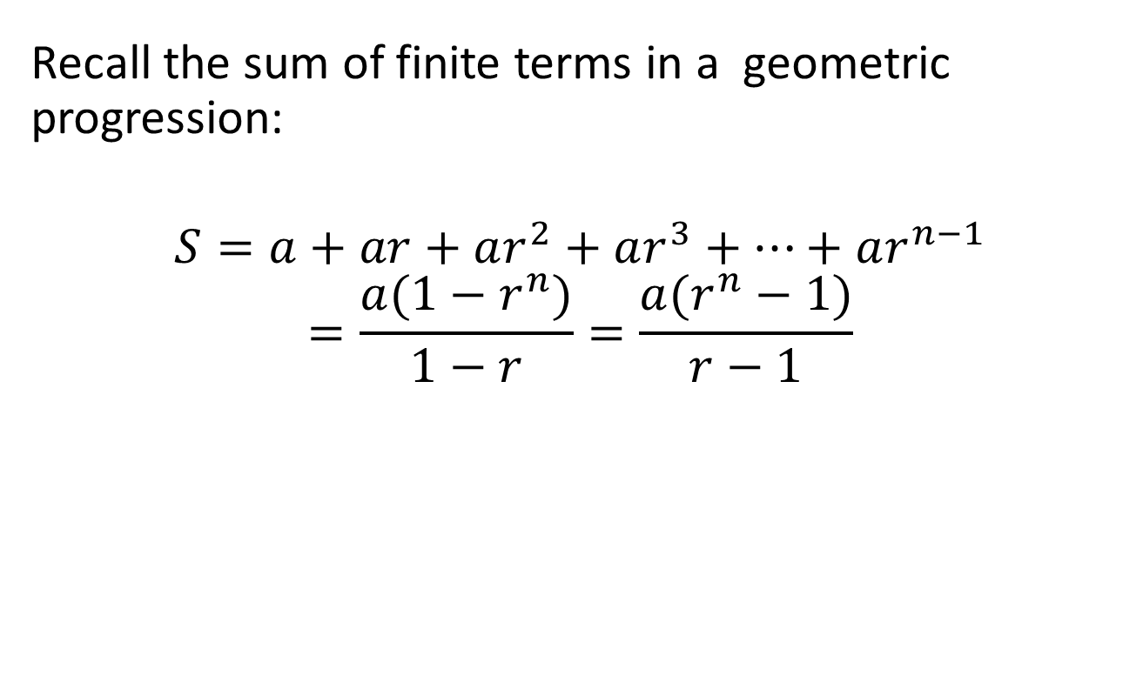
Sum of a geometric progression
Recall the sum of finite terms in a geometric progression:
$$S=a+ar+ar^{2}+ar^{3}+…+ar^{n−1}$$
$$=\frac{a(1−r^{n})}{1−r}=\frac{a(r^{n}−1)}{r−1}$$

Slide 6
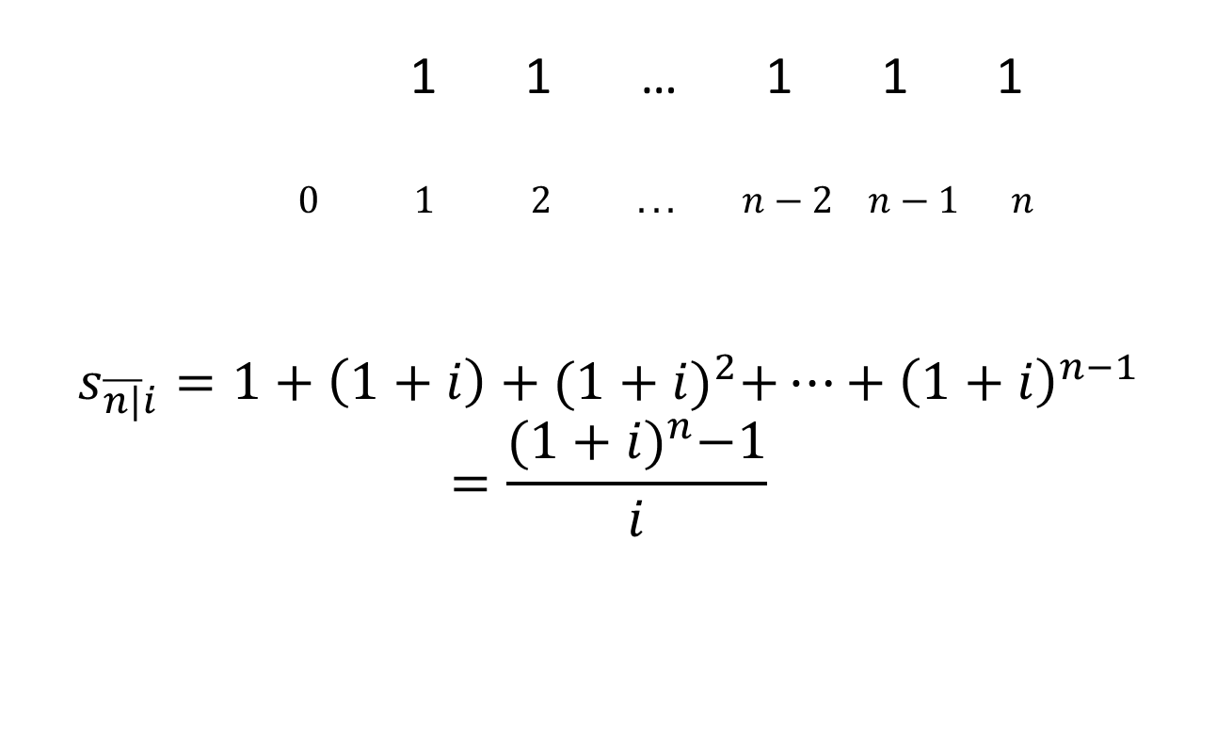
AV of an ordinary annuity, cont’d
1 1 … 1 1 1
$0 1 2 ... n−2 n−1 n$
$$s_{\overline{n|}i}=1+\left(1+i\right)+{(1+i)}^{2}+…+{\left(1+i\right)}^{n−1}$$
$$=\frac{{(1+i)}^{n}−1}{i}$$

Slide 7
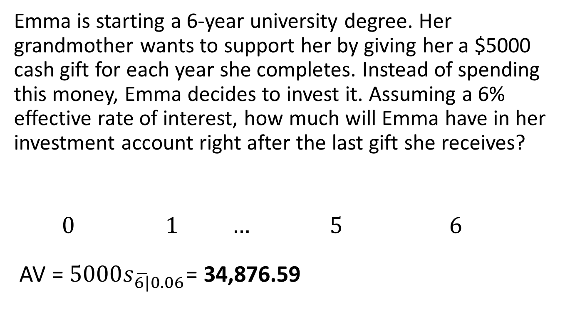
Example 3.1
Emma is starting a 6-year university degree. Her grandmother wants to support her by giving her a $5000 cash gift for each year she completes. Instead of spending this money, Emma decides to invest it. Assuming a 6% effective rate of interest, how much will Emma have in her investment account right after the last gift she receives?
0 $1$ … 5 $6$
AV = ${5000s}_{\overline{6|}0.06}$= 34,876.59

Slide 8
Using a financial calculator
N = the number of compounding periods
PV = 0
I/Y = interest rate per compounding period
PMT = periodic payments
CPT FV

Slide 9
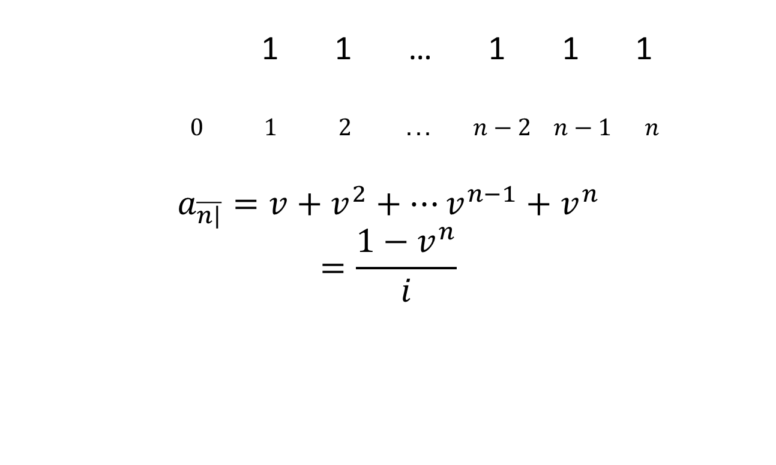
3.3 PV of an ordinary annuity
1 1 … 1 1 1
$0 1 2 ... n−2 n−1 n$
$$a_{\overline{n|}}=v+v^{2}+…v^{n−1}+v^{n}$$
$$=\frac{1−v^{n}}{i}$$

Slide 10
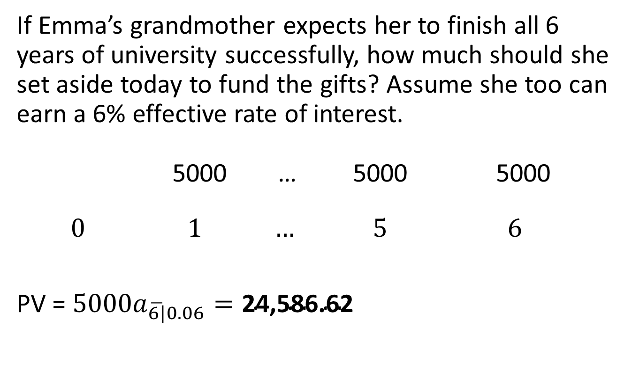
Example 3.1, continued
If Emma’s grandmother expects her to finish all 6 years of university successfully, how much should she set aside today to fund the gifts? Assume she too can earn a 6% effective rate of interest.
5000 … 5000 5000
0 $1$ … 5 $6$
PV = ${5000a}_{\overline{6|}0.06}=\text{24,586.62}$

Slide 11
Using a financial calculator
N = the number of compounding periods
FV = 0
I/Y = interest rate per compounding period
PMT = periodic payments
CPT PV

Slide 12
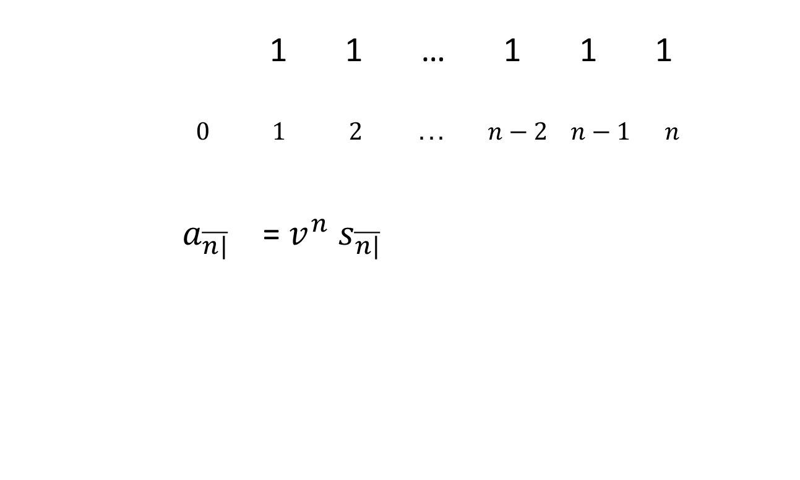
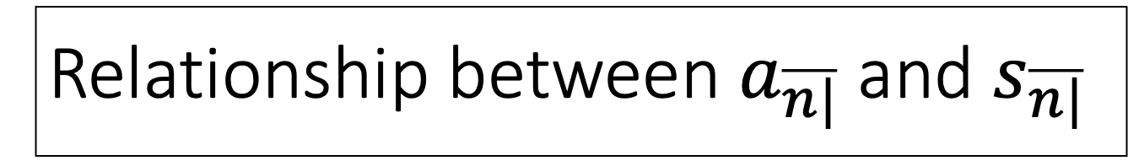
Relationship between $a_{\overline{n|}}$ and $s_{\overline{n|}}$
1 1 … 1 1 1
$0 1 2 ... n−2 n−1 n$
$a_{\overline{n|}}$ = $v^{n}$ $s_{\overline{n|}}$

Slide 13
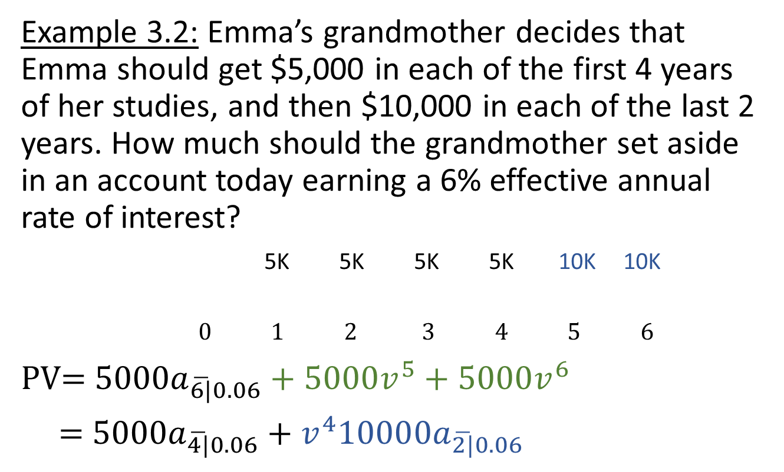
Changing payment amounts
Example 3.2: Emma’s grandmother decides that Emma should get $5,000 in each of the first 4 years of her studies, and then $10,000 in each of the last 2 years. How much should the grandmother set aside in an account today earning a 6% effective annual rate of interest?
5K 5K 5K 5K 10K 10K
$0 1 2 3 4 5 6$
PV= ${5000a}_{\overline{6|}0.06}+5000v^{5}+5000v^{6}$
= ${5000a}_{\overline{4|}0.06}$ + ${v^{4}10000a}_{\overline{2|}0.06}$

Slide 14
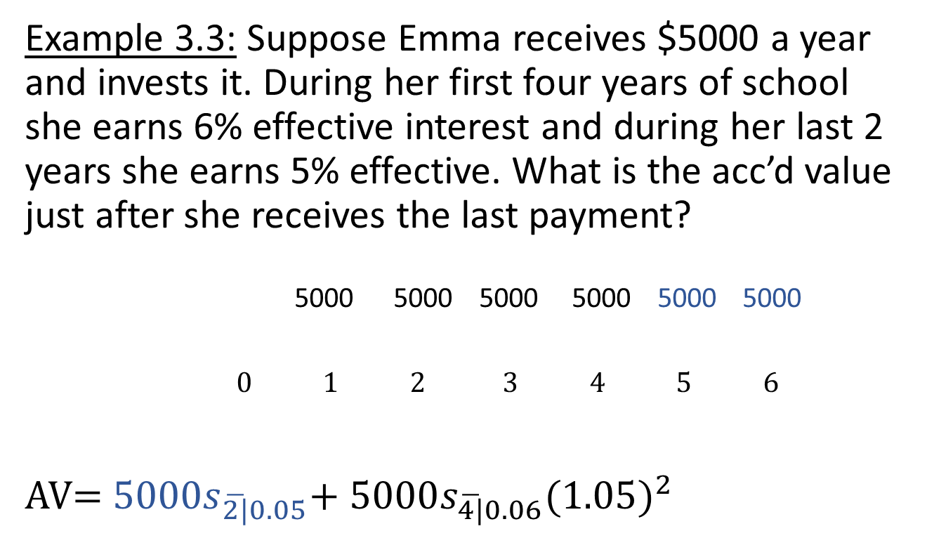
Changing interest rates
Example 3.3: Suppose Emma receives $5000 a year and invests it. During her first four years of school she earns 6% effective interest and during her last 2 years she earns 5% effective. What is the acc’d value just after she receives the last payment?
5000 5000 5000 5000 5000 5000
$0 1 2 3 4 5 6$
AV= ${5000s}_{\overline{2|}0.05}$+ ${5000s}_{\overline{4|}0.06}{(1.05)}^{2}$

Slide 15
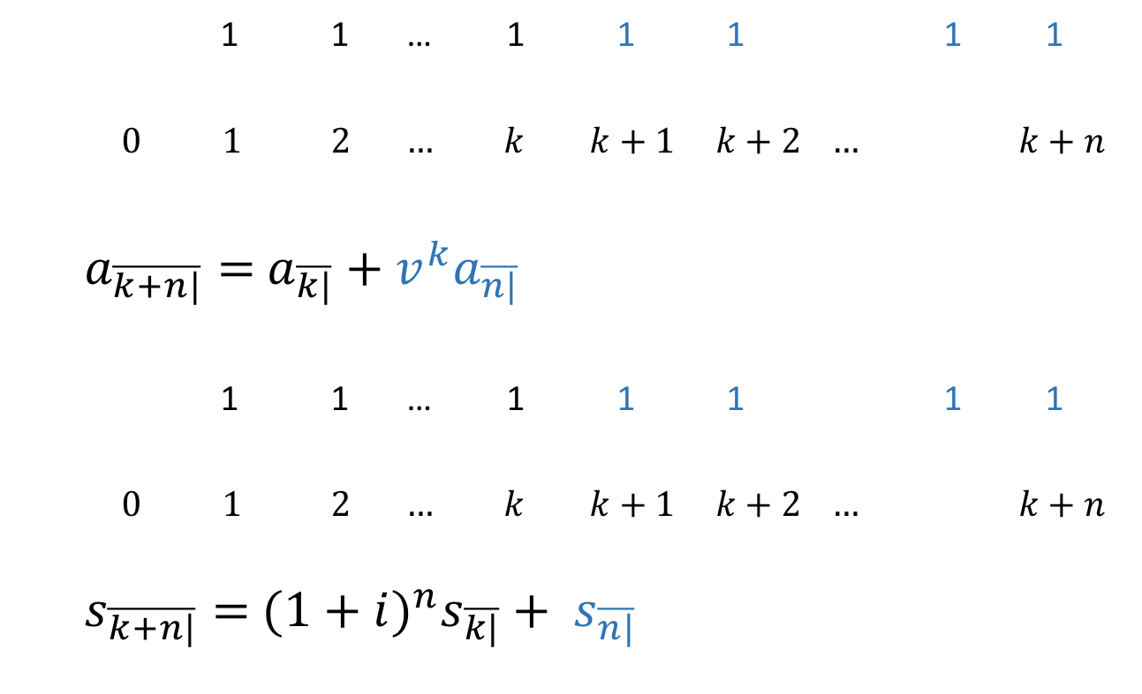
Splitting payment streams
1 1 … 1 1 1 1 1
$0 1 2 … k k+1 k+2 … k+n$
$a_{\overline{k+n|}}=$ $a_{\overline{k|}}+{v^{k}a}_{\overline{n|}}$
1 1 … 1 1 1 1 1
$0 1 2 … k k+1 k+2 … k+n$
$s_{\overline{k+n|}}=$ $(1+i)^{n}s_{\overline{k|}}+ s_{\overline{n|}}$

Slide 16
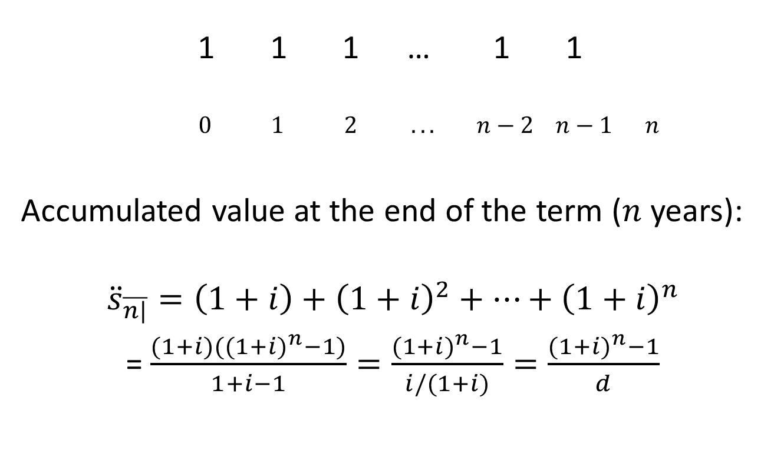
3.4 Annuities due
1 1 1 … 1 1
$0 1 2 ... n−2 n−1 n$
Accumulated value at the end of the term ($n$ years):
$${\ddot{s}}_{\overline{n|}}=\left(1+i\right)+{\left(1+i\right)}^{2}+…+{\left(1+i\right)}^{n}$$
= $\frac{(1+i)({(1+i)}^{n}−1)}{1+i−1}=\frac{{(1+i)}^{n}−1}{i/(1+i)}=\frac{{(1+i)}^{n}−1}{d}$

Slide 17
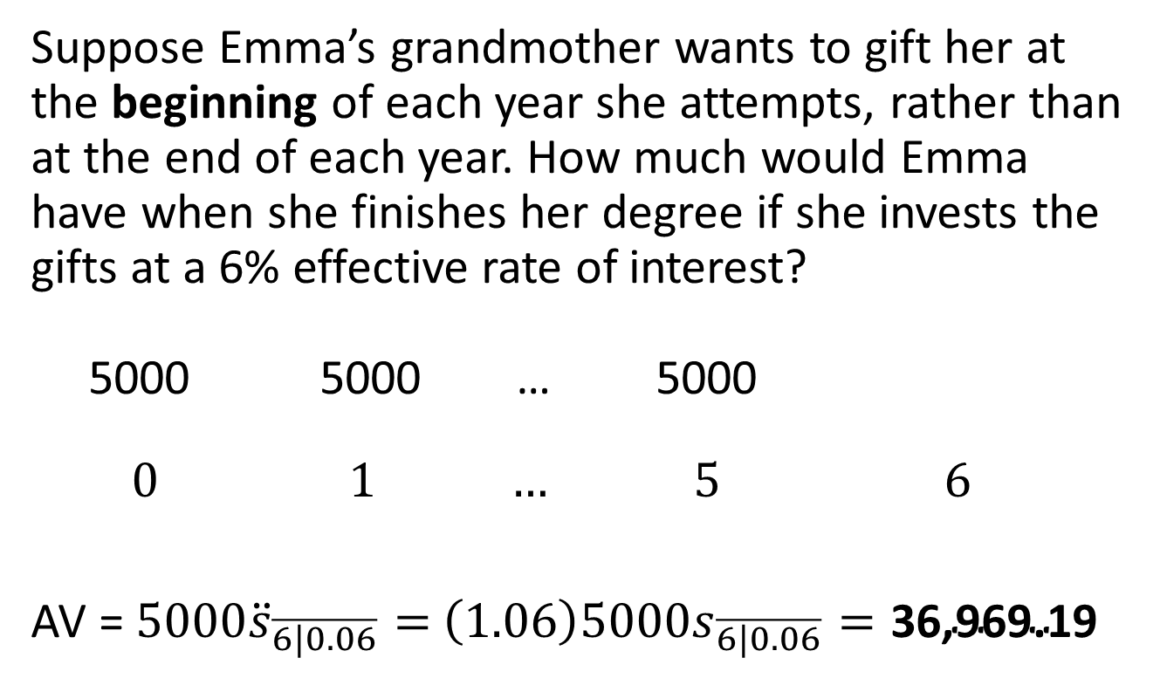
Example 3.1, continued
Suppose Emma’s grandmother wants to gift her at the beginning of each year she attempts, rather than at the end of each year. How much would Emma have when she finishes her degree if she invests the gifts at a 6% effective rate of interest?
5000 5000 … 5000
0 $1$ … 5 $6$
AV = ${5000\ddot{s}}_{\overline{6|0.06}}=$ $\left(1.06\right){5000s}_{\overline{6|0.06}}=\text{36,969.19}$

Slide 18
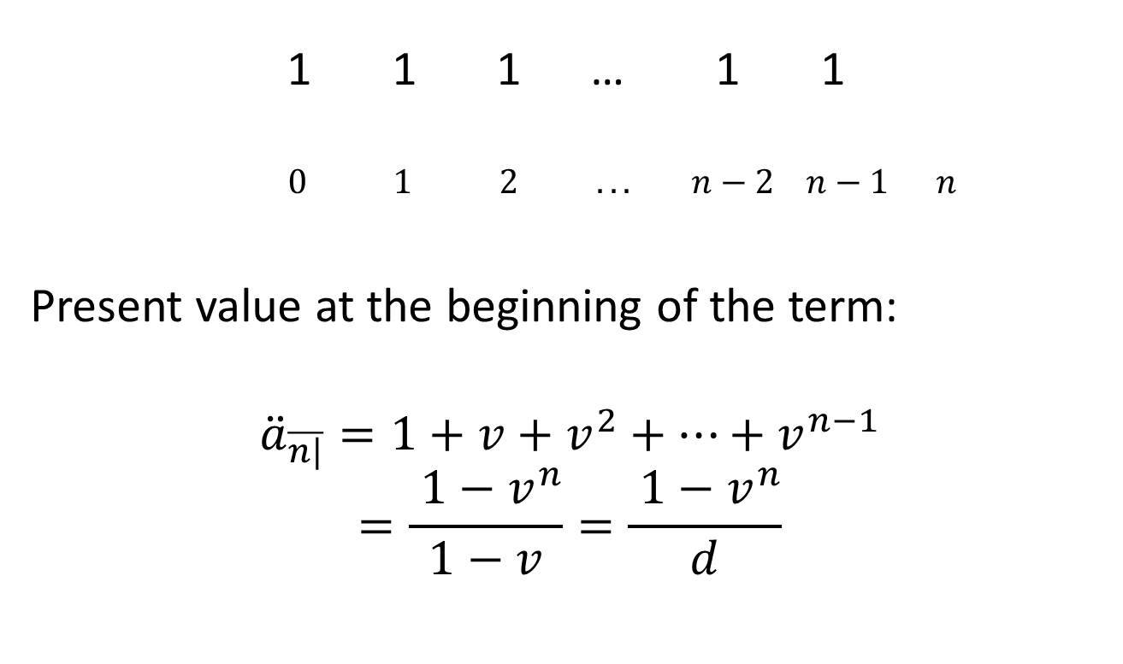
PV of annuity due
1 1 1 … 1 1
$0 1 2 ... n−2 n−1 n$
Present value at the beginning of the term:
$${\ddot{a}}_{\overline{n|}}=1+v+v^{2}+…+v^{n−1}$$
$$=\frac{ 1−v^{n}}{1−v}=\frac{ 1−v^{n}}{d}$$

Slide 19
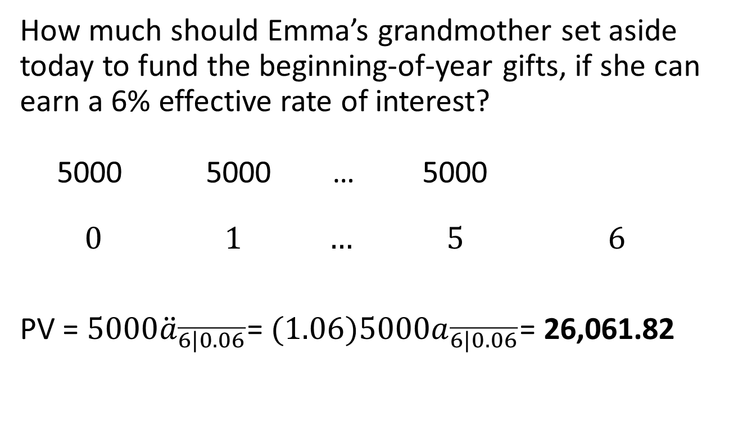
Example 3.1, continued
How much should Emma’s grandmother set aside today to fund the beginning-of-year gifts, if she can earn a 6% effective rate of interest?
5000 5000 … 5000
0 $1$ … 5 $6$
PV = ${5000\ddot{a}}_{\overline{6|0.06}}$= ${(1.06)5000a}_{\overline{6|0.06}}$= 26,061.82

Slide 20
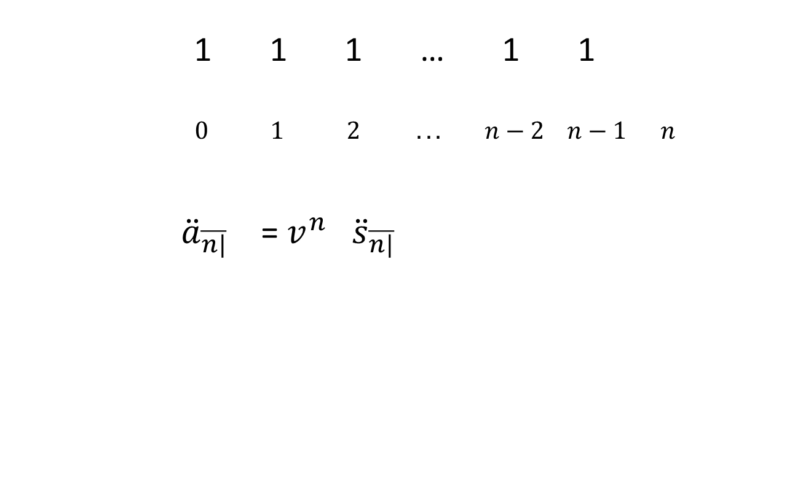
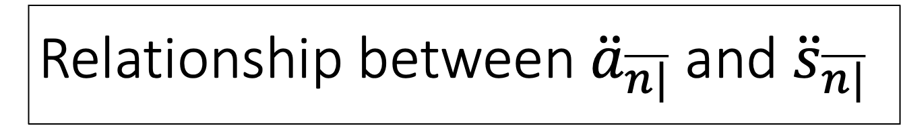
Relationship between ${\ddot{a}}_{\overline{n|}}$ and ${\ddot{s}}_{\overline{n|}}$
1 1 1 … 1 1
$0 1 2 ... n−2 n−1 n$
${\ddot{a}}_{\overline{n|}}$ = $v^{n}$ ${\ddot{s}}_{\overline{n|}}$

Slide 21
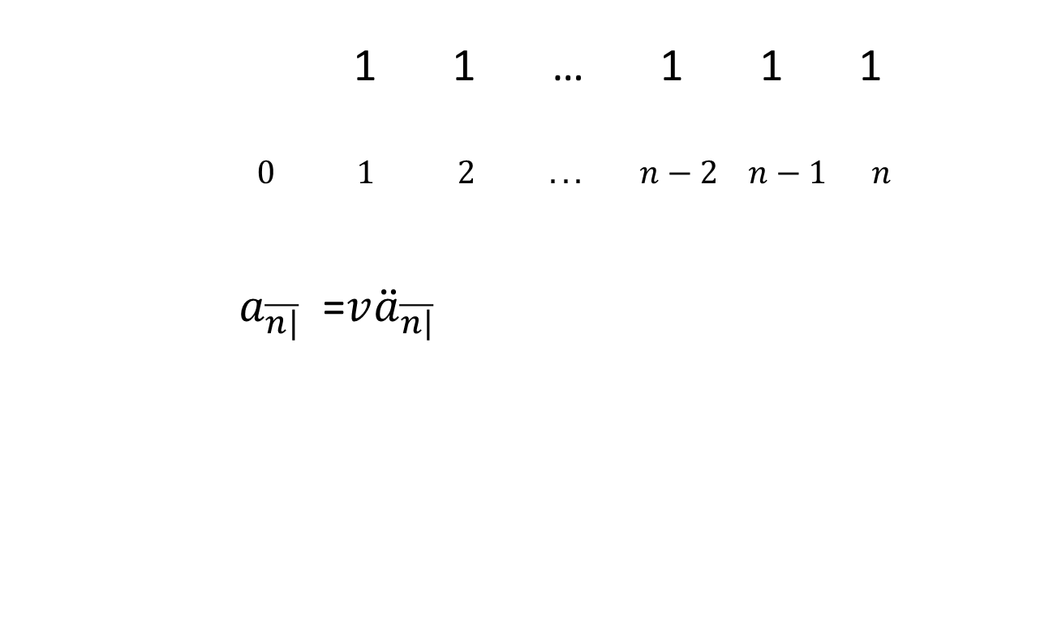
More relationships
1 1 … 1 1 1
$0 1 2 ... n−2 n−1 n$
$a_{\overline{n|}}$ =$v{\ddot{a}}_{\overline{n|}}$

Slide 22
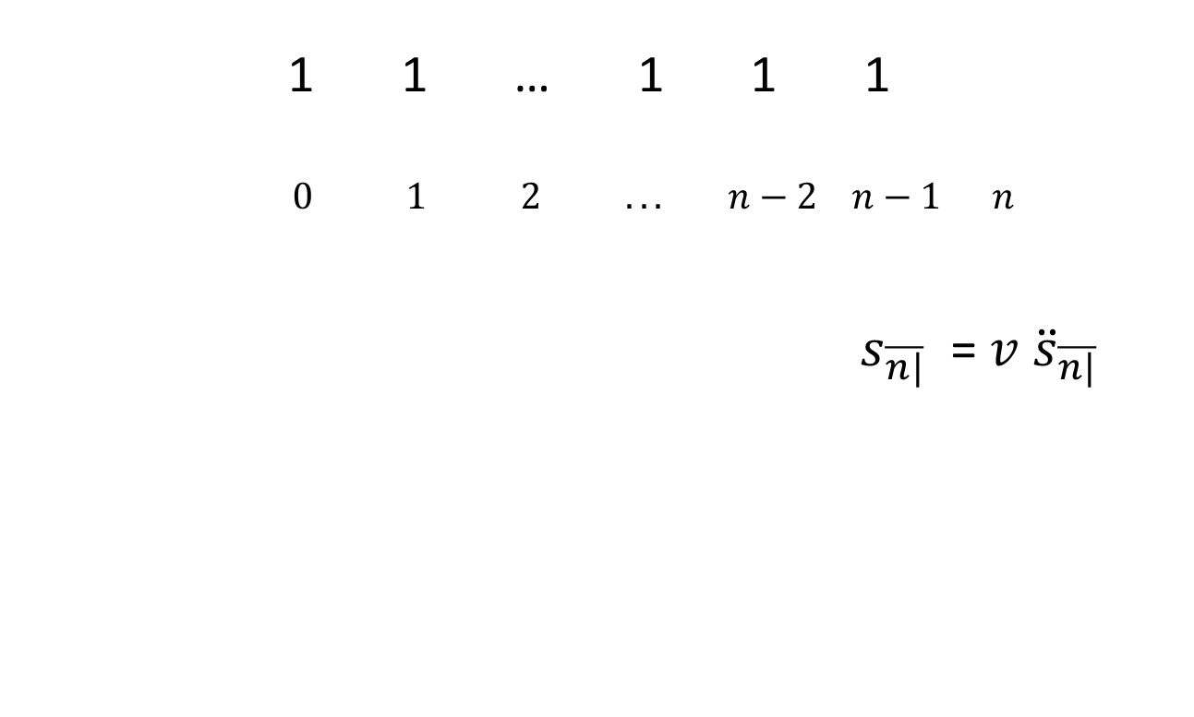
More relationships, continued
1 1 … 1 1 1
$0 1 2 ... n−2 n−1 n$
$s_{\overline{n|}}$ = $v$ ${\ddot{s}}_{\overline{n|}}$

Slide 23
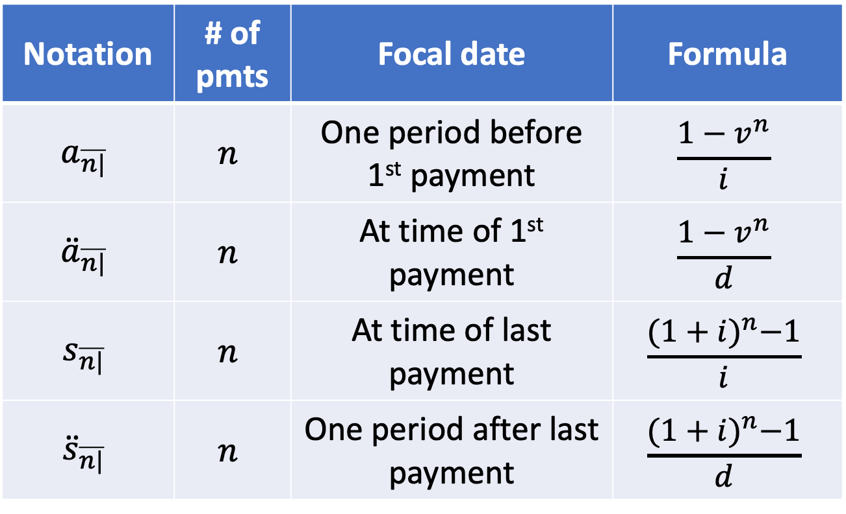
Summary
Notation | # of pmts | Focal date | Formula
$$a_{\overline{n|}}$$ | $$n$$ | One period before 1st payment | $$\frac{1−v^{n}}{i}$$
$${\ddot{a}}_{\overline{n|}}$$ | $$n$$ | At time of 1st payment | $$\frac{1−v^{n}}{d}$$
$$s_{\overline{n|}}$$ | $$n$$ | At time of last payment | $$\frac{{(1+i)}^{n}−1}{i}$$
$${\ddot{s}}_{\overline{n|}}$$ | $$n$$ | One period after last payment | $$\frac{{(1+i)}^{n}−1}{d}$$

